Slide 1
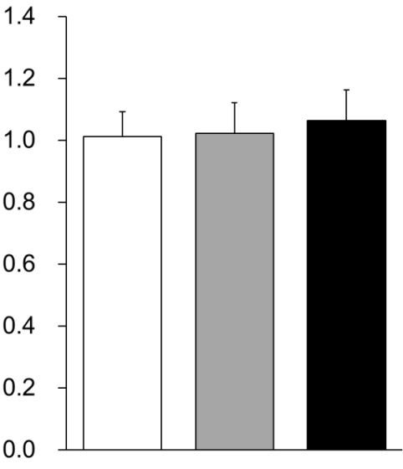
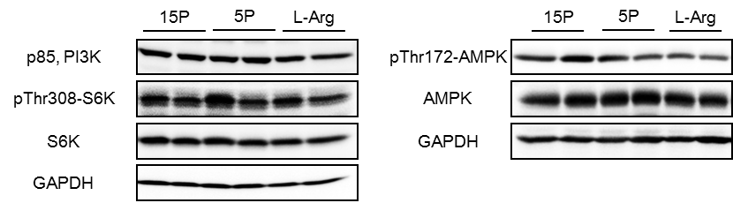

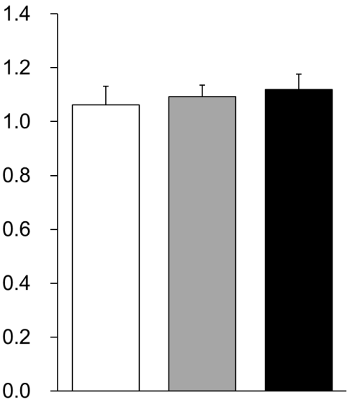
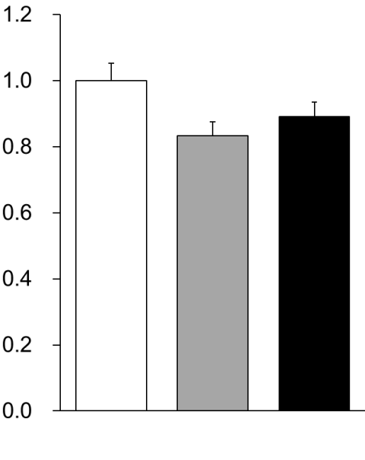
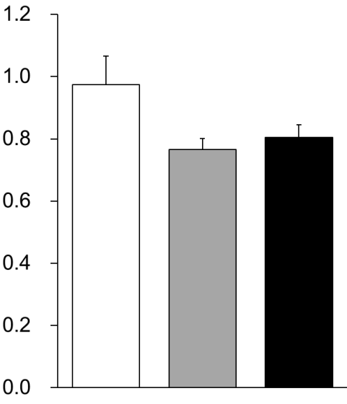

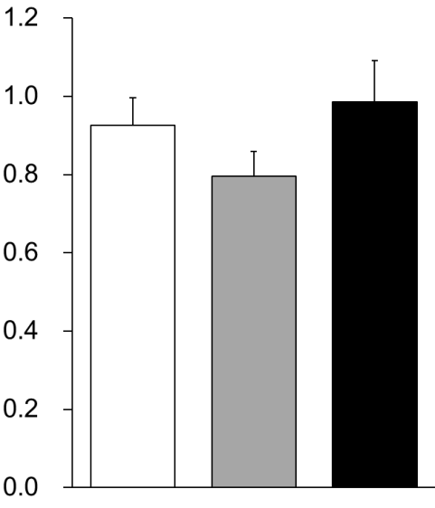
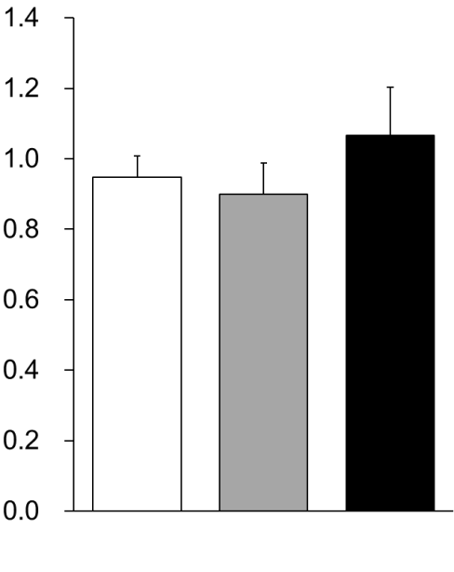
A
B
p85/GAPDH (a.u.)
15P
AA
5P
AA
Low
Arg
C
D
E
S6K/GAPDH (a.u.)
pS6K/GAPDH (a.u.)
pS6K/S6K (a.u.)
15P
AA
5P
AA
Low
Arg
15P
AA
5P
AA
Low
Arg
15P
AA
5P
AA
Low
Arg
F
G
H
AMPK/GAPDH (a.u.)
pAMPK/GAPDH (a.u.)
pAMPK/AMPK (a.u.)
15P
AA
5P
AA
Low
Arg
15P
AA
5P
AA
Low
Arg
15P
AA
5P
AA
Low
Arg

Slide 2
Supplementary Figure 1 Insulin signaling-related protein levels in rats fed the low-protein and low-arginine diets. Six-week-old male Wistar rats were fed the 15PAA (n = 8), low Arg (n = 8), and 5PAA (n = 8) diet for 14 days. Whole-liver lysates were analyzed by immunoprecipitation and immunoblotting with antibodies against p85 (B), S6K (C), pS6K (D), AMPK (F),and pAMPK(G) and S6K as an internal control , pS6K/S6K(E)and pAMPK (H)and GAPDH as an internal control. Representative immunoblots (A) are shown. The values are the means ± standard errors. Asterisks indicate significant differences as assessed by one-way ANOVA with Bonferroni and Tukey–Kramer post-hoc tests (*p < 0.05; **p < 0.01).

Slide 3
Average RER
15P
AA
5P
AA
Low
Arg
15P
AA
5P
AA
Low
Arg
Light
Dark
Supplementary Figure 2 Average values of RER of light period (8am-8pm) and dark period (8pm-8am) were calculated individually. Data of six rats per each group were calculated separately and indicated as means±SEM（n=6）.

