Slide 1
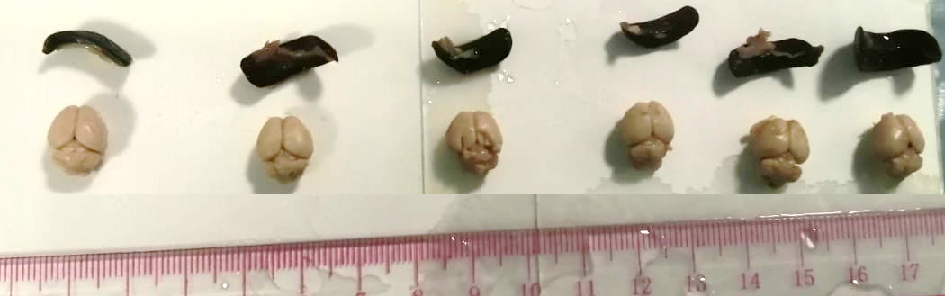
Geraniol attenuates oxidative stress and neuro-inflammation mediated cognitive impairment in D‑galactose‑induced mouse aging model
Image S1
I II III IV V VI

Slide 2
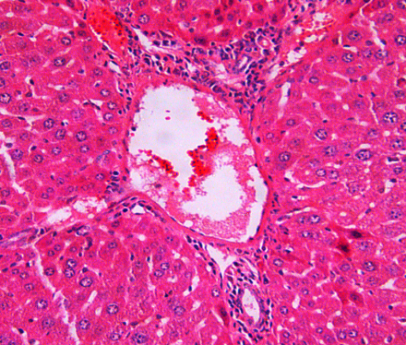
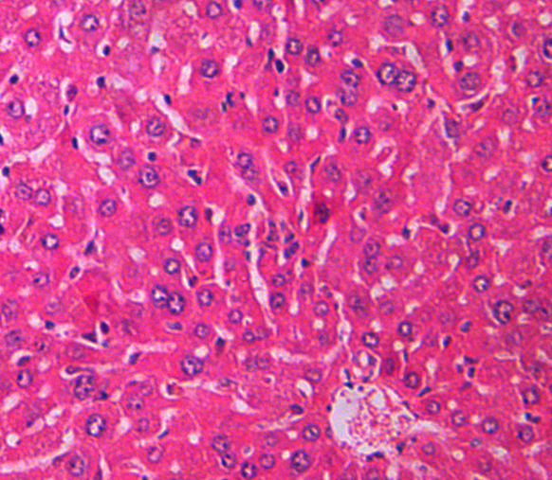
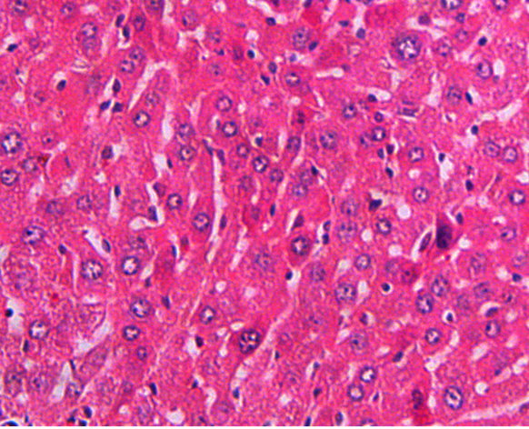
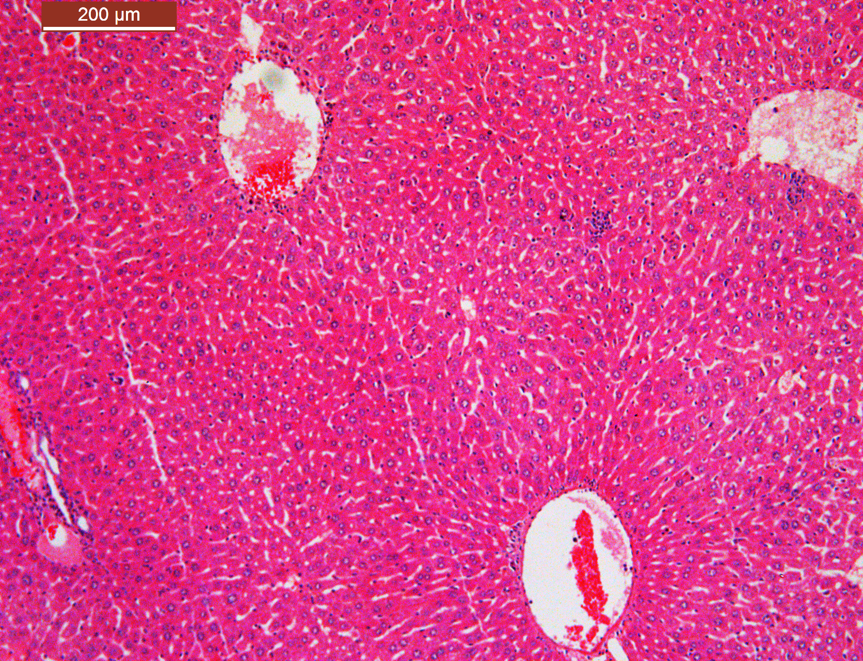
A
Image S2
I
II
III
IV
V
VI
B
Groups | N | Histopathological grade value
 |  | Hepatocytes necrosis | Inflammatory cell infiltration
Control | 6 | 0.0 ± 0 | 0.0 ± 0
D-Gal alone | 6 | 5.37 ± 0.97* | 3.21 ± 0.29#
KFL with D-Gal | 6 | 2.43 ±0.21# | 1.75 ± 0.18#
KFL | 6 | 0.0 ± 0 | 0.0 ± 0
4 month old | 6 | 0.0 ±0 | 0.0 ±0
16 month old | 6 | 4.86.37 ± 0.34 | 5.34 ± 0.31
@
@
Fig 4

Slide 3
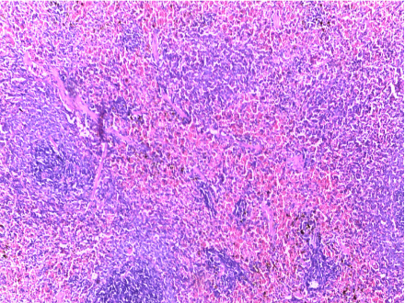
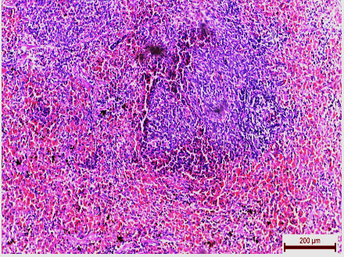
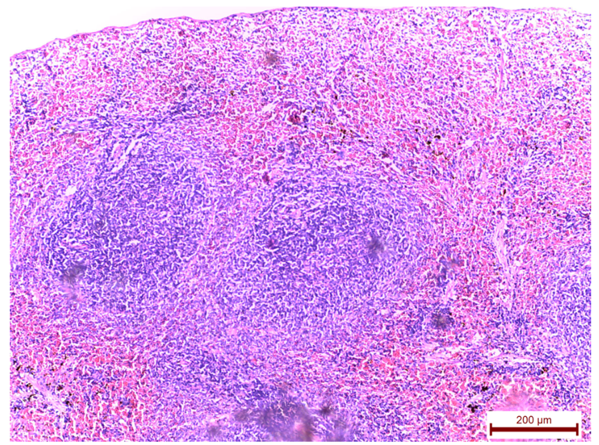
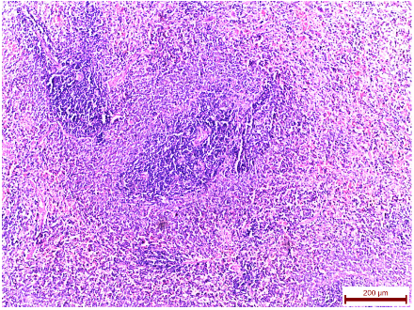
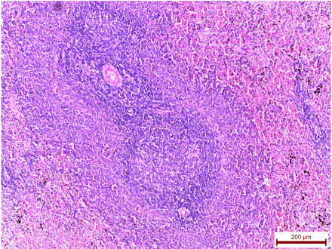
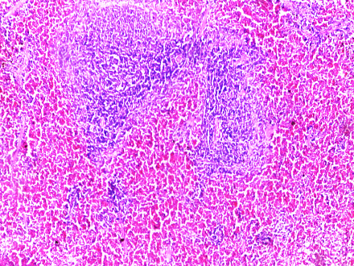
Image S3
I
II
III
IV
V
VI

