Slide 1
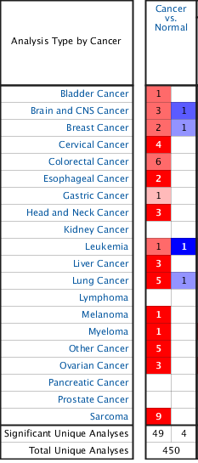
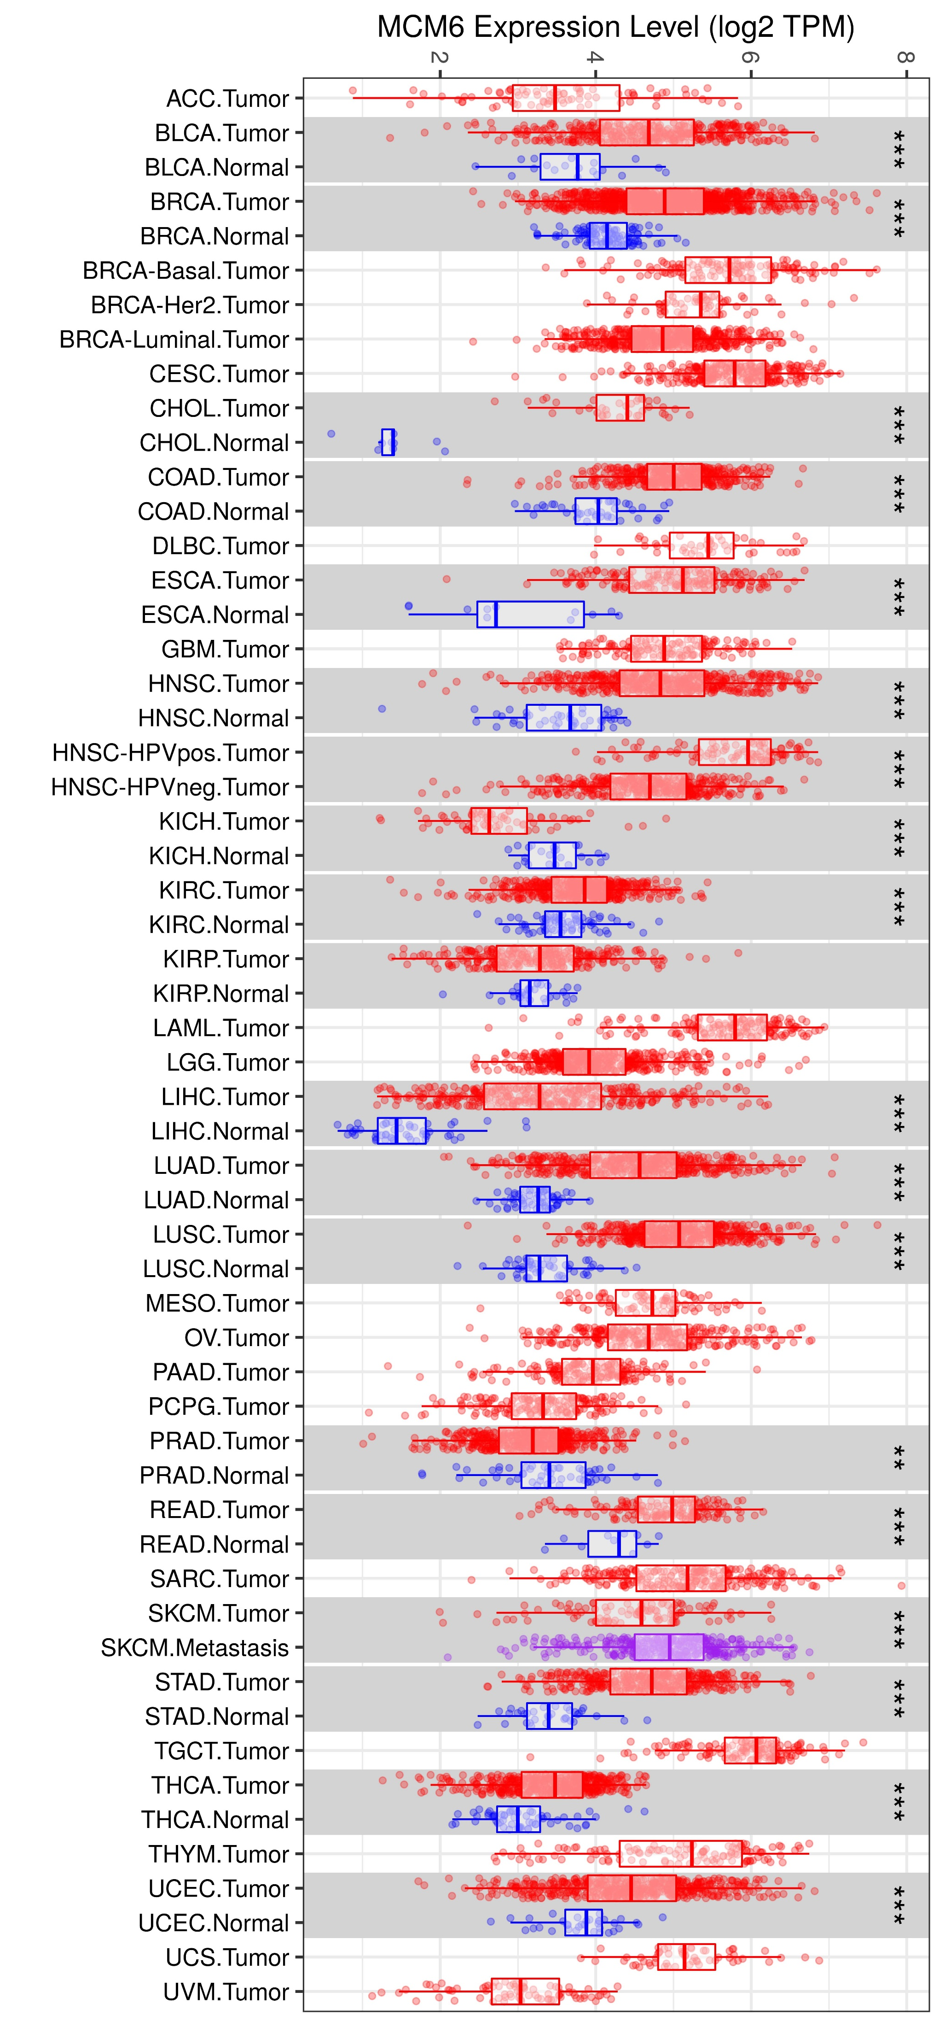
A
B
Notes:
We used public datasets to analyze the expression of MCM6 in tumors and control normal tissues. The MCM6 mRNA levels were analyzed using Oncomine database with P-value of 0.01, fold change of 2, and gene ranking of all. The analysis showed that compared with normal tissues, MCM6 expression is higher in most cancers, such as sarcoma, colorectal cancer, lung cancer, cervical cancer, and liver cancer (Figure S1A). Data from Tumor Immunity Estimation Resource also showed that the expression of MCM6 in almost all TCGA tumors was significantly higher than that in neighboring normal tissues (Figure S1B). The results suggest that MCM6 is a promising tumor prediction and treatment target.

