Slide 1
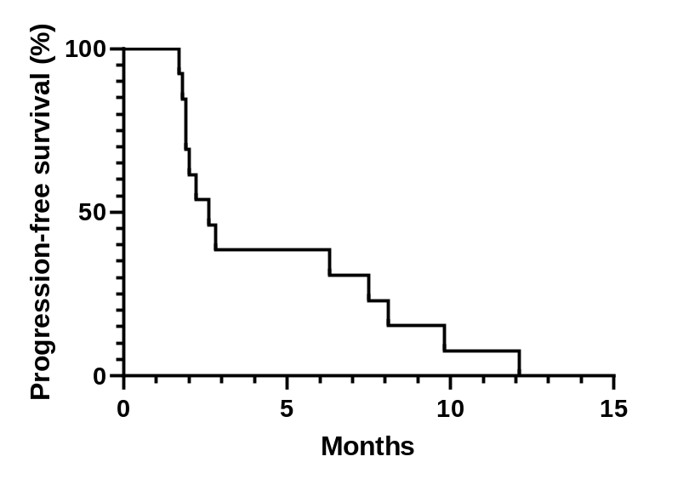
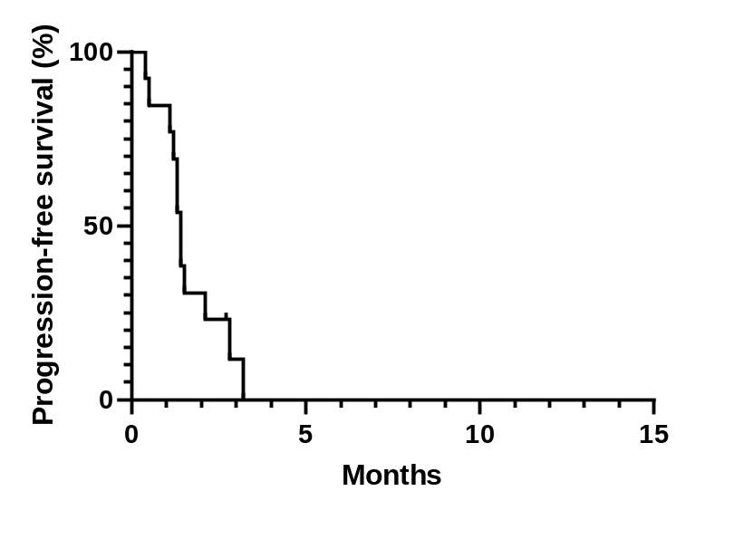
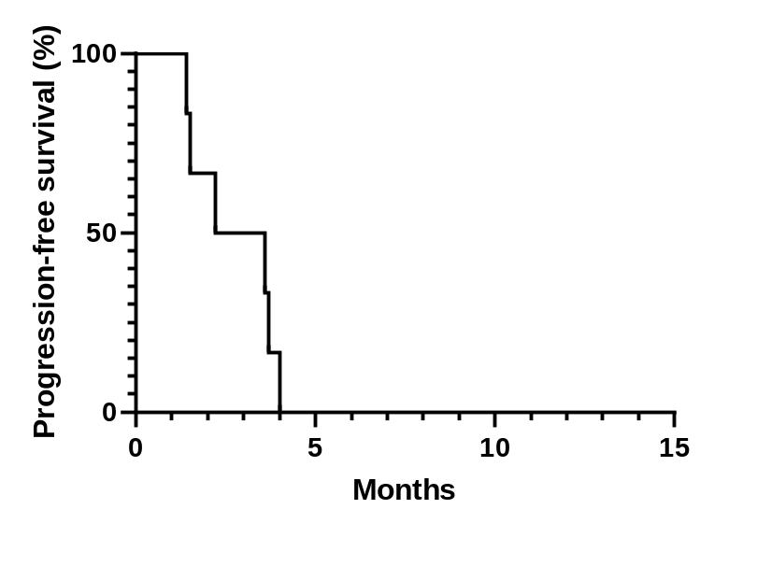
A.
B.
C.
Median PFS: 2.6 months (95% CI, 1.7-3.5)
Median PFS: 1.4 months (95% CI, 1.2-1.6)
Median PFS: 1.2 months (95% CI, 0-4.7)
Cancer | Prior to TAS-117 (n=13) | TAS-117 (n=13) | Subsequent line of treatment (n=6)
Breast cancer | 3 | 4 | 5
Breast cancer | 5 | 6 | none
Breast cancer | 3 | 4 | none
Breast cancer | 4 | 5 | 6
Ovarian cancer | 3 | 4 | 5
Ovarian cancer | 2 | 3 | 4
Endometrial cancer | 3 | 4 | none (expired)
Colon cancer | 3 | 4 | none (expired)
Colon cancer | 2 | 3 | none (expired)
Rectal cancer | 4 | 5 | 6
Gastric cancer | 8 | 9 | none (expired)
Gallbladder cancer | 1 | 2 | 3
Non-small cell lung cancer | 3 | 4 | none (expired)
Figure S1. Analysis of progression-free survival by A) PFS 1 (prior to TAS 117), B) PFS 2 (TAS 117), and C) PFS 3 (after TAS 117)
Table depicts the line of treatments received.
Abbreviations: PFS, progression-free survival; CI, confidence interval.

Slide 2
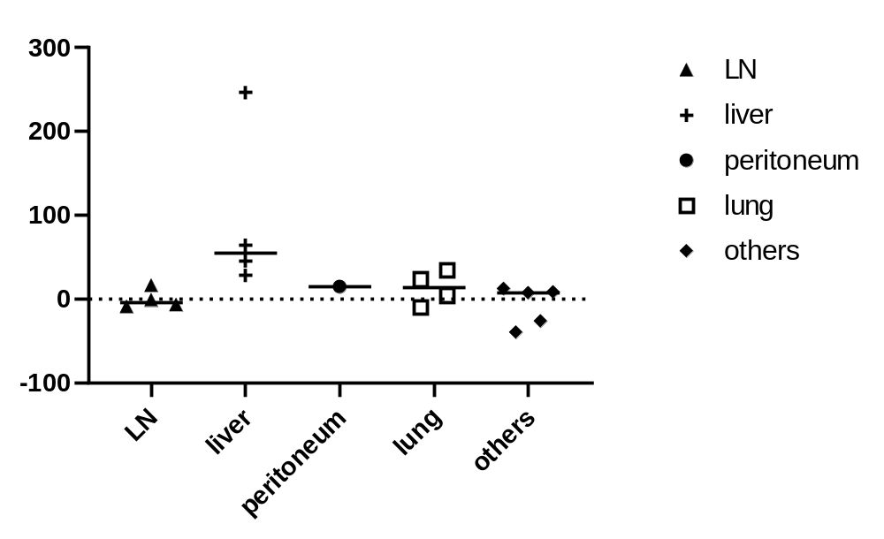
p= 0.107
Figure S2. Analysis of responses per metastatic organs by one-way analysis of variance (ANOVA)
There was no significant difference in progression in all organs (p = 0.076) and in the lymph nodes and liver (p = 0.107). Other metastatic organs included: 1) soft tissue around the peri-aortic area, 2) inguinal mass, 3) pelvic cavity mass, 4) seeding nodule in the anterior renal fascia, and 5) spleen.
Abbreviations: LN, lymph nodes.

Slide 3
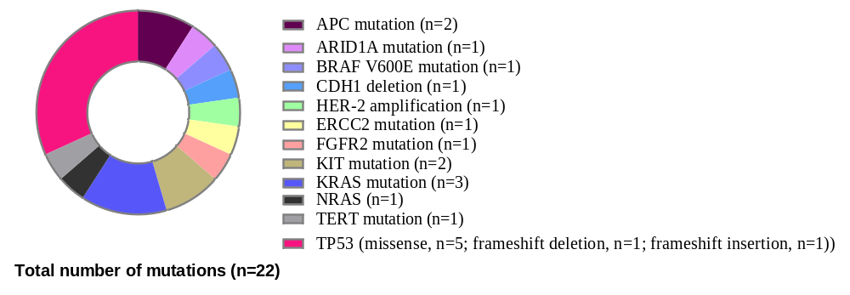
Figure S3. Co-existing mutations identified in patients treated with TAS-117
A total of 22 mutations were identified in 13 patients. TP53 mutations (n = 7) were the most common.
Abbreviations: TP-53, tumor protein 53; APC, adenomatous polyposis coli; KRAS, Kirsten rat sarcoma viral oncogene homolog; ERBB2, Erb-B2 receptor tyrosine kinase 2; CDH1, Cadherin 1; BRAF, B-Raf proto-oncogene; FGFR, fibroblast growth factor receptors; TERT, telomerase reverse transcriptase; ARID-1A, AT-rich interactive domain-containing protein 1A; NRAS, neuroblastoma ras viral oncogene homolog.

Slide 4
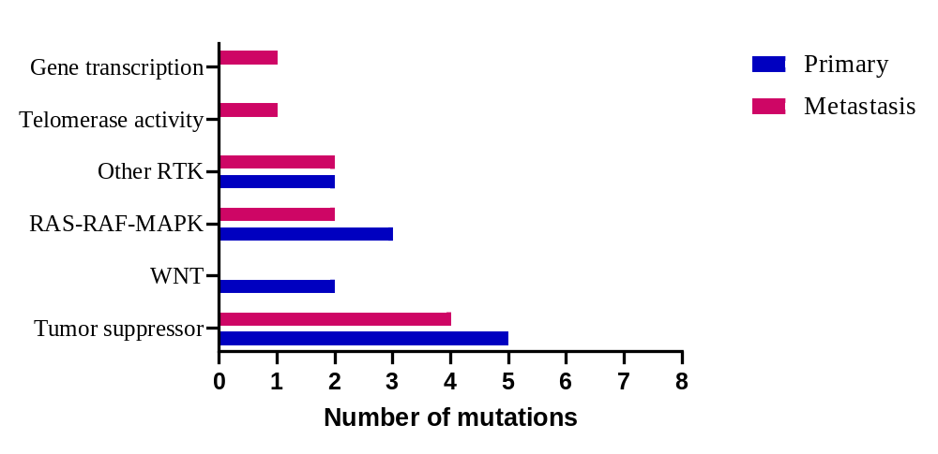
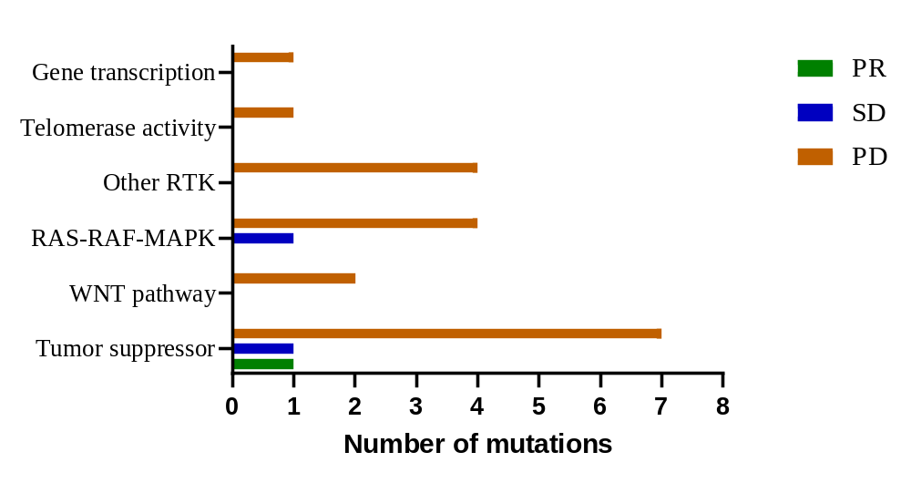
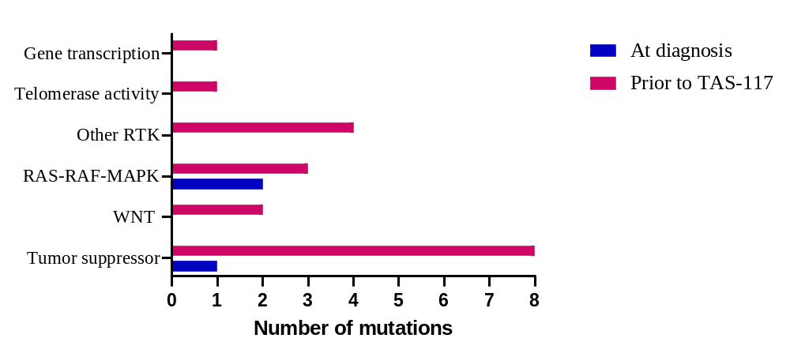
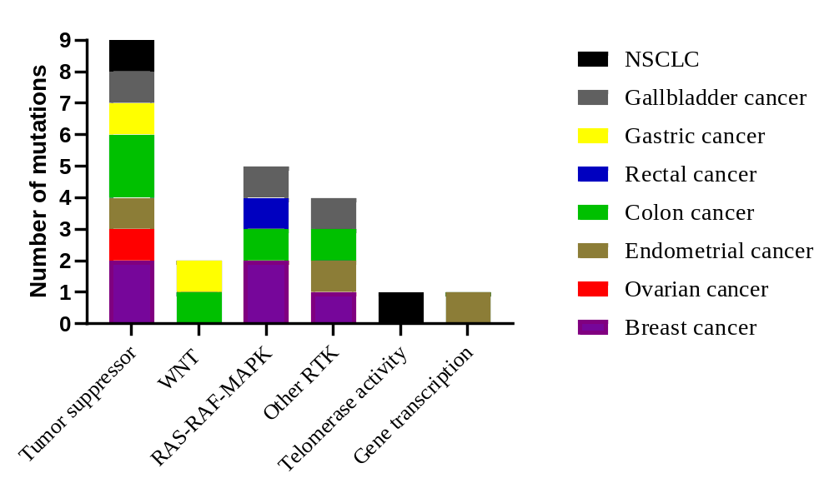
A.
C.
p= 0.526
p=0.978
B.
D.
p= 0.512
p= 0.68
Figure S4. Co-existing mutations categorized according to A) primary or metastatic biopsy site, B) biopsy time period (at initial cancer diagnosis or prior to TAS-117 treatment), C) response evaluation by RECIST criteria (PR, SD, PD), and D) tumor types
There are no correlations between co-existing mutations.
Abbreviations: RTK, receptor tyrosine kinase; RAS-RAF-MAPK, Ras-Raf-Mitogen-activated protein kinase; PR, partial response; SD, stable disease; PD, progressive disease; RECIST, response evaluation criteria in solid tumors; NSCLC, non-small cell lung cancer

Slide 5
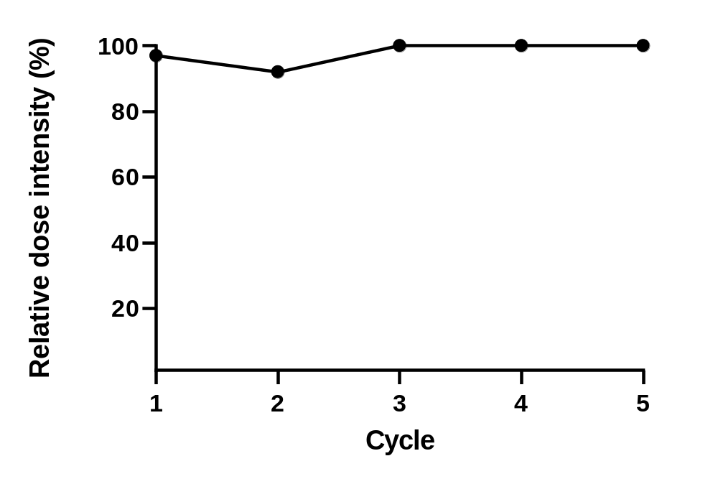
Figure S5. Relative dose intensity of TAS-117

