Slide 1
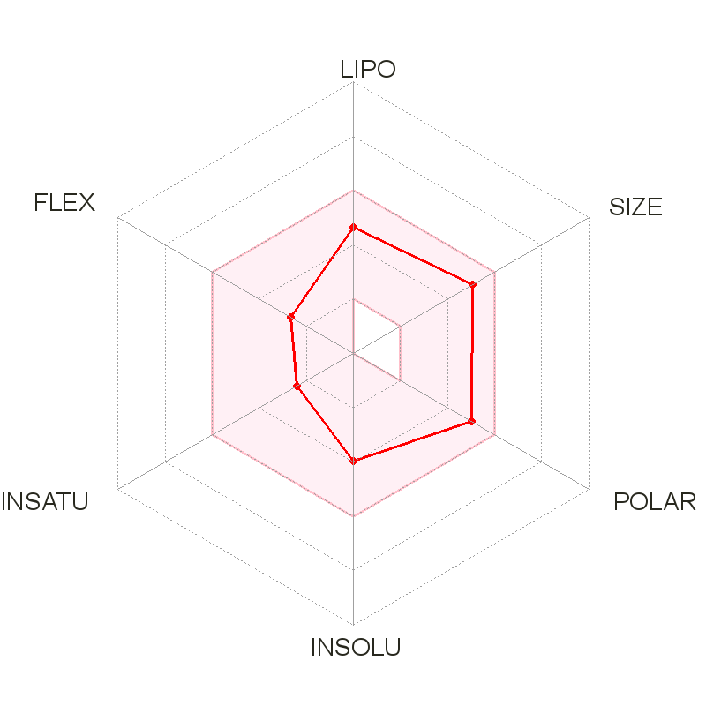
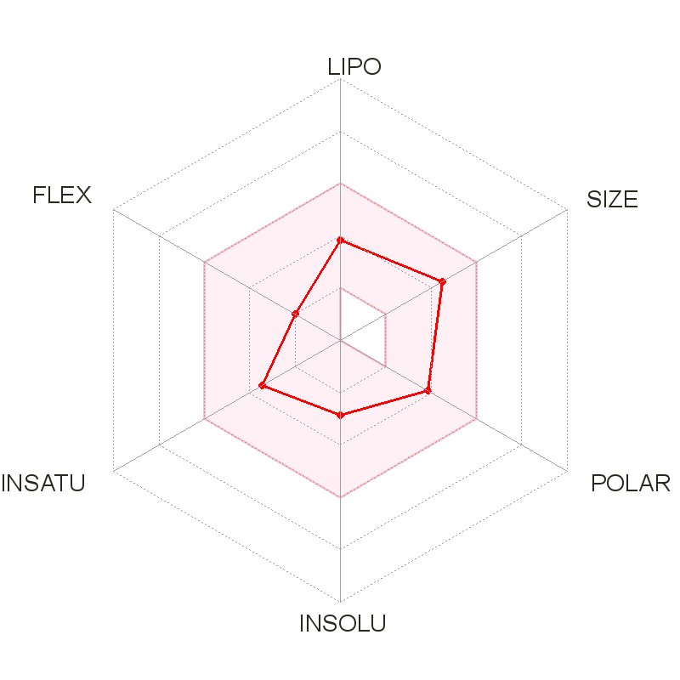
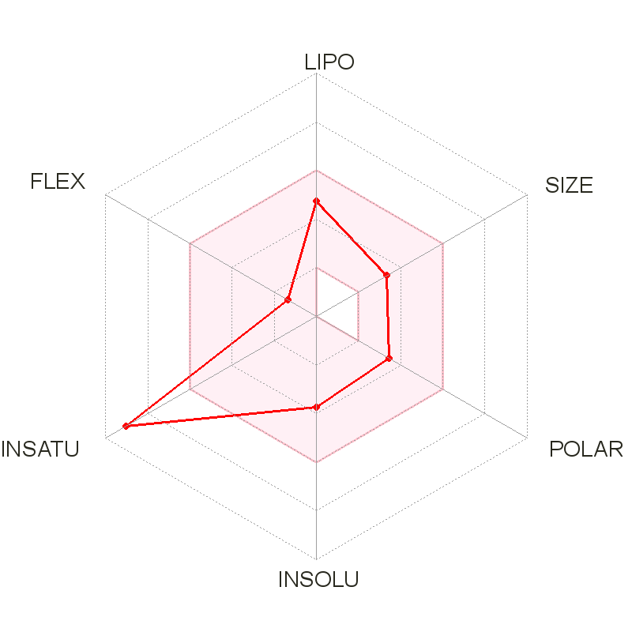
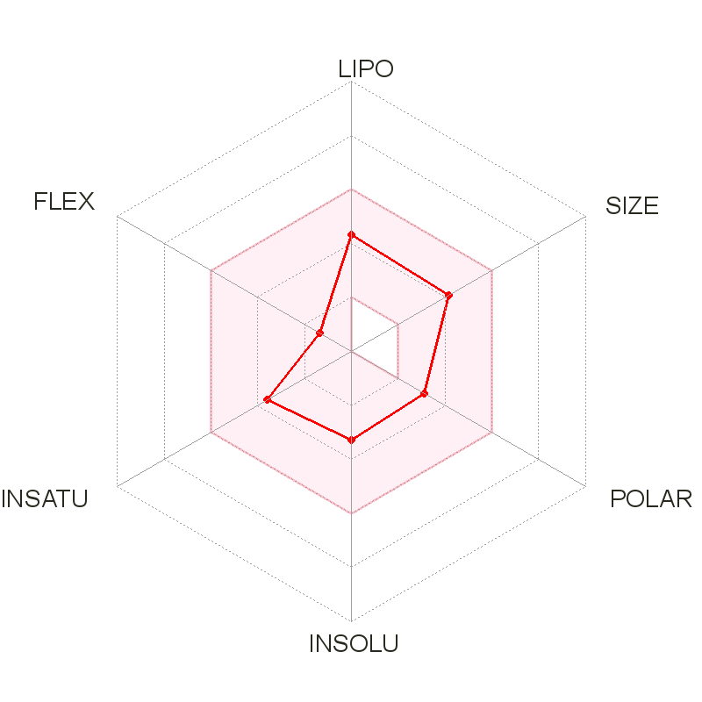
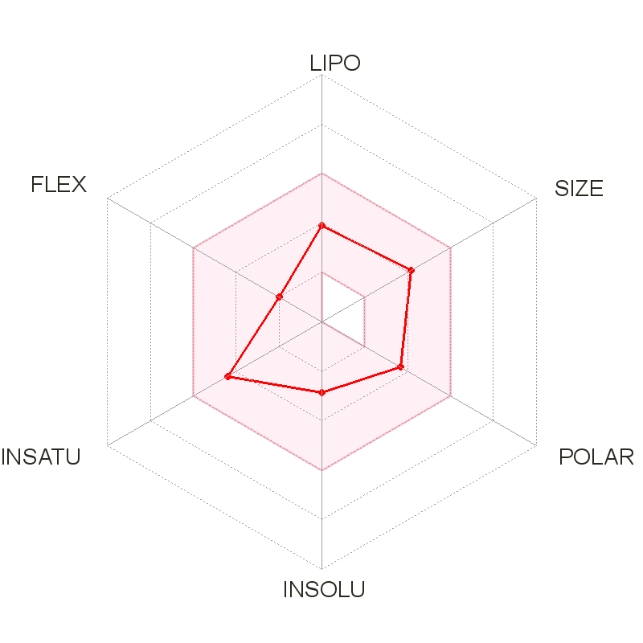
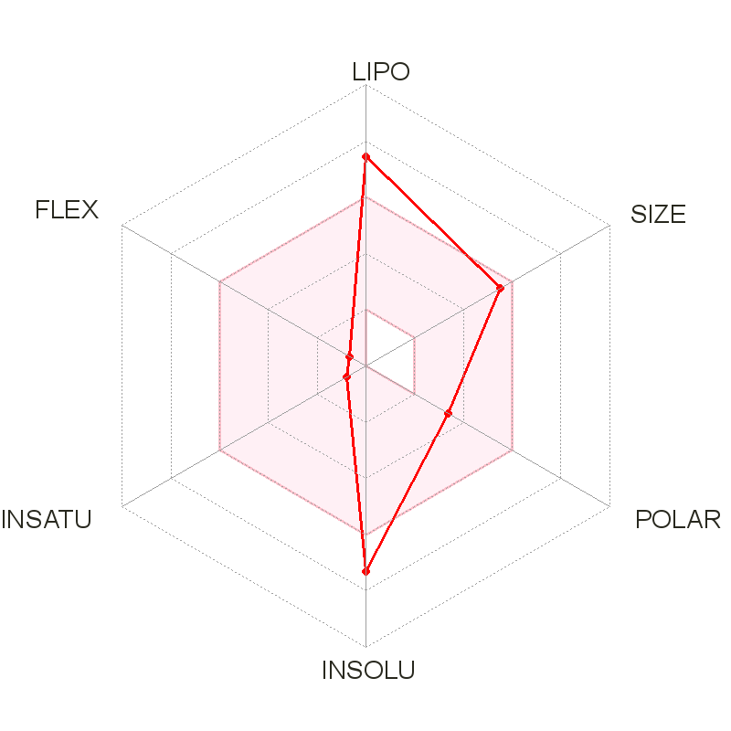
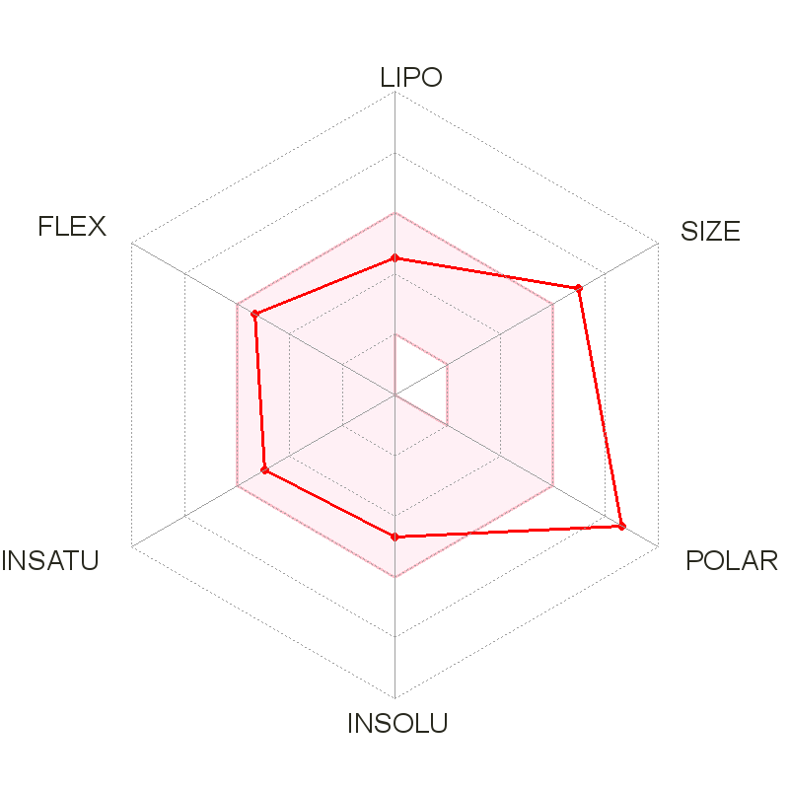
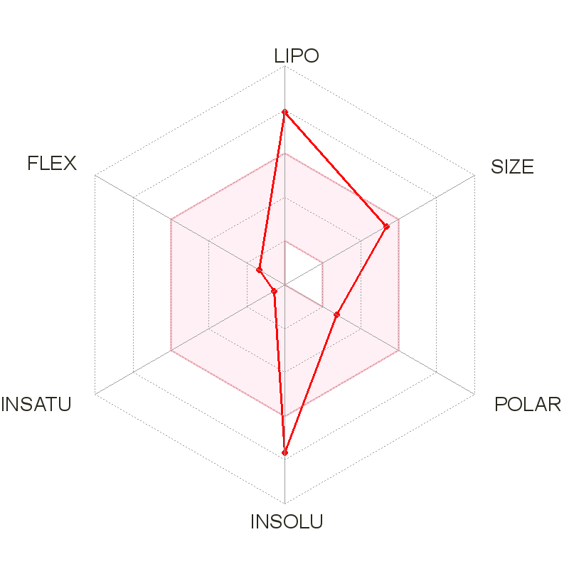
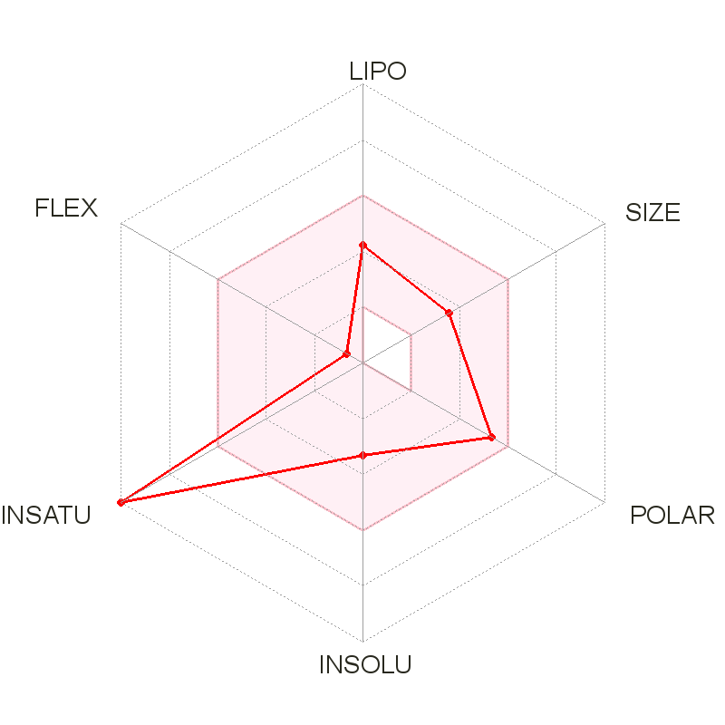
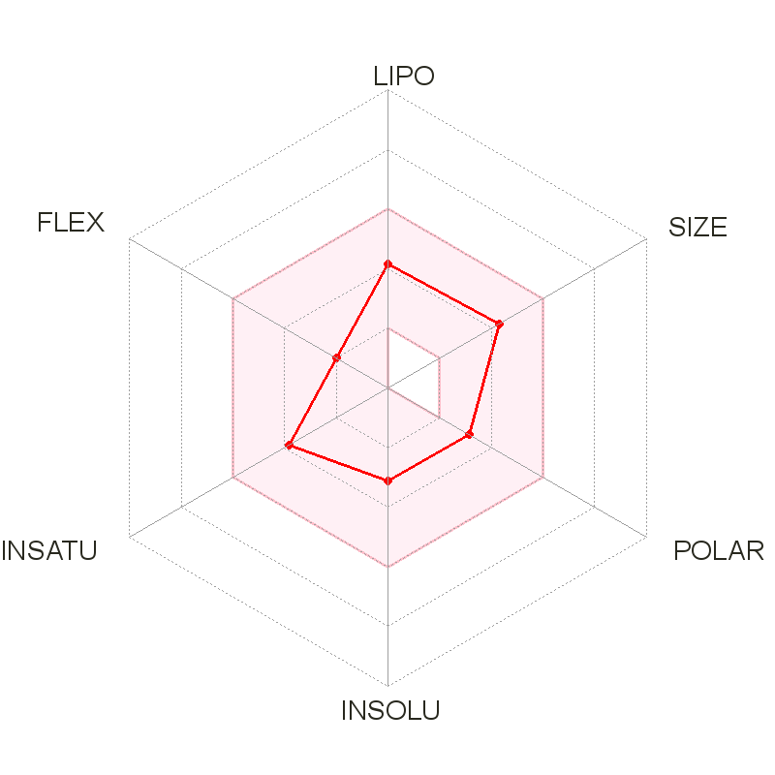
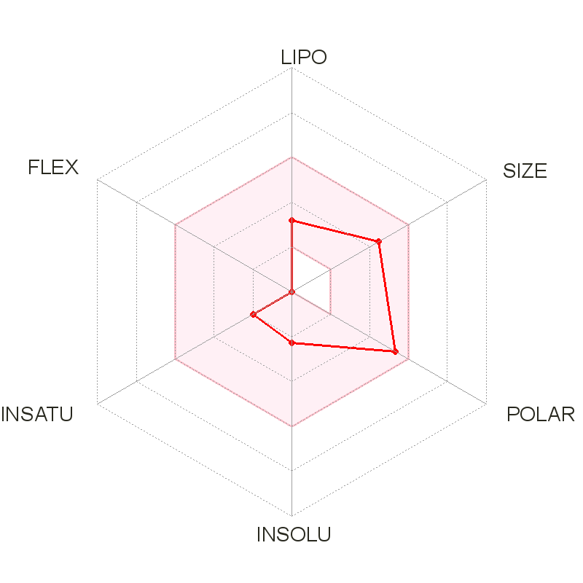
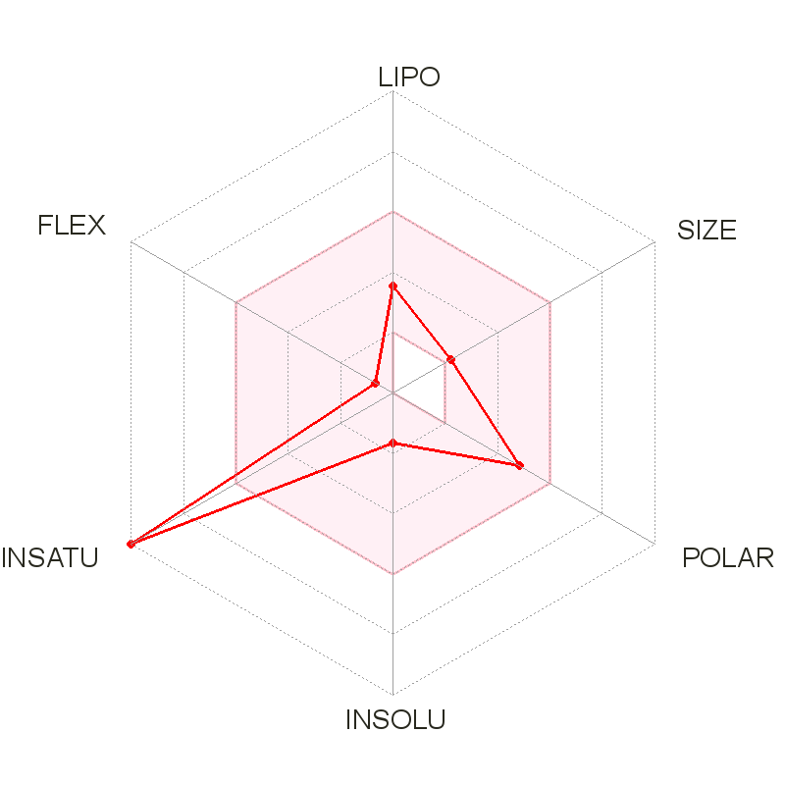
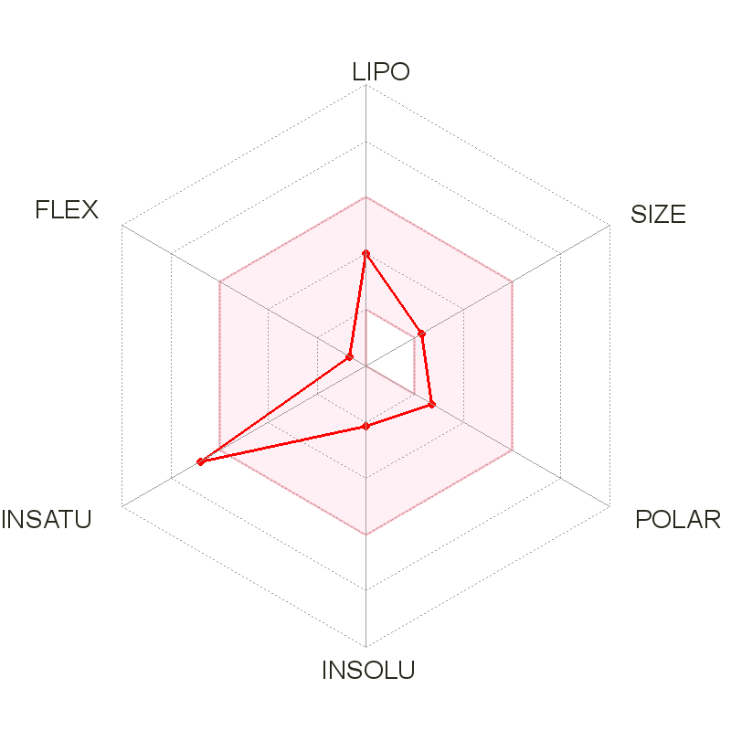
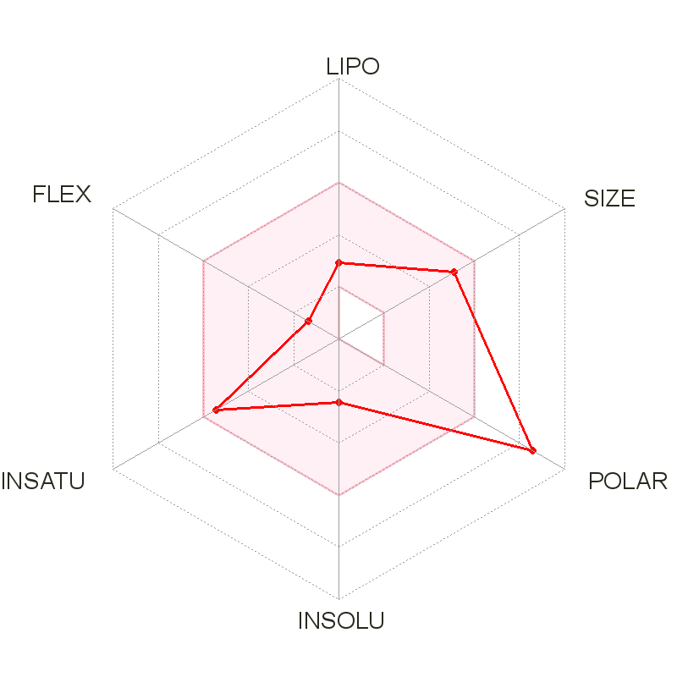
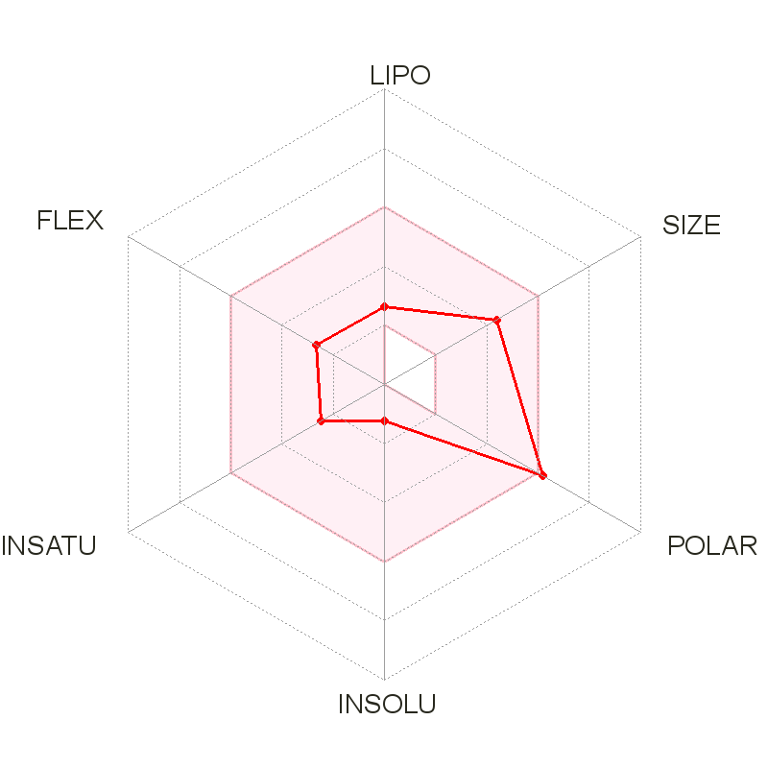
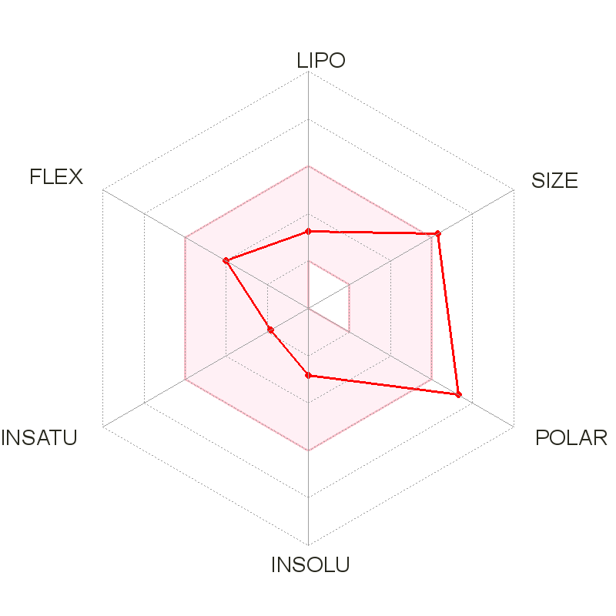
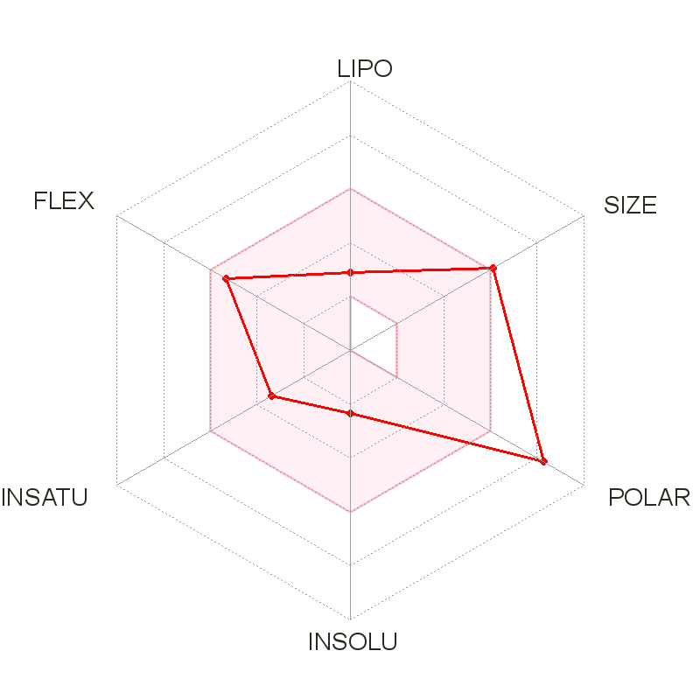
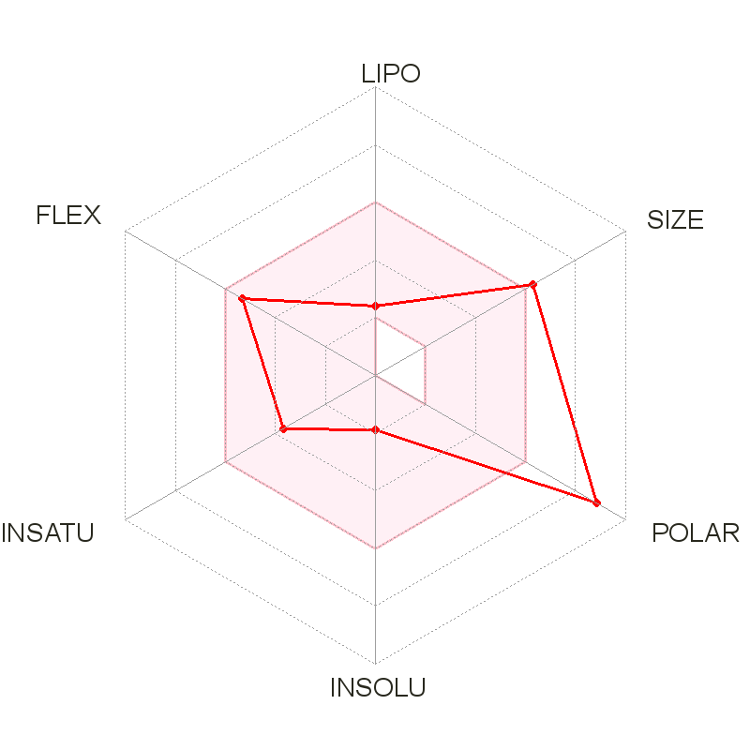
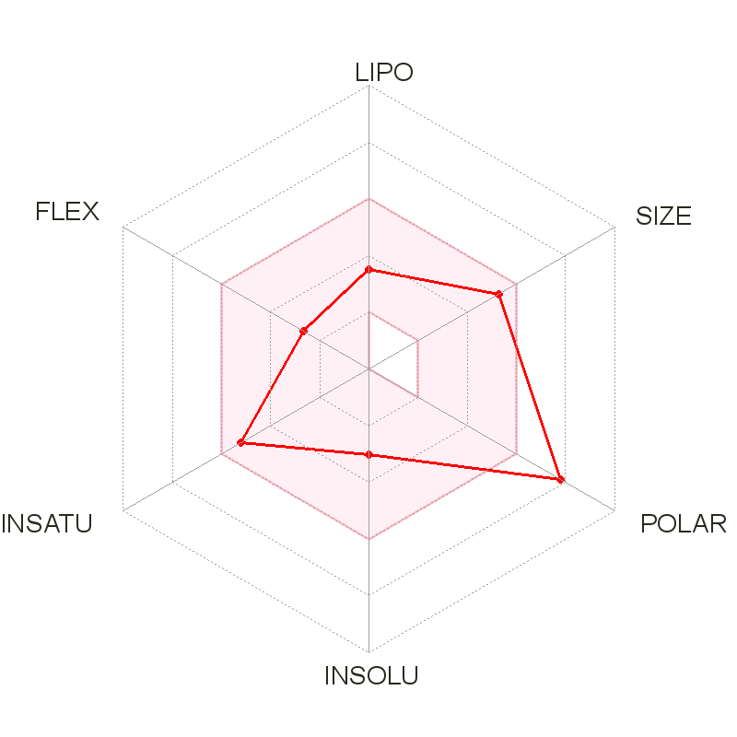
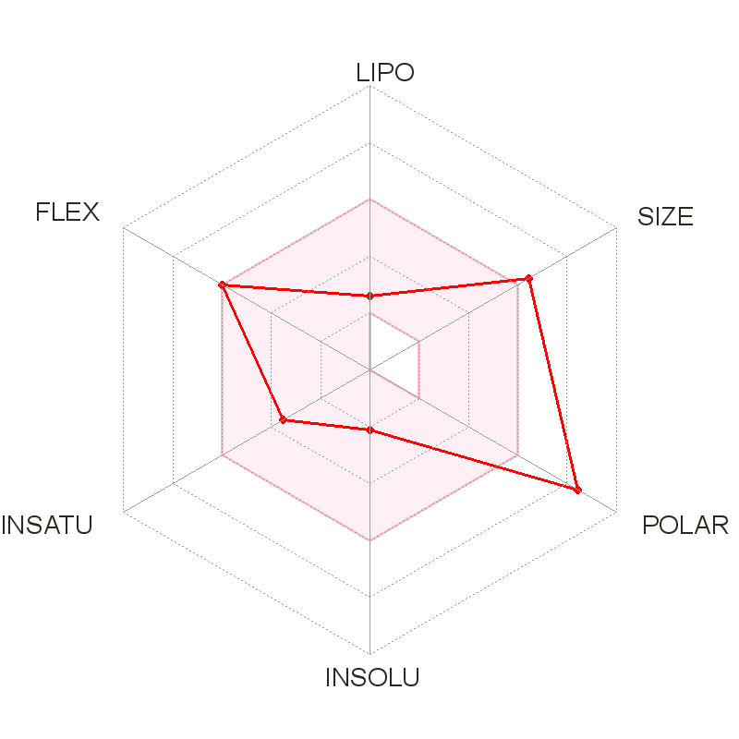
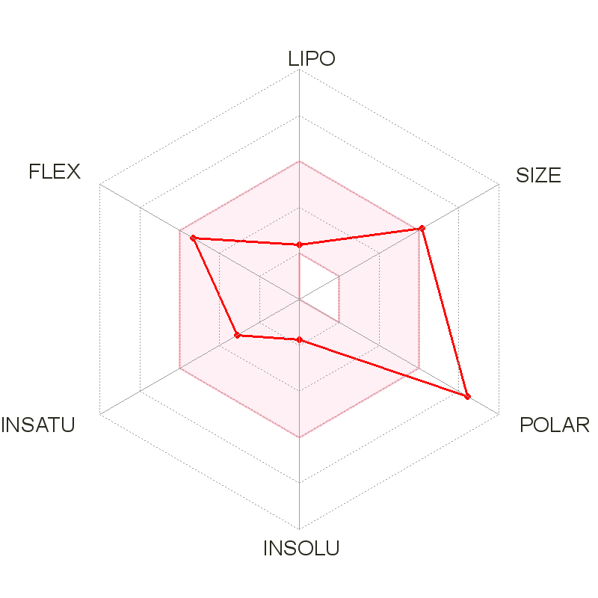
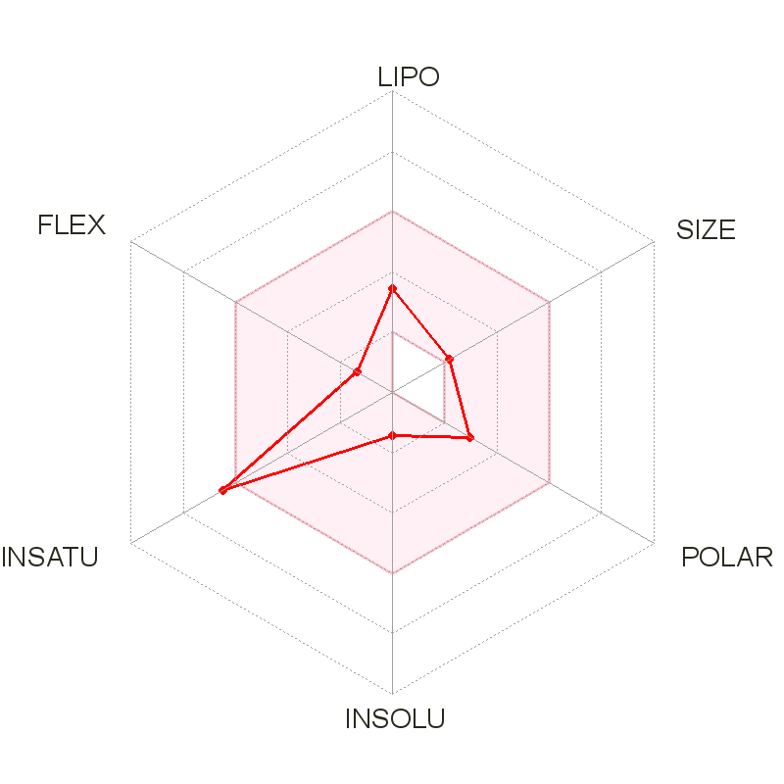
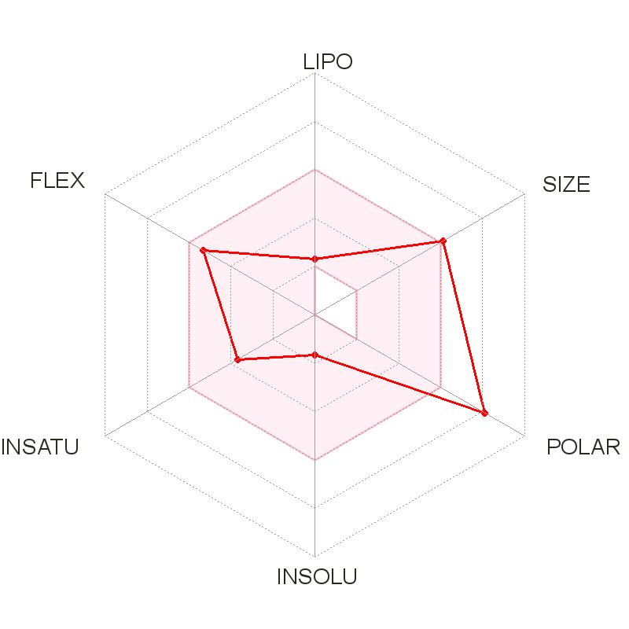
Fig. 1. Comprising the radar plots of phytoconstituents identified from AYUSH-64
Betulin (A1)
Neocaesalpin B (A2)
Burnamine (A3)
Formononetin (A4)
Picrinine (A5)
Vallesamine (A6)
Oleanolic Acid (A7)
Amarogentin (A8)
Gentianine (A9)
Mangiferin (A10)
Sweroside (A11)
Kaempferol (A12)
5-methoxystrictamine (A13)
Neocaesalpin L (A14)
Beta-Caesalpin (A15)
Gallic acid (A16)
Picroside B (A17)
Verminoside (A18)
Swertianolin (A19)
Minecoside (A20)
Apocynin (A21)
Picroside-IV (A22)
Kutkoside (A23)
Picroside-II (A24)

Slide 2
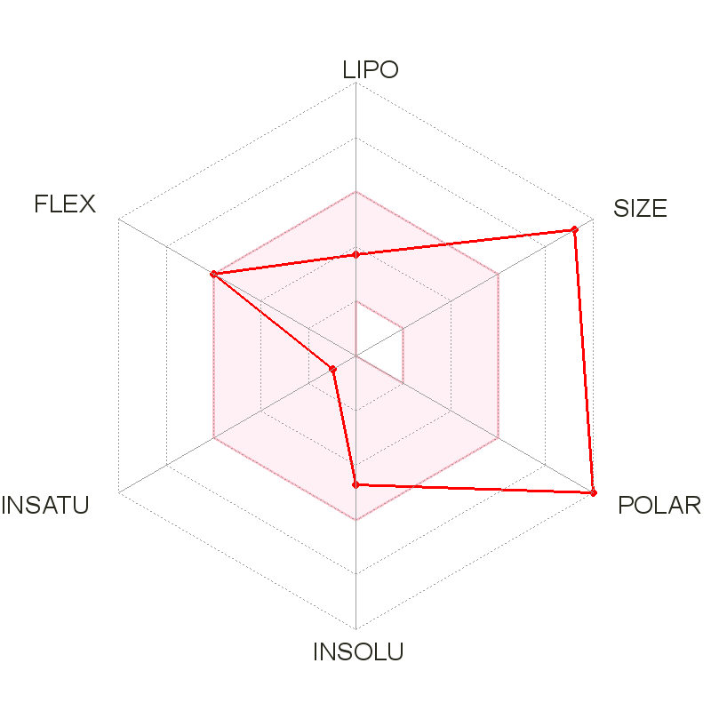
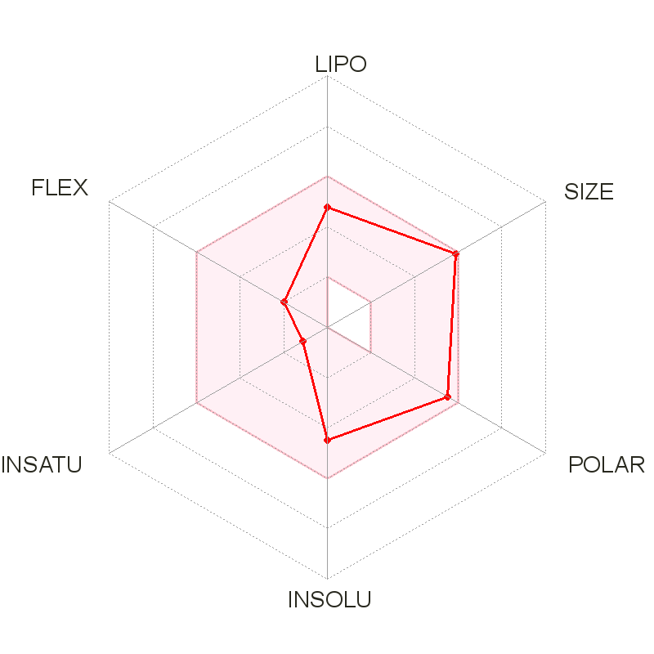
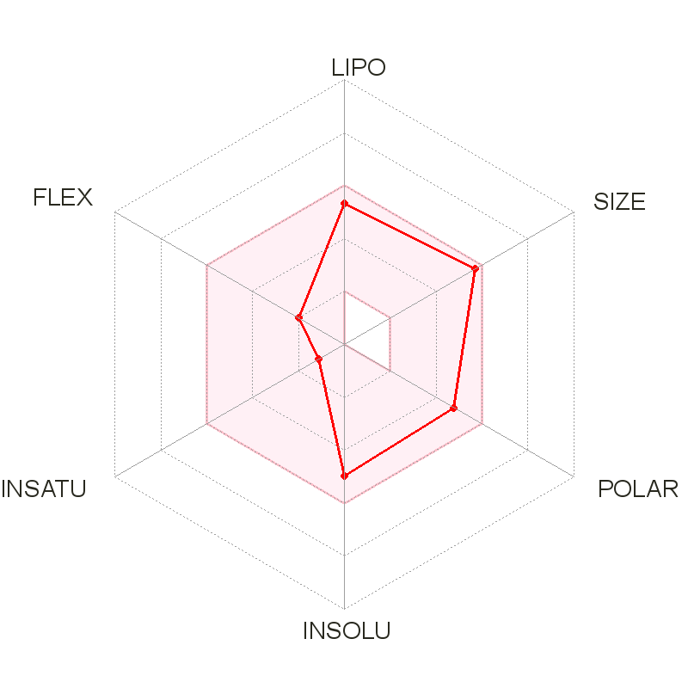
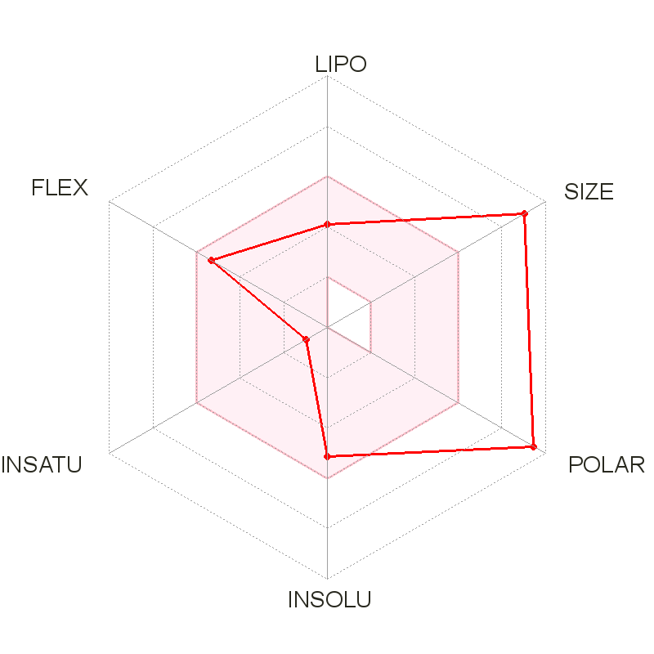
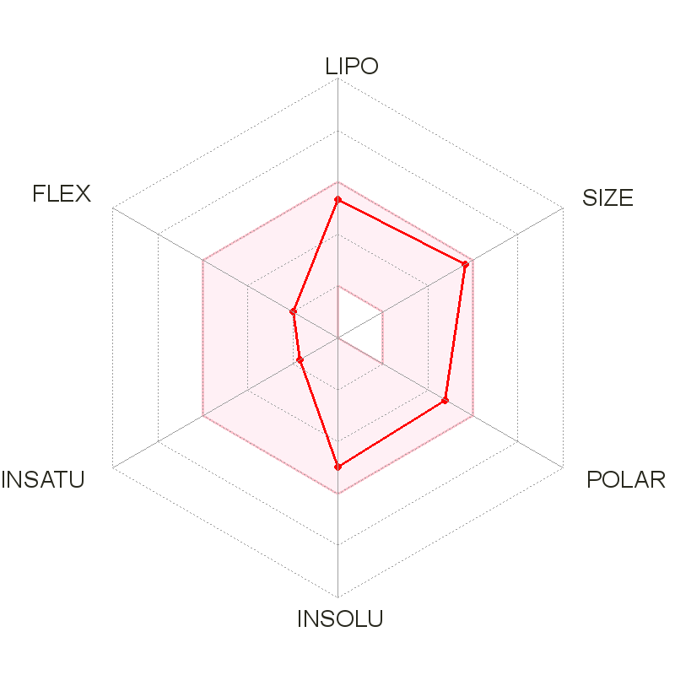

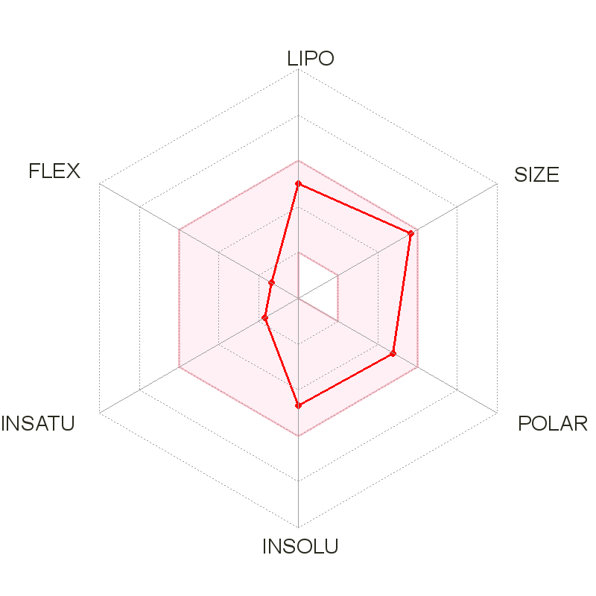
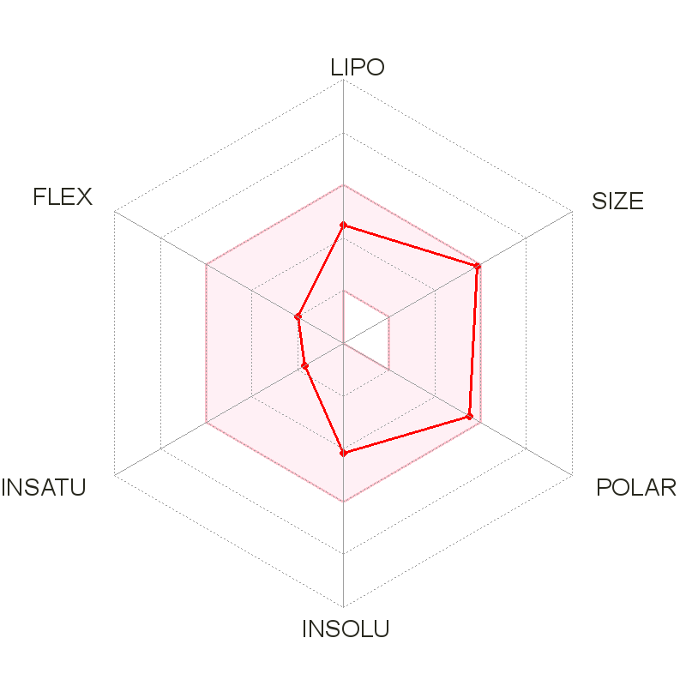
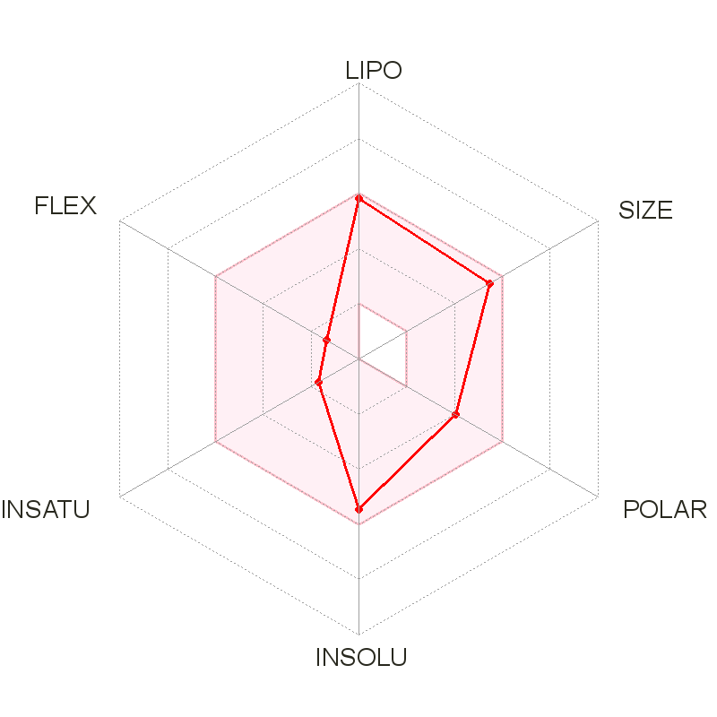
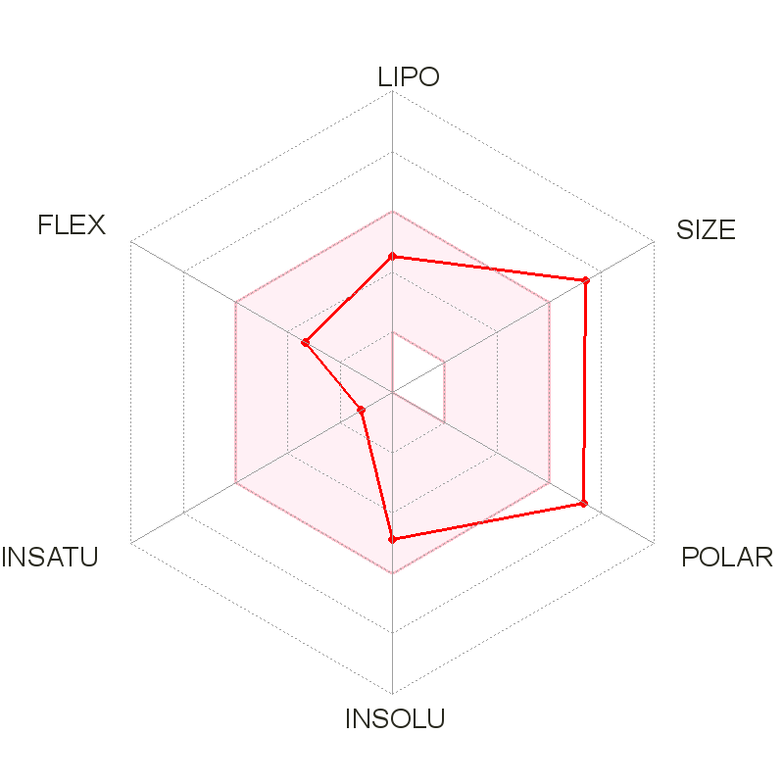
Fig. 2. Comprising the radar plots of phytoconstituents identified from Withania somnifera
Withanoside VII (W1)
Viscosalactone B (W2)
Dihydrowithaferin A (W3)
Withanoside V (W4)
Withaferin A (W5)
12-deoxywithastramonolide
(W6)
Withanolide A (W7)
Withanolide A (W8)
Withanolide B (W9)
Withanoside X (W10)
Coagulin Q (W11)

