Slide 1
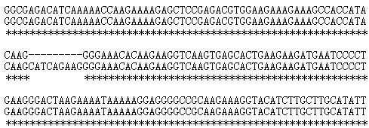
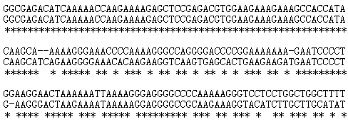
A
T₀-a
WT
T₀-b
B
WT
T₀-b
WT
Fig. S1 Sequence alignment of homozygous T₀-1 and T₀-2 transgenic T₀ plants by CRISPR/Cas9 genome editing

Slide 2
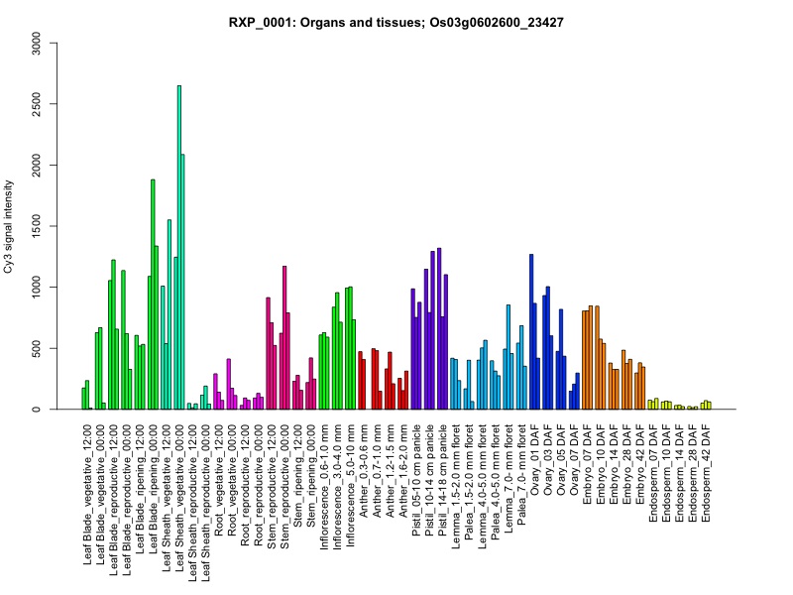
Fig. S2 Expression patterns of TCD7.
Data were obtained from the rice expression profile database, RiceXPro (http://ricexpro.dna.affrc.go.jp/).

Slide 3
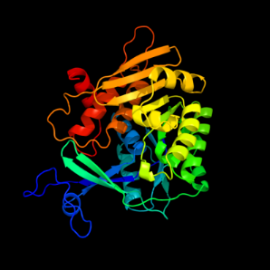
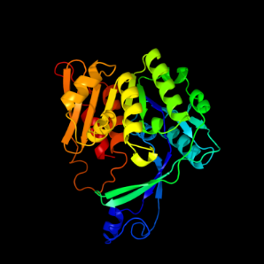
WT
tcd7
A
B
MHRMASLLLPPQFLCSLPCSTNSIRSHLHYKPHFLGNIMTKPKAKMRLLNRNVSSMAKKS
SQDVAEGSSDDESDGETSKTKKRAPRRGRKKATIQASEGETQEGQVSTEEDESPEGTKKI
KRRGRKKAATTASSSEEKDKAKEPKKRGRRKVKTVEELSDNEGEDLGEDLVPSNDRQEKI
SANDLESKIAALLLEDTDDNDINNLIPLVCCFGPAKYSFIPSGRPANRLIDHEIHEGMKD
MFWSPDQFVRAPGGSSSNVALALAASGGRVEFMGKLGDDDYGQSTLYHLNVNGVQTRAIK
MDPSAFTAMSLMKVTGRGSLKMSCAKPCAEDCFVQTDINPAVLKEAKMFYYNSSALLEPT
TRSSLSKAIEVSKKFGGVTFFDLNLPLPLWSSSKETKSLVKEAWEAADIIEITKQELEFL
CGIKPSEKFGTKDNDKSKFTHYSPEVVTKLWHENLKVLFVTNGTSKIHYYTKEHDGWVRG
TEDAPITPFTGDMSQSGDAIVAALMKMLAINPHLVTDKDYLHTAMKHAITCGVIDQWLLA
RERGFLPRERADPTSEQFGVRFVTEKEYRTLPDSIHTEDSSESELLYVE
C
Fig. S3 3D structures of TCD7. (A) TCD7 structure in wild type (WT). (B) TCD7 structure in tcd3 mutant. (C) Amino acid (aa) sequence of TCD7. The red letters represent the amino acids absent in tcd7 mutant and the underlined sequences represent the pfkb domain. The amino acid sequence of TCD7 is from http://swissmodel.expasy.org/.

Slide 4
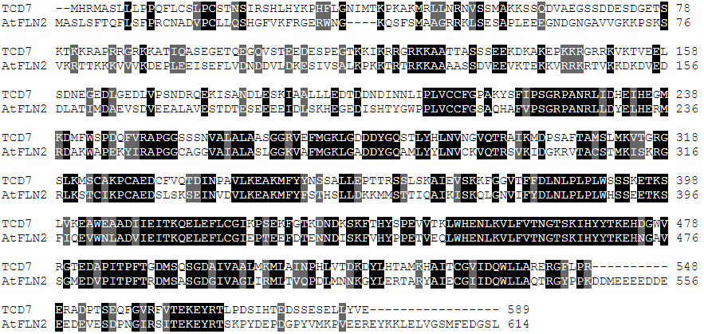
Fig. S4 Amino acid sequence alignment of TCD7 protein and the most homologous protein we identified, Arabidopsis AtFLN2. The similarity between TCD7 and AtFLN2 was about 55% and the mutation site was located in the conserved region as shown in the red box; there exists an amino acid difference between TCD7 (Leu) and AtFLN2 (Ile).

