Slide 1
Graper AL, Noyszewski AK, Anderson NO, Smith AG.
Variability in ITS1 and ITS2 sequences of historic (herbaria) and extant (fresh) Phalaris species.

Slide 2
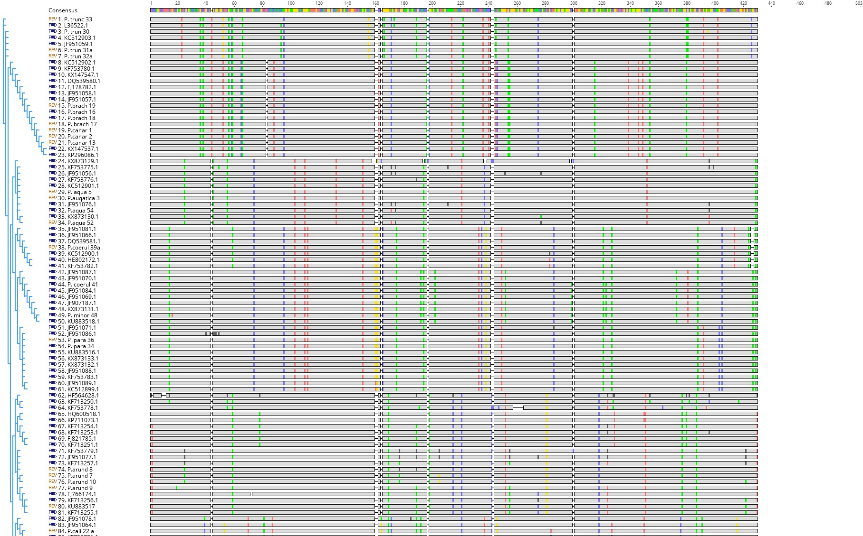
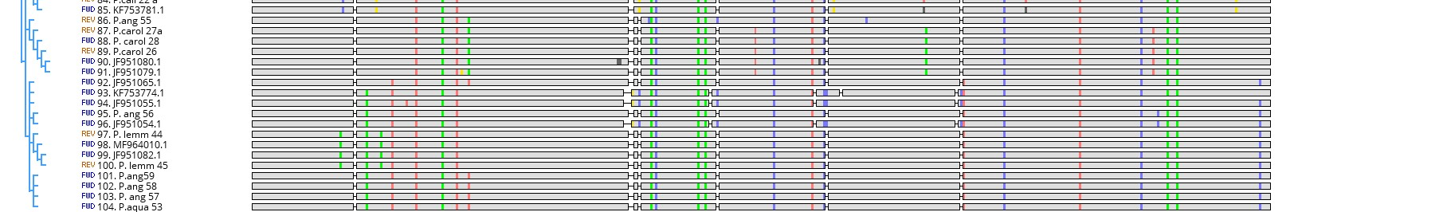
P. truncata (MN811199.1)
T1
T2
T3
T3
T5
P. truncata (L36522.1)
P. truncata
P. truncata (MN811196.1)
P. truncata (KC512903.1)
P. truncata (JF951059.1)
P. truncata (MN811197.1)
P. truncata (MN811198.1)
P. brachystachys (KC512902.1)
B-C1
B-C2
B-C3
B-C4
B-C5
B-C6
P. brachystachys (KF753780.1)
P. canariensis (KX147547.1)
B-C7
P. canariensis (DQ539580.1)
B-C8
P. canariensis (FJ178782.1)
P. canariensis (JF951058.1)
B-C9
P. brachystachys (JF951057.1)
P. brachystachys/
P. canariensis
P. brachystachys (MN811180.1)
P. brachystachys (MN811178.1)
P. brachystachys (MN811179.1)
P. brachystachys (MN811181.1)
P. canariensis (MN811183.1)
P. canariensis (MN811184.1)
P. canariensis (MN811185.1)
P. canariensis (KX147537.1)
P. canariensis (KP296086.1)
P. angusta (KX873129.1)
A1
A2
A3
A4
A5
P. aquatica (KF753775.1)
P. aquatica (JF951056.1)
P. aquatica
P. aquatica (KF753776.1)
P. aquatica (KC512901.1)
P. aquatica (MN811173.1)
P. aquatica (MN811177.1)
P. aquatica (JF951076.1)
P. aquatica (MN811172.1)
P. aquatica (KX873130.1)
P. aquatica (MN811170.1)
P. coerulescens (JF951081.1)
C1
C3
P. coerulescens (JF951066.1)
P. coerulescens
P. coerulescens (DQ539581.1)
P. coerulescens (MN811189.1)
P. coerulescens (KC512900.1)
C2
P. coerulescens (HE802172.1)
P. coerulescens (KF753782.1)
P. minor (JF907187.1)
M1
M2
M3
P. paradoxa (JF951070.1)
P. coerulescens (MN811190.1)
P. minor
P. minor (JF951084.1)
P. minor (JF951069.1)
P. minor (JF907187.1)
P. minor (KX873131.1)
P. minor (MN811193.1)
P. minor (KU883518.1)
P. paradoxa (JF951071.1)
P1
P. minor (JF951086.1)
P. paradoxa (MN811195.1)
P. paradoxa
P. paradoxa (MN811194.1)
P. aquatica (KU883516.1)
P. paradoxa (KX873133.1)
P. paradoxa (KX873132.1)
P. paradoxa (JF951088.1)
P. paradoxa (KF753783.1)
P. paradoxa (JF951089.1)
P. paradoxa (KC512899.1)
P. arundinacea (HF564628.1)
AR1
AR2
AR3
AR4
AR5
AR6
P. arundinacea (KF713250.1)
P. arundinacea (KF753778.1)
P. arundinacea (HQ600518.1)
P. arundinacea (KP711073.1)
P. arundinacea (KF713254.1)
P. arundinacea (KF713253.1)
P. arundinacea (FJ821785.1)
P. arundinacea (KF713251.1)
P. arundinacea
P. arundinacea (KF753779.1)
P. arundinacea (JF951077.1)
P. arundinacea (KF713257.1)
P. arundinacea (MN811175.1)
P. arundinacea (MN811174.1)
P. arundinacea (MN811200.1)
P. arundinacea (MN811176.1)
P. arundinacea (FJ766174.1)
P. arundinacea (KF713256.1)
P. arundinacea (KU883517.1)
P. arundinacea (KF713255.1)
P. californica (JF951078.1)
P. californica
CA1
CA2
P. californica (JF951064.1)
P. californica (MN811182.1)
P. californica (KF753781.1)
P. angusta (MN811166.1)
CR1
P. caroliniana (MN811187.1)
CR2
CR3
P. caroliniana (MN811188.1)
P. caroliniana
P. caroliniana (MN811186.1)
P. caroliniana (JF951080.1)
P. caroliniana (JF951079.1)
P. caroliniana (JF951065.1)
P. angusta
P. angusta (KF7553774.1)
P. angusta (JF951055.1)
P. angusta (MN811168.1)
P. angusta (JF951054.1)
P. lemmonii (MN811191.1)
P. lemmonii
P. lemmonii (MF964010.1)
P. lemmonii (JF951082.1)
P. lemmonii (MN811192.1)
P. angusta (MN811165.1)
P. angusta
P. angusta (MN811167.1)
P. angusta (MN811169.1)
P. aquatica (MN811171.1)

