Slide 1
Single Nucleotide Polymorphism (SNP) in splice sites and prediction for the doublesex (dsx) gene alternative splicing in the malaria vector Anopheles gambiae.
Oswald Y. Djihinto¹, Helga D.M. Saizonou¹, Luc S. Djogbenou^{1,2}*
¹Laboratory of Vector-Borne Infectious Diseases, Institut Régional de Santé Publique, University of Abomey-Calavi, BP 384 Ouidah, Benin.
²Department of Vector Biology, Liverpool School of Tropical Medicine, Pembroke Place, Liverpool L3 5QA, United Kingdom.
*Corresponding author: ldjogbenou22002@yahoo.fr ; Tel: 0022995428543

Slide 2
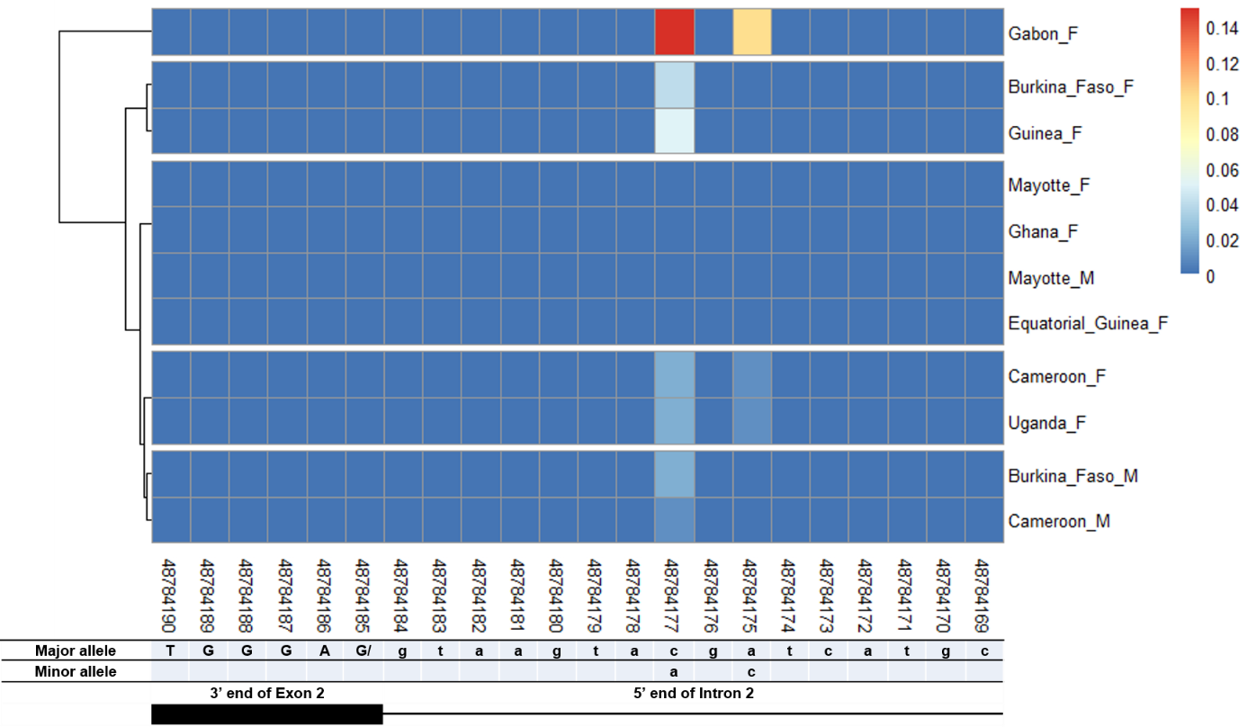
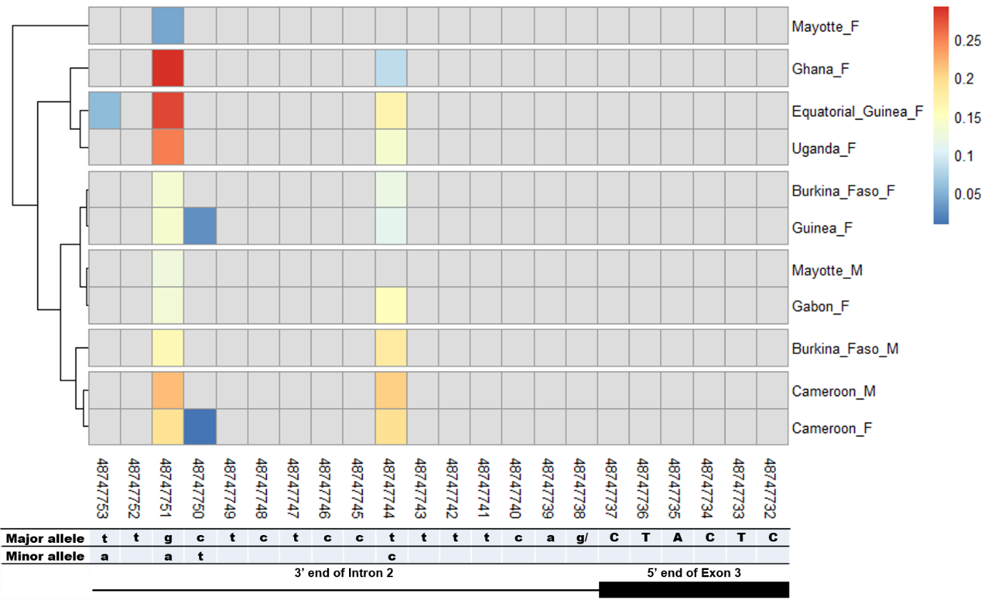
A
B
Figure 1: Single Nucleotide Polymorphism within exon 2 and intron 2 splice sites.
A) SNPs within exon 2 donor splice site between An. gambiae male and female mosquitoes. Legend is similar to Figure 3. The uppercase and lowercase letters denote respectively coding and non-coding region. B) SNPs within intron 2 acceptor splice site between An. gambiae male and female mosquitoes. See Figure 4 for legend. The uppercase and lowercase letters denote respectively coding and non-coding region.

Slide 3
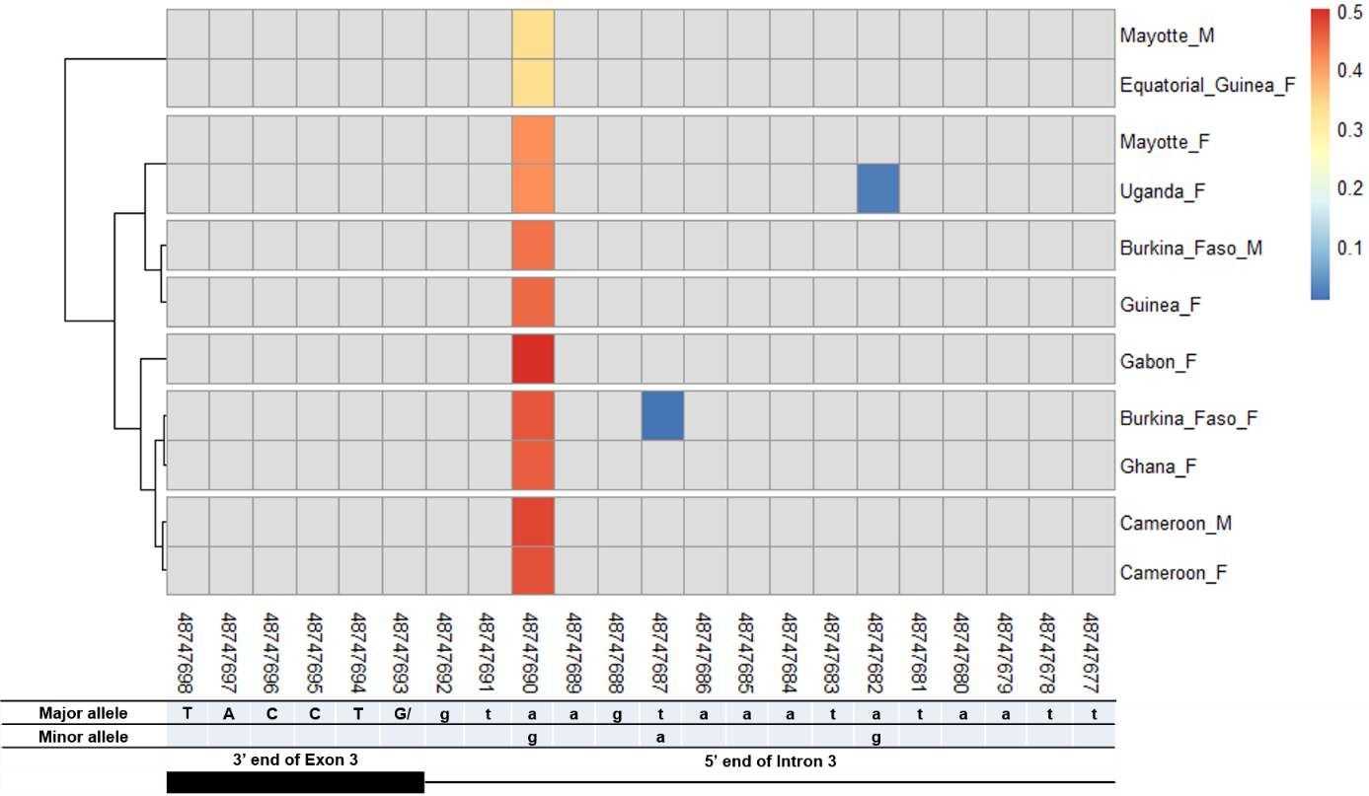
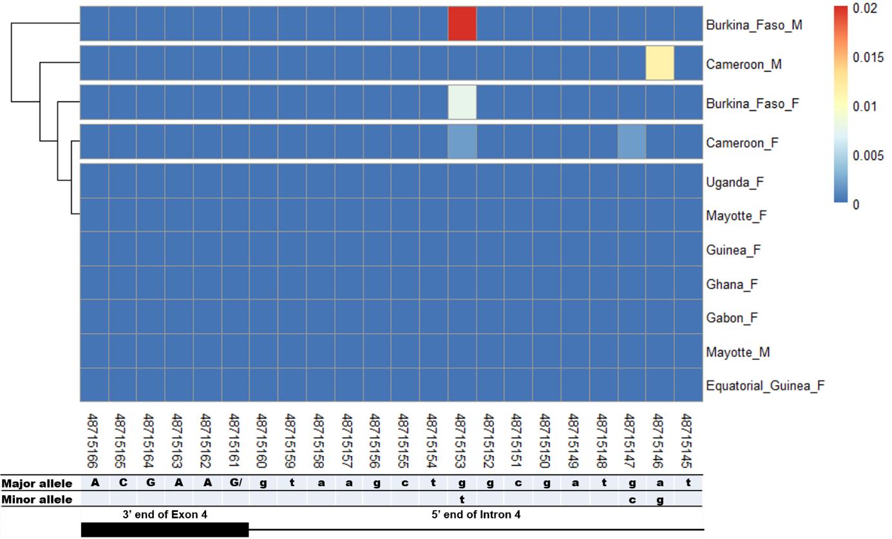
A
B
Figure 2: Single Nucleotide Polymorphism within exon 3 and exon 4 splice sites.
A) SNPs within exon 3 donor splice site between An. gambiae male and female mosquitoes.
See Figure 4 for legend. The uppercase and lowercase letters denote respectively coding and non-coding region. B) SNPs within exon 4 donor splice site between An. gambiae male and female mosquitoes. See Figure 3 for legend. The uppercase and lowercase letters denote respectively coding and non-coding region.

Slide 4
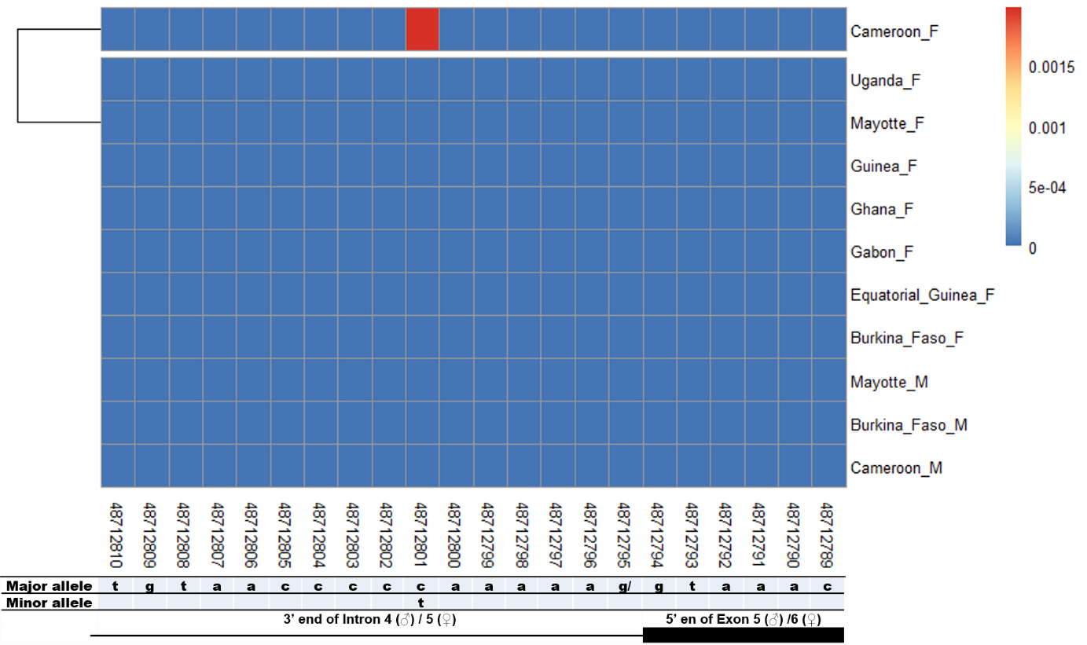
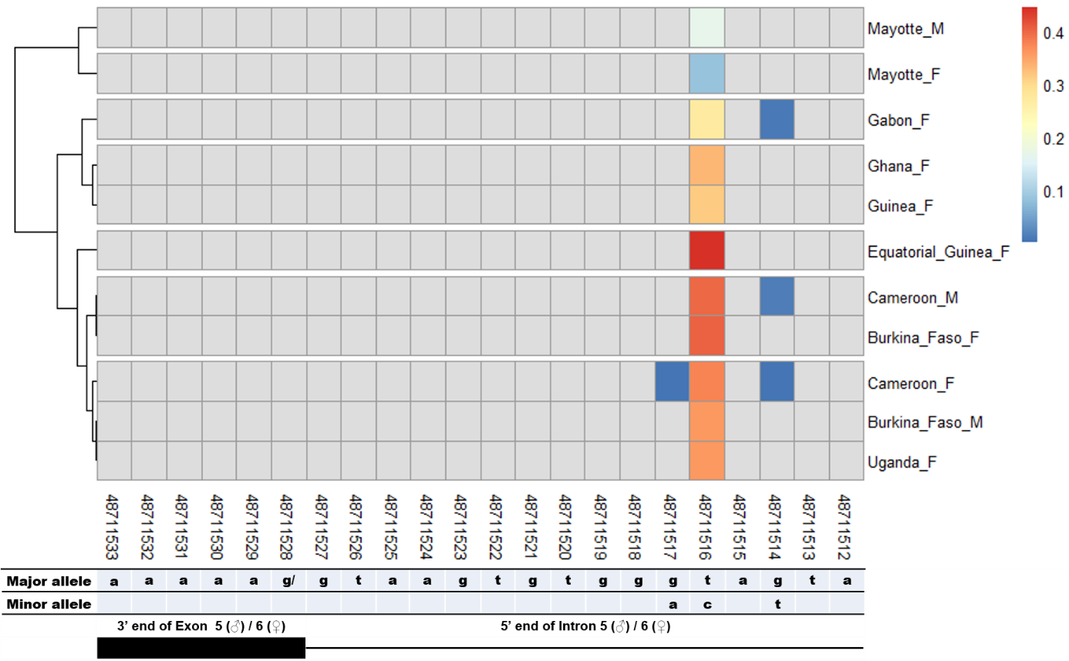
A
B
Figure 3: Single nucleotide polymorphism in the last Agdsx acceptor and donor splice sites.
A) SNPs within the common acceptor site (Intron 4/5) between An. gambiae male and female mosquitoes. The female (♀) specific exon 5 is included in the male (♂) intron 4 sequence making a shift in exon number is male. Thus, the male intron 4 and female intron 5 share the same 3’ end. Similarly, the male exon 5 and female exon 6 share the same 5’ end region. B) SNPs within the common donor site (Exon 5/6) between An. gambiae male and female mosquitoes. The female (♀) specific exon 5 is included in the male (♂) intron 4 sequence making a shift in exon number is male. Thus, the male exon 5 and female exon 6 share the same 3’ end. Similarly, the male intron 5 and female intron 6 share the same 5’ end region.

