Slide 1
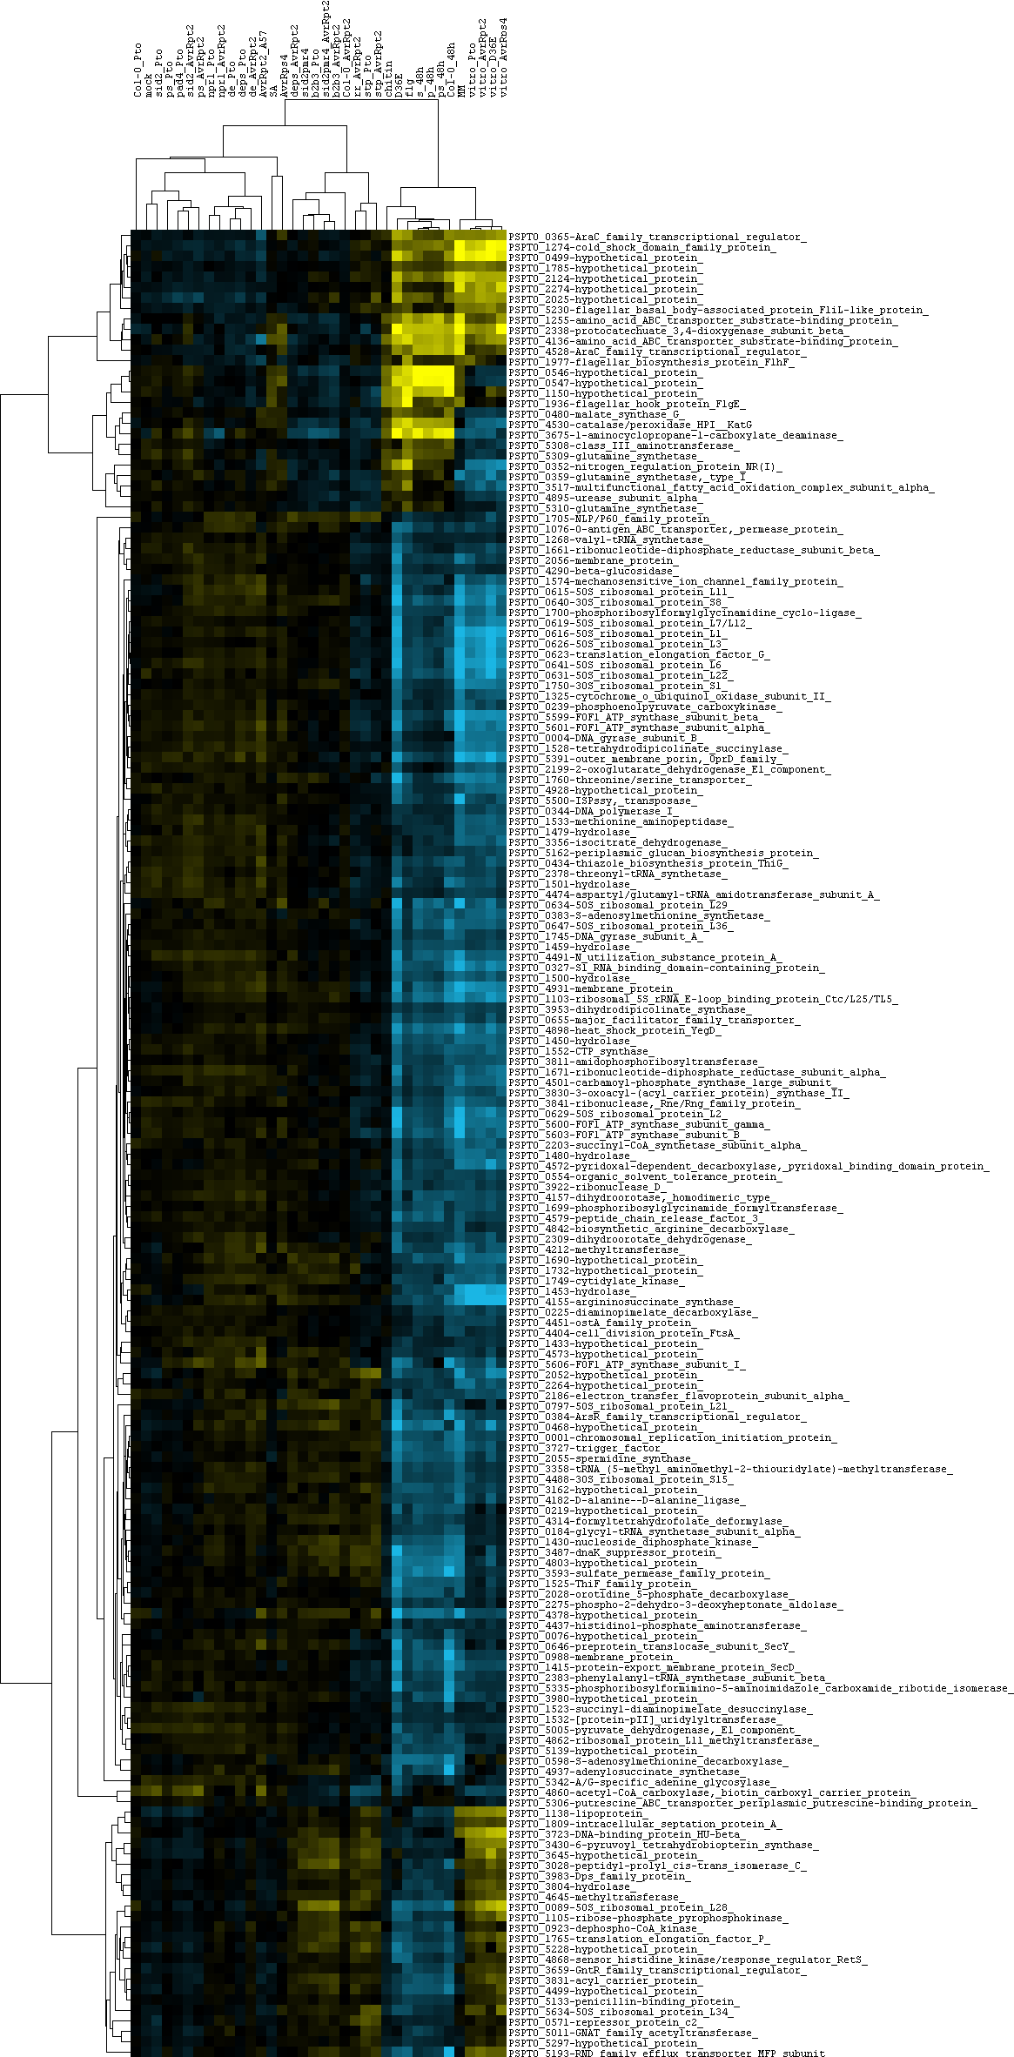
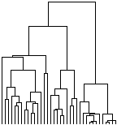

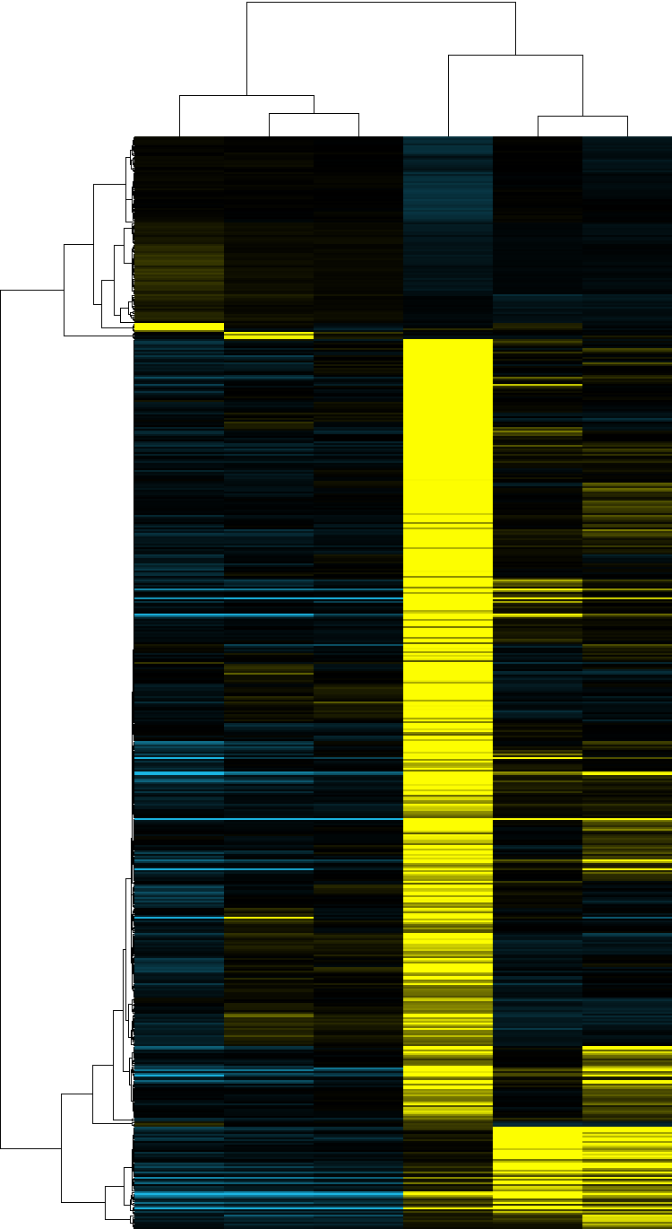
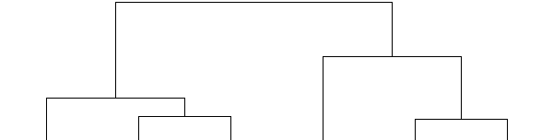

Figure S1
A
In vitro KB avrRps4
In vitro KB D36E
In vitro KB avrRpt2
In vitro KB Pst DC3000
In vitro HIM Pst DC3000
Col-0 Pst DC3000-48 hs
ps Pst DC3000-48 hs
p Pst DC3000-48 hs
s Pst DC3000-48 hs
I
II
III
IV
Flg22 Pst DC3000
D36E Pst DC3000
Chitosan Pst DC3000
stp AvrRpt2
stp Pto
rr AvrRpt2
Col-0 AvrRpt2
b2b3 AvrRpt2
sid2-pmr4 AvrRpt2
b2b3 Pst DC3000
sid2-pmr4
deps AvrRpt2
AvrRps4
SA
pad4 AvrRpt2
de AvrRpt2
deps Pst DC3000
de Pst DC3000
npr1 AvrRpt2
npr1 Pst DC3000
ps AvrRpt2
sid2 AvrRpt2
pad4 Pst DC3000
ps Pst DC3000
sid2 Pst DC3000
mock
Col-0 Pst
I
II
III
IV
B
Apo
Epi
Low N
Low Fe
H₂O₂
NaCl

Slide 2
Table S1A
Sample name | Bacterial strain (phenotype) | Type of experiment | Culture media | Host (phenotype) | Time point
In vitro KB avrRps4 | avrRpsa4 (ETI) | In vitro | KB | none | 6 h
In vitro KB D36E | D36E (PTI) | In vitro | KB | none | 6 h
In vitro KB avrRtp2 | avrRpt2 (ETI) | In vitro | KB | none | 6 h
In vitro KB Pst DC3000 | Pst DC3000 | In vitro | KB | none | 6 h
In vitro HIM Pst DC3000 | Pst DC3000 | In vitro | HIM | none | 6 h
Col-0 Pst DC3000-48 hs | Pst DC3000 | In planta | none | Col-0 | 48 h
ps Pst DC3000-48 hs | Pst DC3000 | In planta | none | Col-0 pad4 sid2 (affected in salicylic acid signalling) | 48 h
p Pst DC3000-48 hs | Pst DC3000 | In planta | none | Col-0 pad4 (affected in salicylic acid signalling) | 48 h
s Pst DC3000-48 hs | Pst DC3000 | In planta | none | Col-0 sid2 (affected in salicylic acid signalling) | 48 h
Flg22 Pst DC3000 | Pst DC3000 | In planta-Flg22 pre-treated | none | Col-0 | 6 h
D36E Pst DC3000 | D36E (PTI) | In planta | none | Col-0 | 6 h
Chitosan Pst DC3000 | Pst DC3000 | In planta-Chitosan pre-treated | none | Col-0 | 6 h
stp AvrRpt2 | AvrRpt2 (ETI) | In planta | none | Col-0 stp1/stp13 (affected in sugar transport) | 6 h
stp Pto | Pst DC3000 | In planta | none | Col-0 stp1/stp13 (affected in sugar transport) | 6 h
rr AvrRpt2 | AvrRpt2 (ETI) | In planta | none | Col-0 rps2/rpm1 (affected in ETI triggering) | 6 h
Col-0 AvrRpt2 | AvrRpt2 (ETI) | In planta | none | Col-0 | 6 h

Slide 3
b2b3 AvrRpt2 | AvrRpt2 (ETI) | In planta | none | Col-0 cyp79b2 cyp79b3 (affected in tryptophan metabolism) | 6 h
sid2-pmr4 AvrRpt2 | AvrRpt2 (ETI) | In planta | none | Col-0 spm (affected in salicylic acid signalling and callose deposition) | 6 h
b2b3 Pst DC3000 | Pst DC3000 | In planta | none | Col-0 cyp79b2 cyp79b3 (affected in tryptophan metabolism) | 6 h
sid2-pmr4 | Pst DC3000 | In planta | none | Col-0 spm (affected in salicylic acid signalling and callose deposition) | 6 h
deps AvrRpt2 | AvrRpt2 (ETI) | In planta | none | Col-0 dde2 ein2 pad4 sid2 (affected in salycilic, jasmonic acid and ethylen signalling) | 6 h
pad4 AvrRpt2 | AvrRpt2 (ETI) | In planta | none | Col-0 pad4 (affected in salicylic acid signalling) | 6 h
de AvrRpt2 | AvrRpt2 (ETI) | In planta | none | Col-0 dde2 ein2 (affected in salycilic, jasmonic acid and ethylen signalling)) | 6 h
deps Pst DC3000 | Pst DC3000 | In planta | none | Col-0 dde2 ein2 pad4 sid2 (affected in salycilic, jasmonic acid and ethylen signalling) | 6 h
de Pst DC3000 | Pst DC3000 | In planta | none | Col-0 dde2 ein2 (affected in salycilic, jasmonic acid and ethylen signalling) | 6 h
npr1 AvrRpt2 | AvrRpt2 (ETI) | In planta | none | Col-0 npr1 (affected in salicylic acid signalling) | 6 h

Slide 4
npr1 Pst DC3000 | Pst DC3000 | In planta | none | Col-0 npr1 (affected in salicylic acid signalling) | 6 h
ps AvrRpt2 | AvrRpt2 (ETI) | In planta | none | Col-0 pad4 sid2 (affected in salicylic acid signalling) | 6 h
sid2 AvrRpt2 | AvrRpt2 (ETI) | In planta | none | Col-0 sid2 (affected in salicylic acid signalling) | 6 h
pad4 Pst DC3000 | Pst DC3000 | In planta | none | Col-0 pad4 (affected in salicylic acid signalling) | 6 h
ps Pst DC3000 | Pst DC3000 | In planta | none | Col-0 pad4 sid2 (affected in salicylic acid signalling) | 6 h
sid2 Pst DC3000 | Pst DC3000 | In planta | none | Col-0 sid2 (affected in salicylic acid signalling) | 6 h
mock | Pst DC3000 | In planta | none | Col-0 (control, mock-pretreatment) | 6 h
Col-0 Pst | Pst DC3000 | In planta | none | Col-0 | 6 h

Slide 5
Table S1B
Sample name | Bacterial strain (phenotype) | Type of experiment | Culture media | Host (phenotype) | Time point
Apo | Pss B728a | In planta | none | P. vulgaris | 72 h
Epi | Pss B728a | In planta | none | P. vulgaris | 48 h
Low N | Pss B728a | In vitro | Minimal médium lacking L-glutamine, (NH4)₂SO₄, and N-(β-ketocaproyl)-L-homoserine lactone | none | 2 h
Low Fe | Pss B728a | In vitro | Minimal médium lacking feCl₃ | none | 2 h
H₂O₂ | Pss B728a | In vitro | Minimal médium with 0.5 mM H₂O₂ | none | 15 min
NaCl | Pss B728a | In vitro | Minimal médium with 0.23M NaCl | none | 15 min

