Slide 1
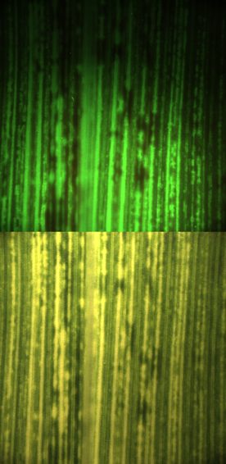
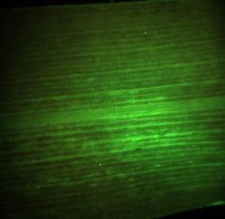
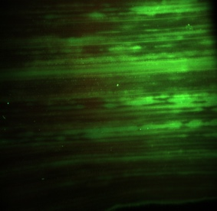
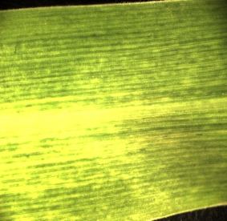
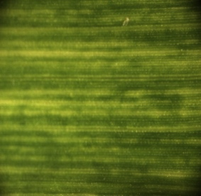
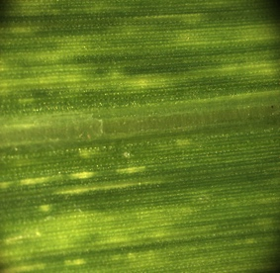
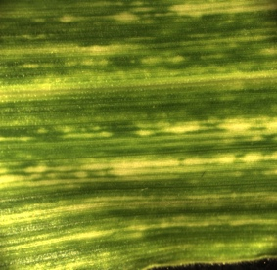
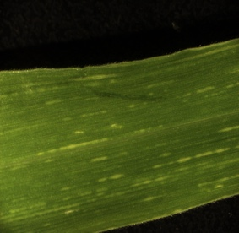
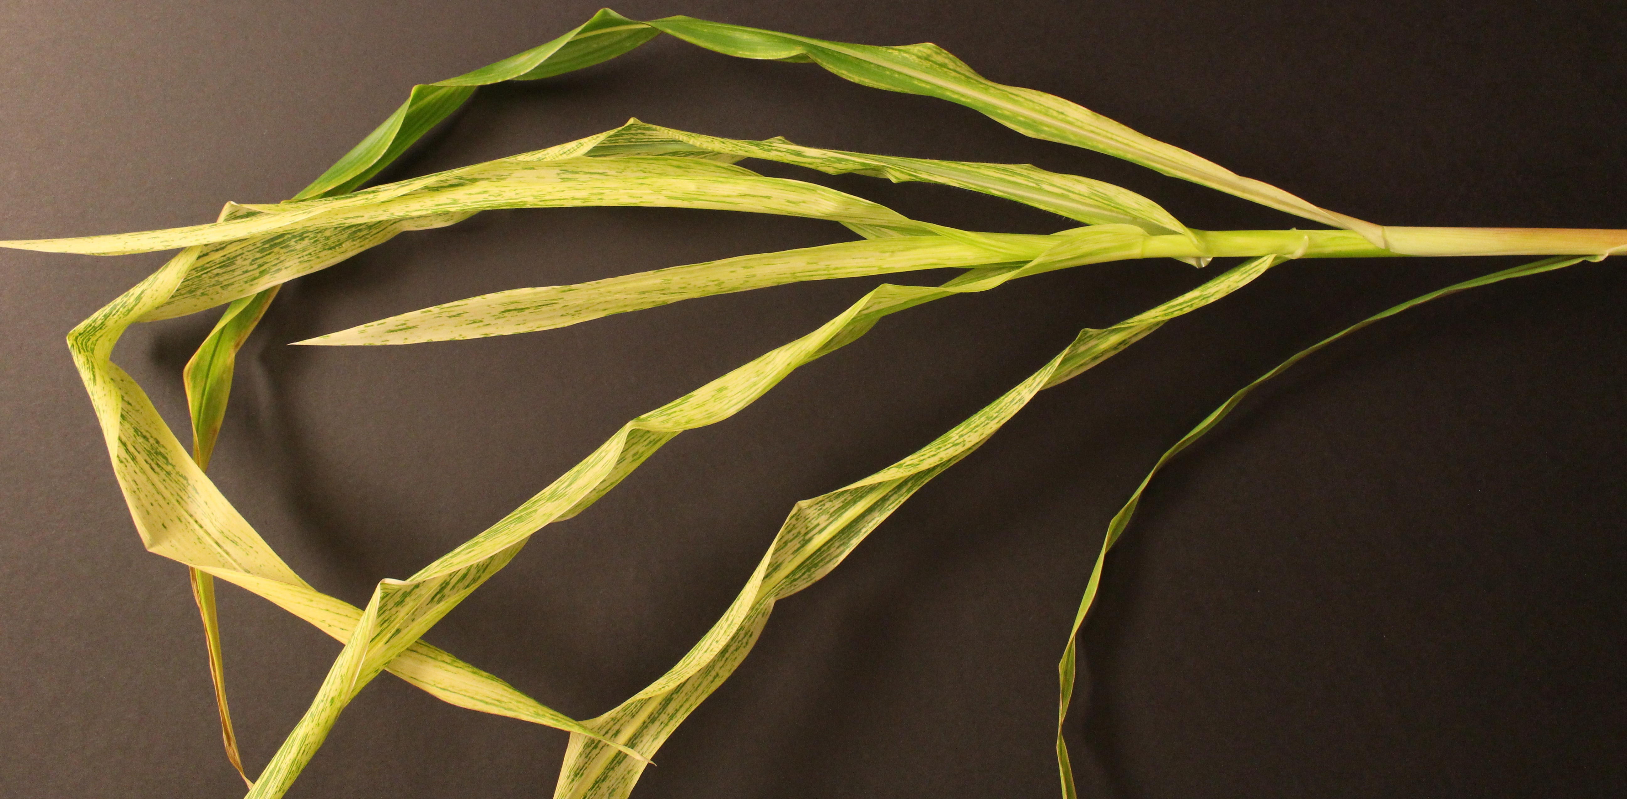
MDMV-ZmChII
MDMV-ZmPDS
pWX56 DNA ctrl
100 bp ladder
100 bp ladder
MDMV-ZmIspH
pWX6 Ctrl
Water ctrl
MDMV-VIGS
Mock Ctrl
A
1000 bp
500 bp
B
***
0P
1P
2P
3P
4P
5P
C
D
Figure S1.

Slide 2
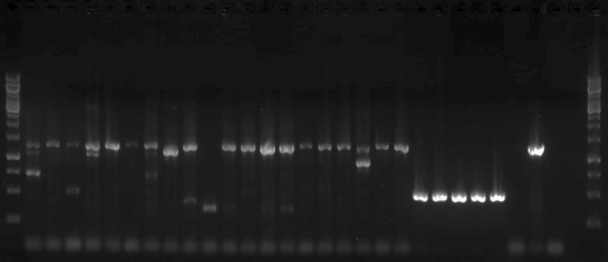
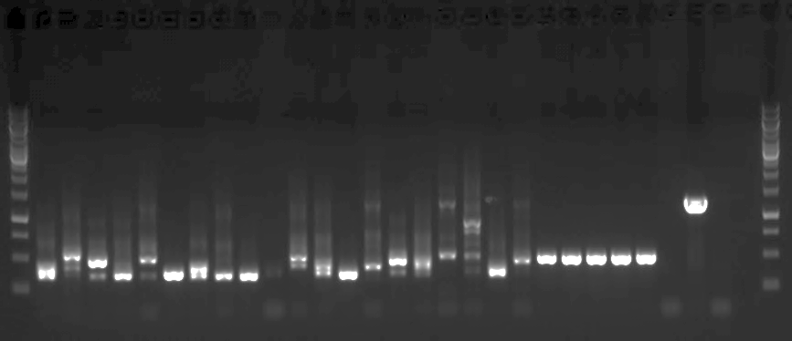
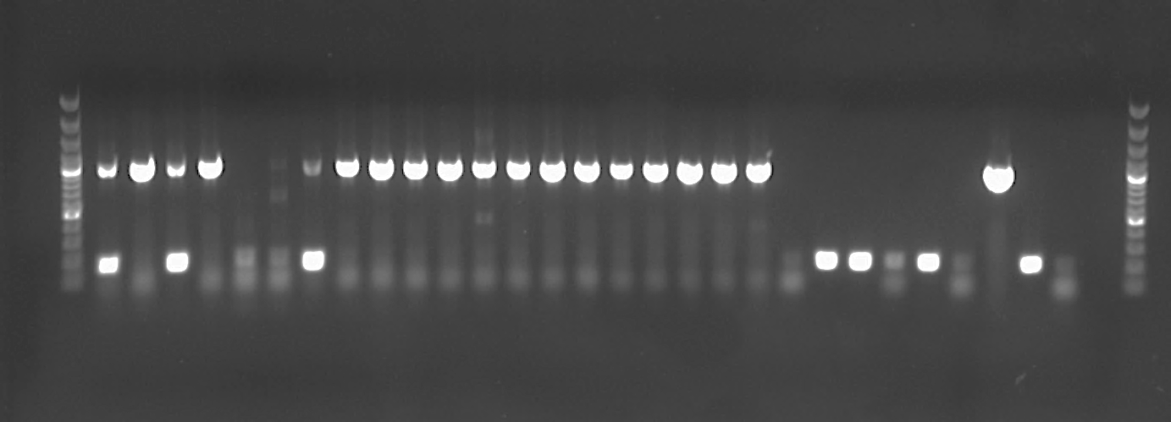
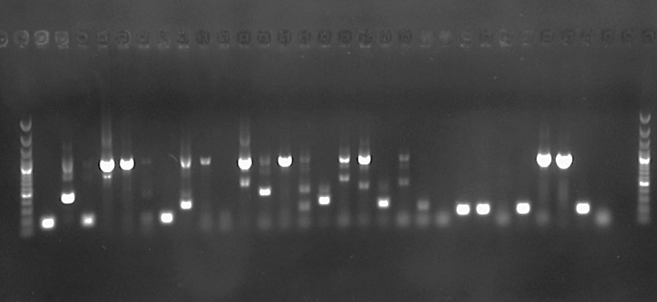
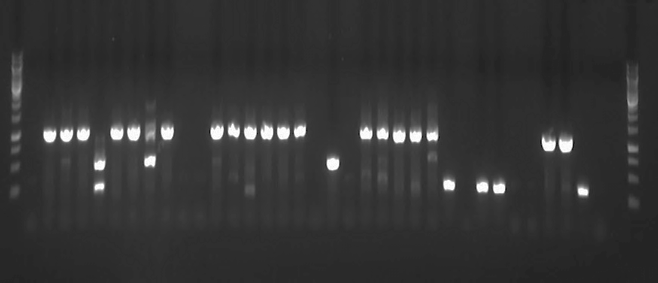
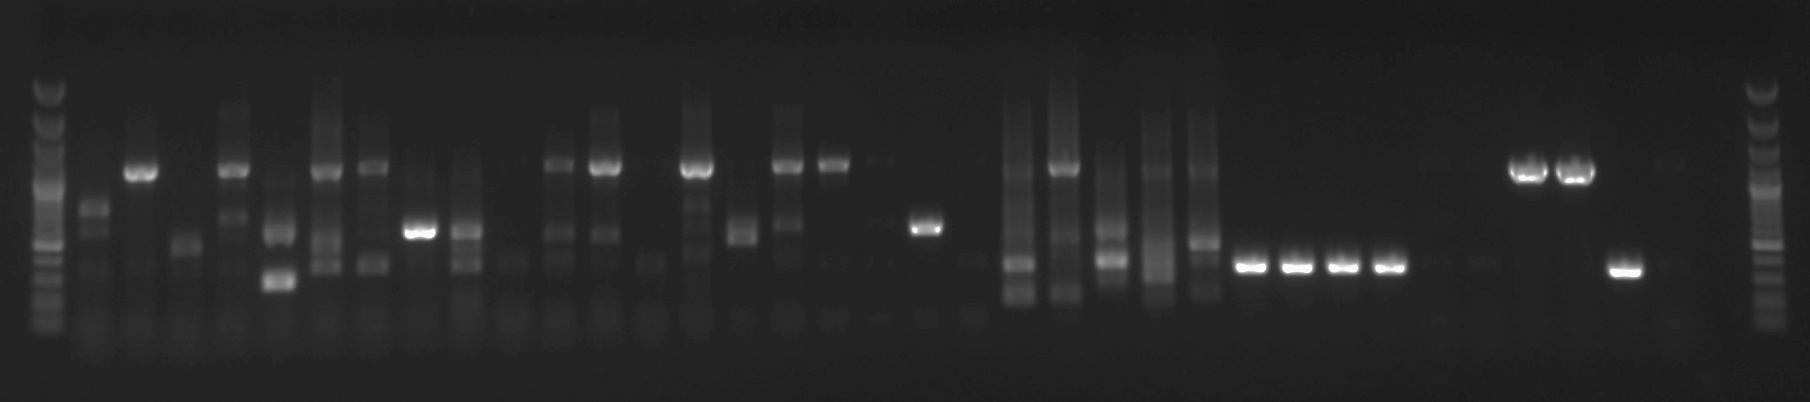


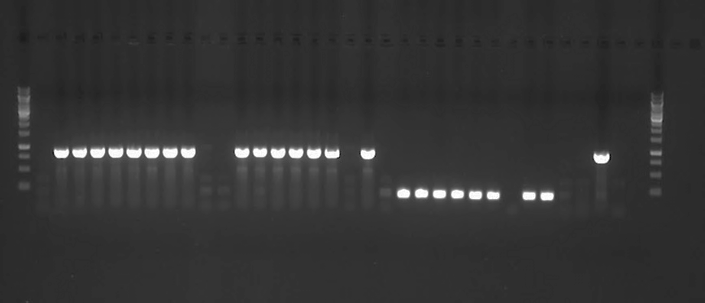
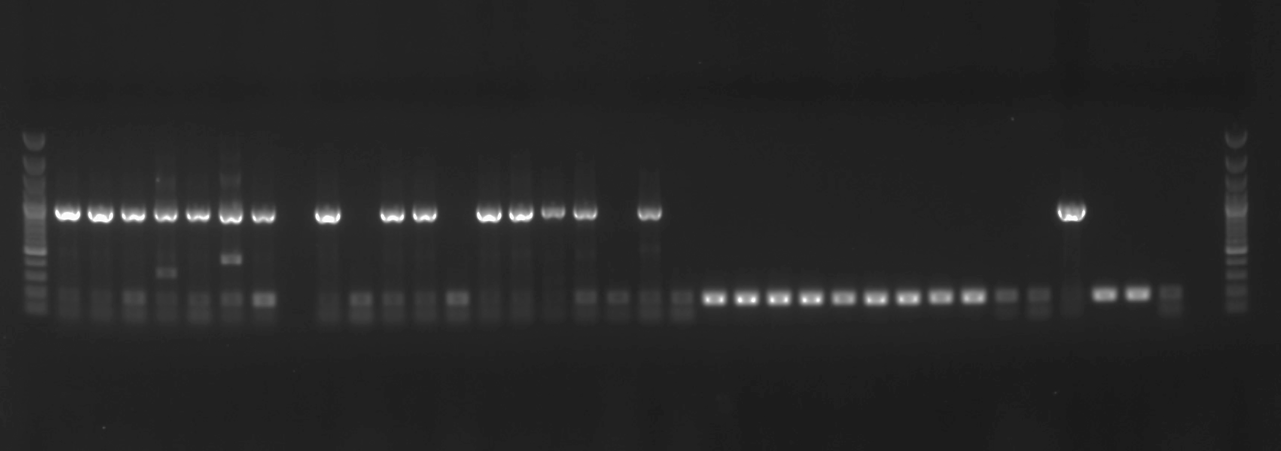



A.
7 dpi
21 dpi
7 14 21
pWX27
1286 bp
506 bp
B.
pWX68
965 bp
176 bp
C.
pWX56
1115 bp
335 bp
D.
pWX56
965 bp
176 bp
Figure S2.

Slide 3
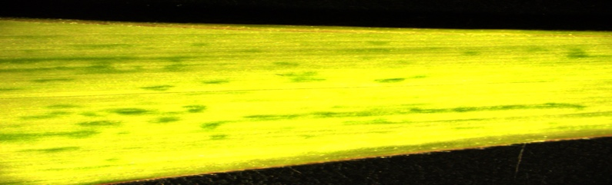
A
HC WT L1 L2 L3 L4 L5
bp
pWX56
pWX6
controls
965
VIGS
B
176
bp
pWX56
pWX6
controls
GFP
1115
335
Figure S3.

