Slide 1
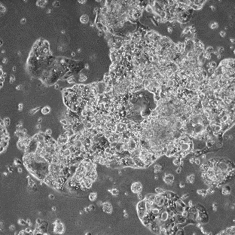
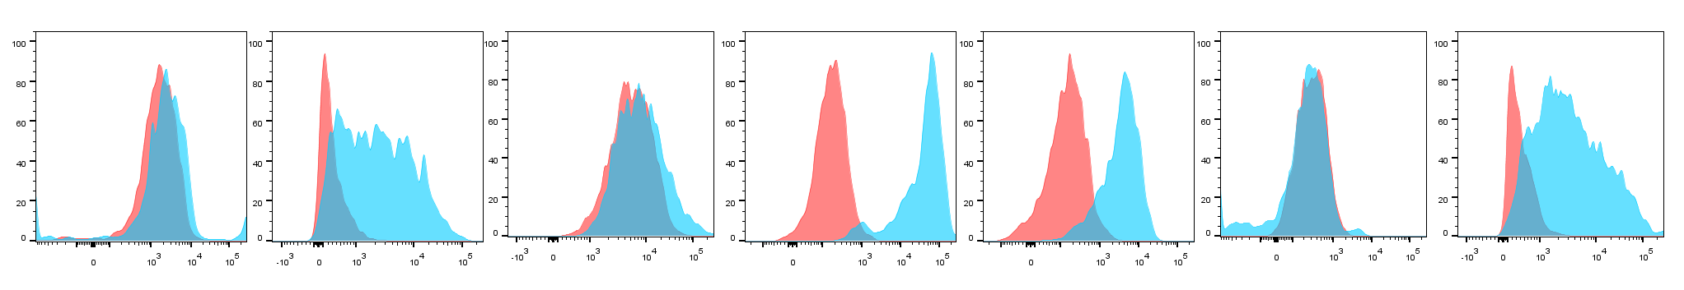
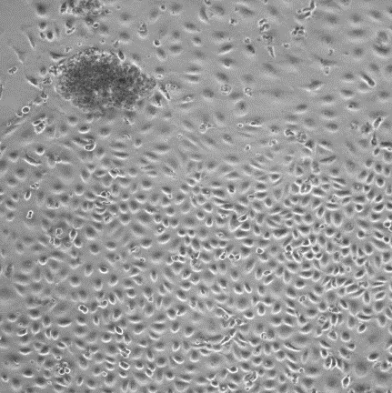
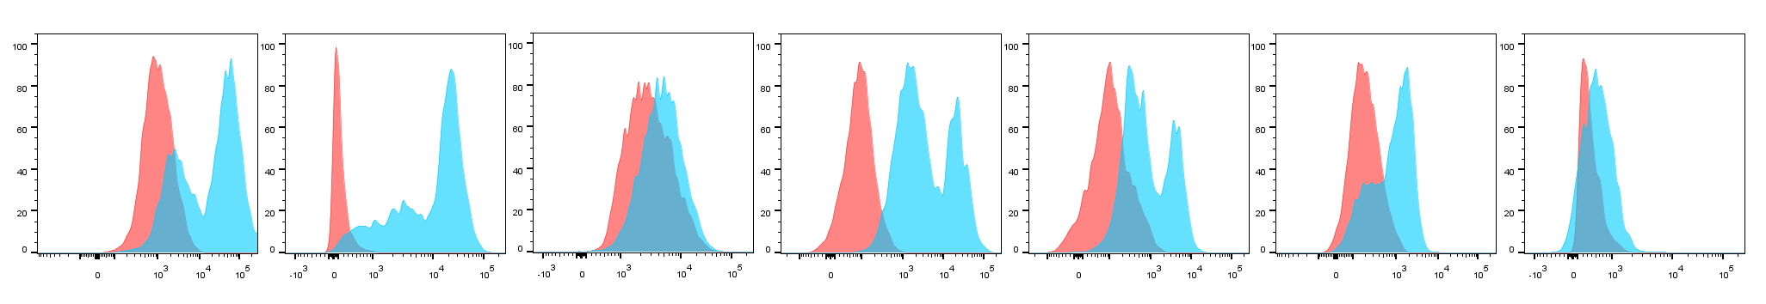
CD90
Podoplanin
Mesothelin
EpCAM
CD24
CD44
CD133
Patient #8
Patient #27
unstained
stained

