Slide 1
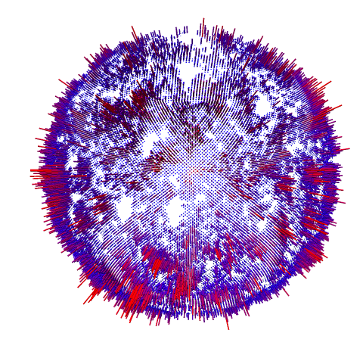
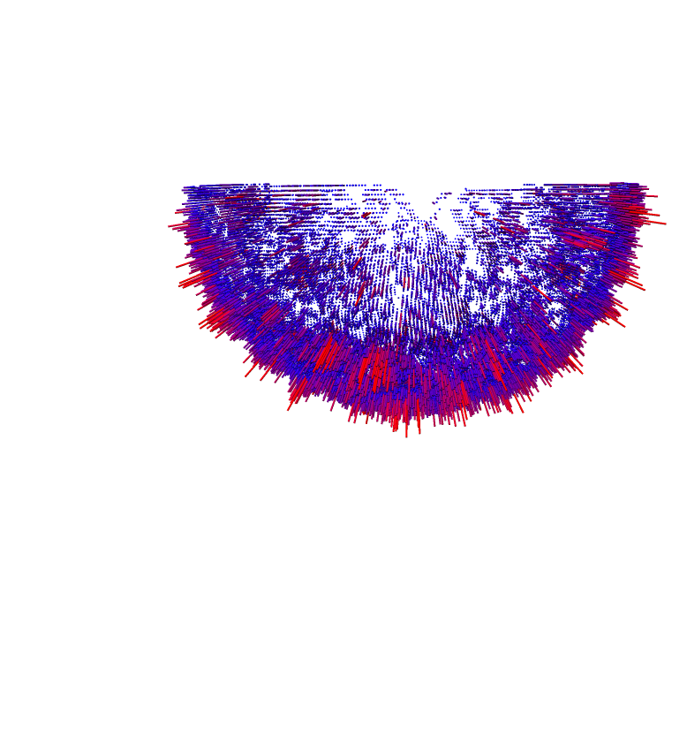
A
B
Supplementary Figure 1:
A) Fourier shell correlation (FSC) of the fibrillin microfibril bead structure. Resolution was calculated from the correlation between two independently refined halves of the data and is 9.7 Å resolution at 0.143 criterion. B) A 3D representation of the angular distribution of particles used in the bead structure reconstruction.

Slide 2
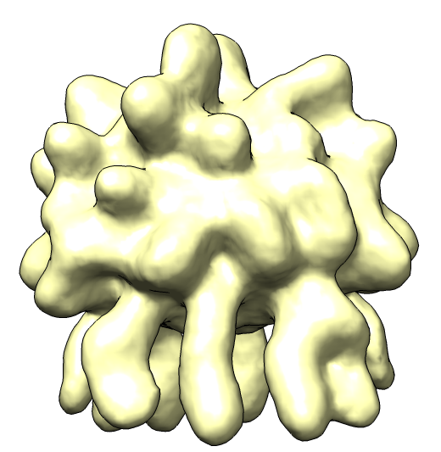
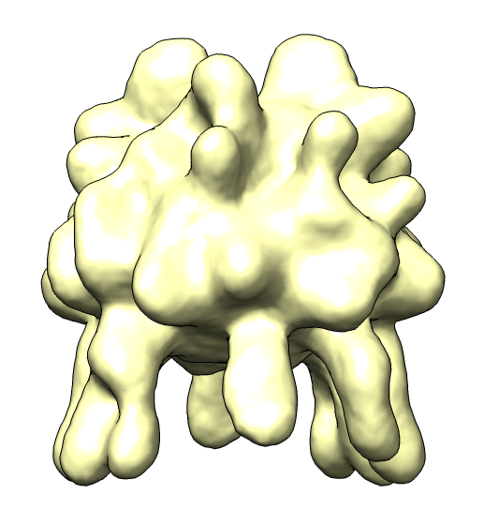
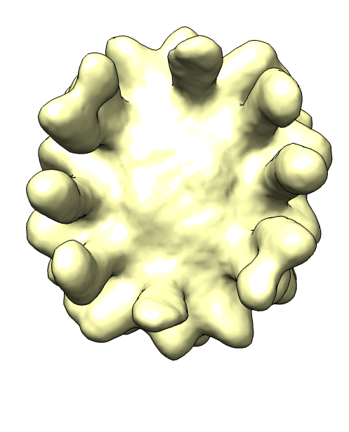
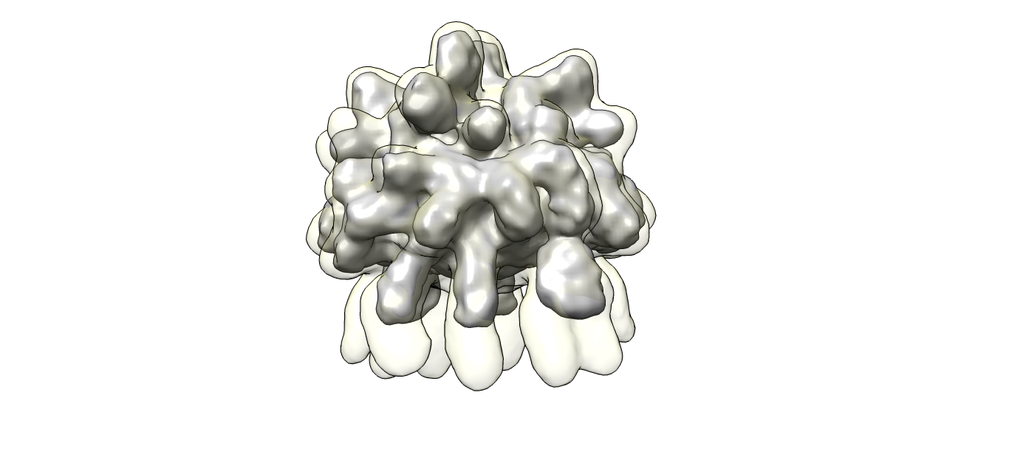
A
90º
90º
B (i)
B (ii)
Supplementary figure 2:
A) 3D reconstruction of the bead region shown in three orthogonal orientations. There are 8 arms which are visible emerging from the bead structure. Highlighted with black arrows are two arms which are wider. The red arrows highlight two arm regions which are masked out in the final bead reconstruction.
B) The reconstruction in (A) is shown overlaid on the final bead reconstruction shown in grey. Panel (Bii) shows a magnified view of the arm regions connecting to the bead region. The red arrow shows how the wider arms connects to the outside of the bead, in contrast the arm highlighted by the black arrow inserts into the centre of the bead.

Slide 3
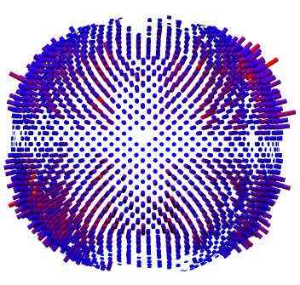
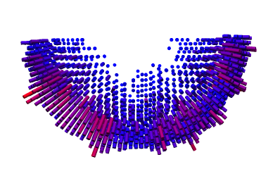
A
B
Supplementary figure 3
A) A Graph of the Fourier shell correlation (FSC) of the fibrillin microfibril arm structure. Resolution was calculated from the correlation between two independently refined halves of the data and is 18.3 Å resolution at 0.143 criterion. B) A 3D representation of the angular distribution of particles used in the arm structure reconstruction.

Slide 4
A
B
Supplementary figure 4
Orientation correlation plots of the microfibril bead region processed with no symmetry (A) or with C2 symmetry imposed during the refinement (B).

Slide 5
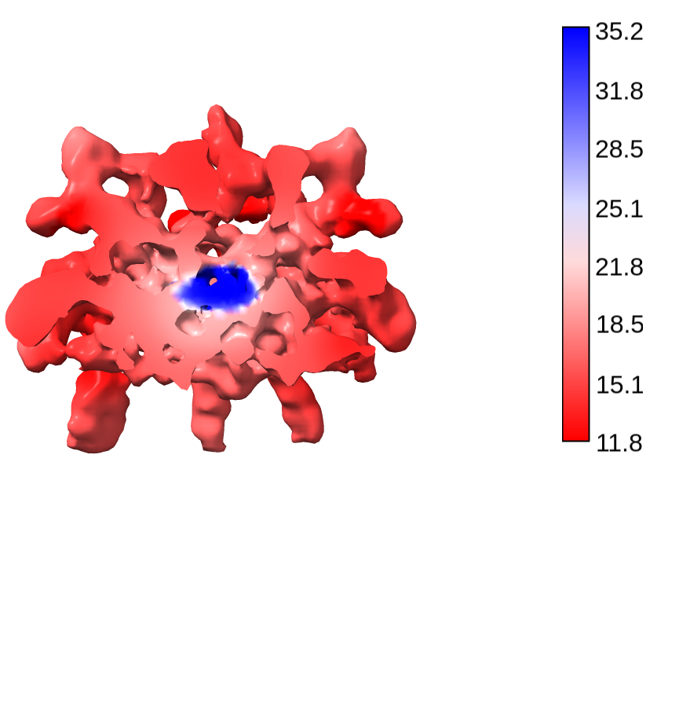
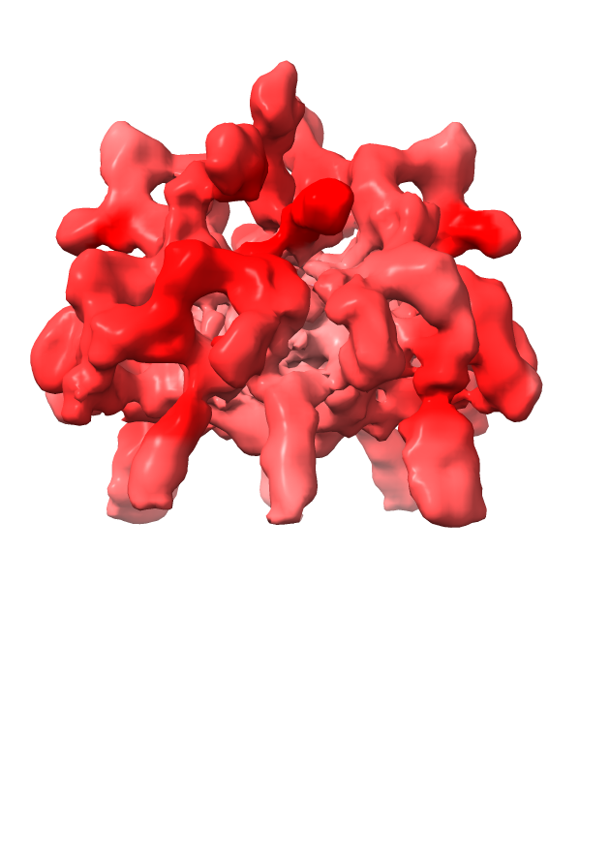
Supplementary figure 5
The final bead postprocessed reconstruction was surface coloured in chimeraX by local resolution estimation calculated in cryoSPARC.

