Slide 1
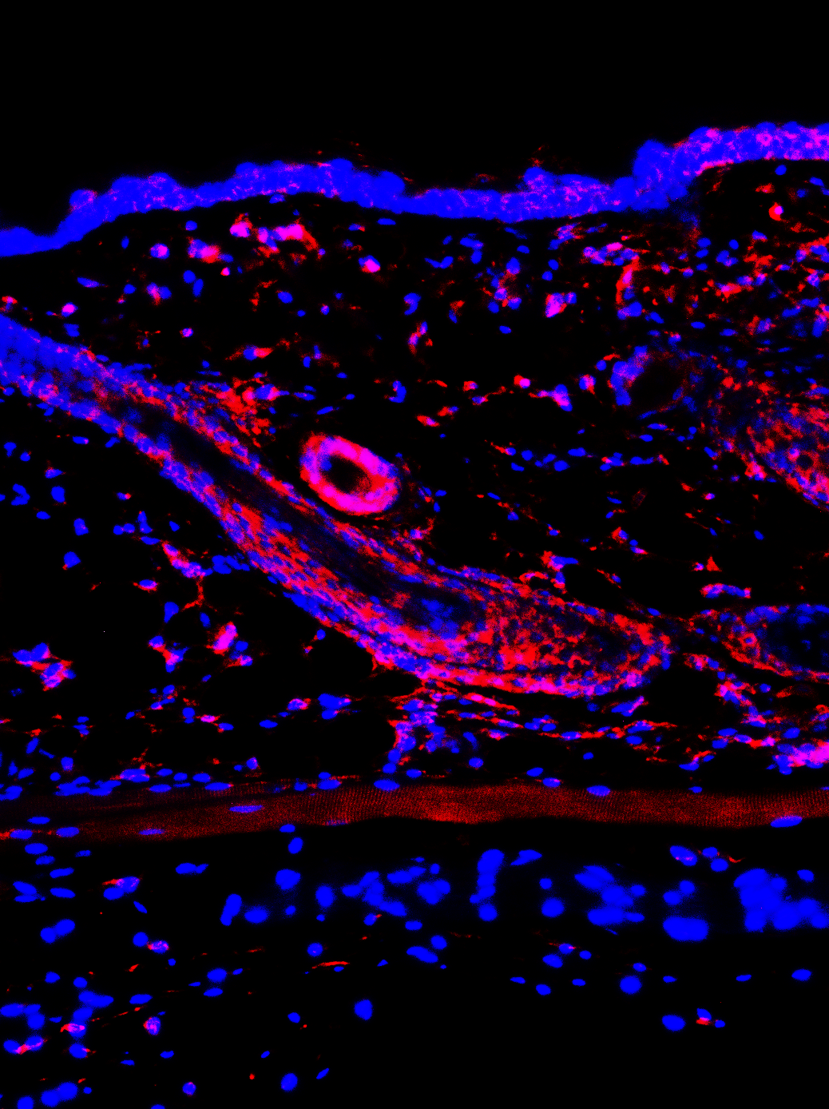
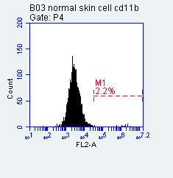
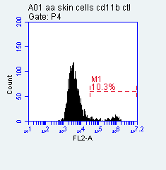
a
b
Normal skin AA skin
Normal skin cells AA skin cells
c
Normal skin cells AA skin cells
2.2%
10.3%
CD11b
Figure S1. CD11b+ myeloid cells are present in AA skin of C3H/HeJ mice. (a) Immunofluorescent staining with CD11b antibody (red) in normal and AA skin of mice. (b) and (c) Skin cell mixture was isolated from skin of normal and AA mice by collagenase digestion and cultured for 3 days. Adherent cells were used for immunofluorescent staining with CD11b antibody (green) (b) and FACS analysis with fluorescent-conjugated CD11b antibody (c). DAPI (blue) was used for a nuclear counterstain. Scale bars, 50 µm.

Slide 2
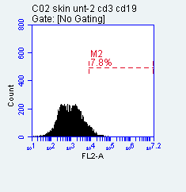
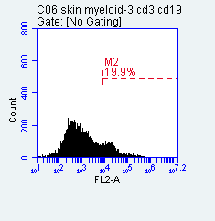
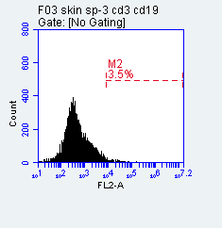
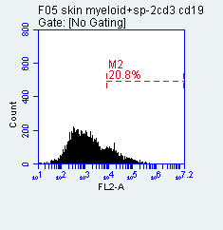
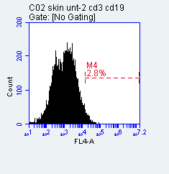
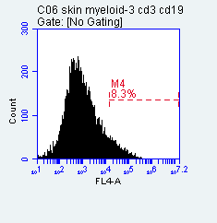
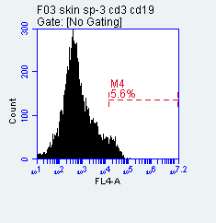
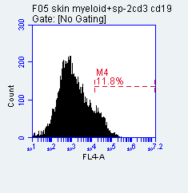
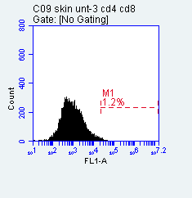
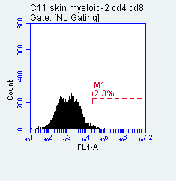
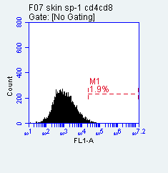
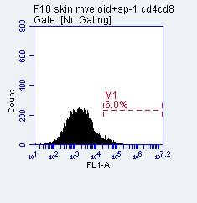
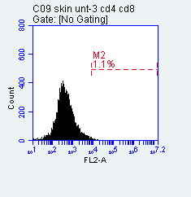
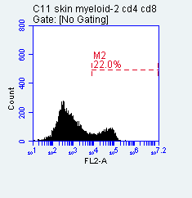

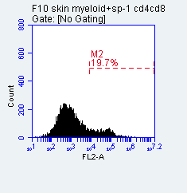
a
Non-treatment Myeloid cells Splenocytes Myeloid cells+SP
CD3
b
Non-treatment Myeloid cells Splenocytes Myeloid cells+SP
CD19
c
Non-treatment Myeloid cells Splenocytes Myeloid cells+SP
d
CD4
Non-treatment Myeloid cells Splenocytes Myeloid cells+SP
CD8

Slide 3
Figure S2. Immune cell percentage in cells isolated from normal and AA skin of mice that received either nothing, M-CSF-stimulated CD11b+ myeloid cells, splenocytes alone or M-CSF-stimulated CD11b+ myeloid cells plus splenocytes for 10 weeks. Three mice without hair loss in untreated group or splenocytes alone group, and three mice with AA in myeloid cells alone or myeloid cells plus splenocytes were selected for this experiment. Skin was digested by collagenase and filtered through a 40 µm cell strainer prior to staining with antibodies. Immune cell population were analyzed by FACS. (a) CD3 stain; (b) CD19 stain; (c) CD4 stain and (d) CD8 stain.

Slide 4
Table S1. The percentage of T-lymphocytes and B-lymphocytes in the skin of mice received different treatments.
.
.
 | No treatment | Splenocytes | M-CSF-treated myeloid cells | Myeloid cells +SP
CD3 | 6.0±1.2% | 10.2±3.9% | 30.0±8.0% P=0.0068 | 31.5±3.7% P=0.0024
CD19 | 1.4±0.4% | 9.7±1.7% | 10.0±1.3% P=0.004 | 14.6±0.7% P=0.0099
CD4 | 3.0±0.6% | 3.4±0.4% | 4.0±0.5% P=0.0908 | 7.5±0.8% P=0.0014
CD8 | 2.2±0.6% | 3.9±0.7% | 20.7±2.8% P=0.0004 | 24.2±3.0% P=0.0003
Note: For comparison, Myeloid cell injected group was compared to no treatment group and myeloid cell plus splenocyte injected group was compared to splenocyte alone injected group. n=3 mice in each group.

Slide 5
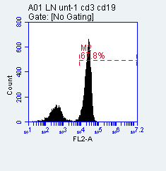
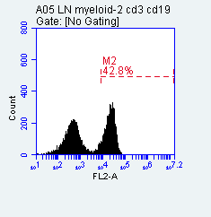
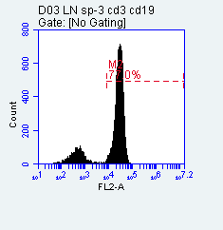
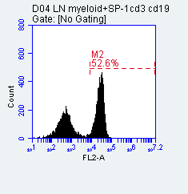
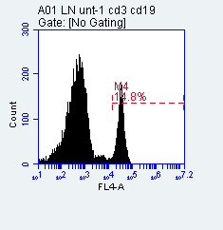
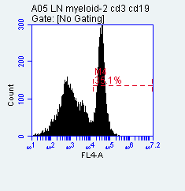
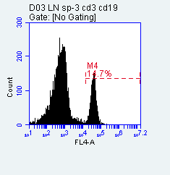
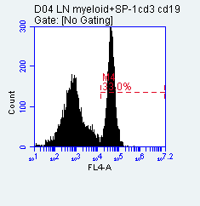
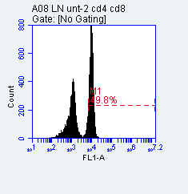
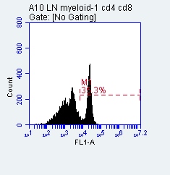
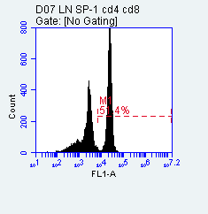
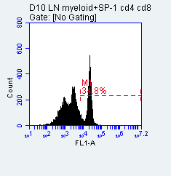
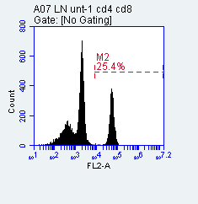
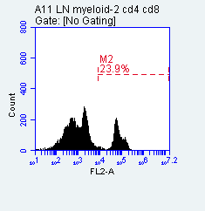
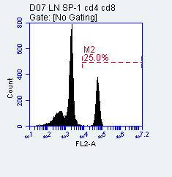
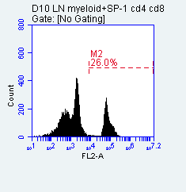
a
Non-treatment Myeloid cells Splenocytes Myeloid cells+SP
b
CD3
Non-treatment Myeloid cells Splenocytes Myeloid cells+SP
c
CD19
Non-treatment Myeloid cells Splenocytes Myeloid cells+SP
d
CD4
Non-treatment Myeloid cells Splenocytes Myeloid cells+SP
CD8

Slide 6
Figure S3. Immune cell percentage in skin-draining lymph nodes of normal and AA mice that received either nothing, M-CSF-stimulated CD11b+ myeloid cells, splenocytes alone or M-CSF-stimulated CD11b+ myeloid cells plus splenocytes for 10 weeks. Three mice without hair loss in untreated group or splenocytes alone group, and three mice with AA in myeloid cells alone or myeloid cells plus splenocytes were selected for this experiment. Cells isolated from lymph nodes were stained with different antibodies, analyzed by FACS. (a) CD3 stain; (b) CD19 stain; (c) CD4 stain and (d) CD8 stain.

Slide 7
Table S2. The percentage of T-lymphocytes and B-lymphocytes in skin-draining lymph nodes of mice received different treatments.
 | No treatment | Splenocytes | M-CSF-treated myeloid cells | Myeloid cells +SP
CD3 | 77.9±5.3% | 80.8±0.7% | 53.6±5.0% p=0.0045 | 58.4±0.8% p<0.0001
CD19 | 17.9±4.0% | 15.1±0.4% | 33.2±5.6% p=0.0183 | 34.5±1.7% p<0.0001
CD4 | 51±5.4% | 51.8±0.5% | 35.6±4.7% p=0.0204 | 34.5±2.3% p=0.0002
CD8 | 27.7±0.8% | 29.7±3.2% | 23.9±1.8% p=0.0288 | 26.1±1.1% p=0.01392
Note: For comparison, Myeloid cell injected group was compared to no treatment group and Myeloid cell plus splenocyte injected group was compared to splenocyte alone injected group. n=3 mice in each group.

Slide 8
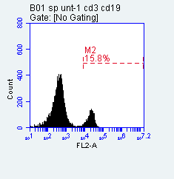
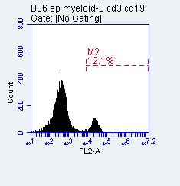
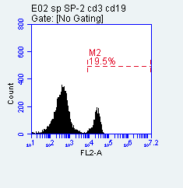
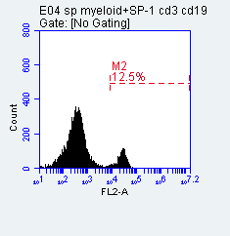
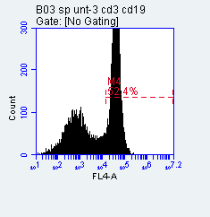
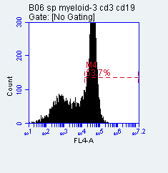
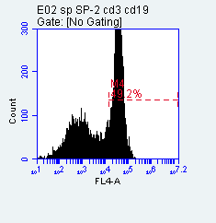
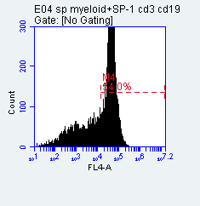
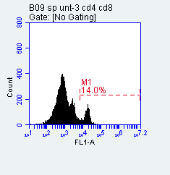
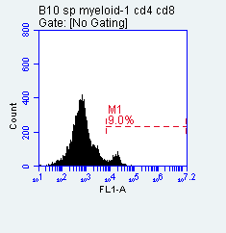
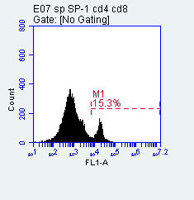
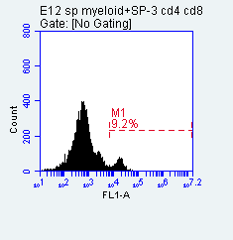
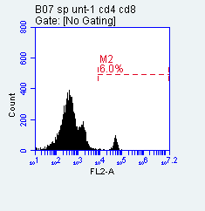
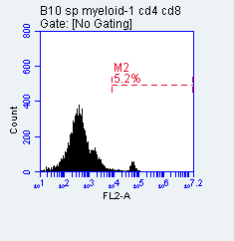


a
Non-treatment Myeloid cells Splenocytes Myeloid cells+SP
CD3
b
Non-treatment Myeloid cells Splenocytes Myeloid cells+SP
CD19
c
Non-treatment Myeloid cells Splenocytes Myeloid cells+SP
CD4
d
Non-treatment Myeloid cells Splenocytes Myeloid cells+SP
CD8

Slide 9
Figure S4. Immune cell percentage in spleen of normal and AA mice that received either nothing, M-CSF-stimulated CD11b+ myeloid cells, splenocytes alone or M-CSF-stimulated CD11b+ myeloid cells plus splenocytes for 10 weeks. Three mice without hair loss in untreated group or splenocytes alone group, and three mice with AA in myeloid cells alone or myeloid cells plus splenocytes were selected for this experiment. Cells isolated from spleen were stained with different antibodies, analyzed by FACS. (a) CD3 stain; (b) CD19 stain; (c) CD4 stain and (d) CD8 stain.

Slide 10
Table S3. The percentage of T-lymphocytes and B-lymphocytes in spleen of mice received different treatments.
.
 | No treatment | Splenocytes | M-CSF-treated myeloid cells | Myeloid cells +SP
CD3 | 21.2±2.6% | 21.2±2.4% | 13.5±2.5% p=0.0209 | 14.6±2.4% p=0.0281
CD19 | 60.4±1.3% | 60.2±1.5% | 61±2.5% p=0.7310 | 64.1±3.8% p=0.1736
CD4 | 14.9±1.1% | 15.9±2.1% | 10±1.9% p=0.0181 | 9.6±1.3% p=0.0115
CD8 | 7.9±1.5% | 7.7±1.5% | 5.3±0.9% p=0.0617 | 5.2±0.6% p=0.0552
Note: For comparison, Myeloid cell injected group was compared to no treatment group and myeloid cell plus splenocyte injected group was compared to splenocyte alone injected group. n=3 mice in each group.

