Slide 1
Supplementary Figure S1. Scanning Electron Micrograph of strain BA0156T.
Notes:
Supplementary Figure S1. Scanning Electron Micrograph of strain BA0156^{T}.

Slide 2
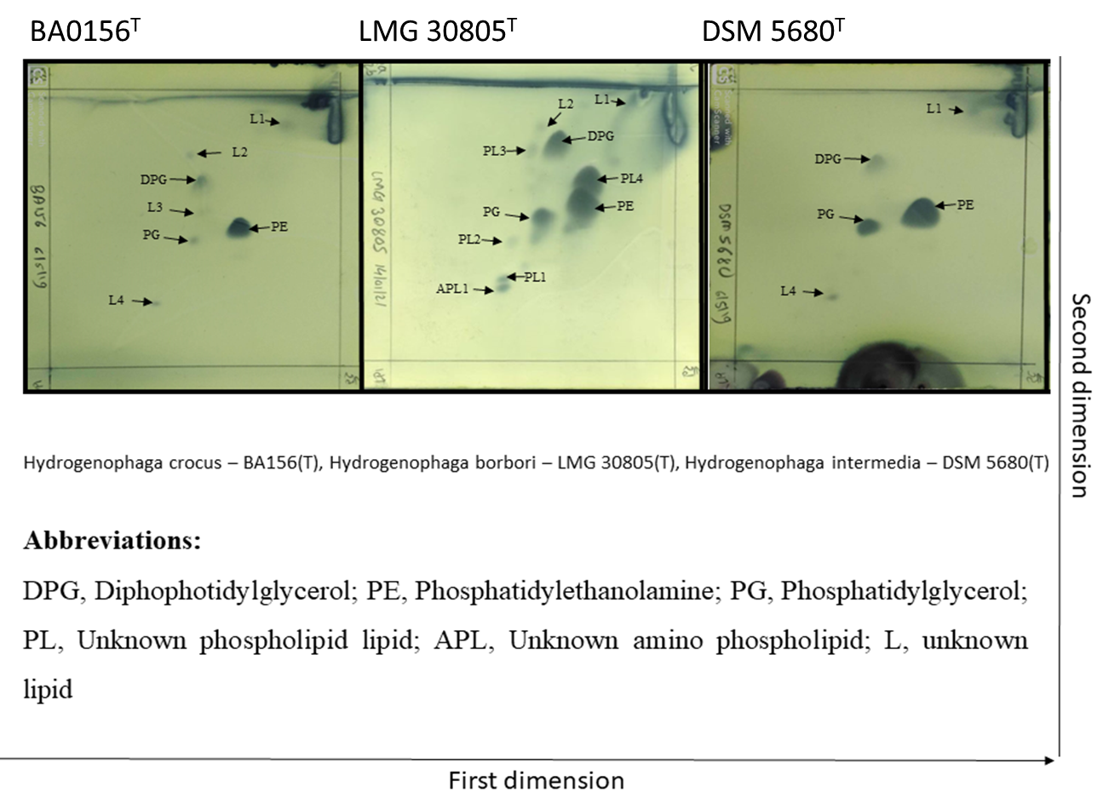
Supplementary Figure S2. Polar Lipid Analysis of strain BA0156T and its closest phylogenetic neighbours. Hydrogenophaga borbori LMG 30805T, Hydrogenophaga intermedia DSM 5680T. All the data were obtained from this study. DPG, Diphophatidylglycerol; PE, Phosphatidylethanolamine; PG, Phosphatidylglycerol; PL, Unknown phospholipid lipid; APL, Unknown amino phospholipid; L, unknown lipid.
Notes:
Supplementary Figure S2. Polar Lipid Analysis of strain BA0156^{T} and its closest phylogenetic neighbours. Hydrogenophaga borbori LMG 30805T, Hydrogenophaga intermedia DSM 5680^{T}. All the data were obtained from this study. DPG, Diphophatidylglycerol; PE, Phosphatidylethanolamine; PG, Phosphatidylglycerol; PL, Unknown phospholipid lipid; APL, Unknown amino phospholipid; L, unknown lipid.

