Slide 1
Supplementary Figures

Slide 2
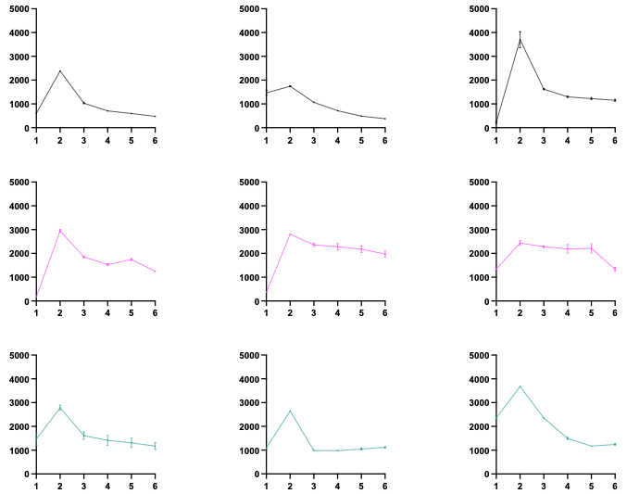
a)
HC
BD
TEER (Ω x cm²)
SZ
Time (Days)

Slide 3
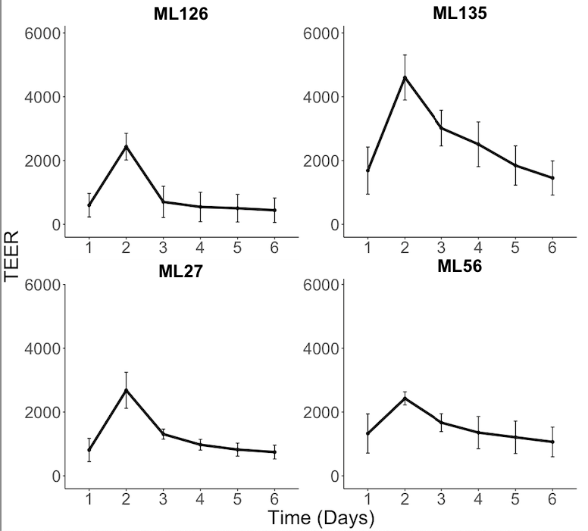
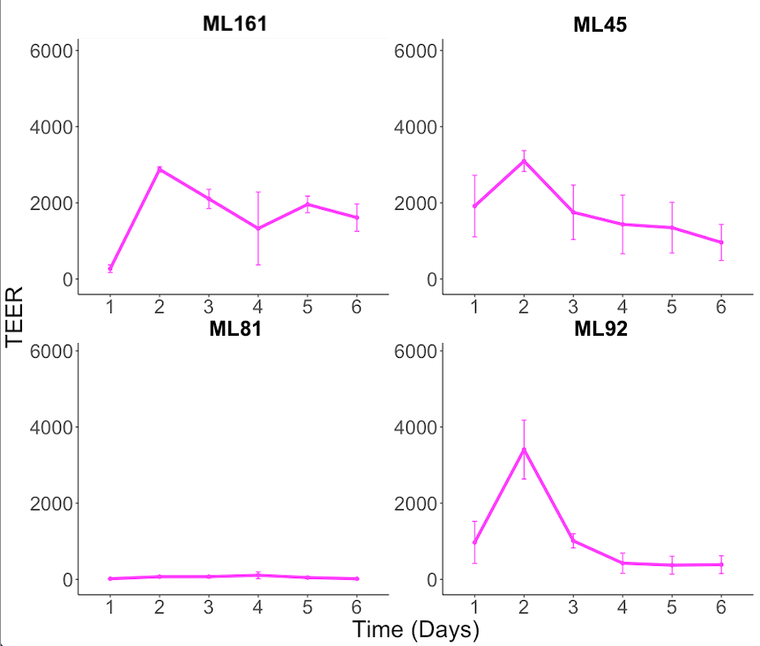
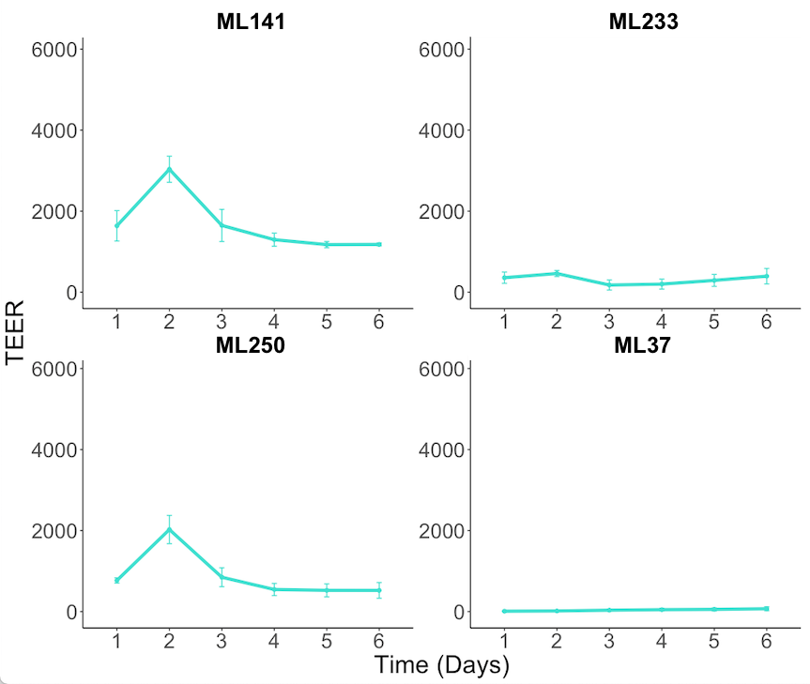
b)
HC
BD
SZ
TEER (Ω x cm²)
Time (Days)

Slide 4
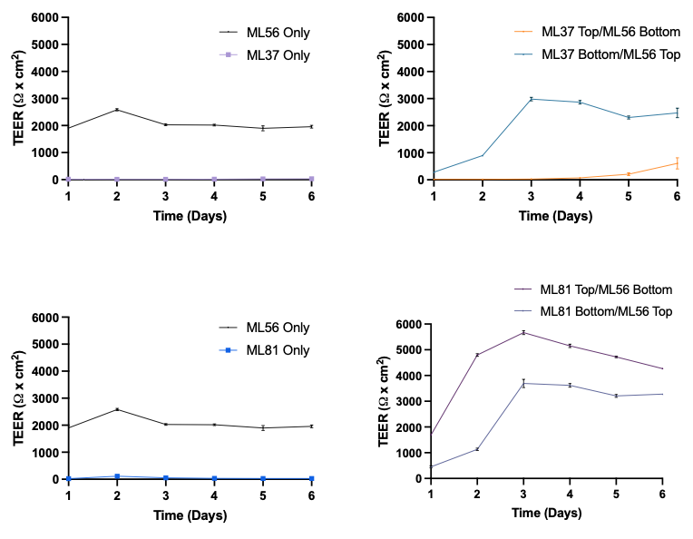
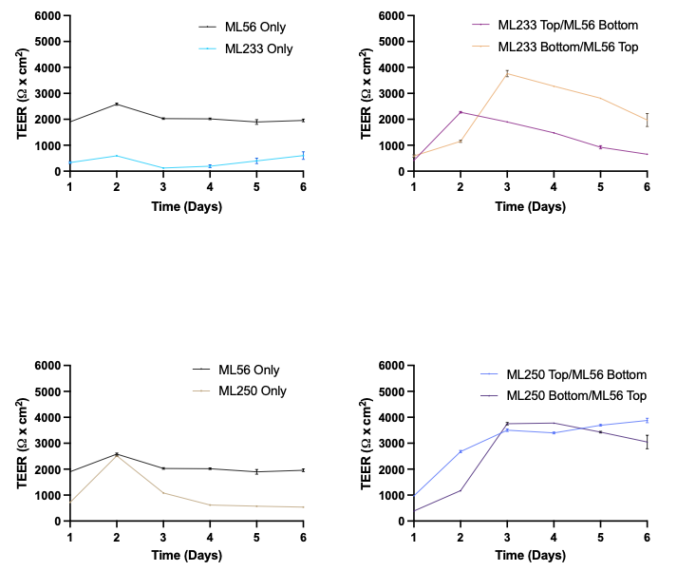
a)
Notes:
Figure supp 3.

Slide 5
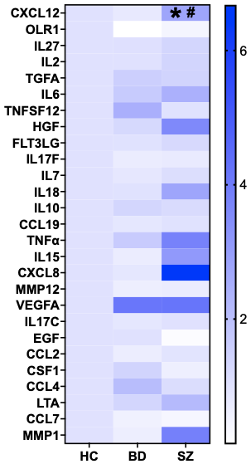
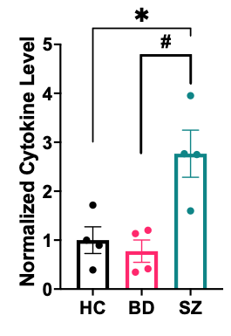
CXCL12
2b)
2c)

Slide 6
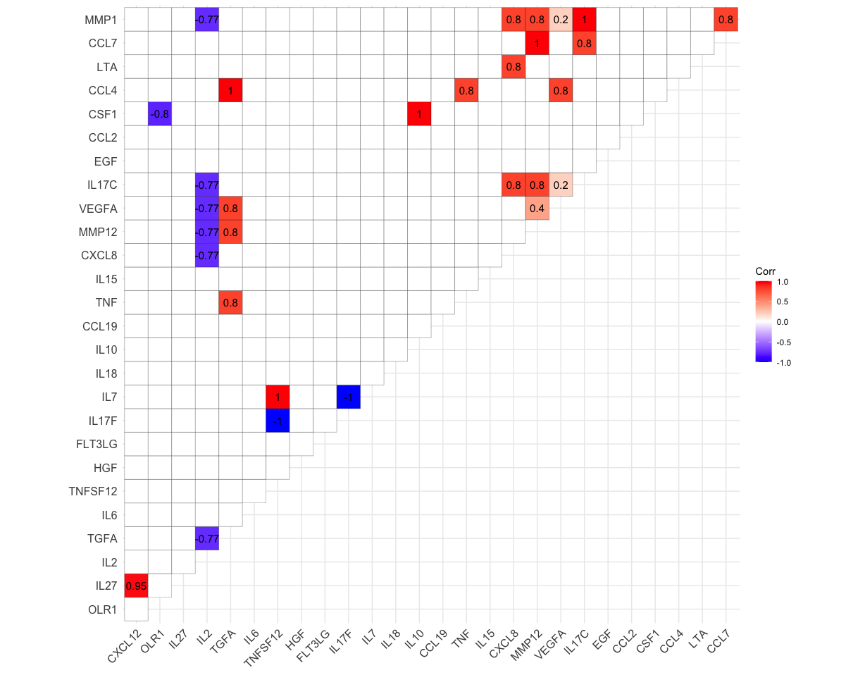
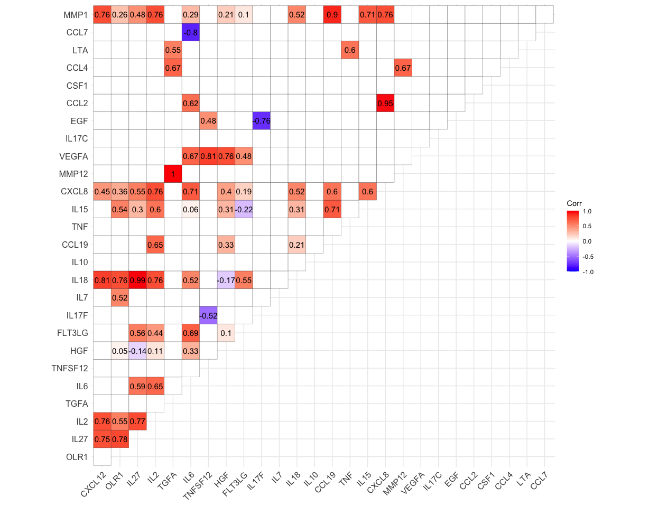
2d
Healthy Control
Schizophrenia and Bipolar Disorder

Slide 7
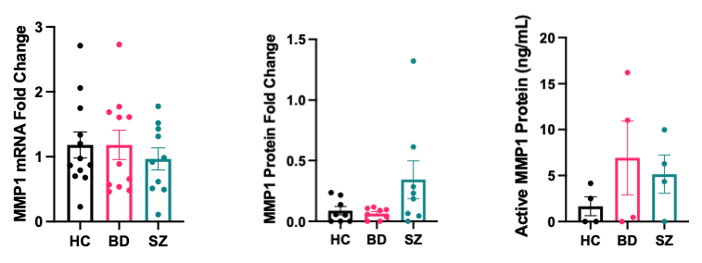
2e)
2f)
2g)

Slide 8
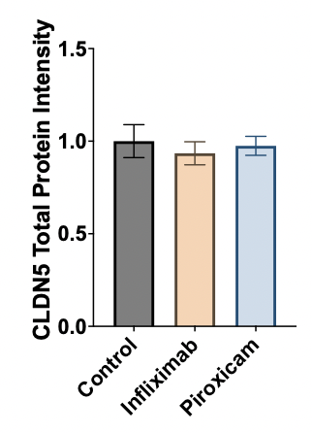
3)

Slide 9
Supplementary Tables

Slide 10
Supplementary Table 1. Data on cell lines used in this study.
Sample ID | Diagnosis | Sex | Age | Race | Age of onset | Medication history | Medical comorbidities | Chromosomal abnormalities
ML 27 | HC | Male | 24 | Caucasian | - | - |  | no CNV
ML 135 | HC | Male | 49 | Caucasian | - | - |  | no CNV
ML 56 | HC | Female | 52 | Caucasian
ML 126 | HC | Female | 55 | Caucasian | - | - |  | no CNV
ML 92 | BD | Male | 24 | Caucasian | 22 | lithium, lamotrigine, risperidone, perphenazine
ML 161 | BD | Male | 32 | Caucasian | - | divalproex, aripiprazole, quetiapine, Adderall, clonazepam, zolpidem |  | no CNV
ML 45 | BD | Female | 45 | Caucasian | - | venlafaxine, clonazepam |  | no CNV
ML 81 | BD | Female | 35 | Caucasian | 15 | gabapentin, olanzapine, fluoxetine, lorazepam, methylphenidate, Dexedrine |  | no CNV
ML 141 | SZ | Male | 40 | Caucasian | 24 | aripiprazole |  | no CNV
ML 250 | SZ | Male | 23 | Caucasian | - | aripiprazole |  | no CNV
ML 37 | SZ | Female | 57 | Caucasian | 18 | clozapine | hyperlipidemia | no CNV
ML 233 | SZ | Female | 37 | Caucasian | - | haloperidol | hypothyroidism | no CNV
Note: There was no significant difference for age between HC vs BD (p=0.096), HC vs SZ (p=0.59), or BD vs SZ (p=0.42)

Slide 11
Supplementary Table 2. List of cytokines targeted in proteomic analysis.
Cytokine ID | Detectable in BMECs conditioned medium? (Yes/No)
CCL8 | No
IL33 | No
CXCL12 | Yes
OLR1 | Yes
IL27 | Yes
IL2 | Yes
CXCL9 | No
TGFA | Yes
IL1B | No
IL6 | Yes
IL4 | No
TNFSF12 | Yes
TSLP | No
CCL11 | No
HGF | Yes
FLT3LG | Yes
IL17F | Yes
IL7 | Yes
IL13 | No
IL18 | Yes
CCL13 | No
TNFSF10 | No
CXCL10 | No
IFNG | No
IL10 | Yes
CCL19 | Yes
TNFa | Yes
IL15 | Yes
CCL3 | No
CXCL8 | Yes
MMP12 | Yes
CSF2 | No
CSF3 | No
VEGFA | Yes
IL17C | Yes
EGF | Yes
CCL2 | Yes
IL17A | No
OSM | No
CSF1 | Yes
CCL4 | Yes
CXCL11 | No
LTA | Yes
CCL7 | Yes
MMP1 | Yes

Slide 12
Supplementary Table 3. List of primers used in qPCR.
Gene ID | Forward primer | Reverse primer
CLDN5 | 5’-CTGGACCACAACATCGTGA-3’ | 5’-CACCGAGTCGTACACTTTGC-3’
OCLN | 5’-TCAGGGAATATCCACCTATCACTTCAG-3’ | 5’-CATCAGCAGCAGCCATGTACTCTTCAC-3’
TJP1 | 5’-TTGTCTTCAAAAACTCCCAC-3’ | 5’-GACTCACAGGAATAGCTTTAG-3’
MMP1 | 5’-AAAGGGAATAAGTACTGGGC-3’ | 5’-CAGTGTTTTCCTCAGAAAGAG-3’
GAPDH | 5’-ACAGTTGCCATGTAGACC-3’ | 5’-TTGAGCACAGGGTACTTTA-3’

Slide 13
Supplementary Table 4. List of primary and secondary antibodies.
Primary Antibodies
Target | Species | Vendor | Product Number | Dilution ICC | Dilution Western
CLDN5 | Mouse | ThermoFisher | 35-2500 | 1:200 | 1:100
OCLN | Rabbit | Cell Signaling | 91131S | 1:200 | 1:100
TJP1 | Rabbit | Cell Signaling | 13663 | 1:200 | 1:100
MMP1 | Rabbit | Proteintech | 10371-2-AP | n/a | 1:100
GAPDH | Mouse | Abcam | 60004-l-lg | 1:200 | 1:100
Secondary Antibodies
Target | Host | Conjugate | Vendor | Product Number | Dilution
Mouse | Donkey | Alexa Fluor 488 | Life Technologies | A-21202 | 1:200
Rabbit | Donkey | Alexa Fluor 555 | Life Technologies | A-31572 | 1:200

Slide 14
Supplementary Table 5. Effect of sex, passage numbers, and cell viabilities on day 2 (peak) TEER values.
 | Biological Replicate 1 |  | Biological Replicate 2 |  | Biological Replicate 3
 | Chi-square | p-value | Chi-square | p-value | Chi-square | p-value
Sex (Male/ Female) | 4.33 | 0.0373* | 2.56 | 0.109 | 2.07 | 0.149
Passage Number (P3-P21) | 5.89 | 0.552 | 8.54 | 0.576 | 8.45 | 0.391
Cell viability (83-99%) | 6.34 | 0.175 | 10.7 | 0.385 | 4.85 | 0.435
*significant effect on peak TEER was determined by Kruskal-Wallis rank sum test.
TEER values from all three biological replicates for each cell line
(HC, n=4, BD, n=4, SZ, n=4 ) were used in the analysis. Standard errors of TEER values ranging from 10.4-339 Ω x cm² were observed across all technical and biological replicates. All reported p-values are two-sided.

