Slide 1
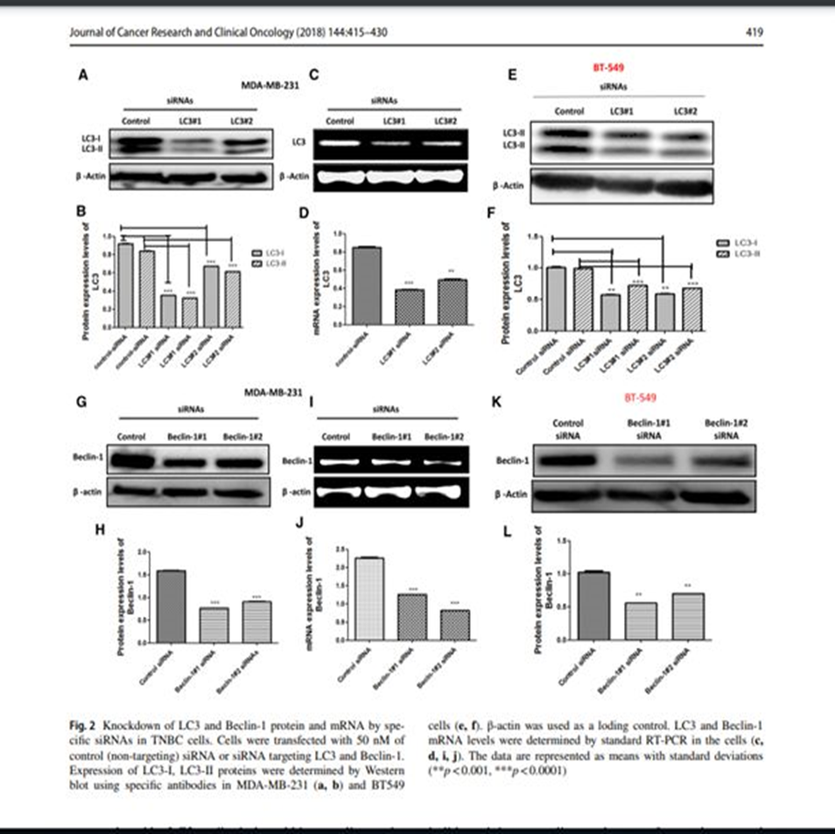
Hamurcu Z, Delibaşı N, Geçene S, Şener EF, Dönmez-Altuntaş H, Özkul Y, Canatan H, Ozpolat B. Targeting LC3 and Beclin-1 autophagy genes suppresses proliferation, survival, migration and invasion by inhibition of Cyclin-D1 and uPAR/Integrin β1/ Src signaling in triple negative breast cancer cells. J Cancer Res Clin Oncol. 2018 Mar;144(3):415-430. doi: 10.1007/s00432-017-2557-5.

