Slide 1
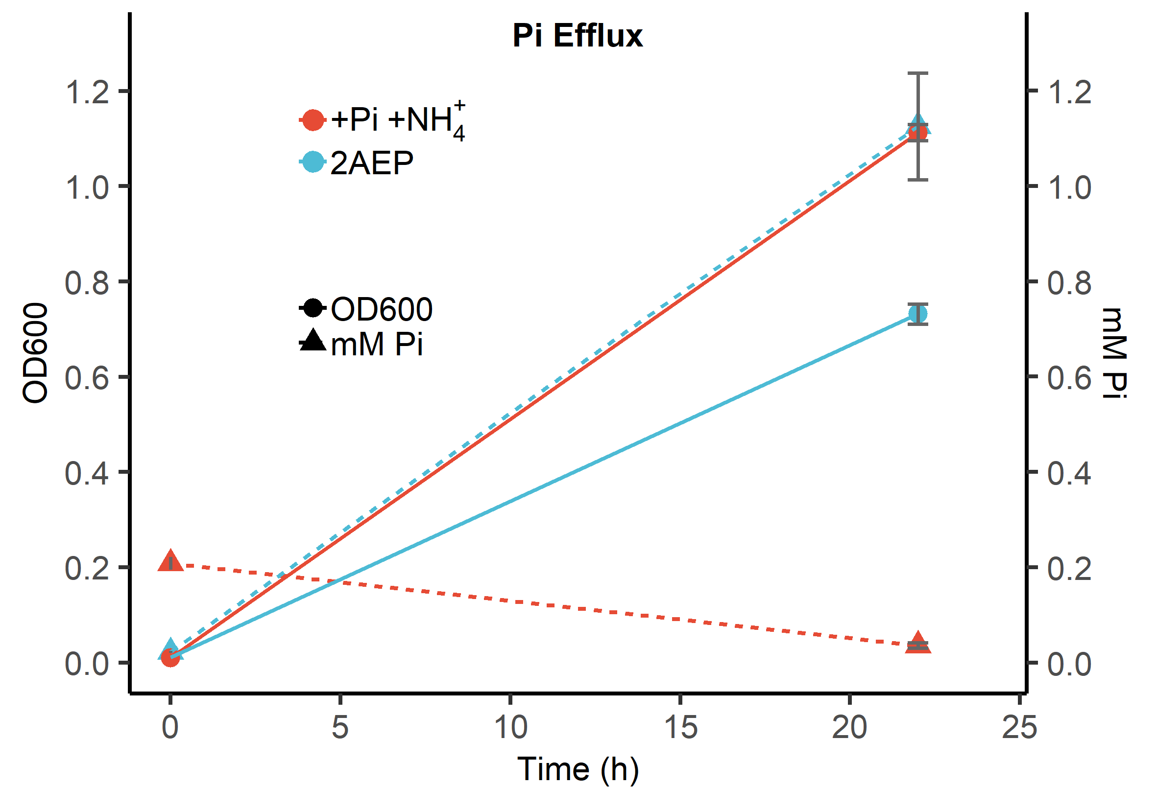
Figure S1. Pi efflux (triangles and dashed lines) and OD600 (circles and solid lines) on 2AEP as the sole N and P source in P. putida BIRD-1 (blue). A positive control for both strains was also established where orthophosphate (Pi) and ammonium (NH₄⁺) were the sole P and N sources respectively (red). All conditions performed in triplicate; error bars represent standard deviation of the mean.

Slide 2
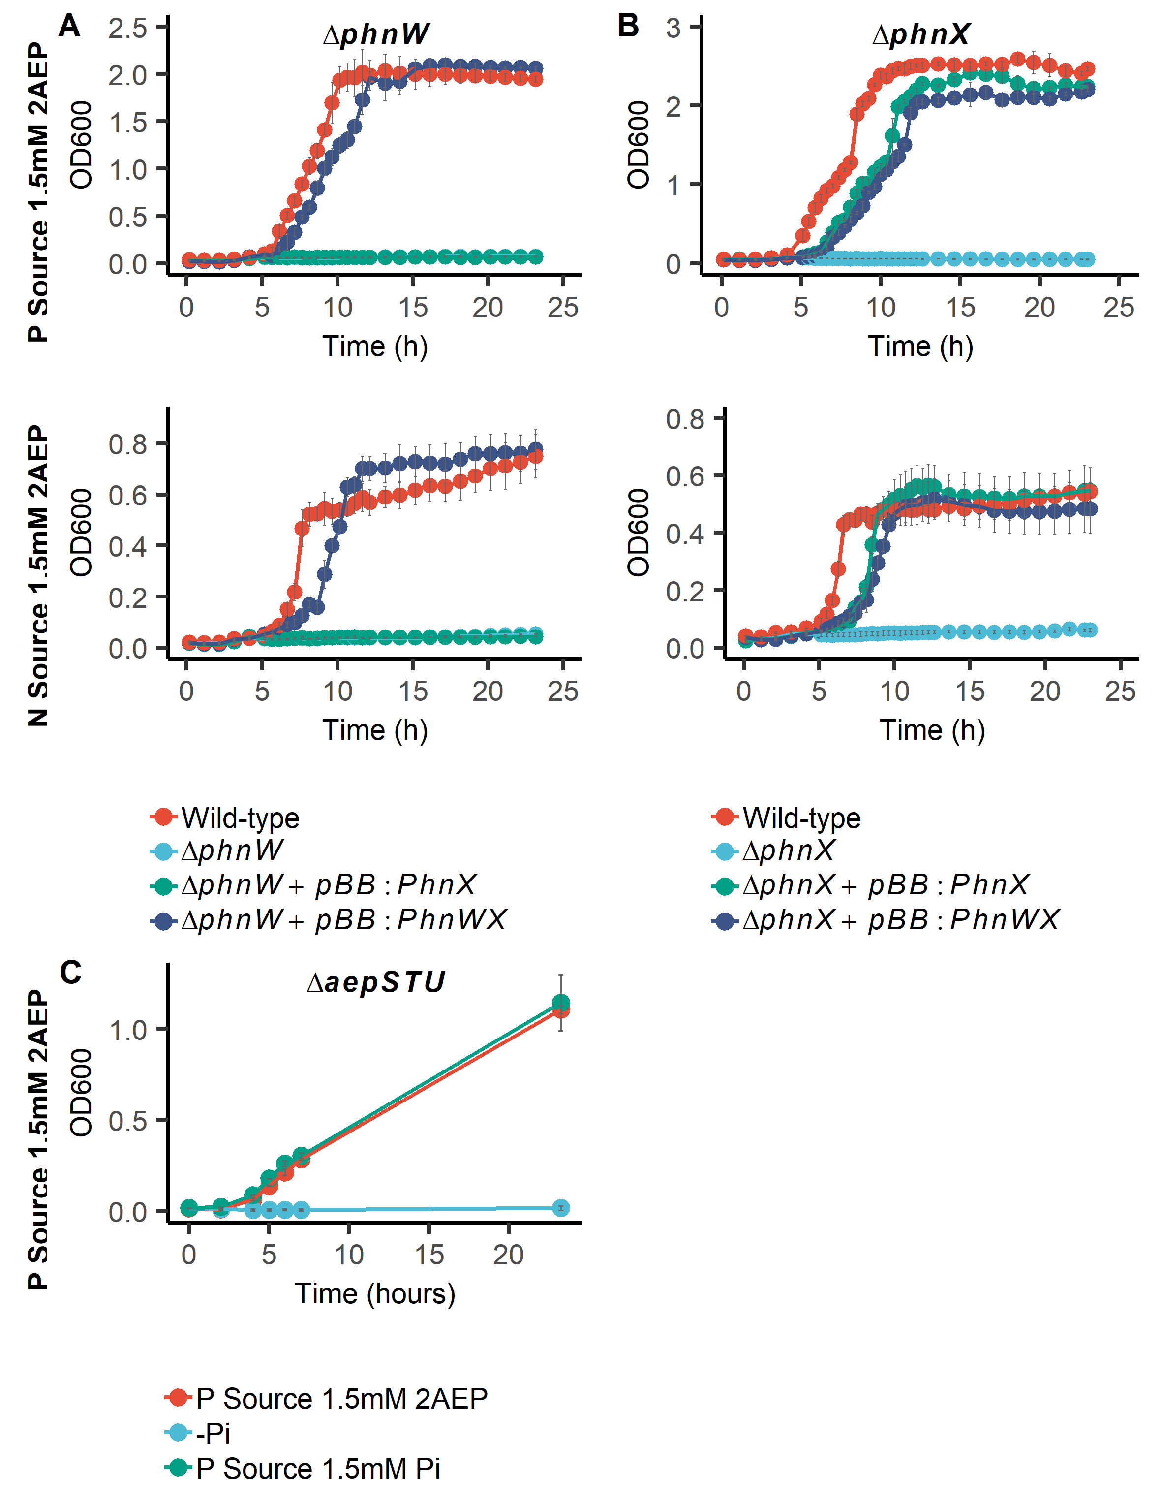
Figure S2 Growth curves of P. putida BIRD-1 on 2AEP as sole N or P source. (A) shows ΔphnW and its complementation, (B) shows ΔphnX and its complementation, and (C) shows ΔaepSTU grown on 2AEP as sole P source. Error bars show standard deviations of the mean.

Slide 3
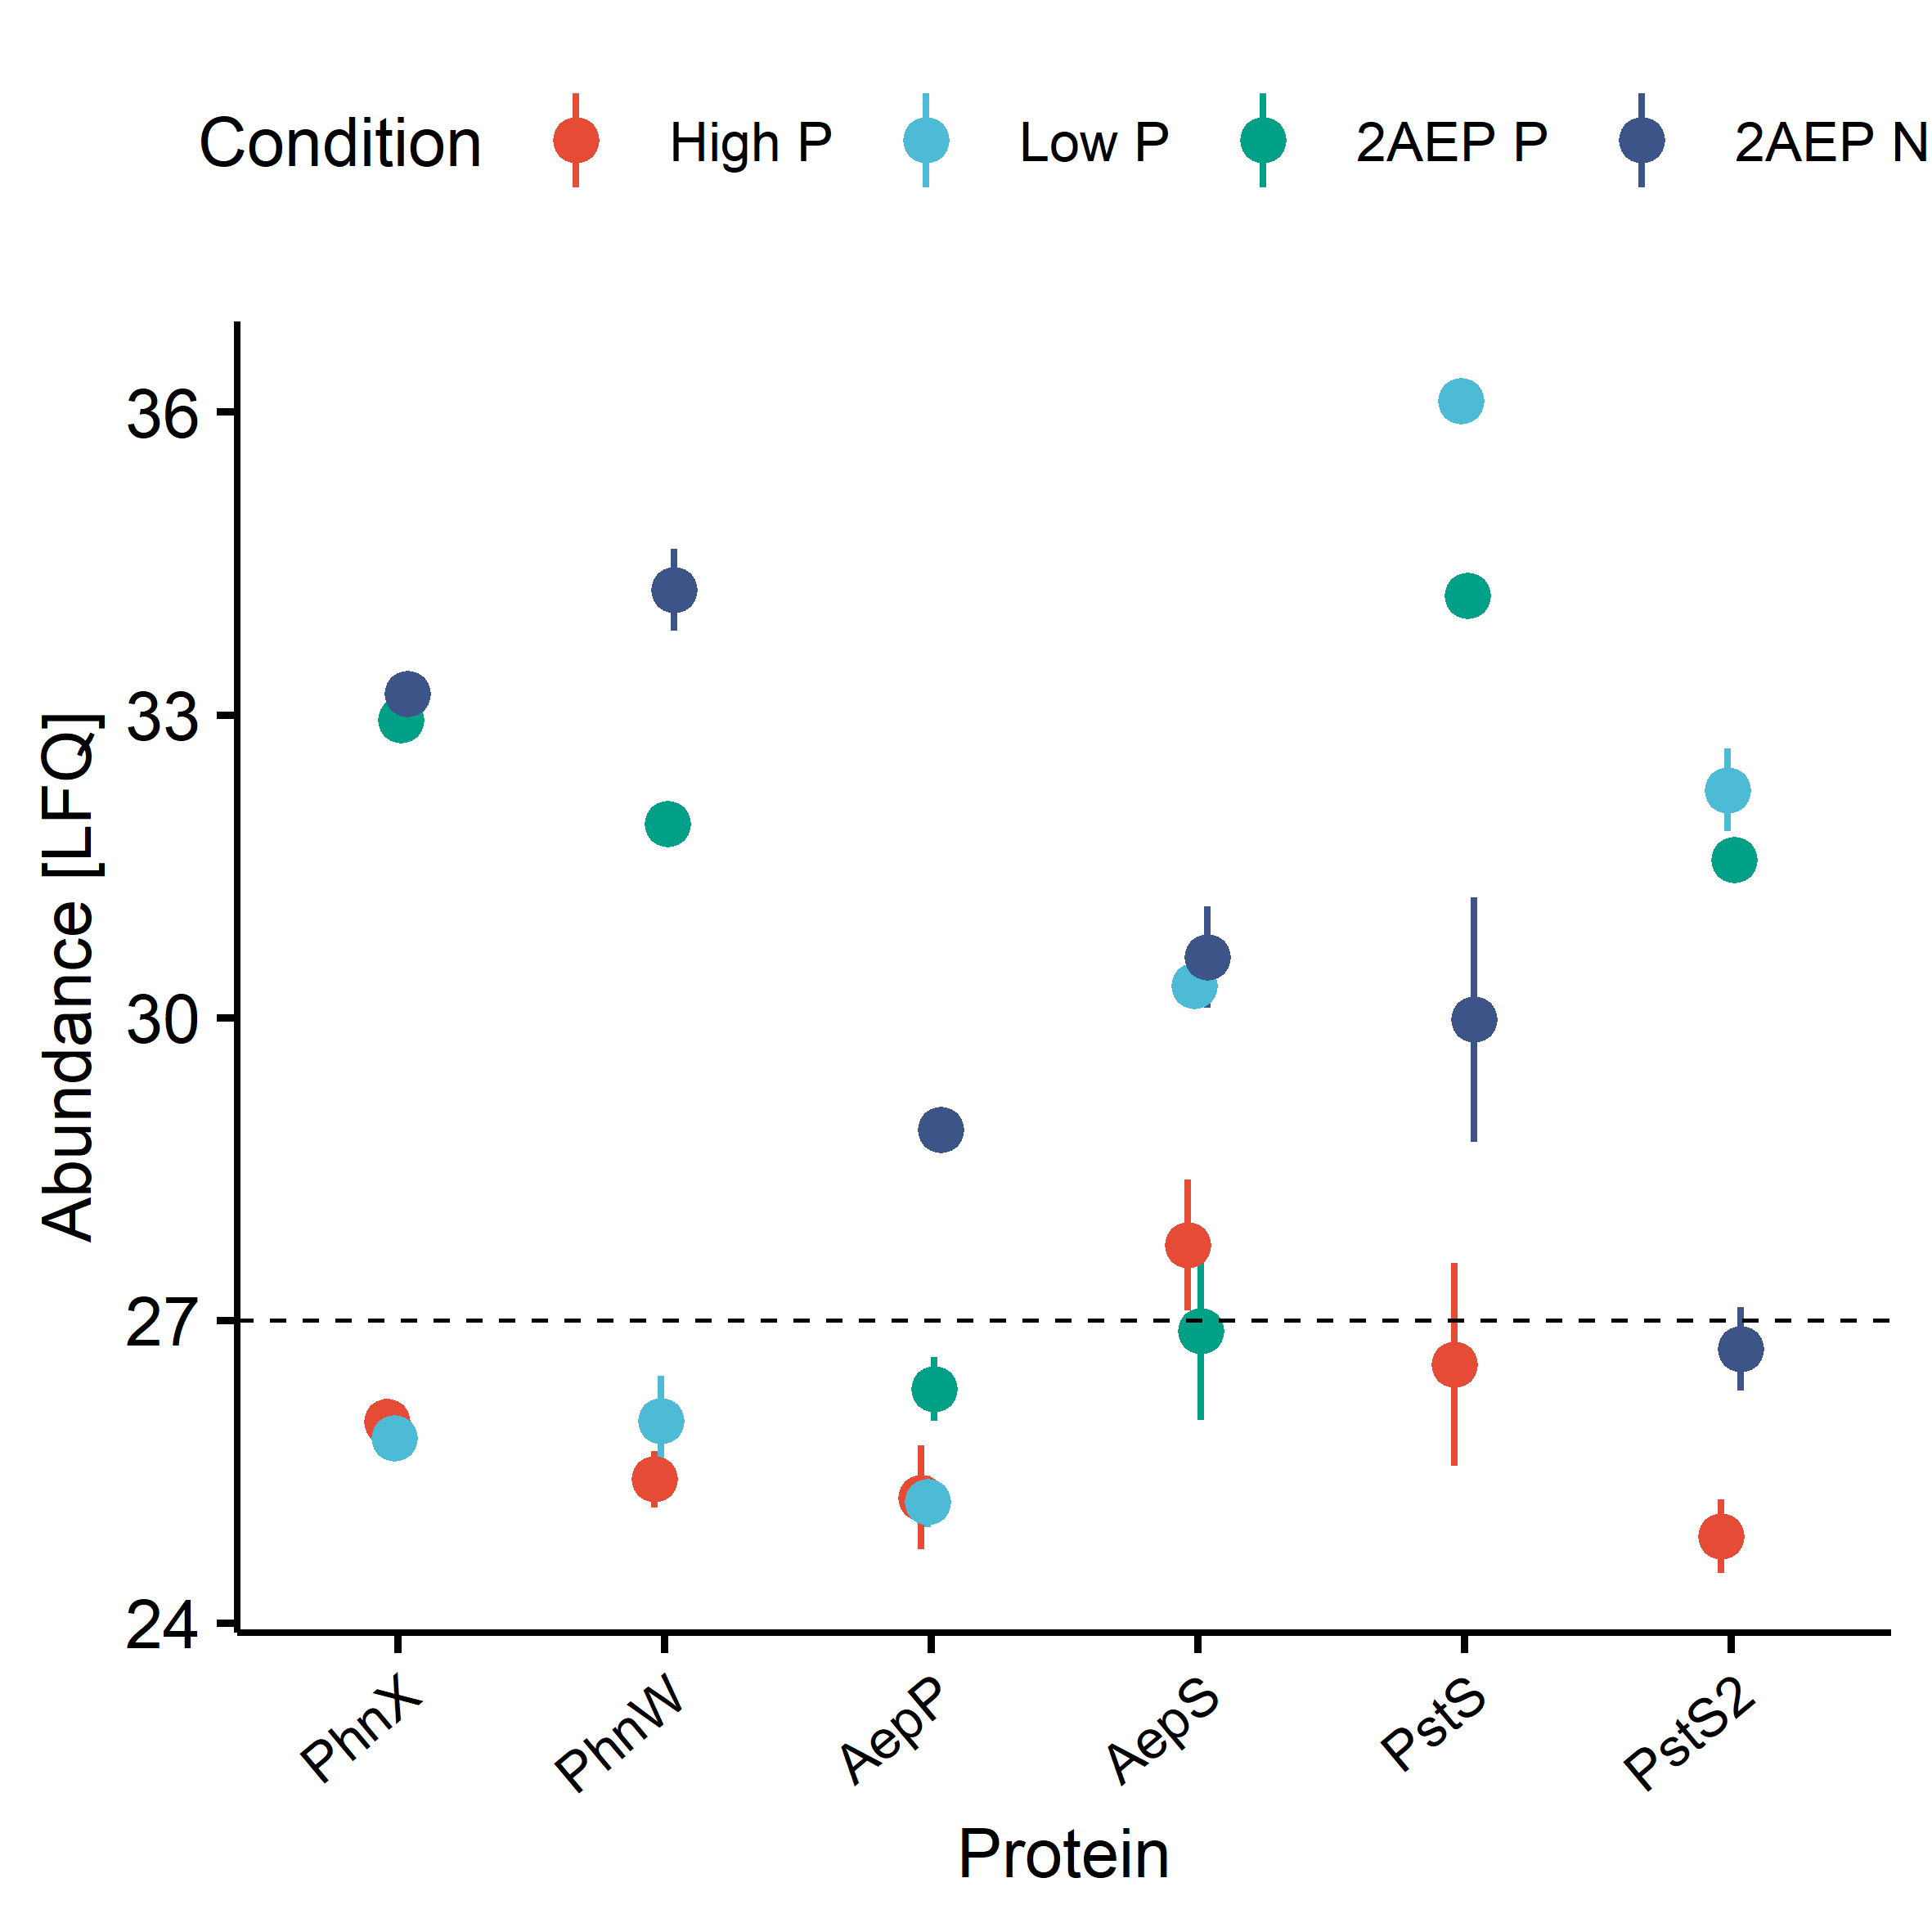
Figure S3. Quantification (LFQ values) of PhnXW, candidate 2AEP transport proteins and phosphate binding proteins (PstS) in ΔaepXVW::gm in response to growth on 2AEP (n=3) as sole P or N source. High and low P controls used orthophosphate (Pi) as the sole P source. Error bars show standard deviation of the mean.

Slide 4
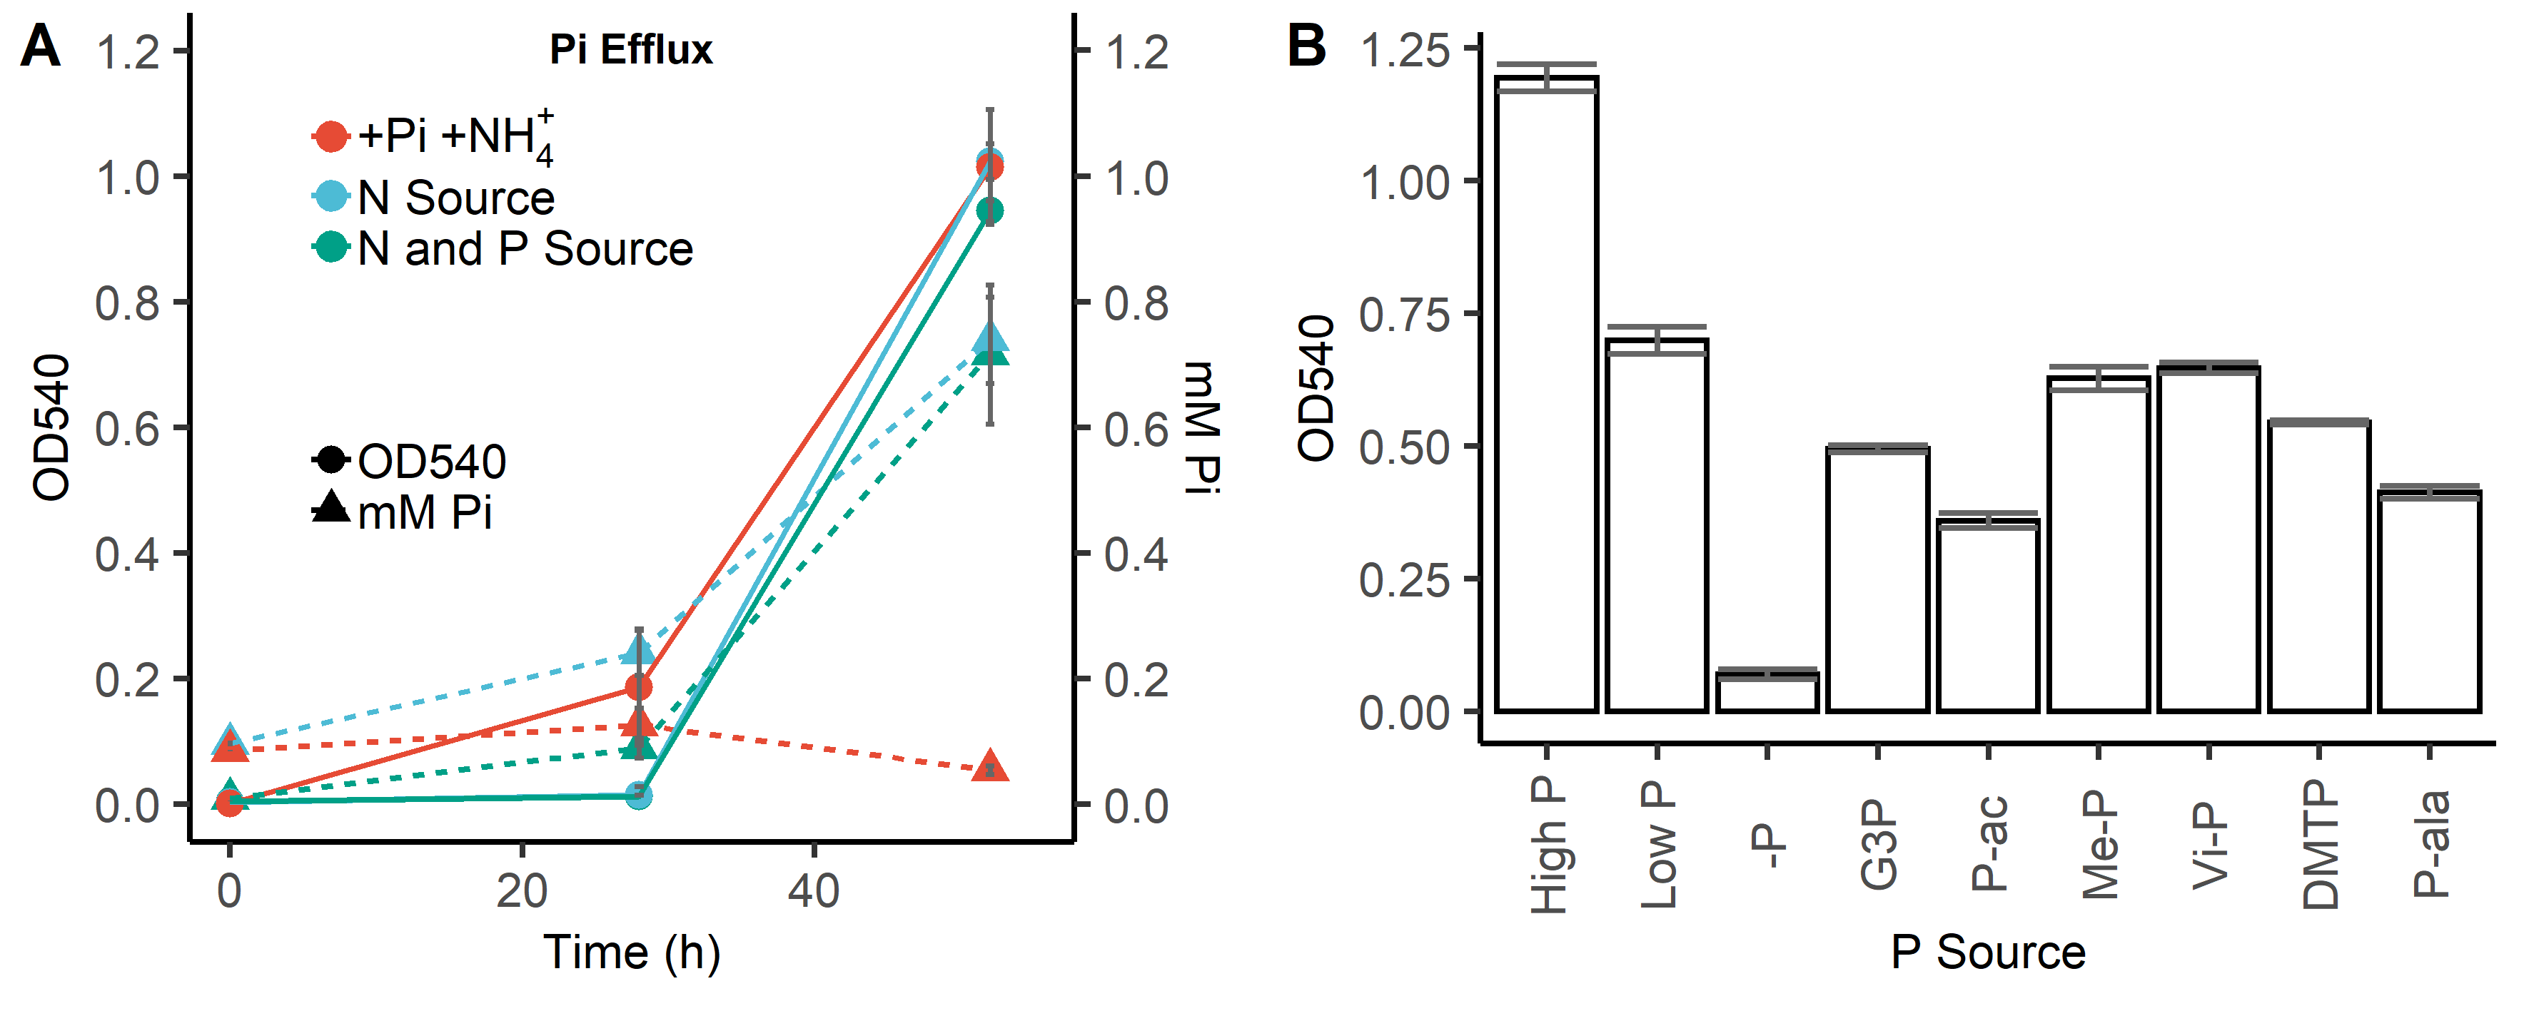
Figure S5. (A) Pi efflux (triangles and dashed lines) during growth (circles and solid lines) on 2AEP as the sole N source, or sole N and P source in S. stellulata. A positive control for both strains was also established where orthophosphate (Pi) and ammonium (NH₄⁺) were the sole P and N sources respectively. All conditions performed in triplicate; error bars represent standard deviation of the mean. (B) Growth of Stappia Stellulata DSM 5886 on various P sources. High P = 1mM Pi, Low P = 0.1mM Pi, -P = No P Control, G3P = Glycerol-3-phosphate, P-ac = Phosphonoacetate, Me-P = Methylphosphonate, Vi-P = Vinylphosphonate, DMTP = Dimethylthiophosphonate, P-ala = Phosphonoalanine. All organic P sources are 0.1mM. Values are the mean of three replicates, error bars are the standard deviation of the mean.

Slide 5
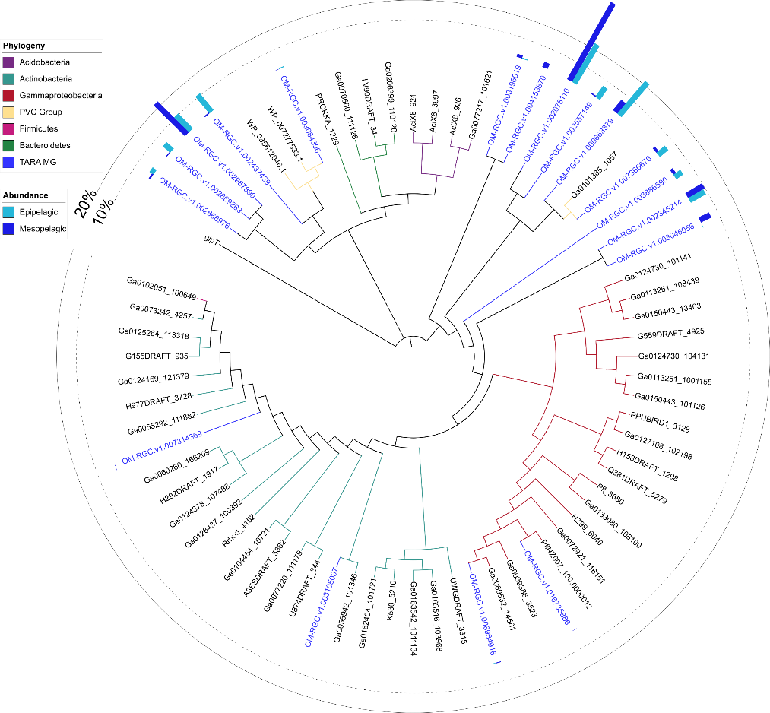
1) OM-RGC.v1. 002345214
A) Kriegella aquimaris DSM 19886
B) Granuliella mallensis MP5ACTX8
C) Haloferula sp. BvORR071
D) Verrucomicrobia SGGC AC-337 J20
E) Streptomyces albulus CCRC 11814
ORFs
AepV^{Pfam00005} PhnR^{Pfam03466}
AepW^{Pfam00528} AepP^{Pfam07690}
AepX^{Pfam13343} AepY^{Pfam02690}
PhnX^{Pfam13419} AepZ^{Pfam00202}
PhnW^{Pfam00266} Oxidoreductase^{Pfam01266}
PhnA^{Pfam01663} Uncharacterised protein
PhnY^{Pfam00171} PHO4 PiT^{Pfam01384}
Alcohol dehydrogenase^{Pfam00465} Aldehyde dehydrogenase^{Pfam00171}
Amidohydrolase^{Pfam07969}
C
A
B
D
1
BIRD-1
E
Figure S6. Phylogenetic and genomic analyses of aepP in marine and terrestrial bacteria. Genetic neighbourhood for selected aepP homologs are presented adjacent to the tree. Numbers indicate environmental OTUs and letters indicate isolates or MAGs/SAGs. Tree topology and branch lengths were calculated by maximum likelihood using the LG+F+I+G4 model of evolution for amino acid sequences based on 301 sites in lQ-TREE software. A consensus tree was generated using 1000 bootstraps. Branches representing isolates or MAGs/SAGs are colour coded based on their phylogenetic affiliation (see legends). Branches and identifiers for representative environmental OTU sequences (clustered at 0.8) retrieved from the TARA Oceans database (blue) are also highlighted. The outer ring denotes the relative abundance of environmental OTUs using the same colour scheme, relative abundance values of 10% (dashed line) and 20% (filled line) are shown for scale., P. putida BIRD-1 aepP is labelled.

Slide 6
Figure S7. Metagenomic (A) and metatranscriptomic (B) abundance of the alternate 2AEP ABC transporter substrate binding proteins AepS and PhnS within the TARA ocean dataset. Data is split between epipelagic (Epi – Red), and mesopelagic (Meso – Blue) waters. Abundance is normalised as a percentage of the median abundance of 10 single copy marker genes within either OM-RGCv2+G (MG) or OM-RGCv2+T (MT).

Slide 7
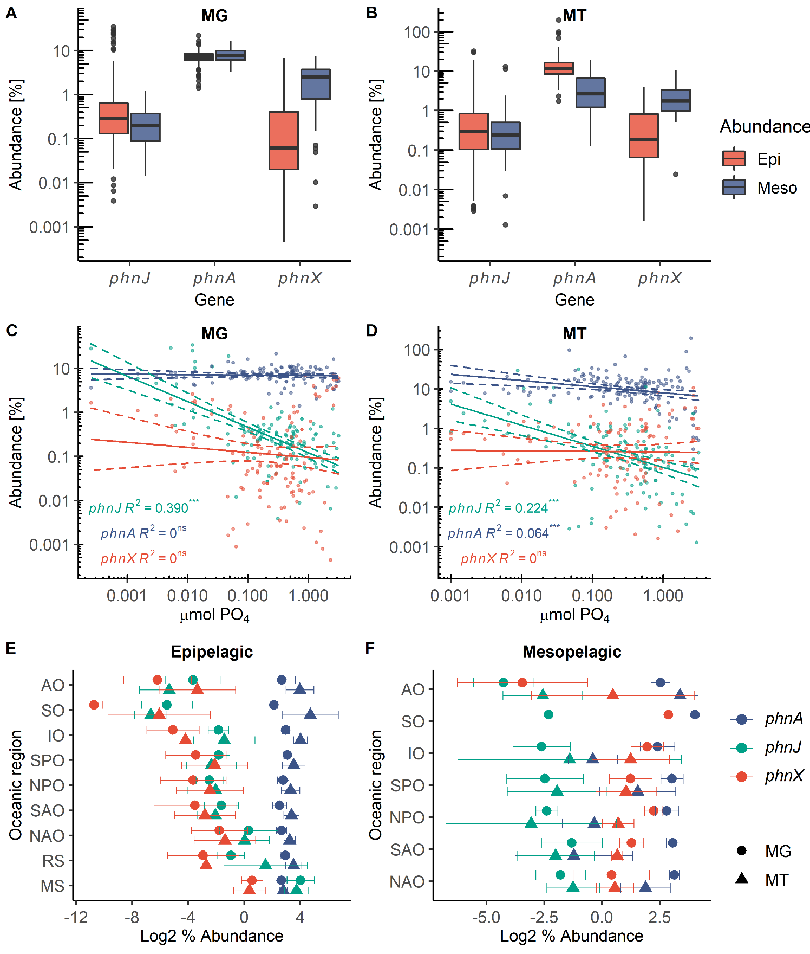
Figure S8. Metagenomic (A) and metatranscriptomic (B) abundance of marker genes for 2AEP degradation within the TARA ocean dataset. Data is split between epipelagic (Epi – Red), and mesopelagic (Meso – Blue) waters. Abundance is normalised as a percentage of the median abundance of 10 single copy marker genes within either OM-RGCv2+G (MG) or OM-RGCv2+T (MT). Log-log linear regressions of MG (C) and MT (D) abundance vs inorganic phosphate concentrations within the TARA ocean dataset (both epipelagic and mesopelagic sites) were performed. R² values are shown. *** = p<0.001, ns =non-significant. Log2 abundance of phosphonate degradation marker genes within metagenome (circles) and metatranscriptome (triangles) in Epipelagic (E) and Mesopelagic (F) waters within various oceanic regions. PhnA (blue), PhnJ (green), PhnX (red). AO = Arctic Ocean, SO = Southern Ocean, IO = Indian Ocean, SPO = South Pacific Ocean, NPO = North Pacific Ocean, SAO = South Atlantic Ocean, NAO = North Atlantic Ocean, RS = Red Sea, MS = Mediterranean Sea.

