Slide 1
Supplement Figure e1
(a) Tumor reduction rate
(b) CA19-9 reduction rate
Change from baseline (%)
Per protocol
Off protocol

Slide 2
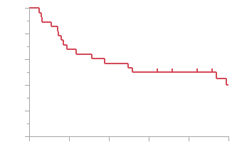
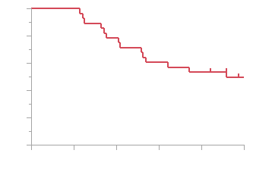
Supplement Figure e2
(a)
(b)
100
100
80
80
60
60
Relapse free survival (%)
Overall survival (%)
40
2yr RFS = 57.1%
40
2yr OS = 49.5%
20
Median survival time = 43.6 months
20
Median survival time = 55.0 months
0
0
0
1y
2y
3y
4y
5y
0
1y
2y
3y
4y
5y
No. at risk
28
19
16
14
12
8
No. at risk
28
28
22
17
15
11
%
100
67.9
57.1
50.0
50.0
40.0
%
100
100
78.6
60.7
53.6
49.5

Slide 3
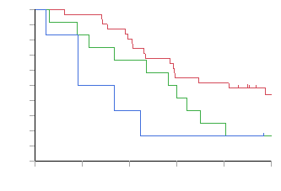
Supplement Figure e3
100
80
60
Overall survival (%)
- Per-protocol resection (Median survival time = 49.2 months)
40
- Off-protocol resection (Median survival time = 34.9 months)
20
- No resection (Median survival time = 15.6 months)
0
0
1y
2y
3y
4y
5y
No. at risk
31
30
25
17
16
10
%
100
96.8
80.7
54.8
51.6
44.0
No. at risk
12
10
8
6
3
2
%
100
83.3
66.7
50.0
25.0
16.7
No. at risk
6
3
2
1
1
1
%
100
50.0
33.3
16.7
16.7
16.7

