Slide 1
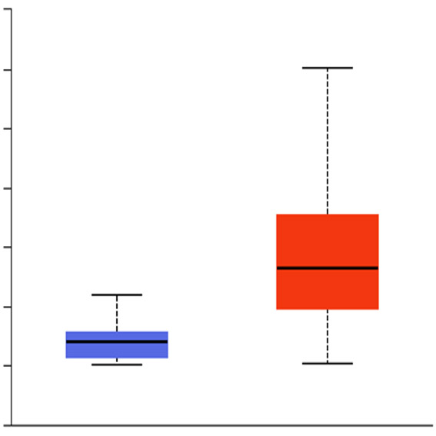
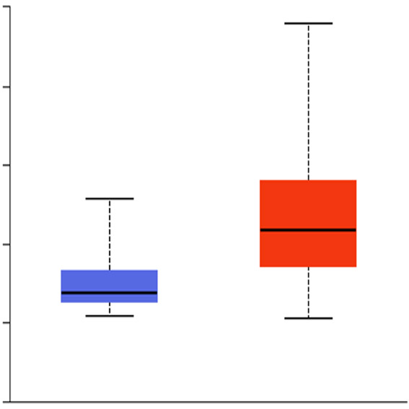
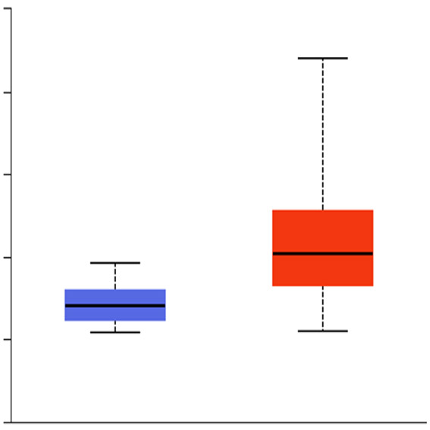
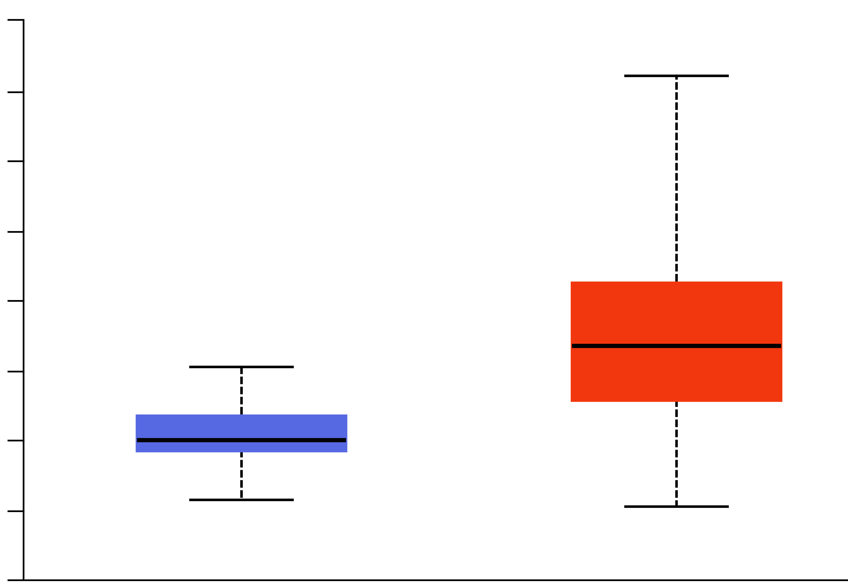
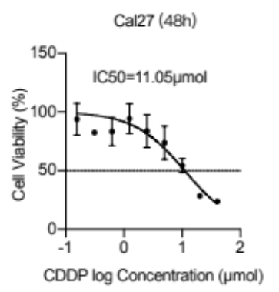
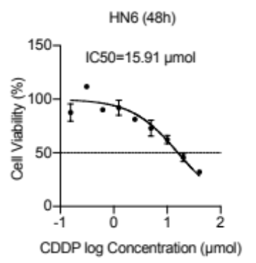
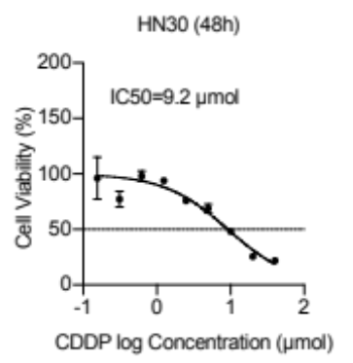
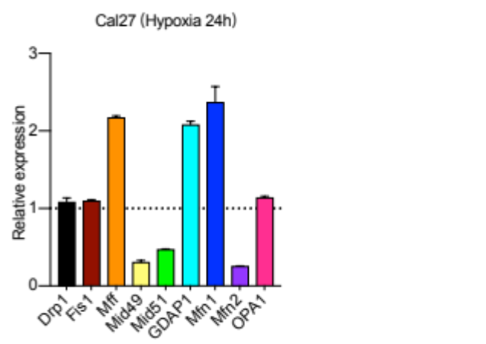
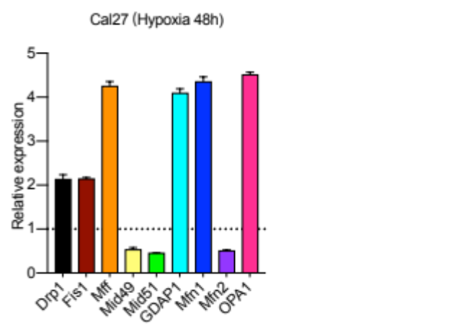
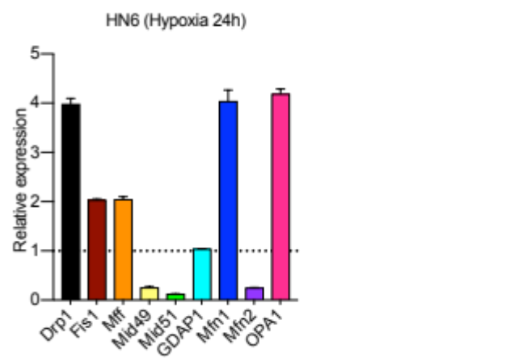
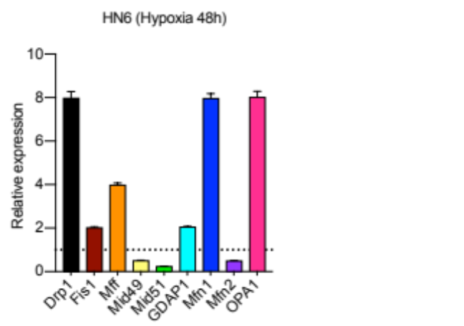
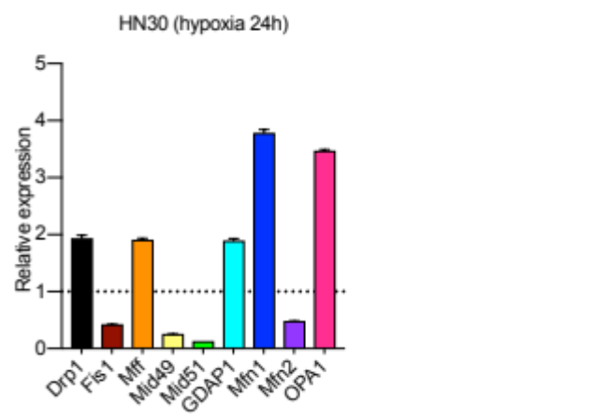
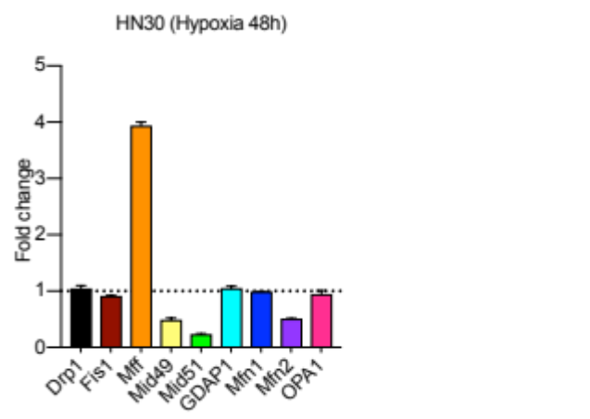
A
Expression of SLC2A1 in HNSC
Expression of PDGFB in HNSC
Expression of VEGFA in HNSC
Expression of HIF-1α in HNSC
1500
p=1.62E-12
40
p=6.44E-15
200
p=1E-12
350
p=1.62E-12
1250
30
150
300
p=1E-12
1000
20
250
750
100
200
Transcript per million
Transcript per million
Transcript per million
500
Transcript per million
150
250
10
50
100
0
0
0
50
-250
-10
-50
0
Normal(n=44)
Primary tumor
(n=520)
Normal(n=44)
Primary tumor
(n=520)
Normal(n=44)
Primary tumor
(n=520)
-50
Normal(n=44)
Primary tumor
(n=520)
B
C
Supplementary figure 1. (A) The expression levels of hypoxia markers (SLC2A1, PDGFB, VEGFA and HIF-1α ) were analyzed in TCGA database. (B) The IC50 value of CDDP for Cal27, HN6 or HN30 cells, respectively. (C) The mitochondrial fission and fusion genes was screened by RT-PCR.

Slide 2
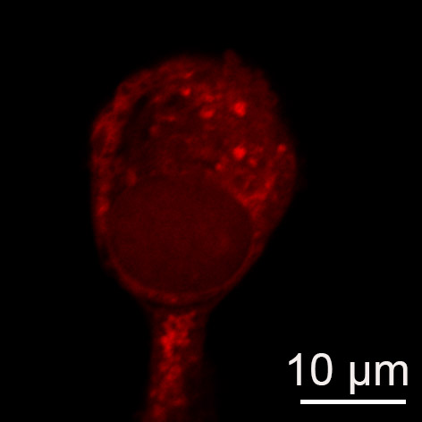
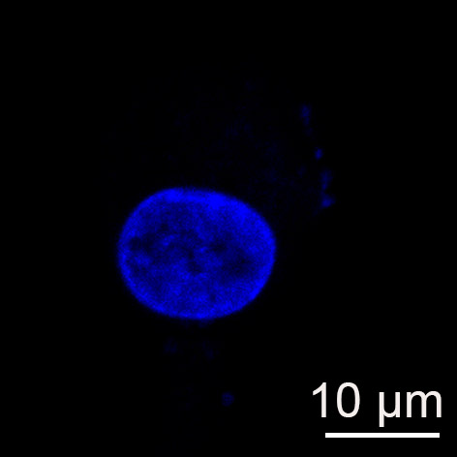
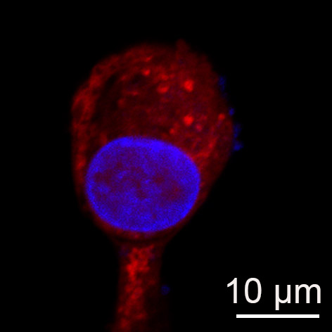
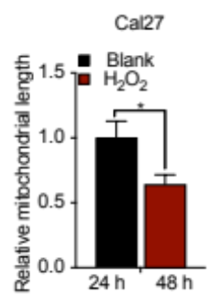
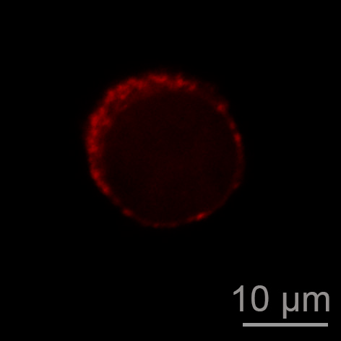
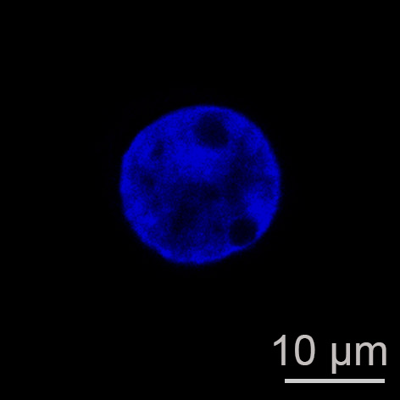
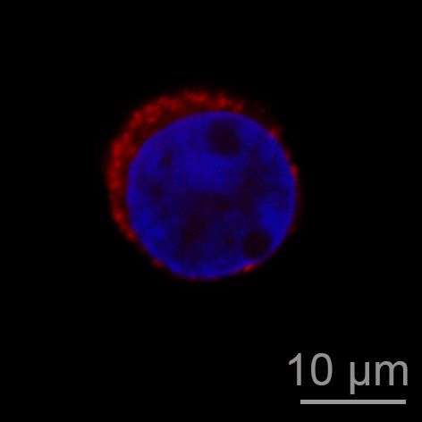
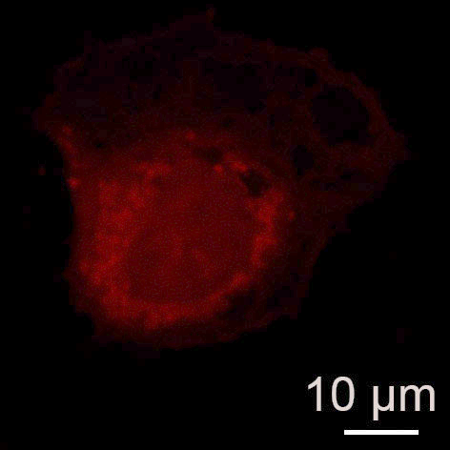
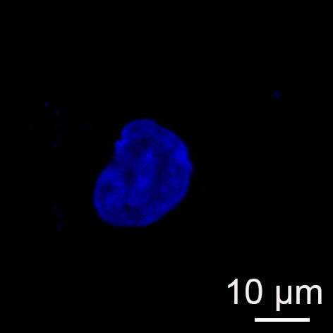
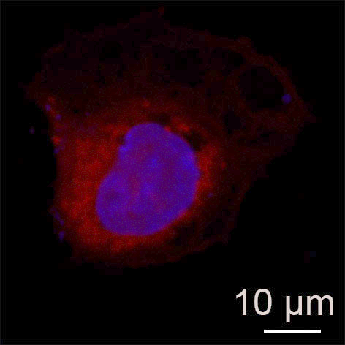
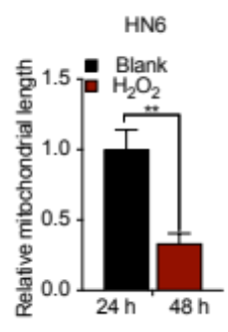
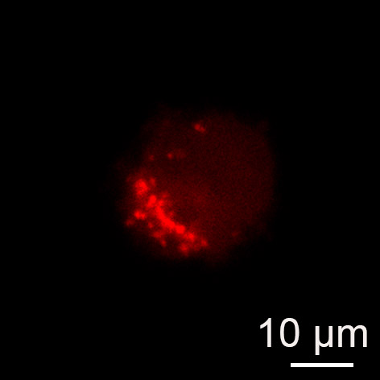
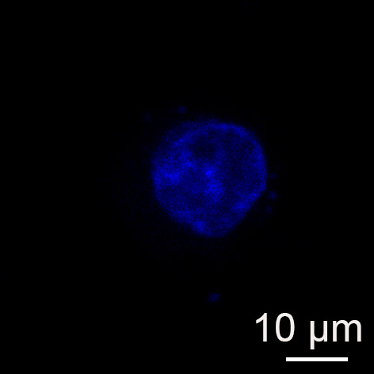
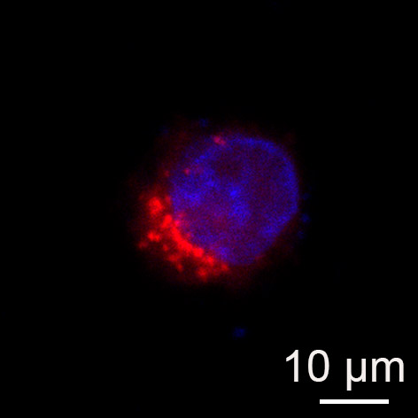
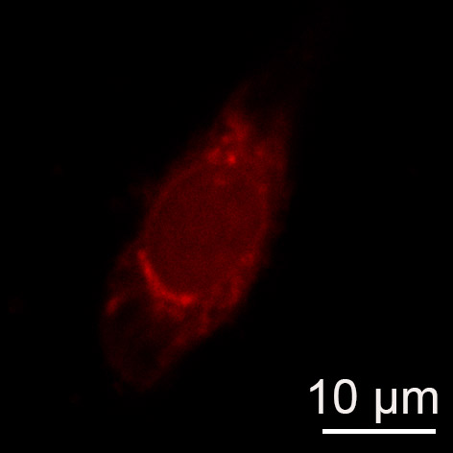
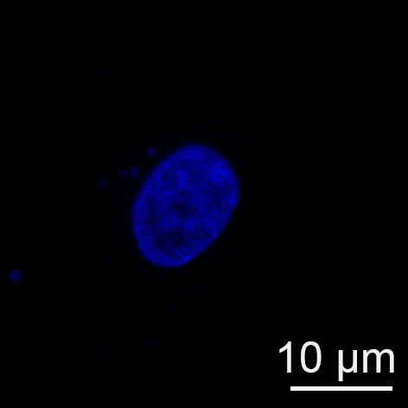
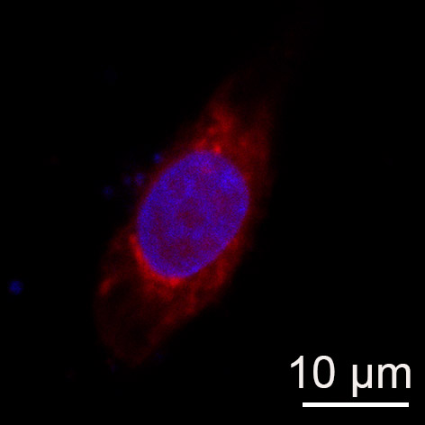
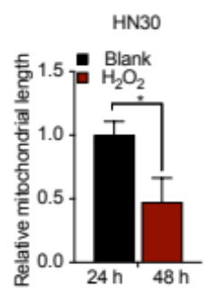
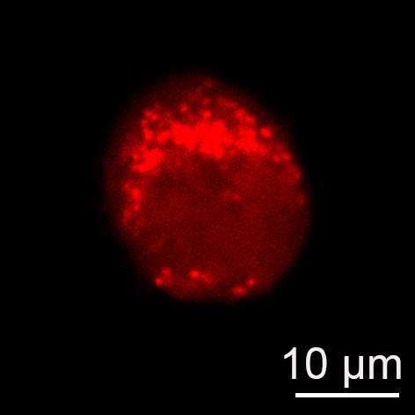
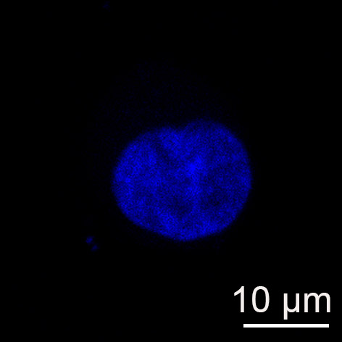
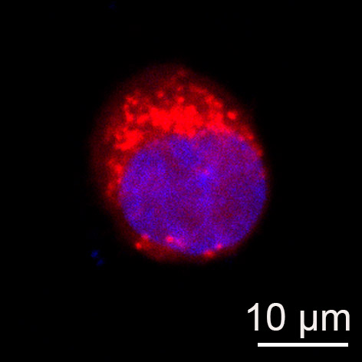









A
MitoSpy
DAPI
Merge
Blank
Cal27
H₂O₂
Blank
HN6
H₂O₂
Blank
HN30
H₂O₂
B
Cal27
HN6
HN30
H₂O₂
-
+
-
+
-
+
HIF-1α
Mff
β-actin
Supplementary figure 2. (A) Exogenous H₂O₂ promoted mitochondrial fission in HNSCC cells. (B) Western blot analysis was used to detect HIF-1α and Mff protein expression in HNSCC cells treated with exogenous H₂O_{2.}

Slide 3


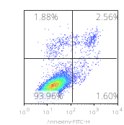
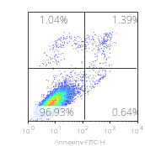
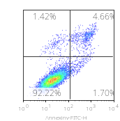
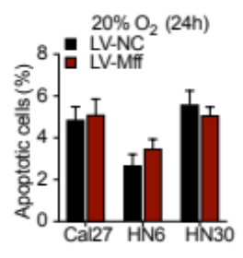
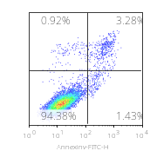
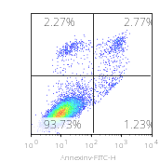
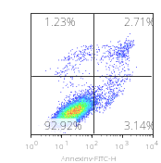
A
LV-NC
LV-NC
LV-NC
LV-Mff
LV-Mff
LV-Mff
Mff
β-actin
Cal27
HN6
HN30
B
Cal27
HN6
HN30
LV-NC
LV-Mff
Supplementary figure 3. (A) Western blot analysis was used to detect Mff protein expression in HNSCC cells stably transfected with LV-Mff . (B) The flow cytometric analysis was used to analyze apoptosis proportion of HNSCC cells stably transfected with LV-Mff or LV-NC under 20% O₂ conditon.

