Slide 1
A
B
C
D
Supplementary Figure 1: Comparison of DNA methylation measurements generated using 5-base, ONT, and EPICv2 platforms for sample NEURO-27. Panel A: Density-based correlation plot comparing CpG-level methylation values obtained from 5-base sequencing and EPICv2 arrays. Panel B: Bland–Altman plot for 5-base sequencing versus EPICv2 arrays, presenting the difference between paired methylation measurements as a function of their mean value. Panel C: Density-based correlation plot comparing CpG-level methylation values obtained from ONT and EPICv2 platforms. Panel D: Bland–Altman plot for ONT sequencing versus EPICv2 arrays, presenting the difference between paired methylation measurements as a function of their mean value. Color intensity indicates the local density of paired CpG measurements.

Slide 2
A
B
C
D
Supplementary Figure 2: Comparison of DNA methylation measurements generated using 5-base, ONT, and EPICv2 platforms for sample NEURO-58. Panel A: Density-based correlation plot comparing CpG-level methylation values obtained from 5-base sequencing and EPICv2 arrays. Panel B: Bland–Altman plot for 5-base sequencing versus EPICv2 arrays, presenting the difference between paired methylation measurements as a function of their mean value. Panel C: Density-based correlation plot comparing CpG-level methylation values obtained from ONT and EPICv2 platforms. Panel D: Bland–Altman plot for ONT sequencing versus EPICv2 arrays, presenting the difference between paired methylation measurements as a function of their mean value. Color intensity indicates the local density of paired CpG measurements.

Slide 3
A
B
Supplementary Figure 3: Comparison of DNA methylation measurements generated using 5-base and EPICv2 platforms for sample NEURO-69. Panel A: Density-based correlation plot comparing CpG-level methylation values obtained from 5-base sequencing and EPICv2 arrays. Panel B: Bland–Altman plot for 5-base sequencing versus EPICv2 arrays, presenting the difference between paired methylation measurements as a function of their mean value.

Slide 4
A
B
Supplementary Figure 4: Comparison of DNA methylation measurements generated using 5-base and EPICv2 platforms for sample NEURO-84. Panel A: Density-based correlation plot comparing CpG-level methylation values obtained from 5-base sequencing and EPICv2 arrays. Panel B: Bland–Altman plot for 5-base sequencing versus EPICv2 arrays, presenting the difference between paired methylation measurements as a function of their mean value.

Slide 5
A
B
C
D
Supplementary Figure 5: Comparison of DNA methylation measurements generated using 5-base, ONT, and EPICv2 platforms for sample NEURO-91. Panel A: Density-based correlation plot comparing CpG-level methylation values obtained from 5-base sequencing and EPICv2 arrays. Panel B: Bland–Altman plot for 5-base sequencing versus EPICv2 arrays, presenting the difference between paired methylation measurements as a function of their mean value. Panel C: Density-based correlation plot comparing CpG-level methylation values obtained from ONT and EPICv2 platforms. Panel D: Bland–Altman plot for ONT sequencing versus EPICv2 arrays, presenting the difference between paired methylation measurements as a function of their mean value. Color intensity indicates the local density of paired CpG measurements.

Slide 6
A
B
C
D
Supplementary Figure 6: Comparison of DNA methylation measurements generated using 5-base, ONT, and EPICv2 platforms for sample NEURO-96. Panel A: Density-based correlation plot comparing CpG-level methylation values obtained from 5-base sequencing and EPICv2 arrays. Panel B: Bland–Altman plot for 5-base sequencing versus EPICv2 arrays, presenting the difference between paired methylation measurements as a function of their mean value. Panel C: Density-based correlation plot comparing CpG-level methylation values obtained from ONT and EPICv2 platforms. Panel D: Bland–Altman plot for ONT sequencing versus EPICv2 arrays, presenting the difference between paired methylation measurements as a function of their mean value. Color intensity indicates the local density of paired CpG measurements.

Slide 7
A
B
C
D
Supplementary Figure 7: Comparison of DNA methylation measurements generated using 5-base, ONT, and EPICv2 platforms for sample NEURO-99. Panel A: Density-based correlation plot comparing CpG-level methylation values obtained from 5-base sequencing and EPICv2 arrays. Panel B: Bland–Altman plot for 5-base sequencing versus EPICv2 arrays, presenting the difference between paired methylation measurements as a function of their mean value. Panel C: Density-based correlation plot comparing CpG-level methylation values obtained from ONT and EPICv2 platforms. Panel D: Bland–Altman plot for ONT sequencing versus EPICv2 arrays, presenting the difference between paired methylation measurements as a function of their mean value. Color intensity indicates the local density of paired CpG measurements.

Slide 8
A
B
C
D
Supplementary Figure 8: Comparison of DNA methylation measurements generated using 5-base, ONT, and EPICv2 platforms for sample NEURO-101. Panel A: Density-based correlation plot comparing CpG-level methylation values obtained from 5-base sequencing and EPICv2 arrays. Panel B: Bland–Altman plot for 5-base sequencing versus EPICv2 arrays, presenting the difference between paired methylation measurements as a function of their mean value. Panel C: Density-based correlation plot comparing CpG-level methylation values obtained from ONT and EPICv2 platforms. Panel D: Bland–Altman plot for ONT sequencing versus EPICv2 arrays, presenting the difference between paired methylation measurements as a function of their mean value. Color intensity indicates the local density of paired CpG measurements.

Slide 9
A
B
Supplementary Figure 9: Comparison of DNA methylation measurements generated using 5-base and EPICv2 platforms for sample NEURO-103. Panel A: Density-based correlation plot comparing CpG-level methylation values obtained from 5-base sequencing and EPICv2 arrays. Panel B: Bland–Altman plot for 5-base sequencing versus EPICv2 arrays, presenting the difference between paired methylation measurements as a function of their mean value.

Slide 10
A
B
C
D
Supplementary Figure 10: Comparison of DNA methylation measurements generated using 5-base, ONT, and EPICv2 platforms for sample NEURO-115. Panel A: Density-based correlation plot comparing CpG-level methylation values obtained from 5-base sequencing and EPICv2 arrays. Panel B: Bland–Altman plot for 5-base sequencing versus EPICv2 arrays, presenting the difference between paired methylation measurements as a function of their mean value. Panel C: Density-based correlation plot comparing CpG-level methylation values obtained from ONT and EPICv2 platforms. Panel D: Bland–Altman plot for ONT sequencing versus EPICv2 arrays, presenting the difference between paired methylation measurements as a function of their mean value. Color intensity indicates the local density of paired CpG measurements.

Slide 11
A
B
C
D
Supplementary Figure 11: Comparison of DNA methylation measurements generated using 5-base, ONT, and EPICv2 platforms for sample NEURO-123. Panel A: Density-based correlation plot comparing CpG-level methylation values obtained from 5-base sequencing and EPICv2 arrays. Panel B: Bland–Altman plot for 5-base sequencing versus EPICv2 arrays, presenting the difference between paired methylation measurements as a function of their mean value. Panel C: Density-based correlation plot comparing CpG-level methylation values obtained from ONT and EPICv2 platforms. Panel D: Bland–Altman plot for ONT sequencing versus EPICv2 arrays, presenting the difference between paired methylation measurements as a function of their mean value. Color intensity indicates the local density of paired CpG measurements.

Slide 12
A
B
Supplementary Figure 12: Comparison of DNA methylation measurements generated using 5-base and EPICv2 platforms for sample NEURO-154. Panel A: Density-based correlation plot comparing CpG-level methylation values obtained from 5-base sequencing and EPICv2 arrays. Panel B: Bland–Altman plot for 5-base sequencing versus EPICv2 arrays, presenting the difference between paired methylation measurements as a function of their mean value.

Slide 13
A
B
C
D
Supplementary Figure 13: Comparison of DNA methylation measurements generated using 5-base, ONT, and EPICv2 platforms for sample NEURO-183. Panel A: Density-based correlation plot comparing CpG-level methylation values obtained from 5-base sequencing and EPICv2 arrays. Panel B: Bland–Altman plot for 5-base sequencing versus EPICv2 arrays, presenting the difference between paired methylation measurements as a function of their mean value. Panel C: Density-based correlation plot comparing CpG-level methylation values obtained from ONT and EPICv2 platforms. Panel D: Bland–Altman plot for ONT sequencing versus EPICv2 arrays, presenting the difference between paired methylation measurements as a function of their mean value. Color intensity indicates the local density of paired CpG measurements.

Slide 14
A
B
Supplementary Figure 14: Comparison of DNA methylation measurements generated using 5-base and EPICv2 platforms for sample NEURO-199. Fig. 14A: Density-based correlation plot comparing CpG-level methylation values obtained from 5-base sequencing and EPICv2 arrays. Fig. 14B: Bland–Altman plot for 5-base sequencing versus EPICv2 arrays, presenting the difference between paired methylation measurements as a function of their mean value.

Slide 15
A
B
Supplementary Figure 15: Comparison of DNA methylation measurements generated using 5-base and EPICv2 platforms for sample NEURO-201. Panel A: Density-based correlation plot comparing CpG-level methylation values obtained from 5-base sequencing and EPICv2 arrays. Panel B: Bland–Altman plot for 5-base sequencing versus EPICv2 arrays, presenting the difference between paired methylation measurements as a function of their mean value.

Slide 16
A
B
C
D
Supplementary Figure 16: Comparison of DNA methylation measurements generated using 5-base, ONT, and EPICv2 platforms for sample NEURO-202. Panel A: Density-based correlation plot comparing CpG-level methylation values obtained from 5-base sequencing and EPICv2 arrays. Panel B: Bland–Altman plot for 5-base sequencing versus EPICv2 arrays, presenting the difference between paired methylation measurements as a function of their mean value. Panel C: Density-based correlation plot comparing CpG-level methylation values obtained from ONT and EPICv2 platforms. Panel D: Bland–Altman plot for ONT sequencing versus EPICv2 arrays, presenting the difference between paired methylation measurements as a function of their mean value. Color intensity indicates the local density of paired CpG measurements.

Slide 17
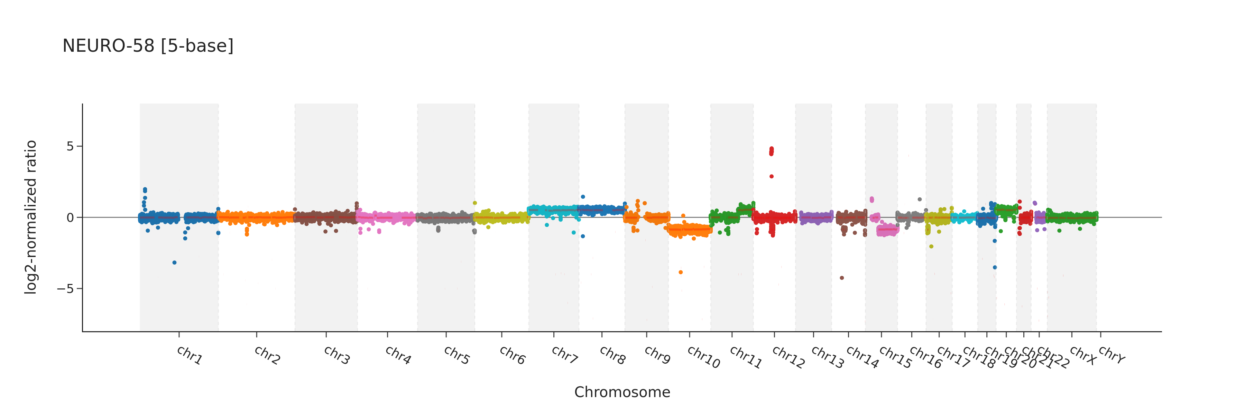
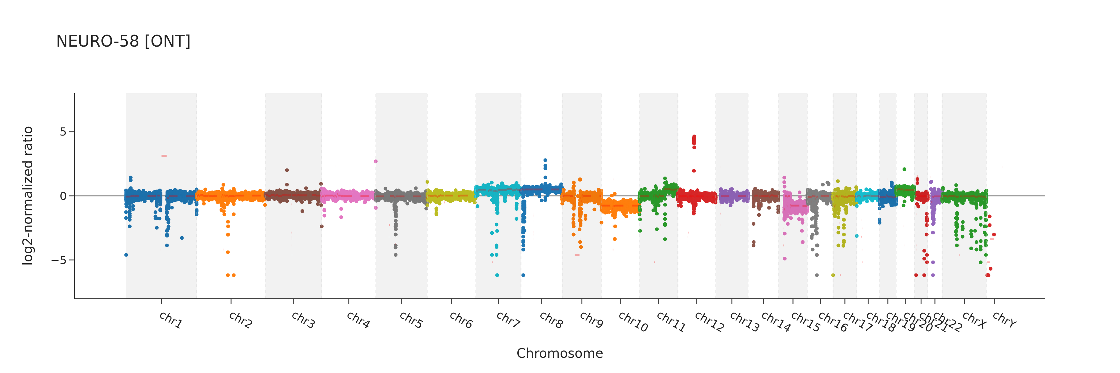
Supplementary Figure 17. Genome-wide copy-number variation (CNV) profiles for sample NEURO-58 generated using 5-base (upper panel) and ONT (lower panel) platforms. The x-axis represents genomic position ordered by chromosome (chr1–chrY), and the y-axis represents the log2-normalized ratio used for CNV assessment. Positive and negative deviations from zero indicate relative copy-number gains and losses, respectively.

Slide 18
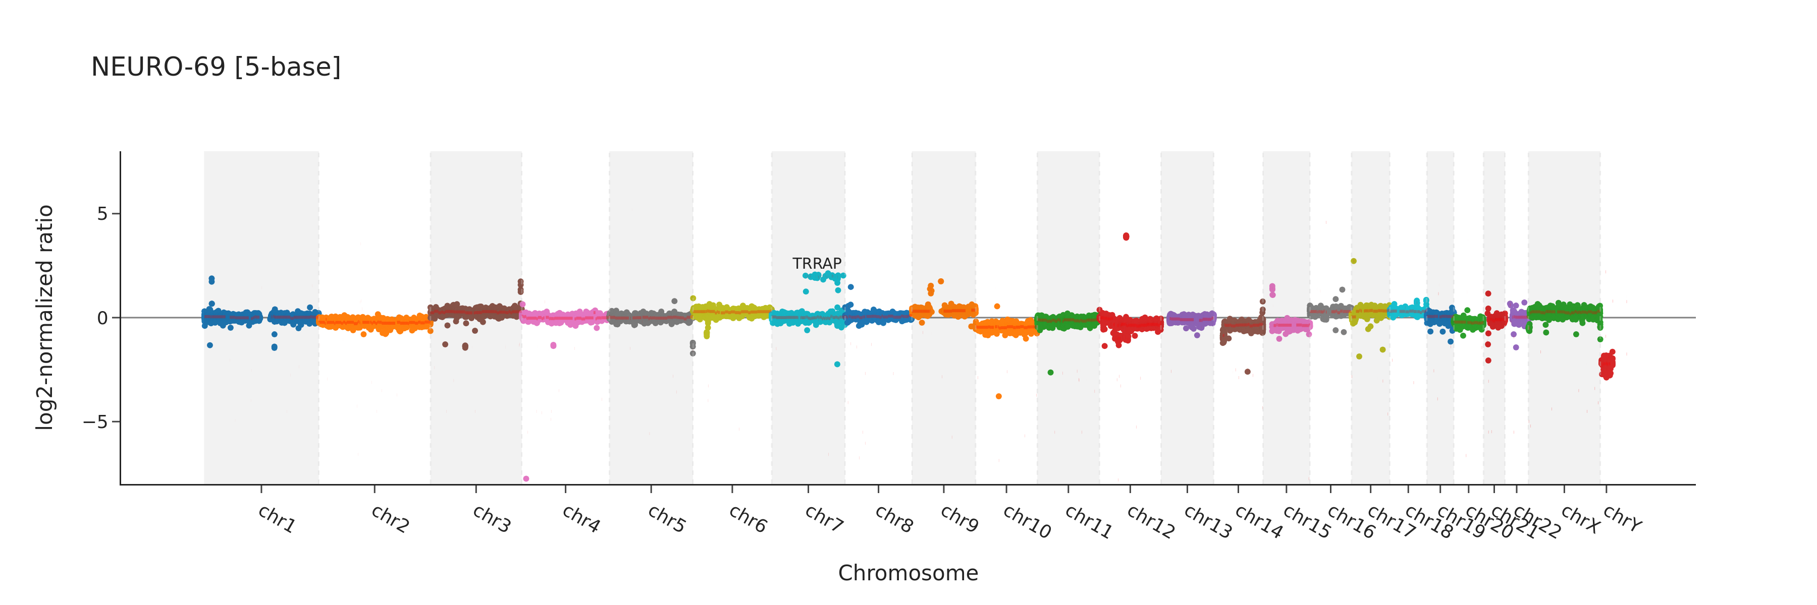
Supplementary Figure 18. Genome-wide copy-number variation (CNV) profile for sample NEURO-69 generated using 5-base platform. The x-axis represents genomic position ordered by chromosome (chr1–chrY), and the y-axis represents the log2-normalized ratio used for CNV assessment. Positive and negative deviations from zero indicate relative copy-number gains and losses, respectively.

Slide 19
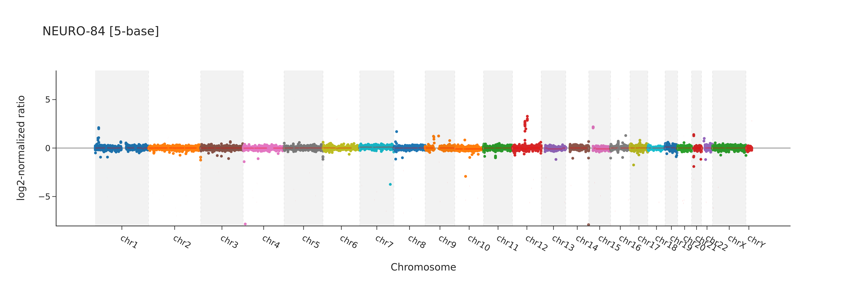
Supplementary Figure 19. Genome-wide copy-number variation (CNV) profile for sample NEURO-84 generated using 5-base platform. The x-axis represents genomic position ordered by chromosome (chr1–chrY), and the y-axis represents the log2-normalized ratio used for CNV assessment. Positive and negative deviations from zero indicate relative copy-number gains and losses, respectively.

Slide 20
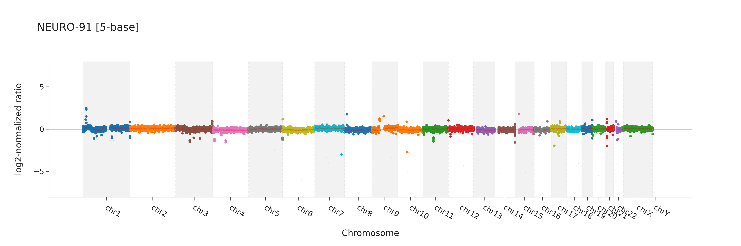
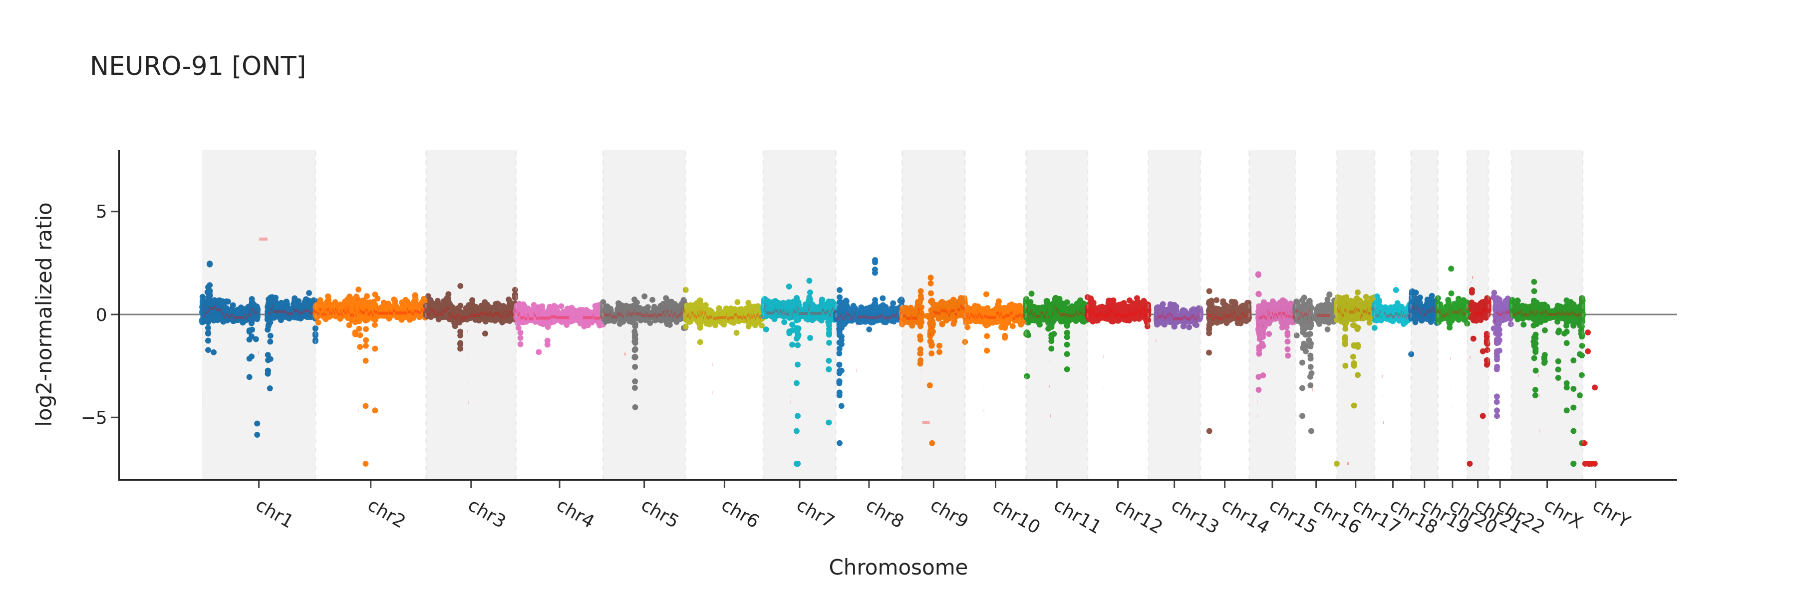
Supplementary Figure 20. Genome-wide copy-number variation (CNV) profiles for sample NEURO-91 generated using 5-base (upper panel) and ONT (lower panel) platforms. The x-axis represents genomic position ordered by chromosome (chr1–chrY), and the y-axis represents the log2-normalized ratio used for CNV assessment. Positive and negative deviations from zero indicate relative copy-number gains and losses, respectively.

Slide 21
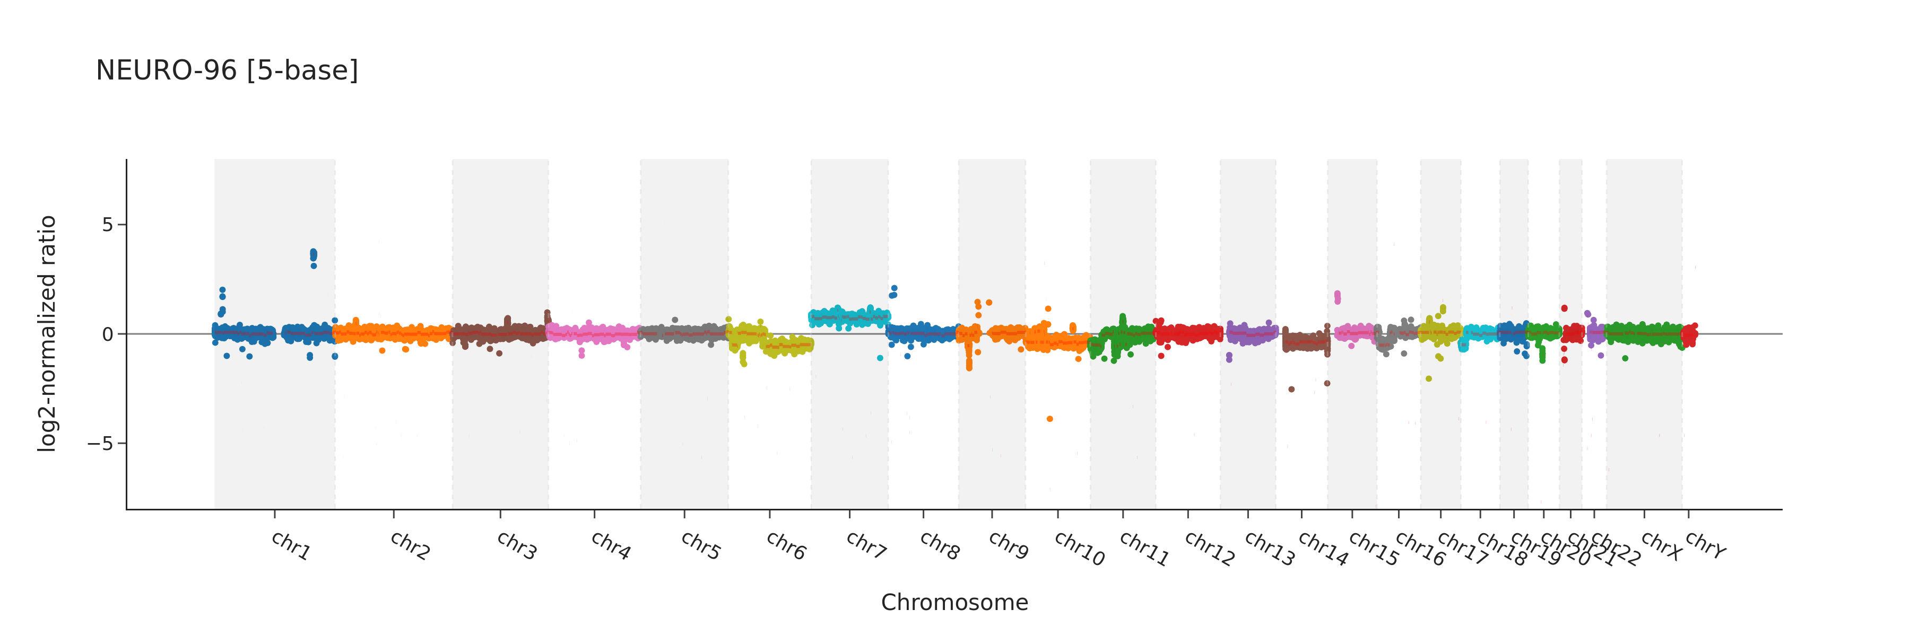
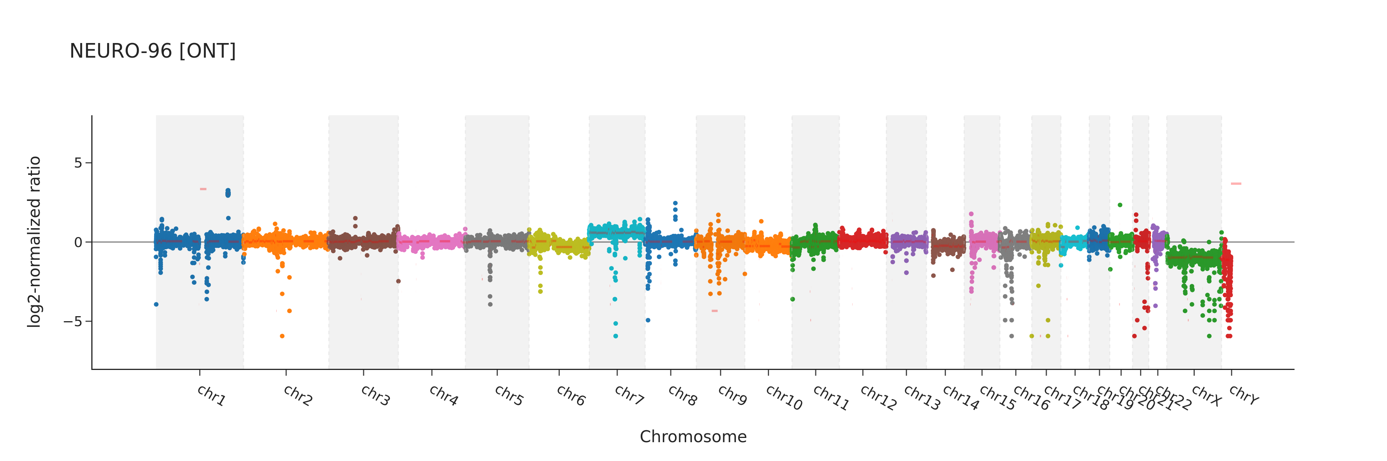
Supplementary Figure 21. Genome-wide copy-number variation (CNV) profiles for sample NEURO-96 generated using 5-base (upper panel) and ONT (lower panel) platforms. The x-axis represents genomic position ordered by chromosome (chr1–chrY), and the y-axis represents the log2-normalized ratio used for CNV assessment. Positive and negative deviations from zero indicate relative copy-number gains and losses, respectively.

Slide 22
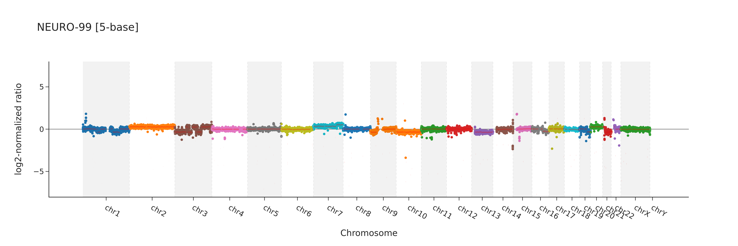
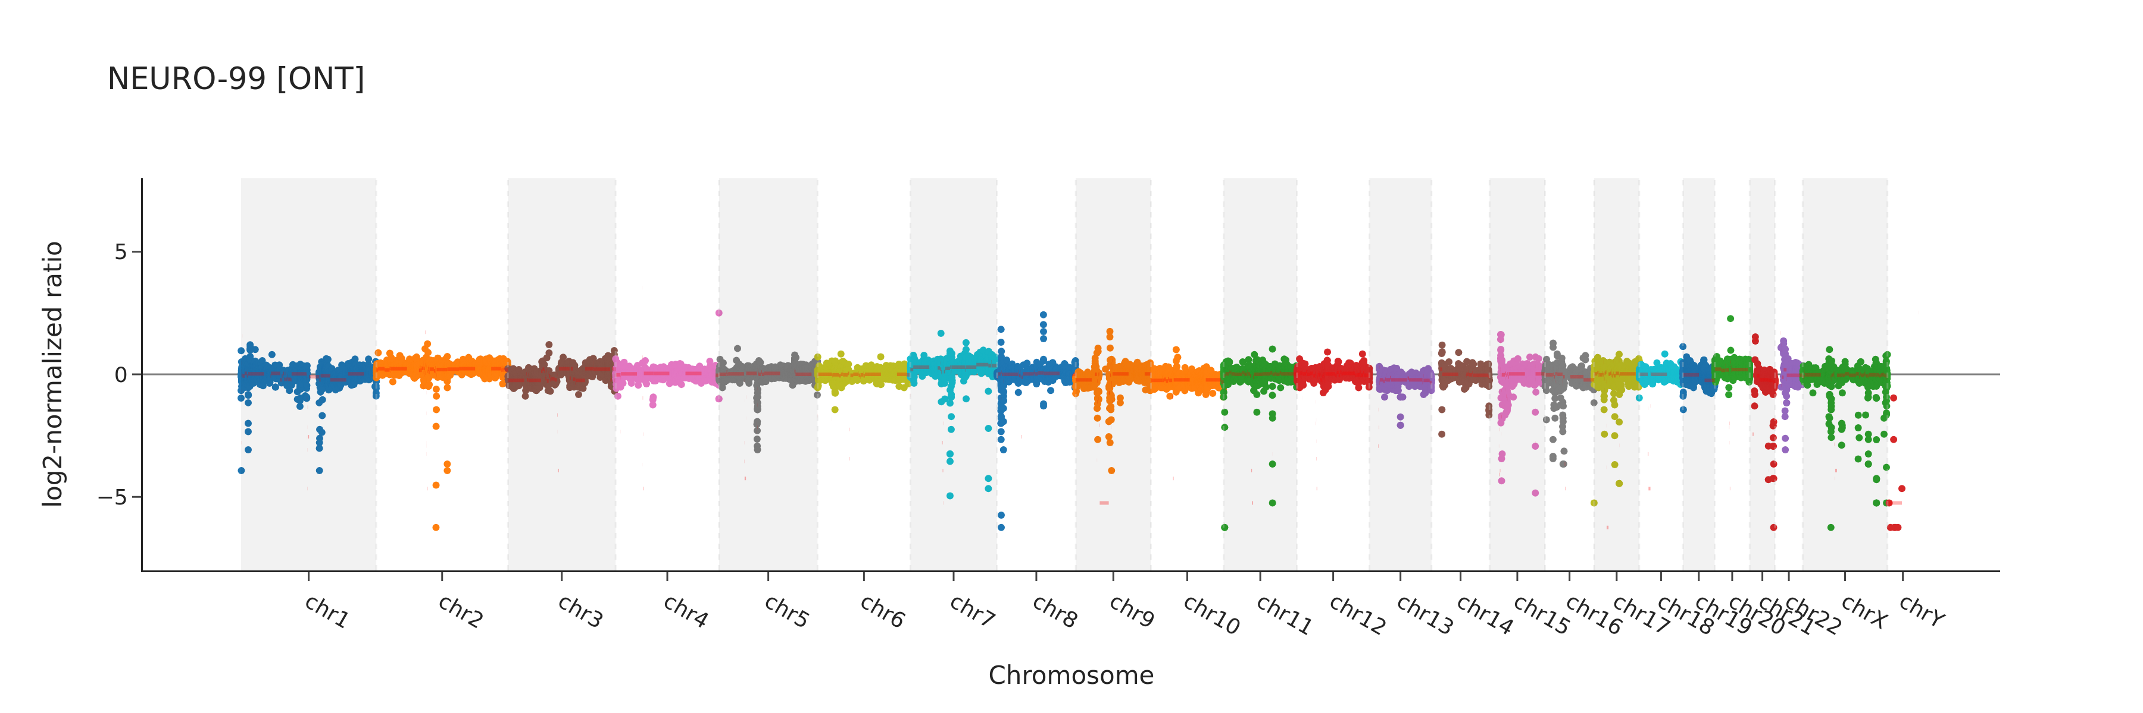
Supplementary Figure 22. Genome-wide copy-number variation (CNV) profiles for sample NEURO-99 generated using 5-base (upper panel) and ONT (lower panel) platforms. The x-axis represents genomic position ordered by chromosome (chr1–chrY), and the y-axis represents the log2-normalized ratio used for CNV assessment. Positive and negative deviations from zero indicate relative copy-number gains and losses, respectively.

Slide 23
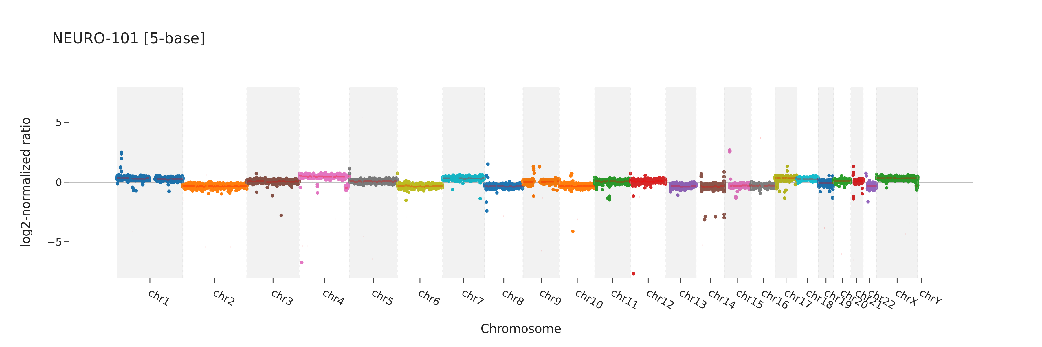
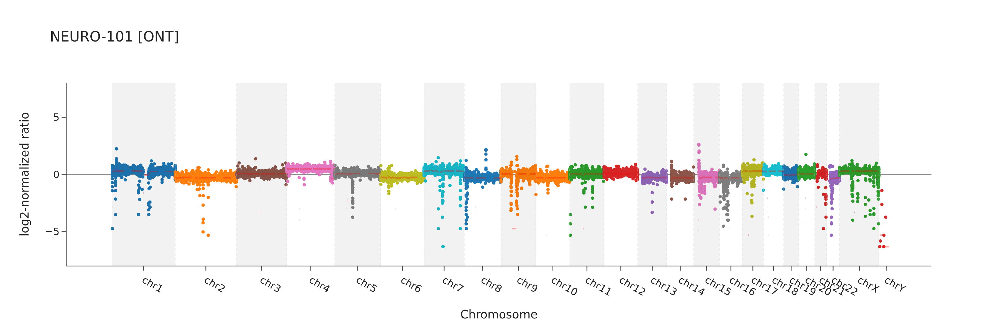
Supplementary Figure 23. Genome-wide copy-number variation (CNV) profiles for sample NEURO-101 generated using 5-base (upper panel) and ONT (lower panel) platforms. The x-axis represents genomic position ordered by chromosome (chr1–chrY), and the y-axis represents the log2-normalized ratio used for CNV assessment. Positive and negative deviations from zero indicate relative copy-number gains and losses, respectively.

Slide 24
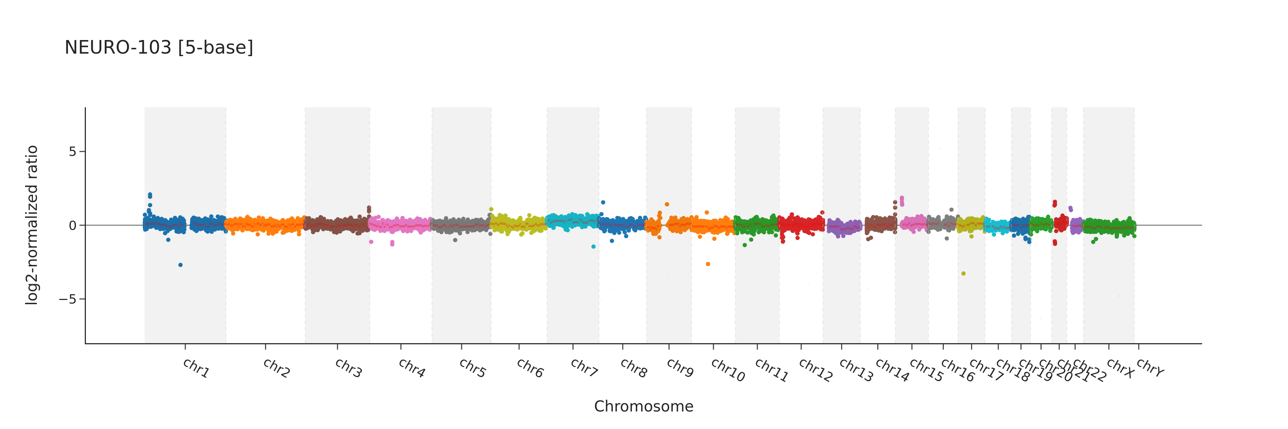
Supplementary Figure 24. Genome-wide copy-number variation (CNV) profile for sample NEURO-103 generated using 5-base platform. The x-axis represents genomic position ordered by chromosome (chr1–chrY), and the y-axis represents the log2-normalized ratio used for CNV assessment. Positive and negative deviations from zero indicate relative copy-number gains and losses, respectively.

Slide 25
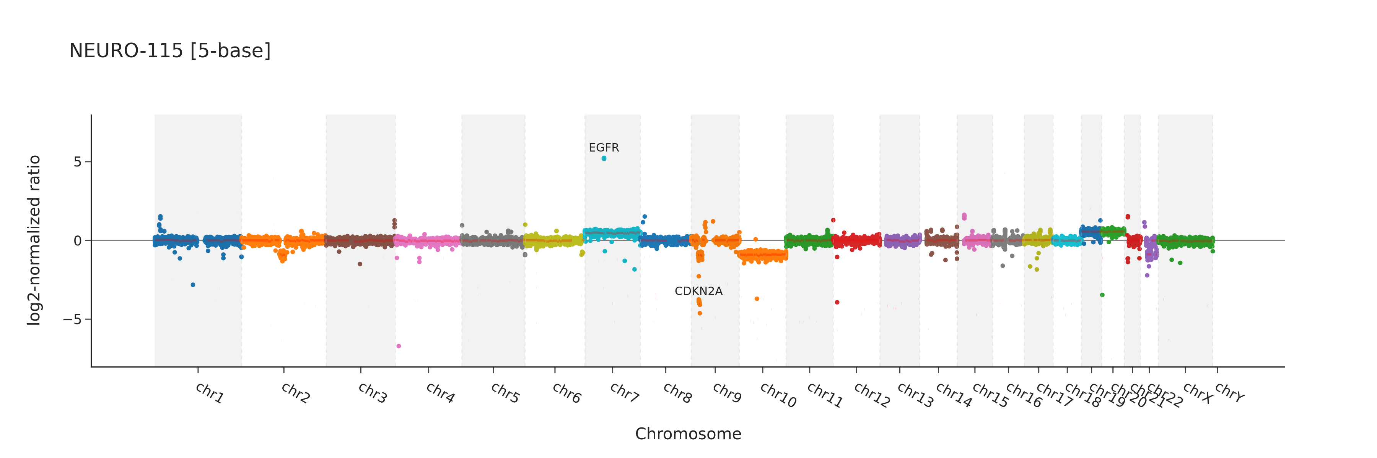
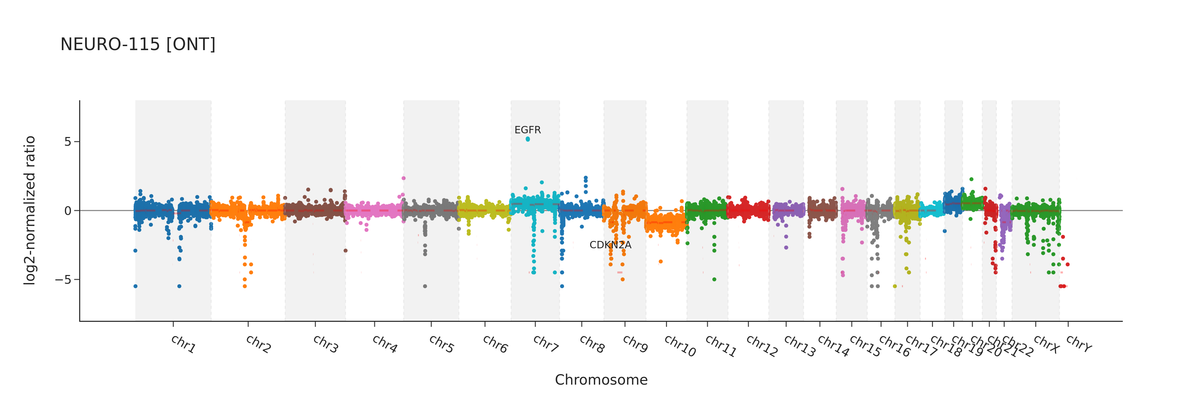
Supplementary Figure 25: Genome-wide copy-number variation (CNV) profiles for sample NEURO-115 generated using 5-base (upper panel) and ONT (lower panel) platforms. The x-axis represents genomic position ordered by chromosome (chr1–chrY), and the y-axis represents the log2-normalized ratio used for CNV assessment. Positive and negative deviations from zero indicate relative copy-number gains and losses, respectively.

Slide 26
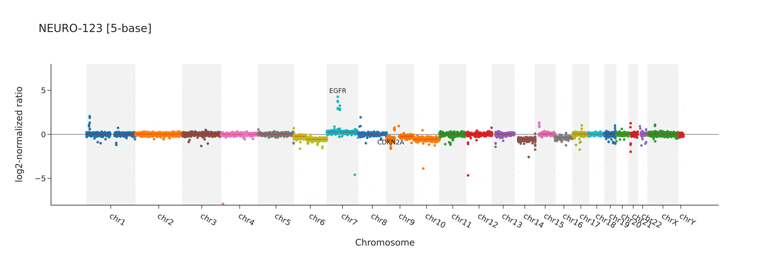
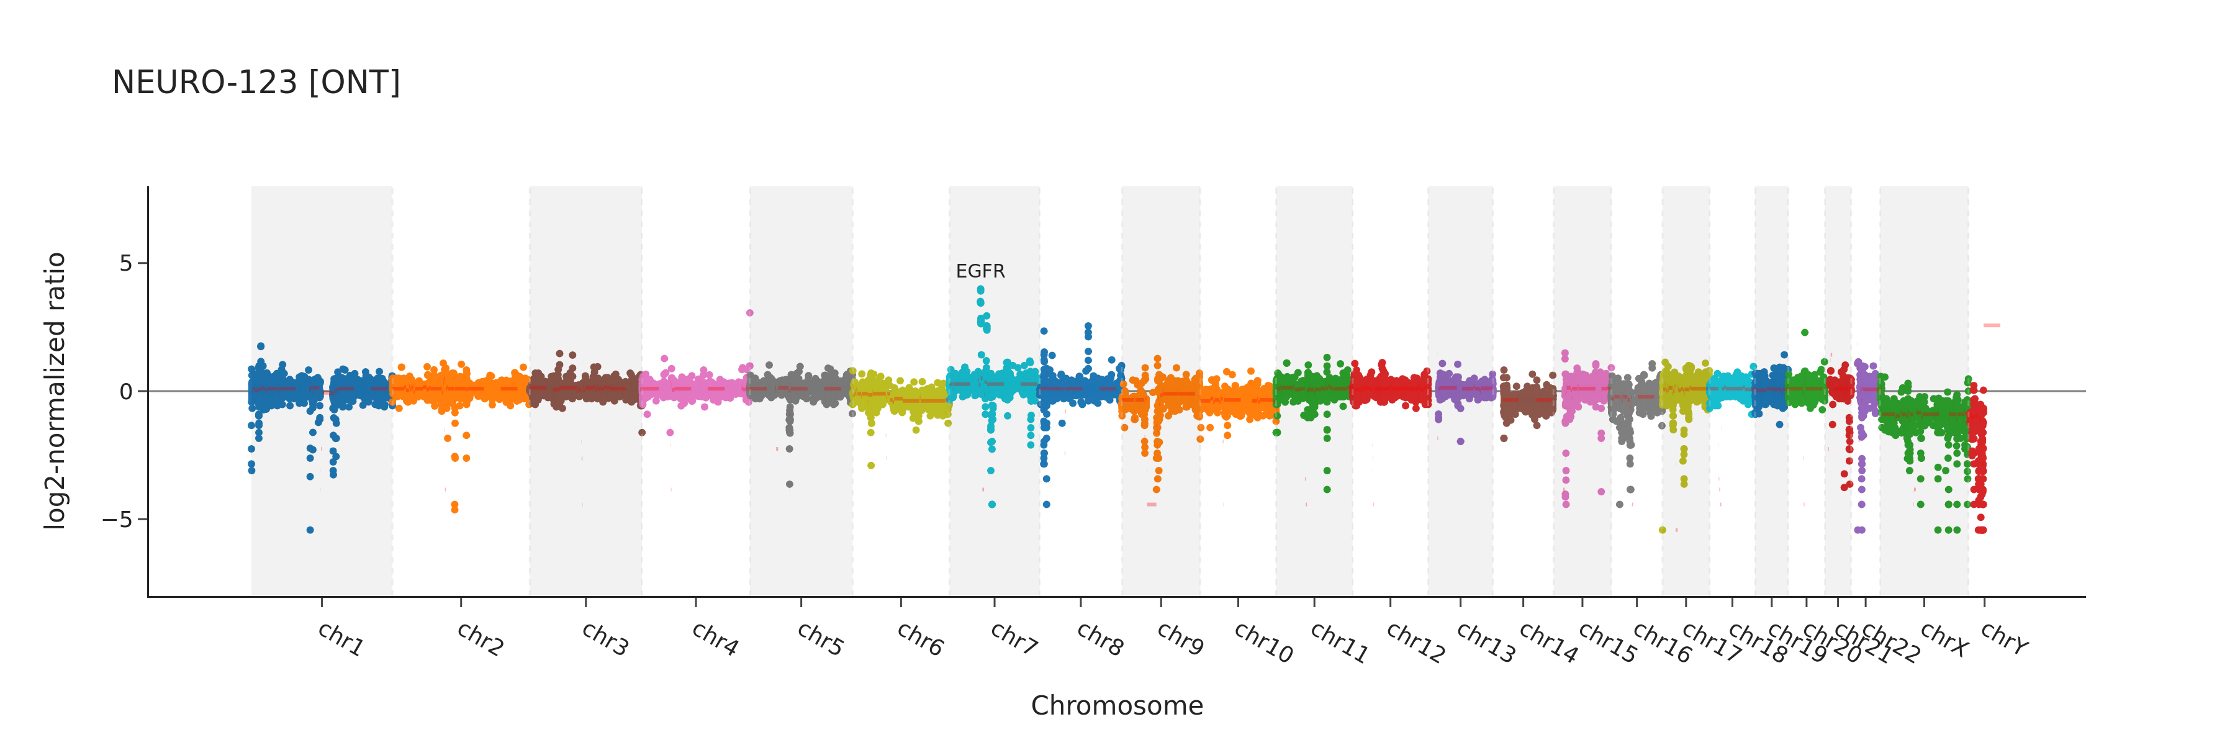
Supplementary Figure 26: Genome-wide copy-number variation (CNV) profiles for sample NEURO-123 generated using 5-base (upper panel) and ONT (lower panel) platforms. The x-axis represents genomic position ordered by chromosome (chr1–chrY), and the y-axis represents the log2-normalized ratio used for CNV assessment. Positive and negative deviations from zero indicate relative copy-number gains and losses, respectively.

Slide 27
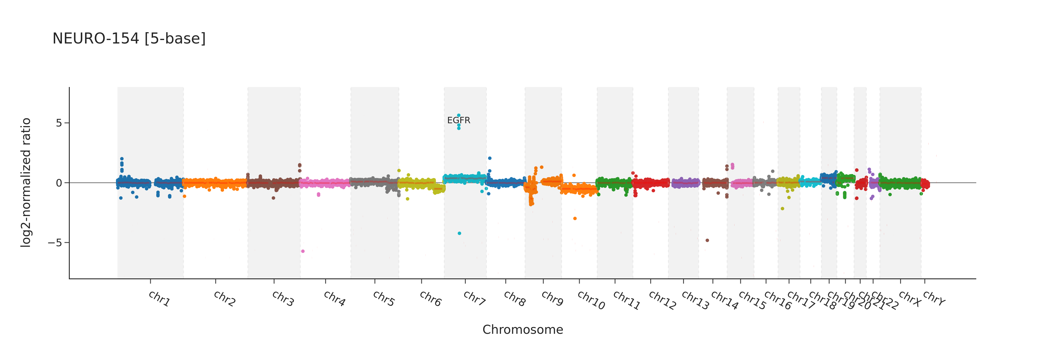
Supplementary Figure 27: Genome-wide copy-number variation (CNV) profile for sample NEURO-154 generated using 5-base platform. The x-axis represents genomic position ordered by chromosome (chr1–chrY), and the y-axis represents the log2-normalized ratio used for CNV assessment. Positive and negative deviations from zero indicate relative copy-number gains and losses, respectively.

Slide 28

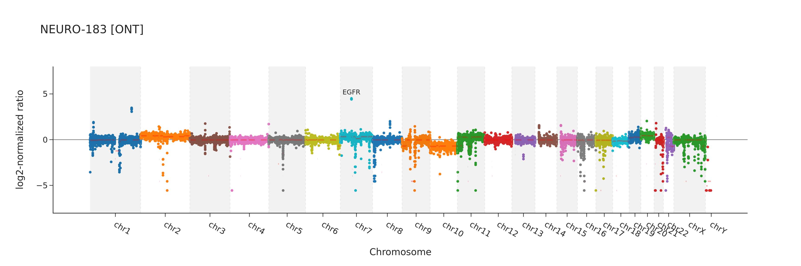
Supplementary Figure 28: Genome-wide copy-number variation (CNV) profiles for sample NEURO-183 generated using 5-base (upper panel) and ONT (lower panel) platforms. The x-axis represents genomic position ordered by chromosome (chr1–chrY), and the y-axis represents the log2-normalized ratio used for CNV assessment. Positive and negative deviations from zero indicate relative copy-number gains and losses, respectively.

Slide 29
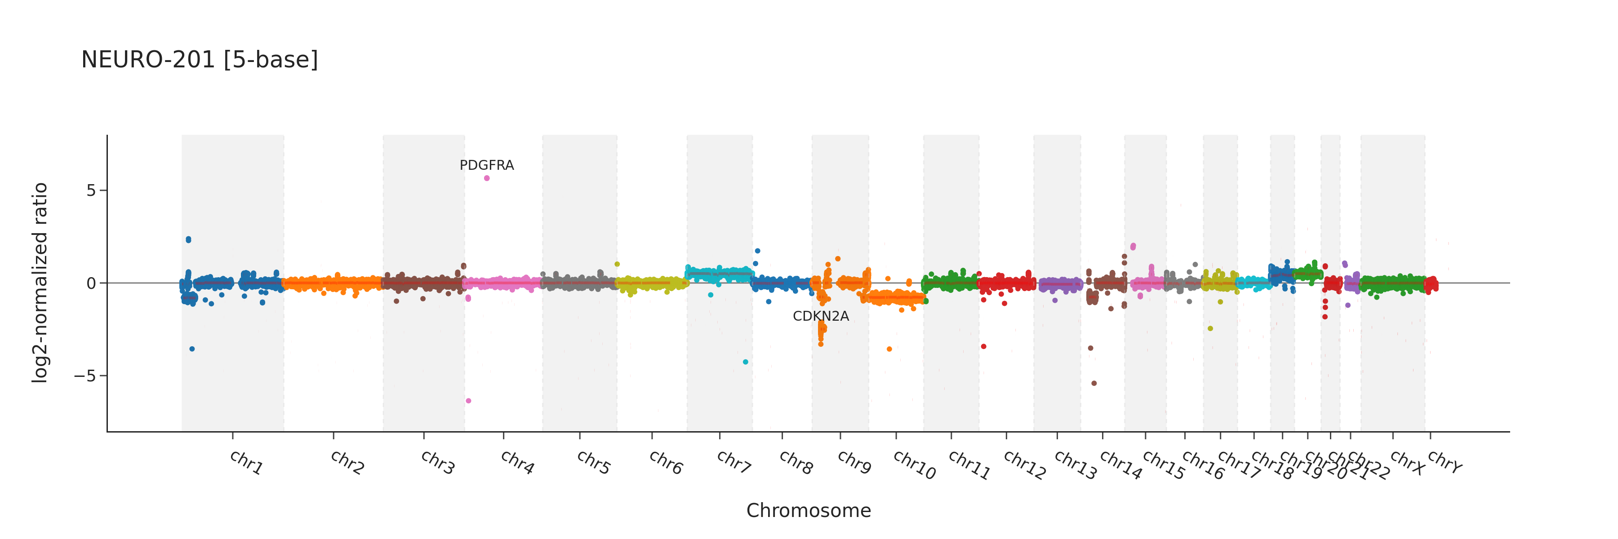
Supplementary Figure 29: Genome-wide copy-number variation (CNV) profile for sample NEURO-201 generated using 5-base platform. The x-axis represents genomic position ordered by chromosome (chr1–chrY), and the y-axis represents the log2-normalized ratio used for CNV assessment. Positive and negative deviations from zero indicate relative copy-number gains and losses, respectively.

Slide 30
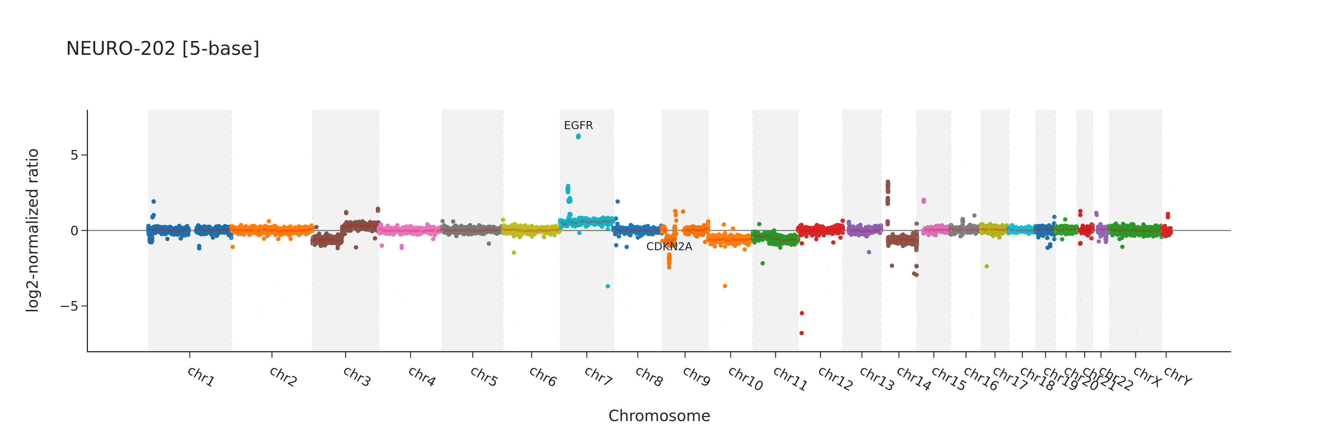
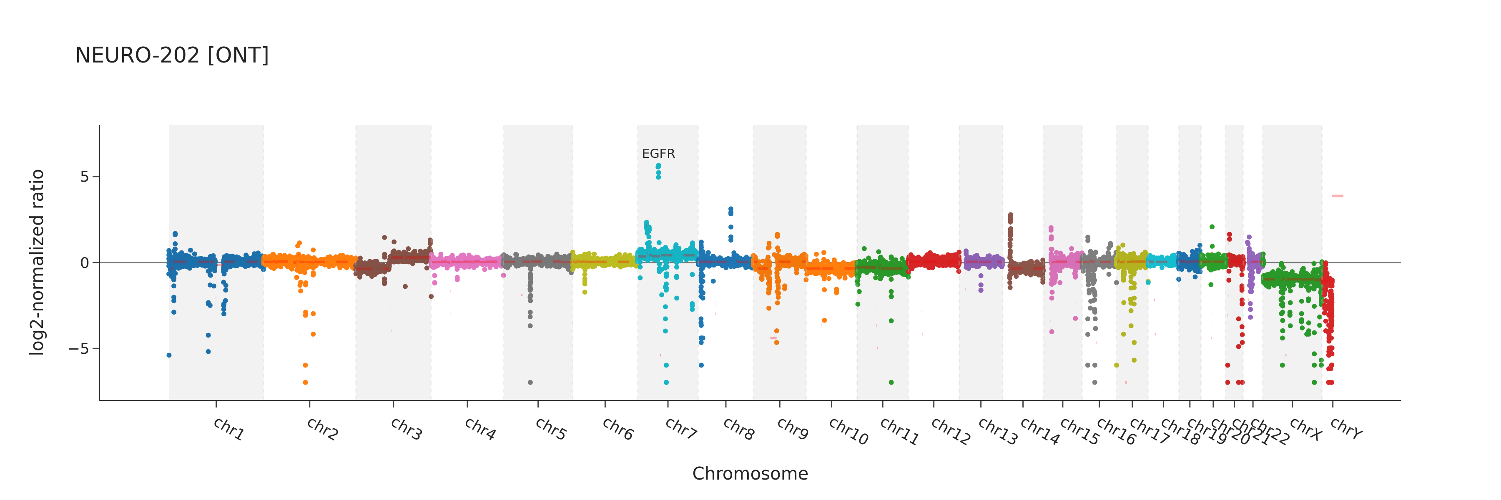
Supplementary Figure 30: Genome-wide copy-number variation (CNV) profiles for sample NEURO-202 generated using 5-base (upper panel) and ONT (lower panel) platforms. The x-axis represents genomic position ordered by chromosome (chr1–chrY), and the y-axis represents the log2-normalized ratio used for CNV assessment. Positive and negative deviations from zero indicate relative copy-number gains and losses, respectively.

Slide 31
Supplementary Figure 31: Figure displays 14 tracks representing DNA methylation levels assessed using 5-base for 14 samples classified as GBMs, within 23 kbp window centered around MGMT promoter. Sample NEURO-99 for which intermediate DNA methylation within MGMT promoter has been observed is marked with red color.

