Slide 1
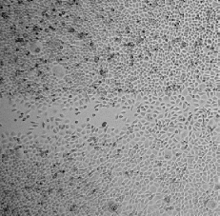
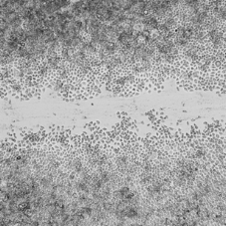
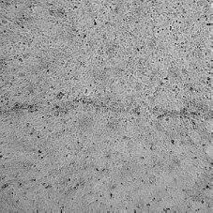
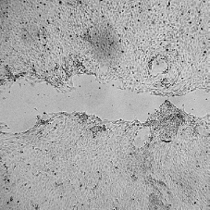
Supplementary Figure 1
a
Absorbance at 450 nm
b
CNT
MK-0429
RT7
SAS
*
RT7
Fold change of Wound Size
/ Original scratch
SAS
CNT
MK-0429
CNT
MK-0429

Slide 2
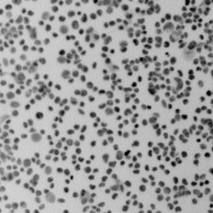
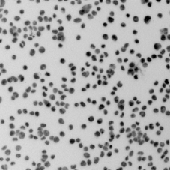
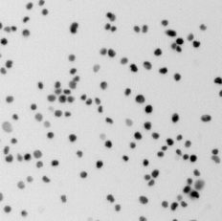
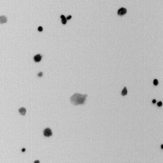
Supplementary Figure 1
c
MK-0429 (µM)
CNT
1.0
10
100
RT7
SAS
RT7
*
*
*
SAS
*
*
Attached cell number
(µM)

