Slide 1
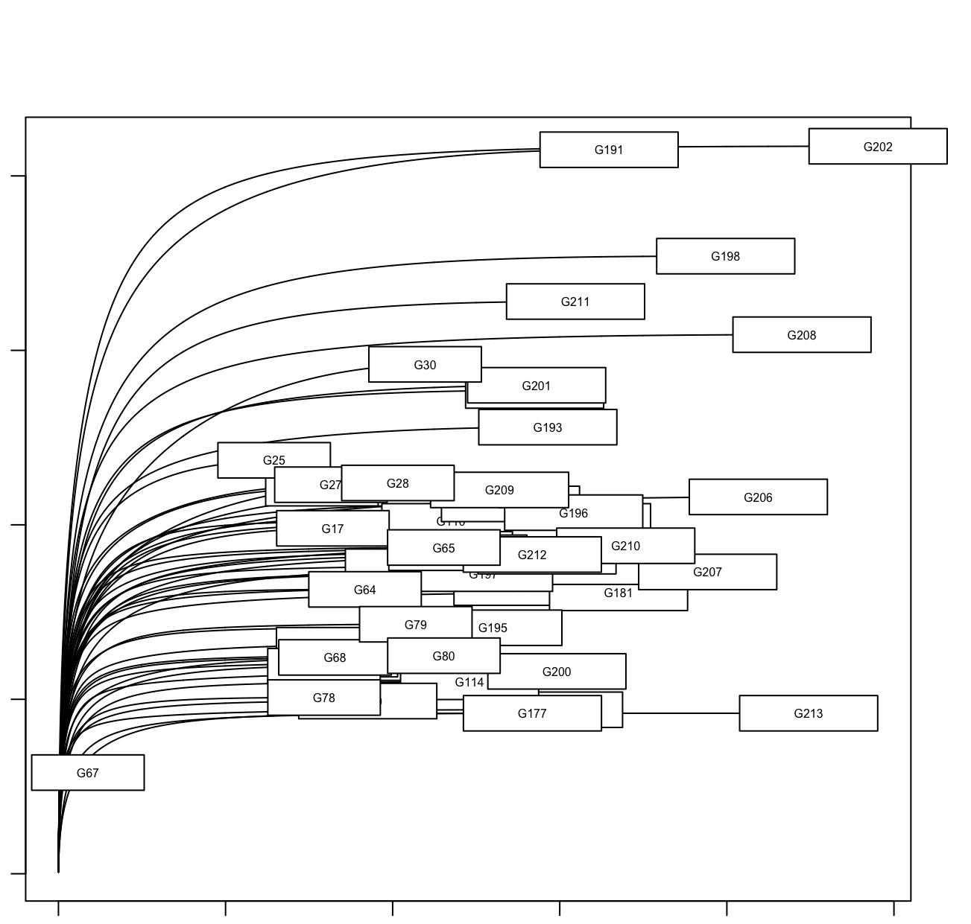
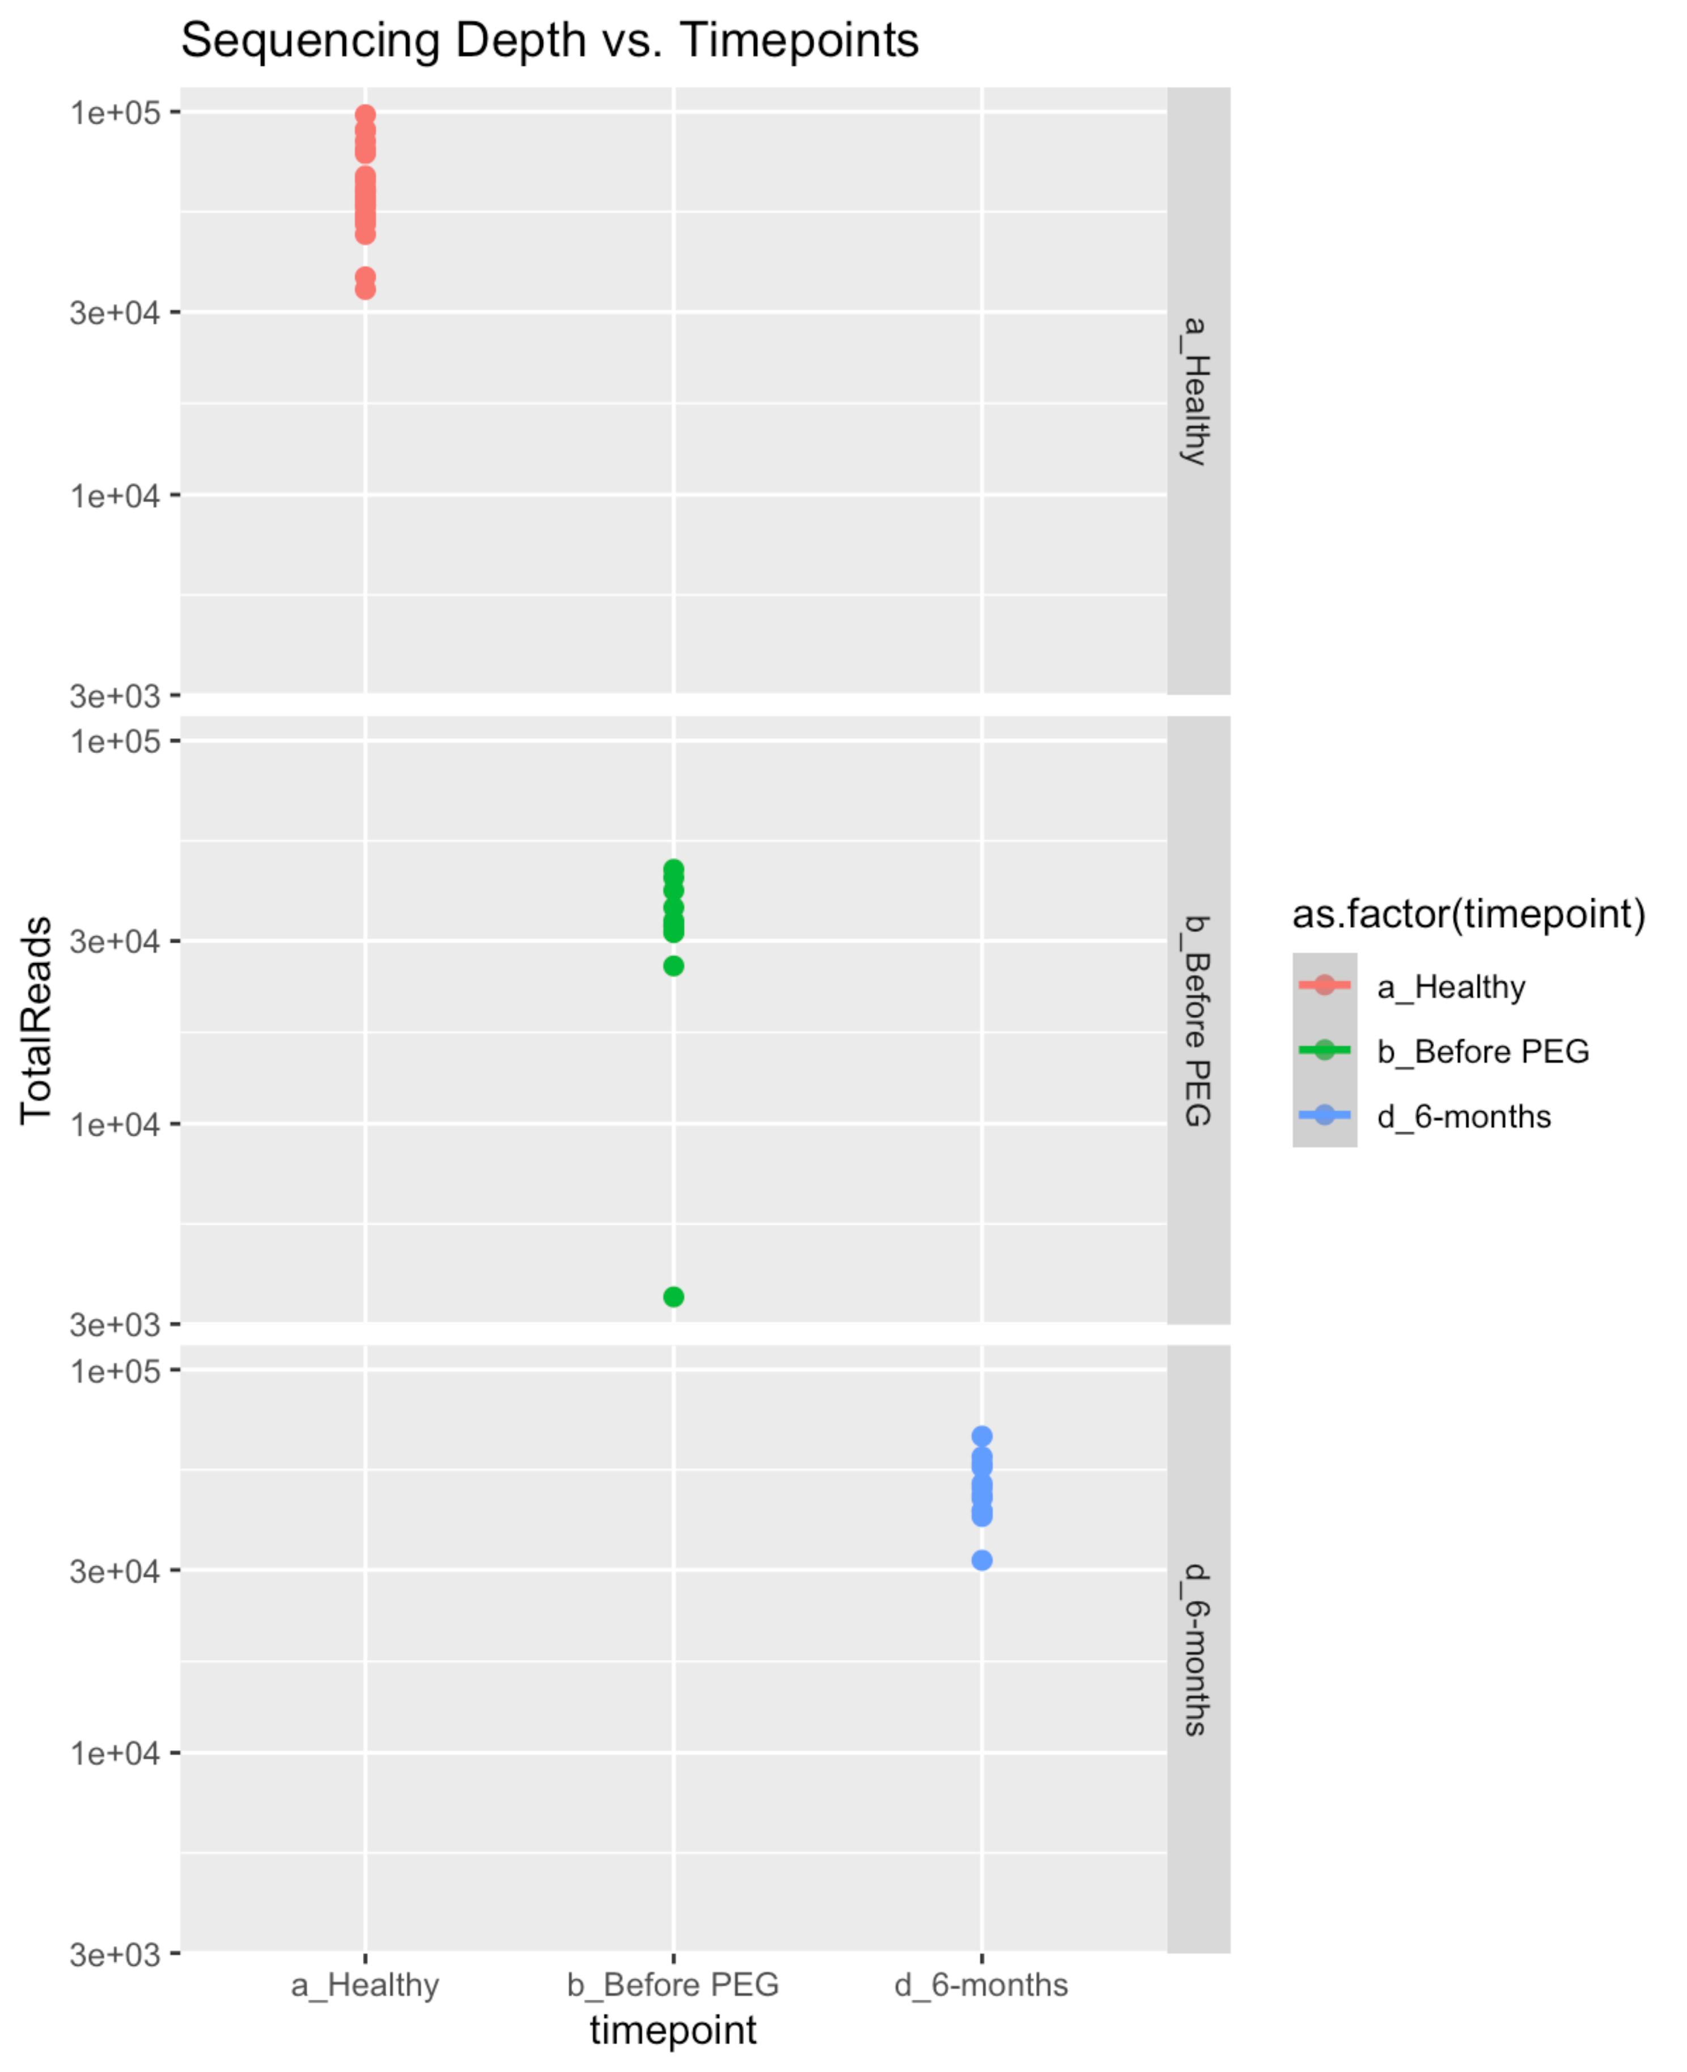
A
B
400
1e+05
300
3e+04
ASV
200
1e+04
100
0
3e+03
0e+00
2e+04
4e+04
6e+04
8e+04
1e+05
Non-cancer (NC)
CRC pre-op
CRC post-op
Sample size/#reads
Notes:
Supplementary Figure 1. Overview of raw sequencing reads. (A) Rarefaction curves of all samples sequenced, showing the number of ASVs observed at different sequencing depths. (B) Dot-plots showing sequencing depth across the samples groups.

