Slide 1

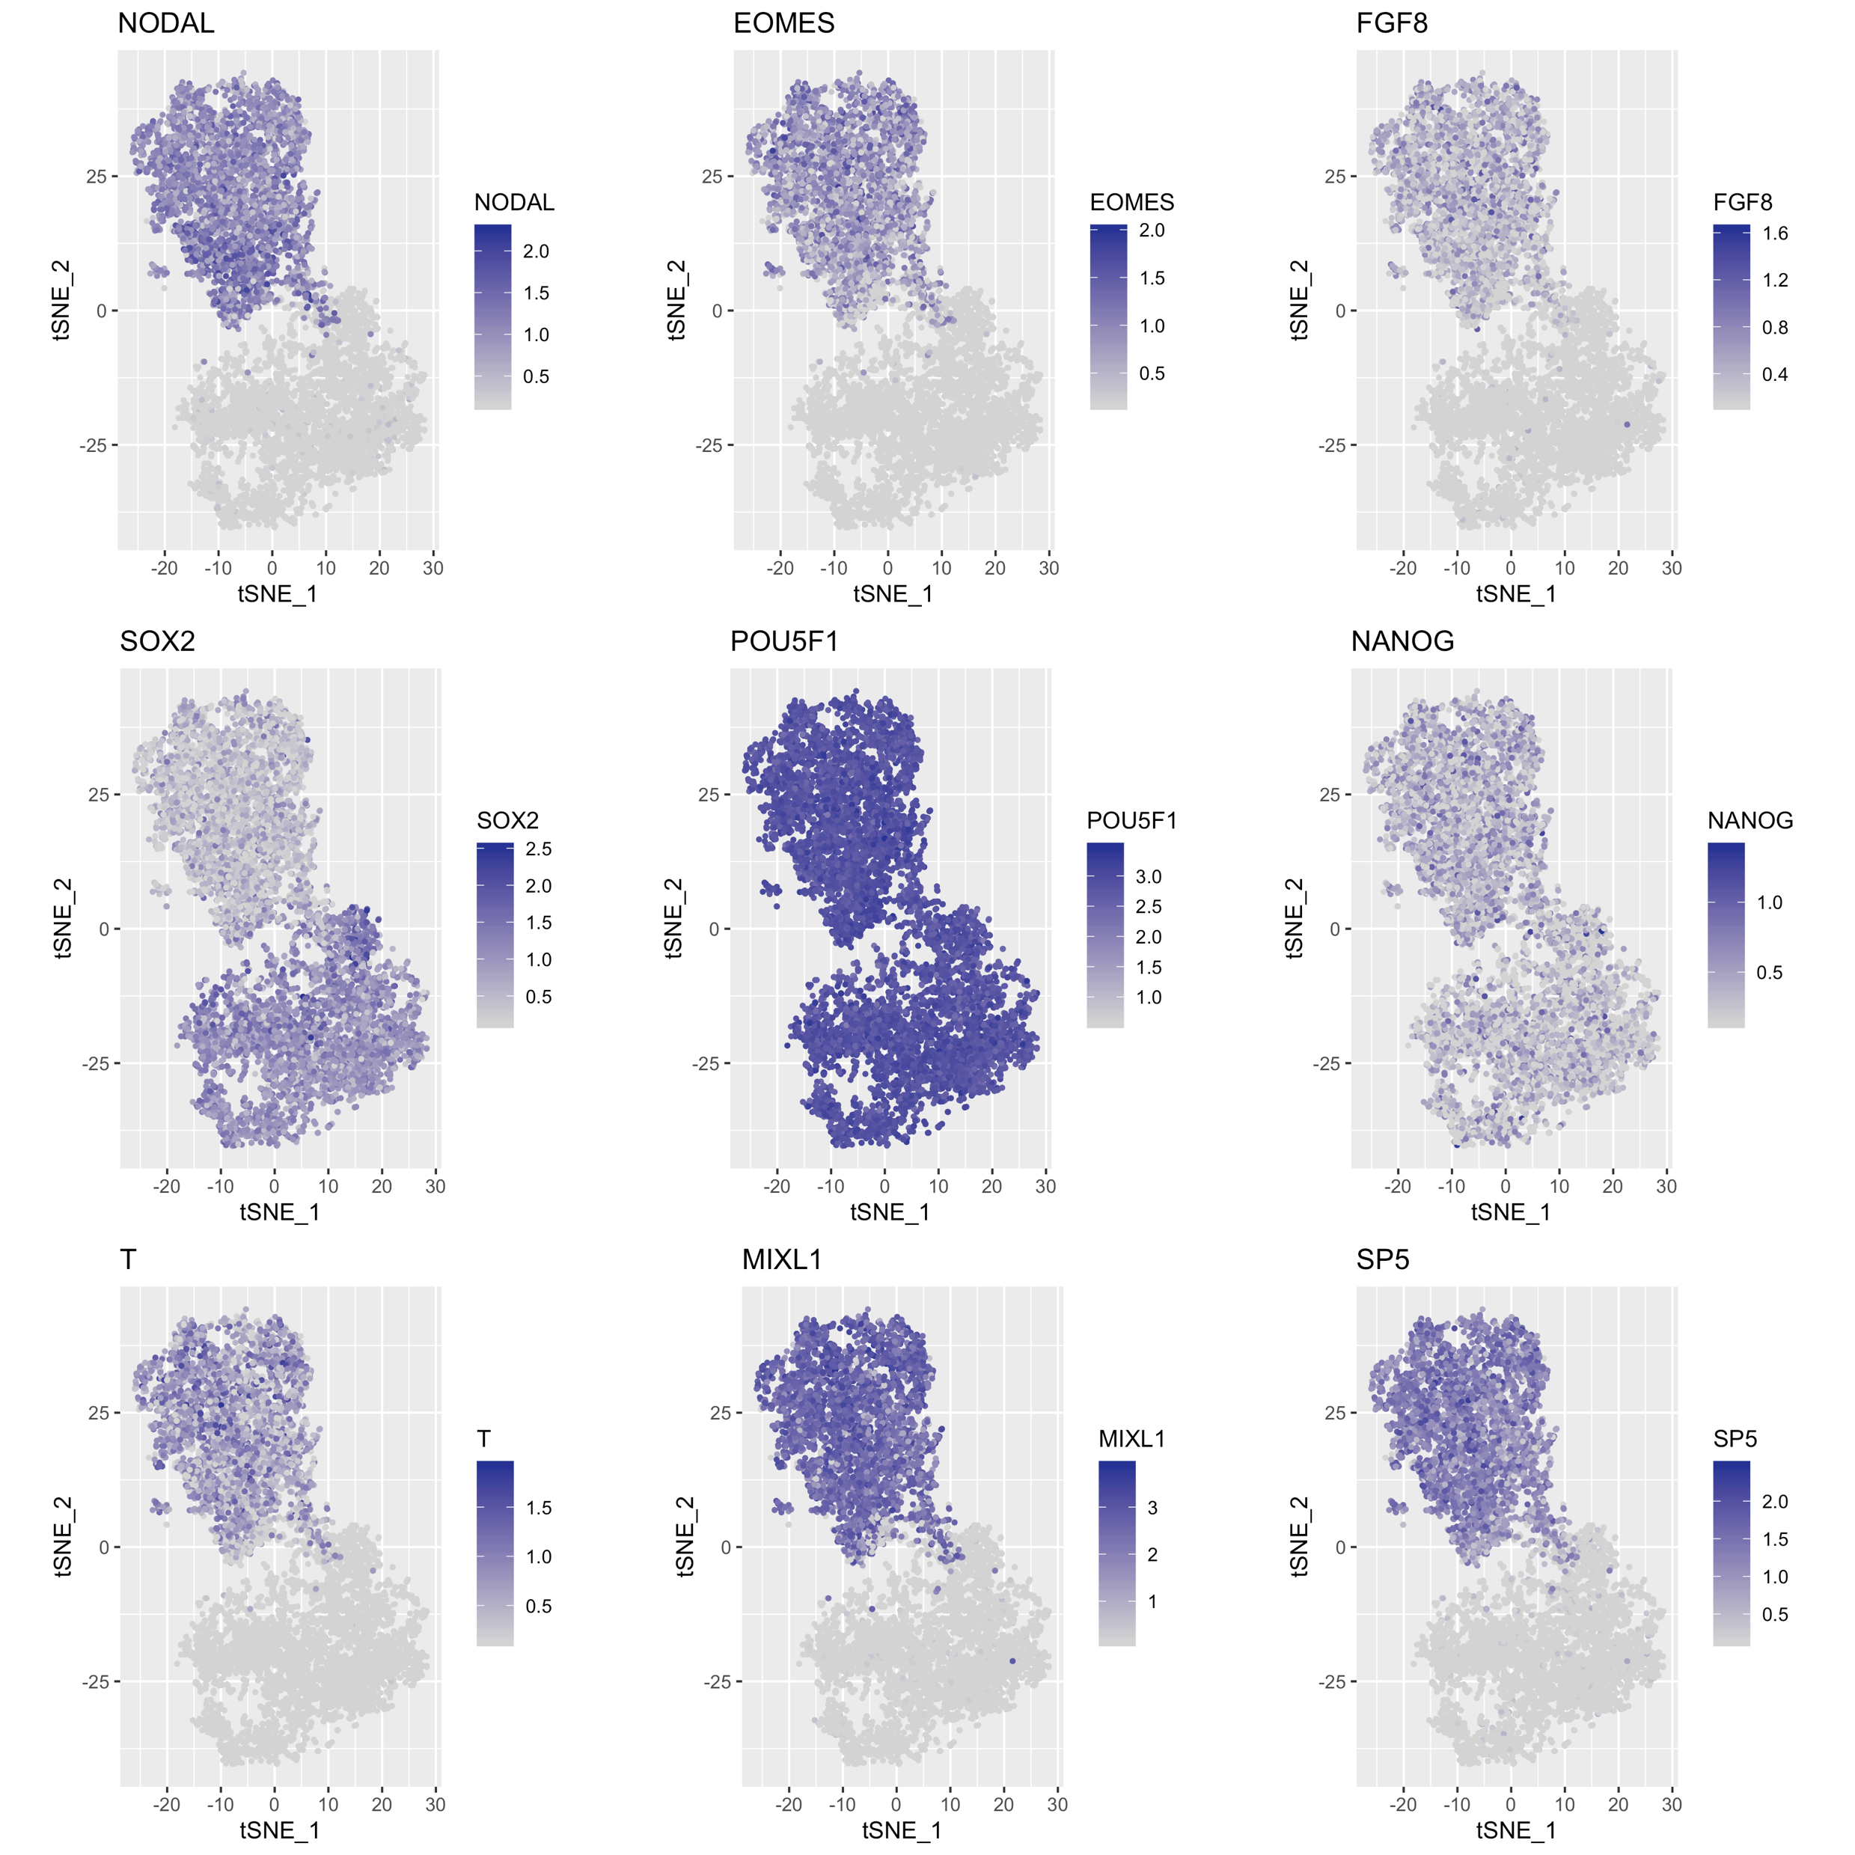
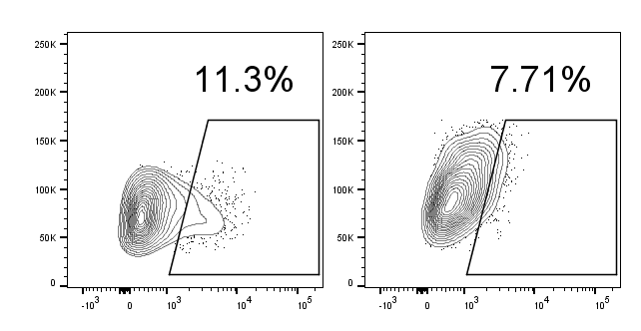
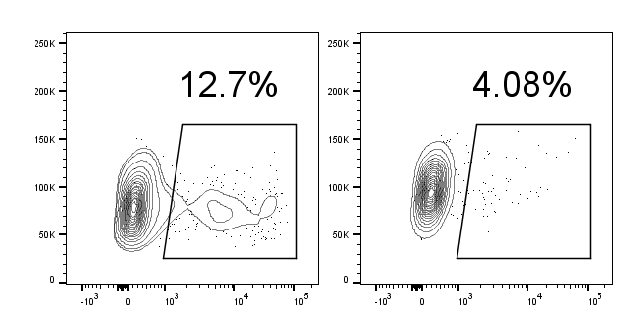
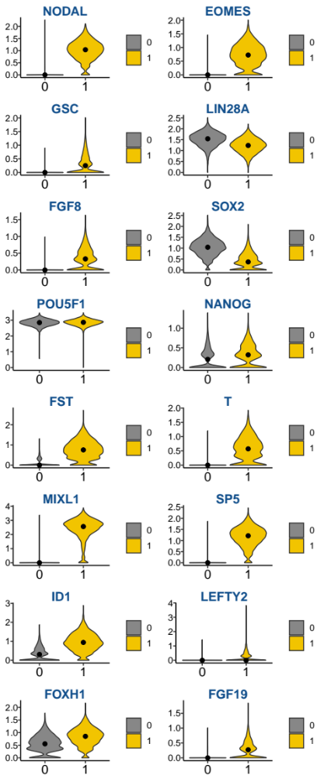
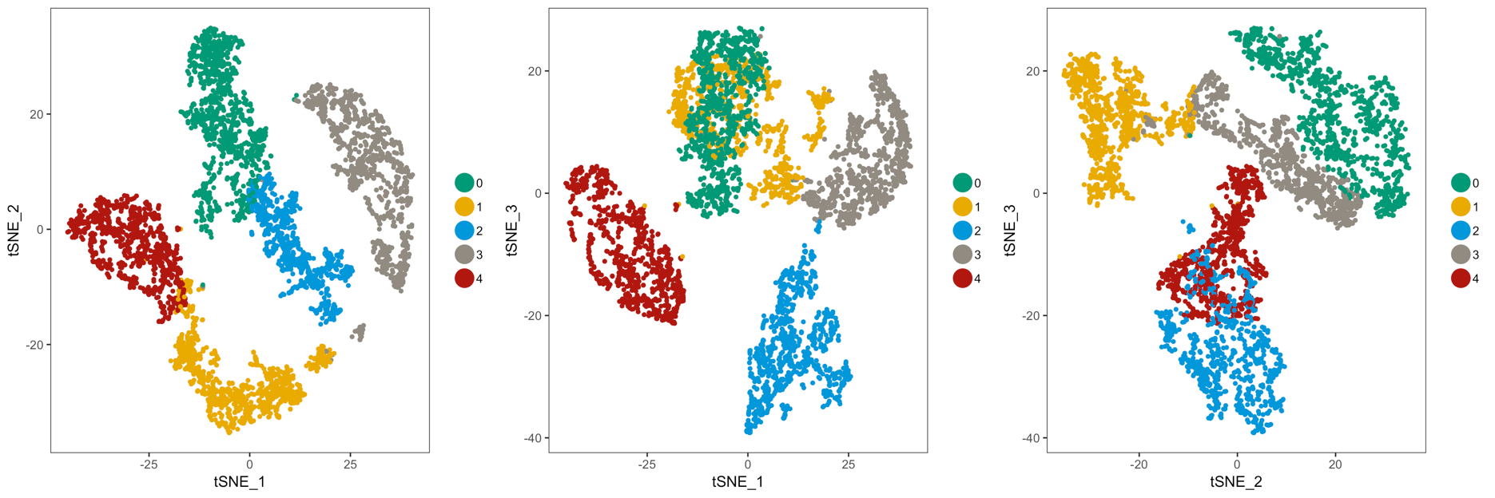
Fig. S1
A Prevailing protocols for human PGCLC specification
B Single-cell RNA-seq comparison of hPSCs vs. posterior epiblast
Sasaki et al., 2015; Kobayashi et al., 2017
Upregulated in posterior epiblast
NODAL
EOMES
FGF8
Phase I: Primitive streak media, 2D (TGFβ + WNT + Y27632), 12-42 hrs
Phase II: PGC media, 3D (BMP + SCF + EGF + LIF + Y27632), 4 days
Kobayashi et al., 2017
Sasaki et al., 2015
SSC-A
Upregulated in posterior epiblast
hPSC and posterior epiblast
NANOS3-mCherry
T/BRACHYURY
SP5
NANOG
SOX17-GFP
C hPSC vs. posterior epiblast comparison
ES
PE
ES
PE
ES
PE
ES
PE
ES
PE
ES
PE
Normalized expression (single cell-RNA-seq)
ES
PE
ES
PE
ES
PE
ES
PE
ES
PE
ES
PE
ES
PE
ES
PE
ES
PE
ES
PE
Notes:
Figure S1. Flow cytometry analysis of fluorescent reporter expression during differentiation of WIS1 NANOS3-mCherry hESCs and H9 SOX17-GFP hESCs differentiated using previously-published protocols (Kobayashi et al., 2017; Sasaki et al., 2015)

Slide 2
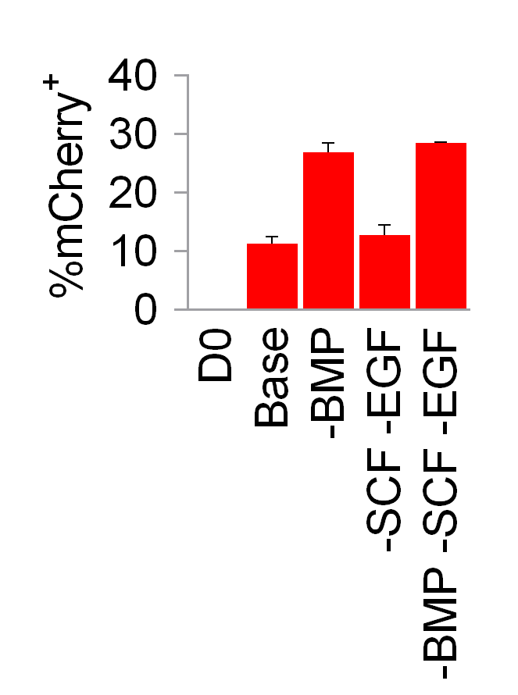
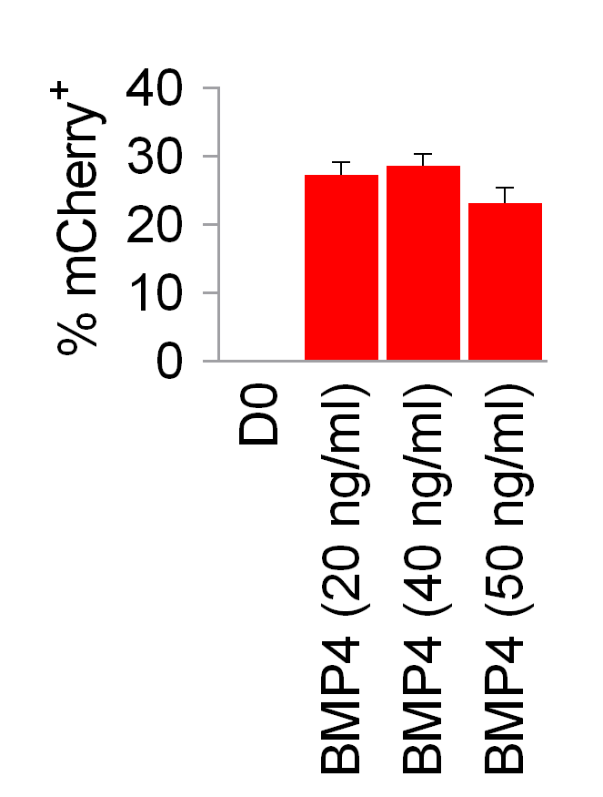
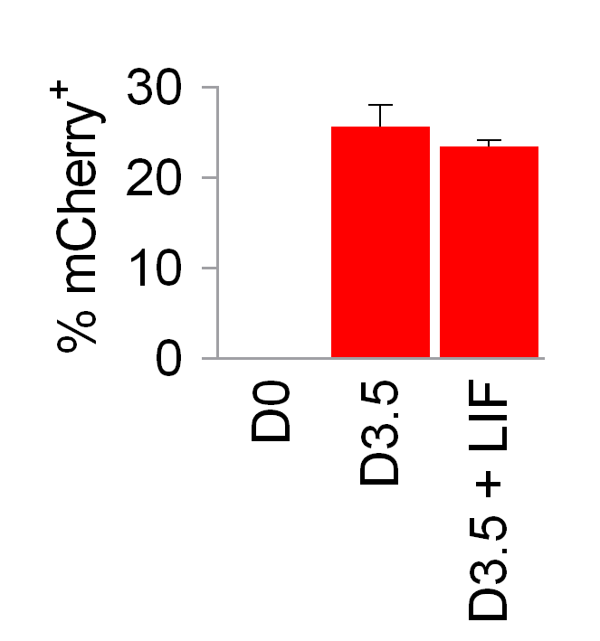
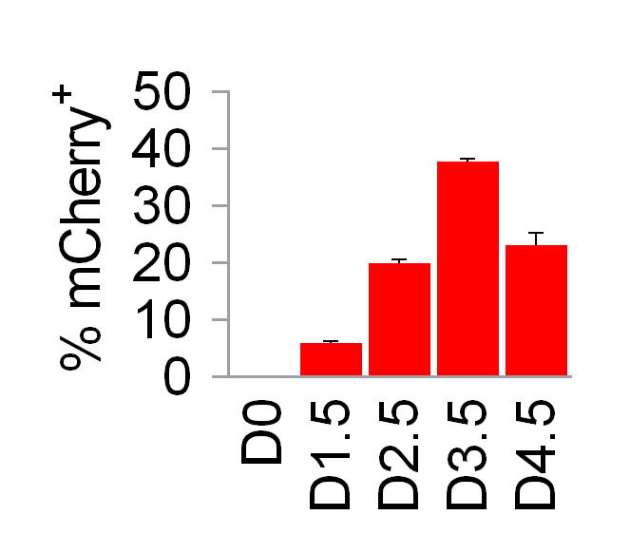
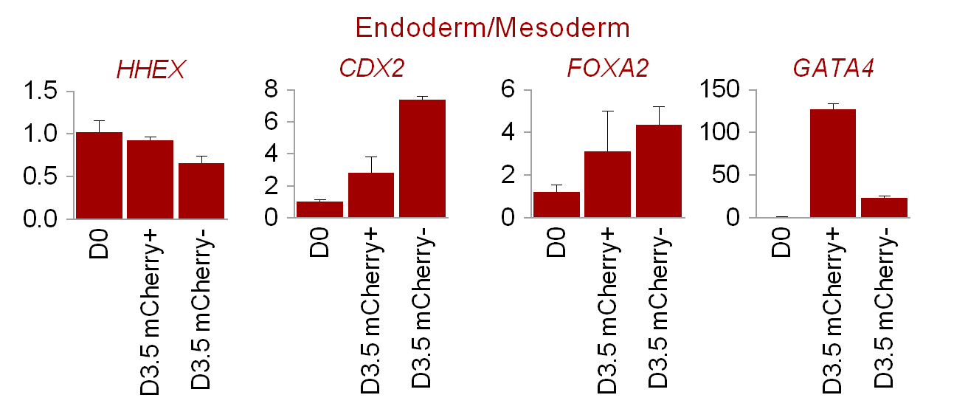
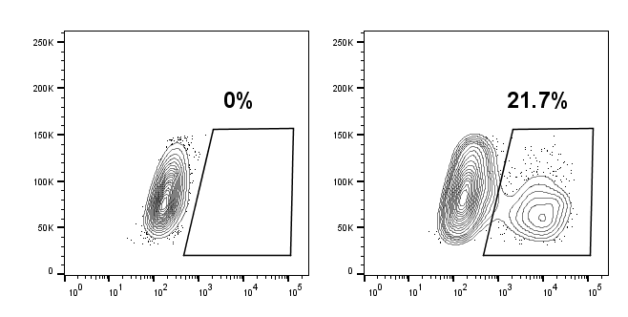
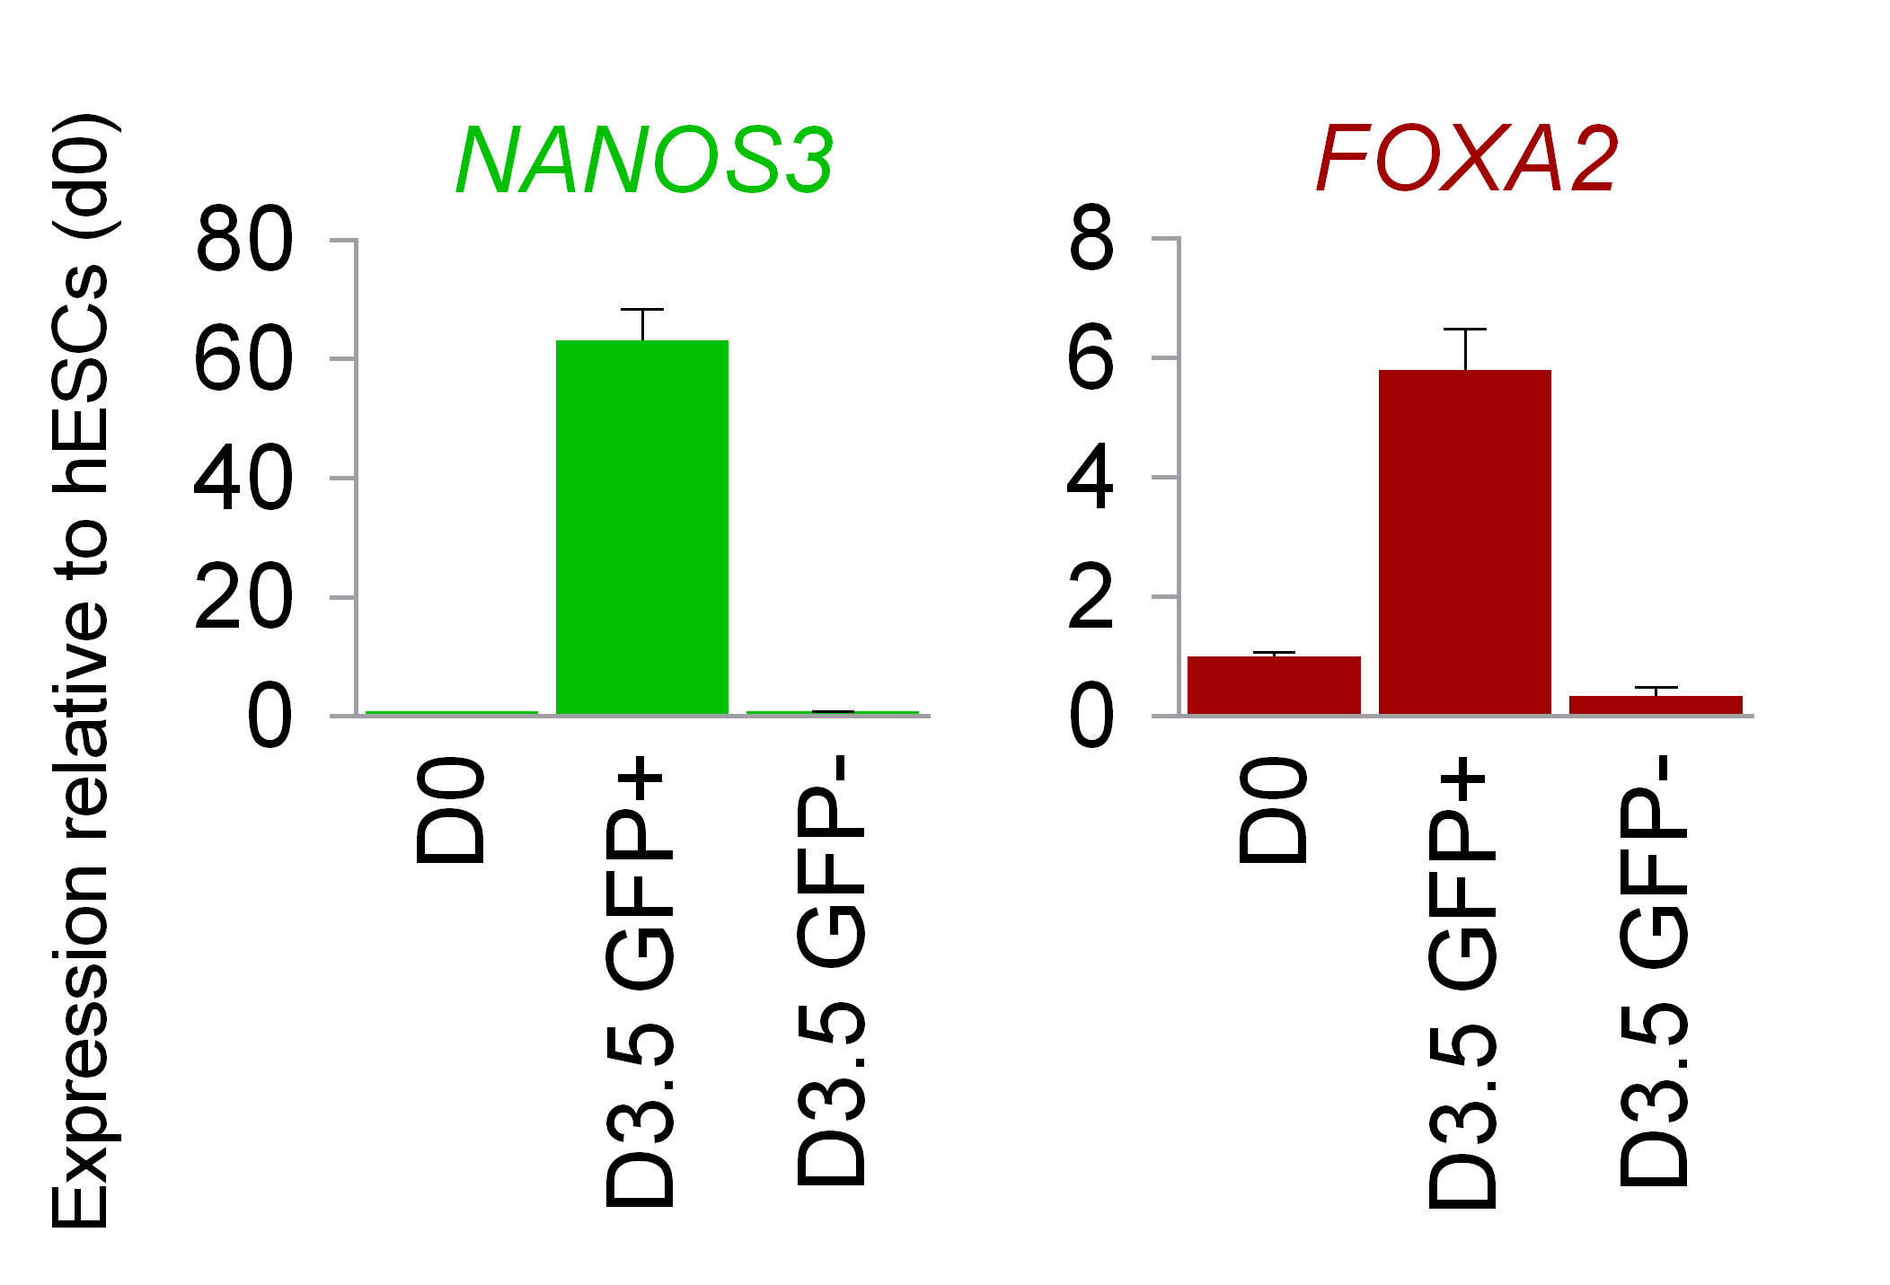
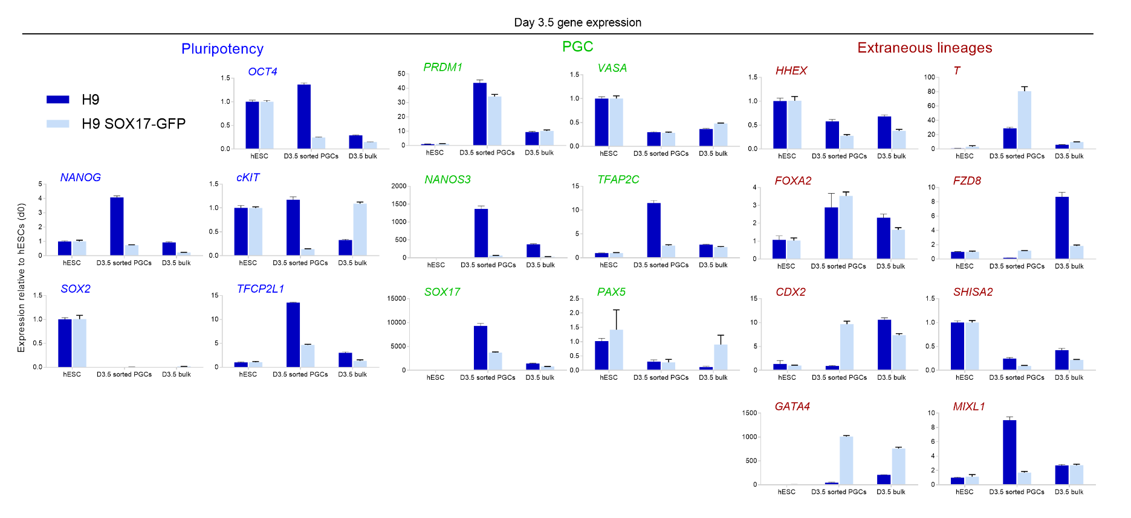
Fig. S2
A SCF and EGF are dispensable on the D0.5-D1.5 interval
B Low BMP doses needed for monolayer differentiation
ACY
D0
ACY
D0
BMP/
SCF/
EGF/
XAV939/Y-27632
and/or
D0.5-D1.5
-SCF -EGF
and/or D1.5-D2.5
-BMP4
D0.5
BMP4 (20/40/50 ng/ml)/
SCF/
EGF/
XAV939/Y-27632
D0.5
-SCF
-EGF
D1.5
D1.5
D2.5
-BMP4
D2.5
D3.5
D3.5
C LIF is dispensable for the second differentiation stage
D 3 days are optimal for the second differentiation stage
ACY
D0
D0
D0.5
ACY
BMP4 20/
SCF/
EGF/
XAV939/Y-27632 +/- LIF
D1.5
BMP4 20/
SCF/
EGF/
XAV939/Y-27632
D0.5
D1.5
D2.5
D2.5
D3.5
D3.5
D4.5
E hPSC-derived NANOS3-mCherry⁺ PGCs do not express other markers
F Generating SOX17-GFP⁺ PGCs from hPSCs
qPCR of FACS-sorted D3.5 cells
D0 hPSCs
D3.5 differentiated
HHEX
CDX2
FOXA2
GATA4
SSC-A
Expression relative to day 0 hESCs (qPCR)
SOX17-GFP
G Loss of one SOX17 allele in the SOX17-GFP reporter line partially impairs PGC specification
Notes:
Figure S1. In vitro monolayer induction of primordial germ cells.
Optimizations of in vitro monolayer PGC induction evaluated with NANOS3-mCherry reporter expression readout.
WNT inhibition via XAV939 from D0.5 to D3.5 (in the context of BMP4 + SCF +EGF+ Y-27632) enhances efficiency.
Culturing cells in monolayer from D0.5 to 3.5 instead of in embryoid bodies as described previously results in minimal loss of efficiency.
In the context of BMP4 + SCF + EGF + XAV939 +Y-27632 from D0.5-3.5, BMP4 subtraction from D1.5-2.5 and SCF/EGF subtraction from D0.5-1.5 both enhance efficiency.
BMP4 can be titrated to 20 ng/ml with negligible loss in efficiency.
Addition of LIF during D0.5-3.5 does not improve efficiency.
mCherry expression peaks on D3.5 of differentiation.
Confirmation of Kobayashi et al., 2017 that posterior epiblast induction is optimized at 12hr length.
Y-27632, but not alternative ROCK inhibitors, increases induction efficiency.

Slide 3
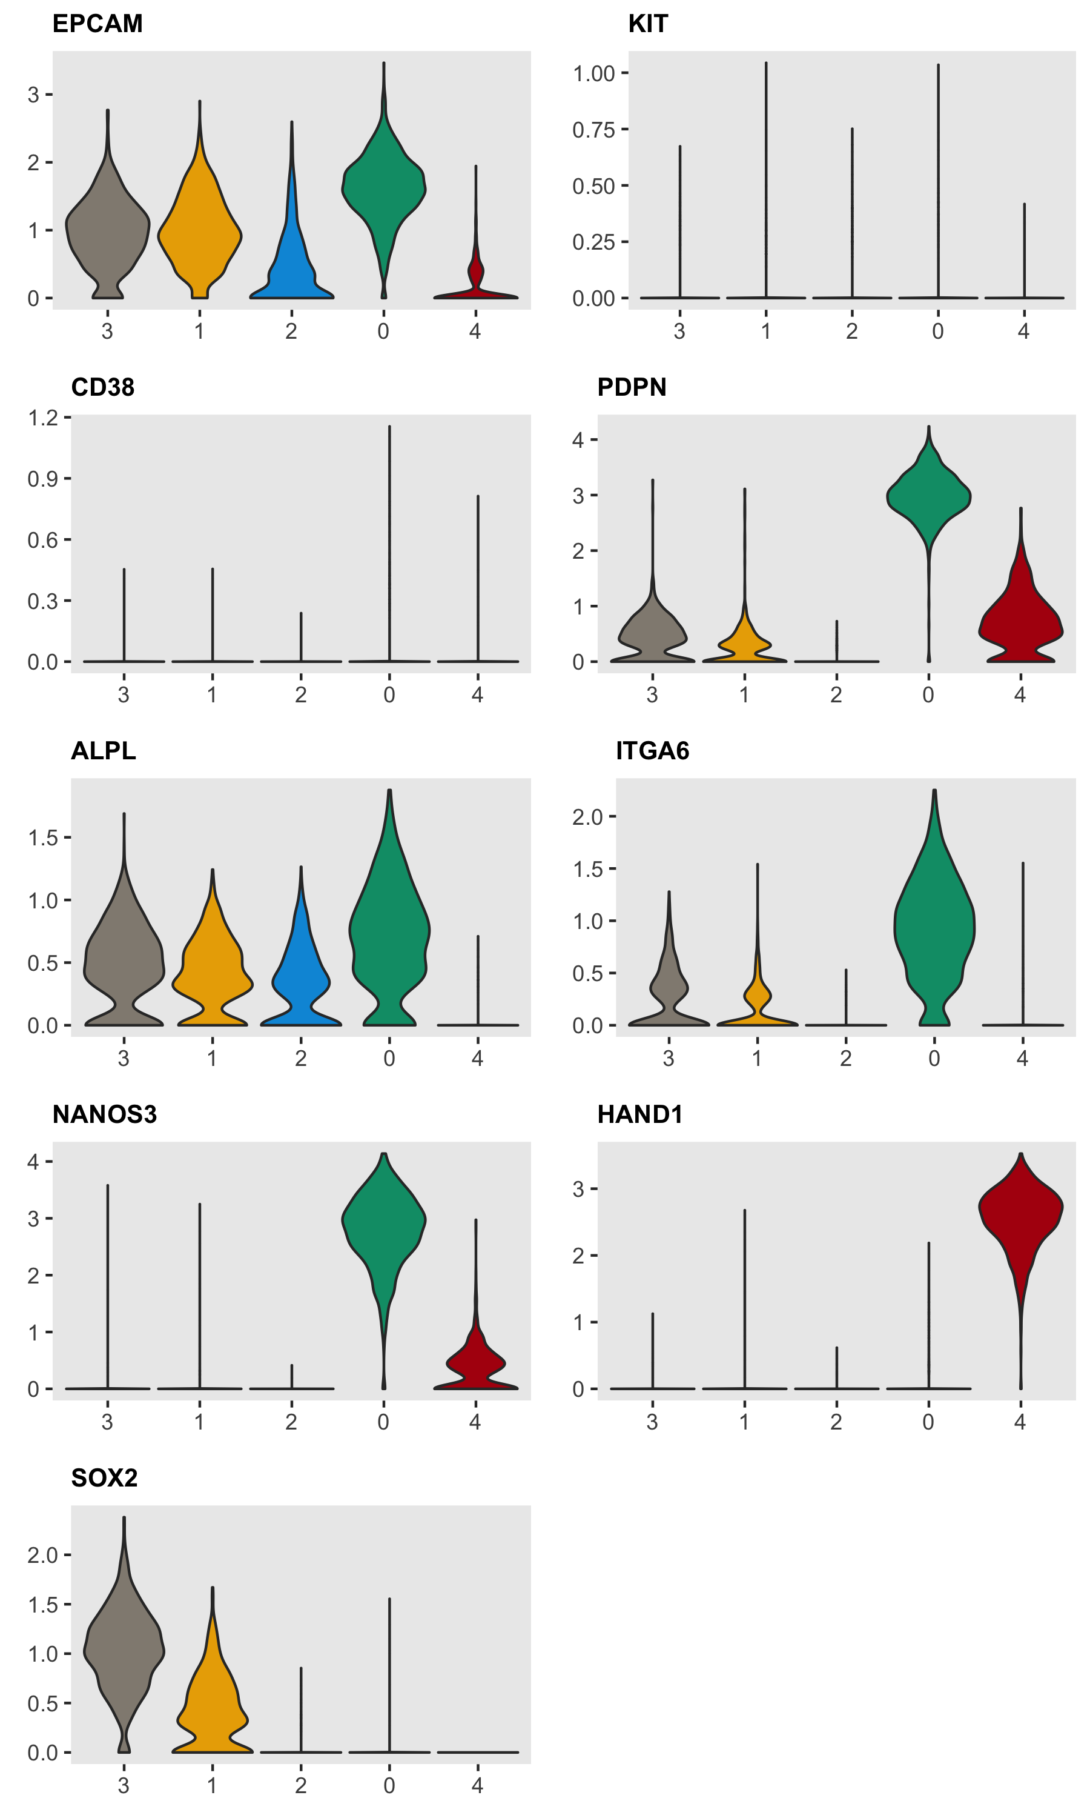
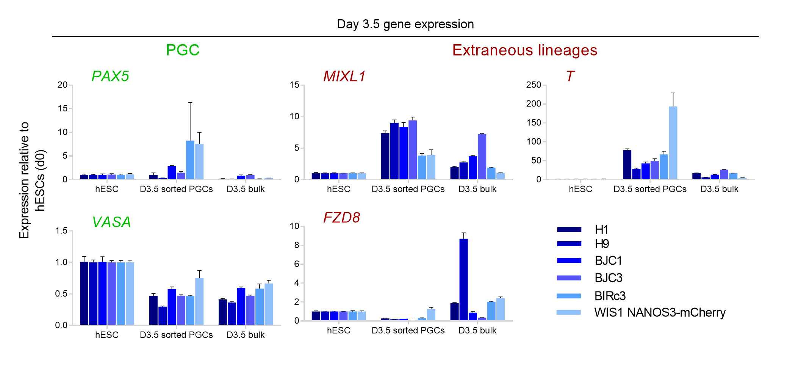
Fig. S3
A Multiple PGCLC cell-surface markers are expressed in undifferentiated hPSCs
EPCAM
KIT
ITGA6
ES
PE
En
PGC
Me
ES
PE
En
PGC
Me
ES
PE
En
PGC
Me
Normalized expression (single-cell RNA-seq)
CD38
PDPN
TNAP/ALPL
ES
PE
En
PGC
Me
ES
PE
En
PGC
Me
ES
PE
En
PGC
Me
B PGCs generated from multiple hPSC lines display appropriate marker expression

Slide 4
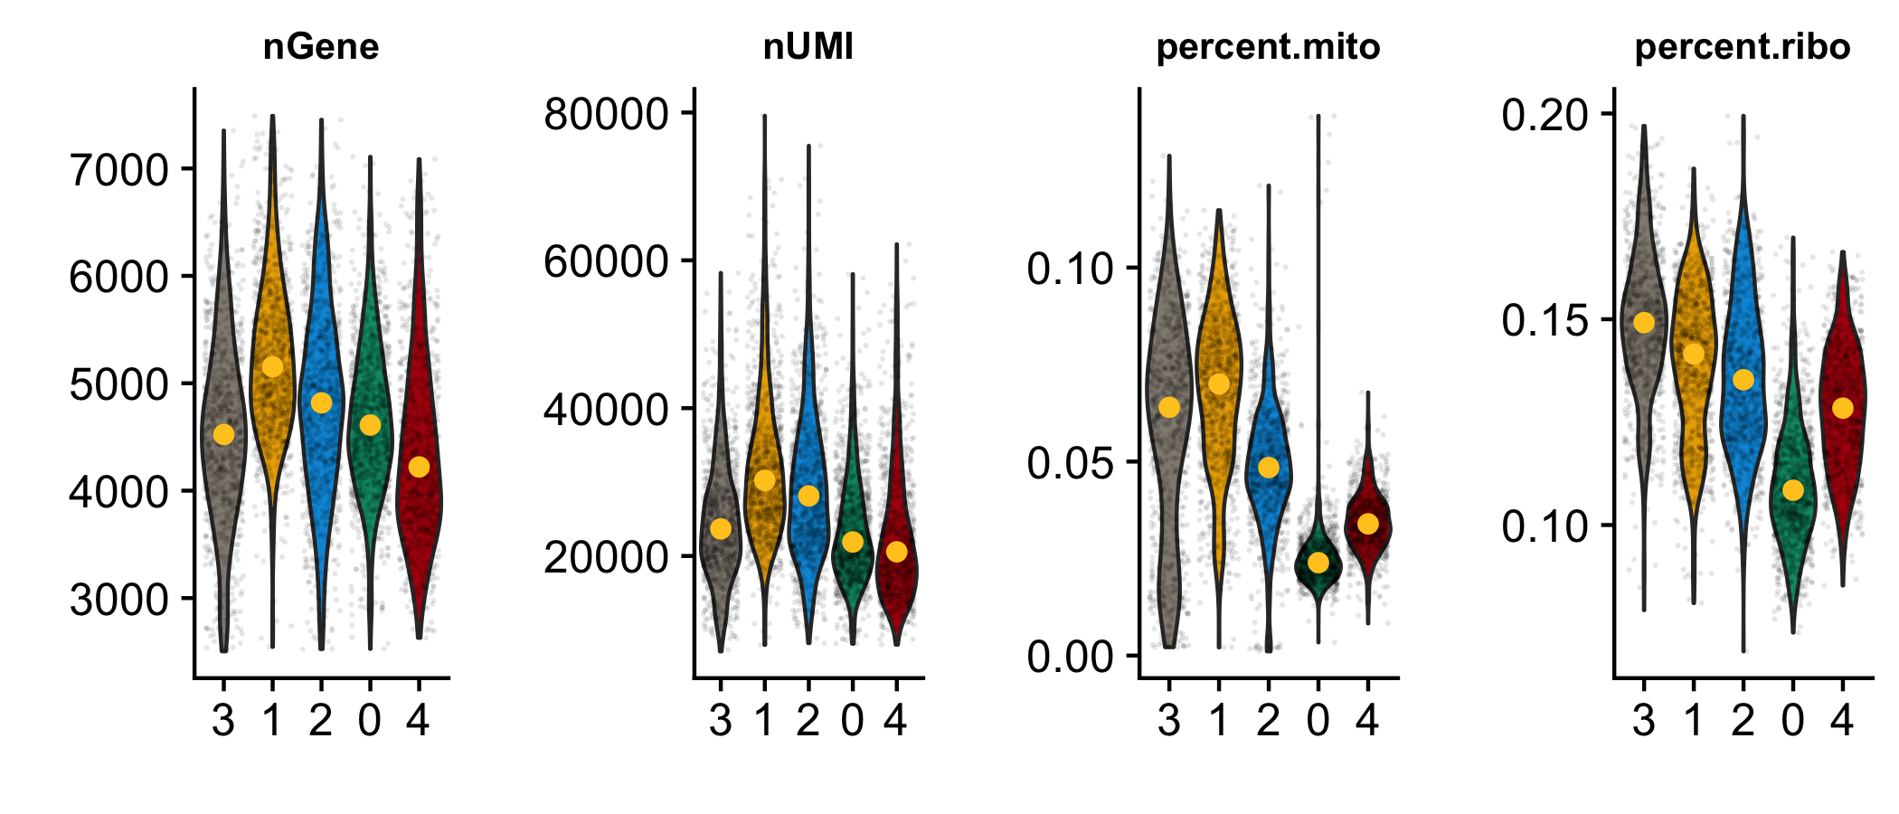
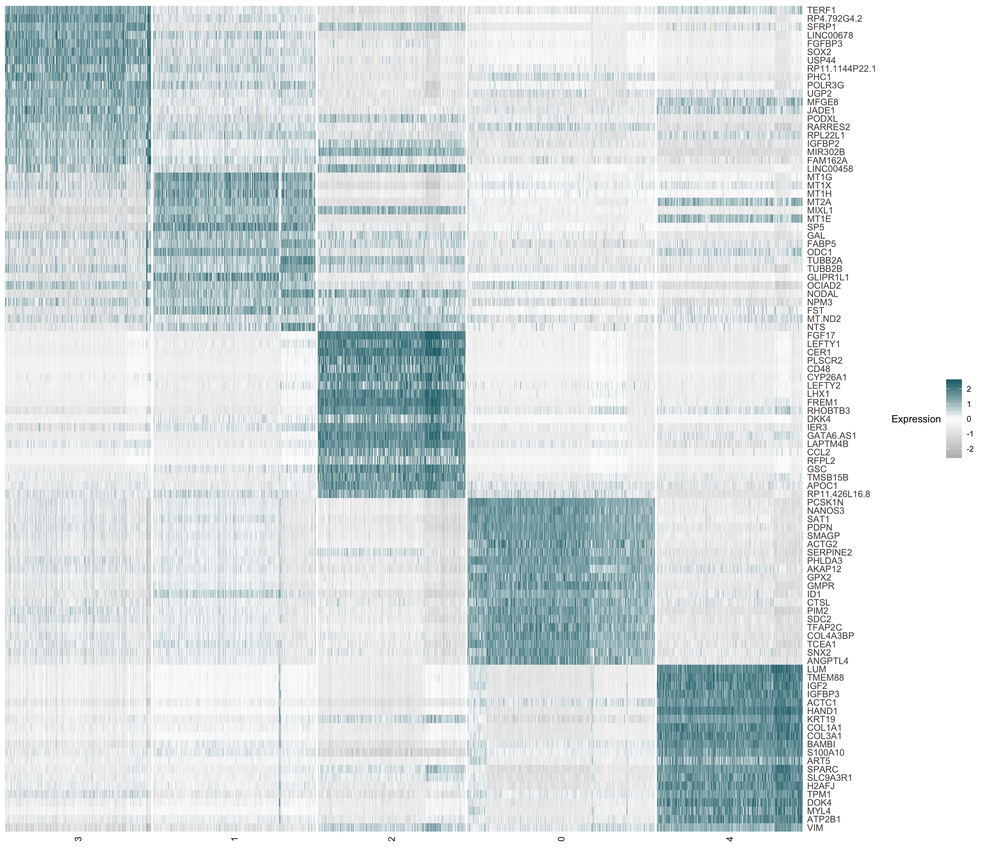
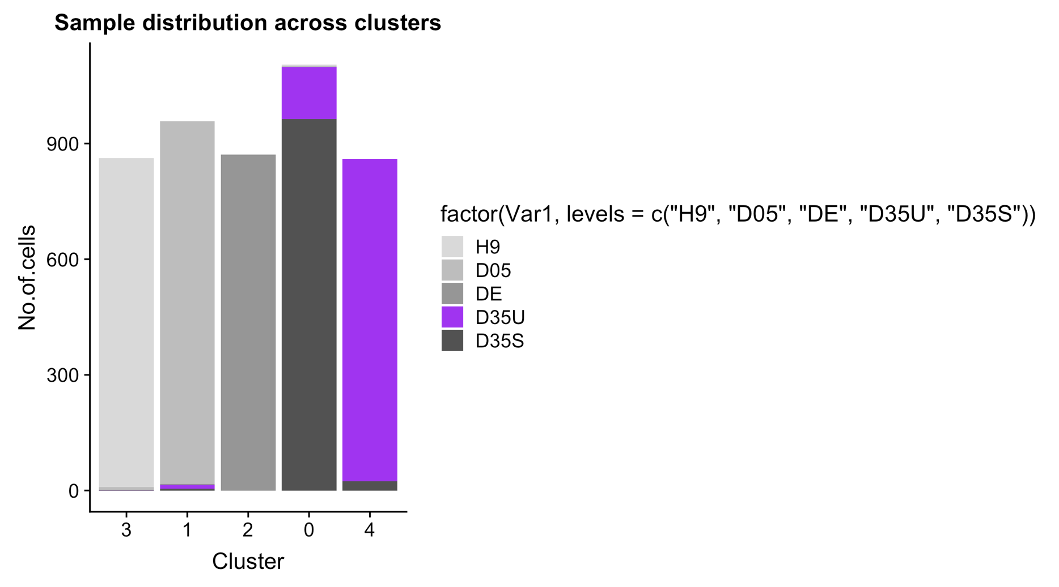
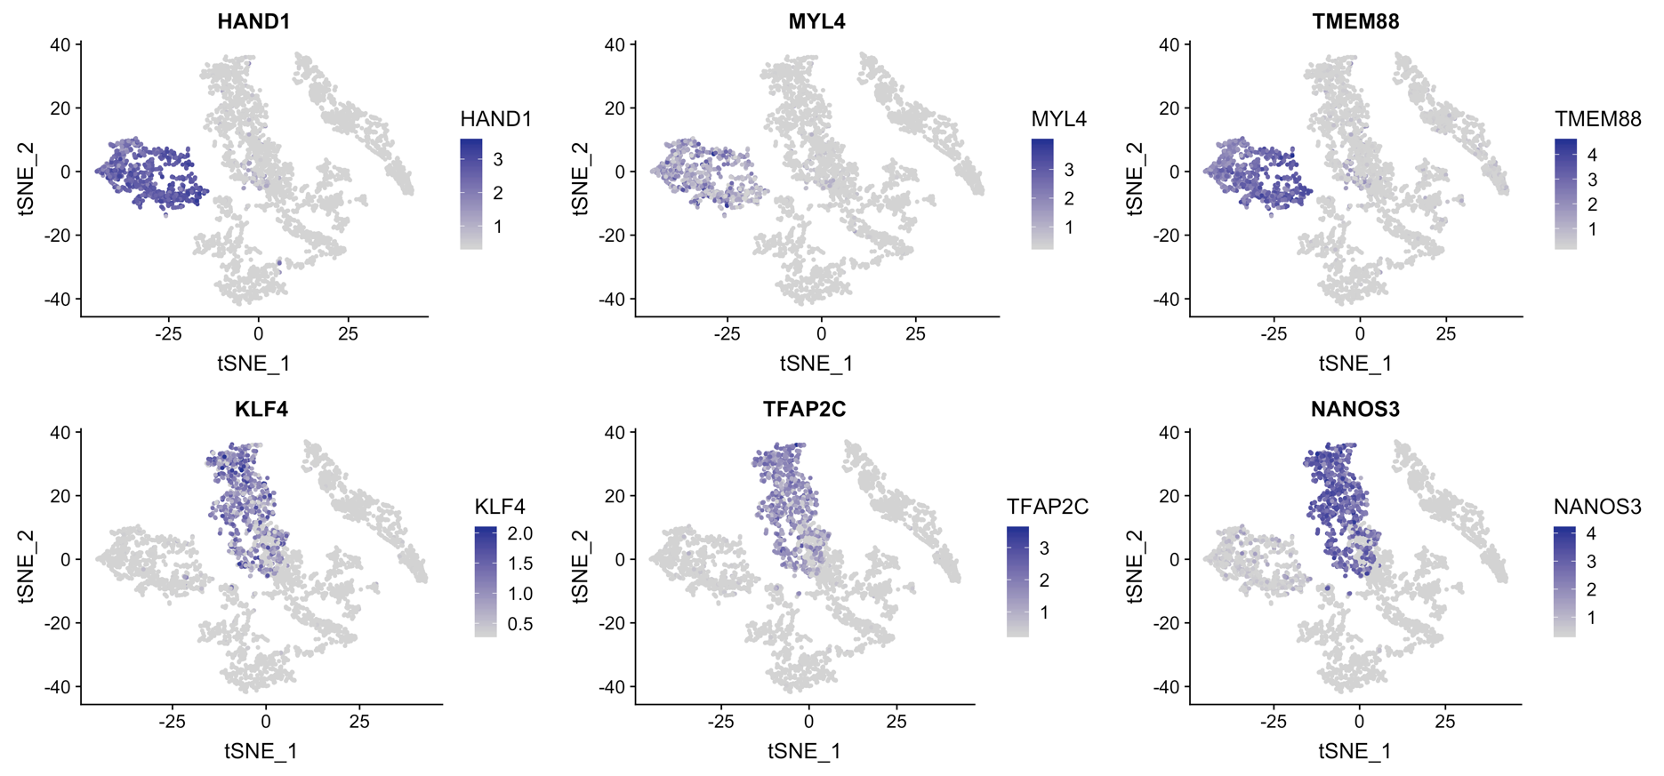
Fig. S4
A Quality metrics of single-cell RNA-seq data
D Top differentially expressed genes distinguishing the major cell-types
Genes detected
UMI
ES
PE
En
PGC
Me
ES
PE
En
PGC
Me
% mitochondrial reads
% ribosomal reads
ES
PE
En
PGC
Me
ES
PE
En
PGC
Me
B Transcriptionally assigning cell-types from scRNAseq data
Sample ID
Cell number
D0 hESC
D0.5 posterior epiblast
D2 endoderm
D3.5 unsorted population
D3.5 sorted PGCs
ES
PE
En
PGC
Me
Cell-type ID
C Mutually-exclusive germ vs. mesoderm marker expression
PGC marker expression
TFAP2C
NANOS3
Mesodermal marker expression
HAND1
TMEM88
ES
PE
En
PGC
Me
ES
PE
En
PGC
Me

Slide 5
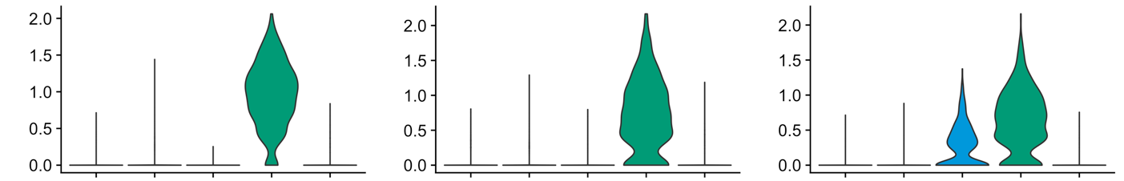
Fig. S5
A PGC marker expression in hPSC-derived PGCs and other cell-types
C NANOG protein continuously expressed during germ cell differentiation
PGC/naïve pluripotency markers (single-cell RNA-seq)
Intracellular flow cytometry
KLF4
TCL1B
PRDM1/BLIMP1
Normalized expression
ES
D0
D0.5
ES
PE
En
PGC
Me
ES
PE
En
PGC
Me
ES
PE
En
PGC
Me
PE
D1.5
+
D2.5
PGC
Me
Non-PGC
PGC
D3.5
PGC
+
Me
NANOG protein
B Bifurcation of NANOG⁺ hPSCs/posterior epiblast into NANOG⁺ CXCR4⁺ PGCs vs. NANOG⁻ CXCR4⁻ non-PGCs
D3.5
D0 hPSC
D0.5 posterior epiblast
D1.5
D2.5
0.0
0.0
0.0
0.0
0.0
1.7
2.5
7.5
1.6
8.2
PGC
PGC
CXCR4
ES
PE
Me
Me
3.2
96.8
0.3
99.7
3.8
94.4
70.3
19.7
89.8
0.4
NANOG-2A-YFP
0.0
0.1
0.0
3.2
0.7
2.7
11.0
6.8
PGC
2.9
9.2
PGC
CXCR4
ES
97.2
PE
29.4
Me
1.1
Me
2.7
1.3
95.4
67.2
81.1
79.2
8.6
NANOG protein

Slide 6
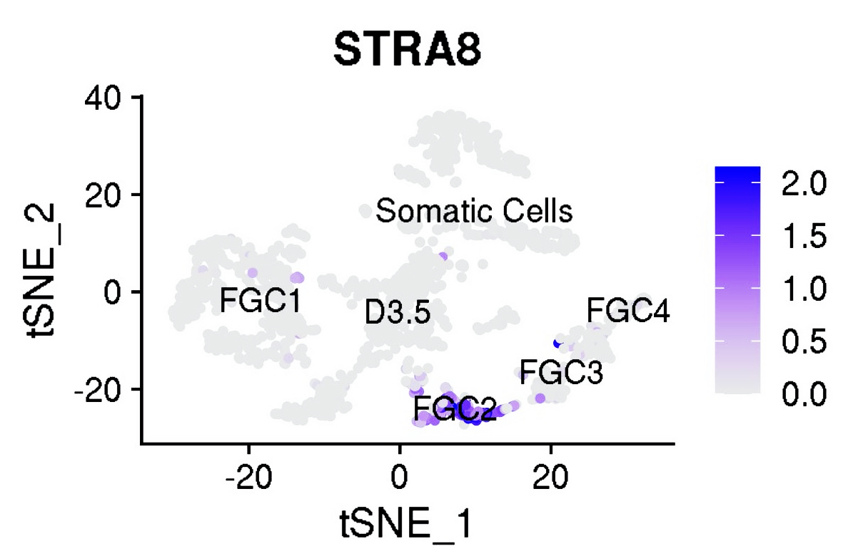
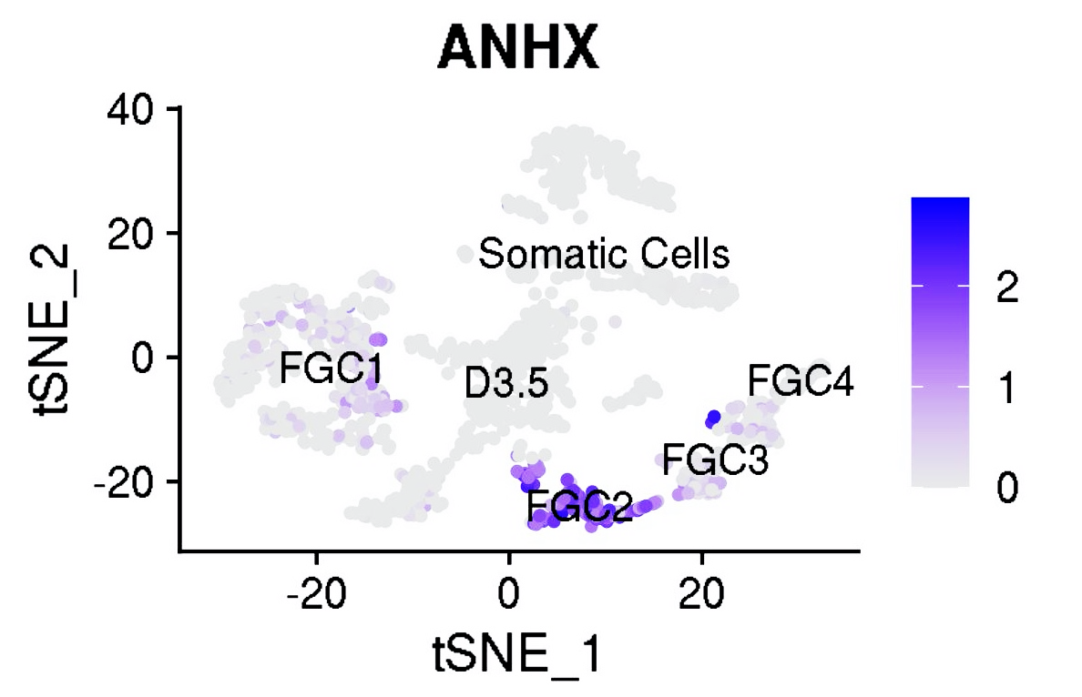
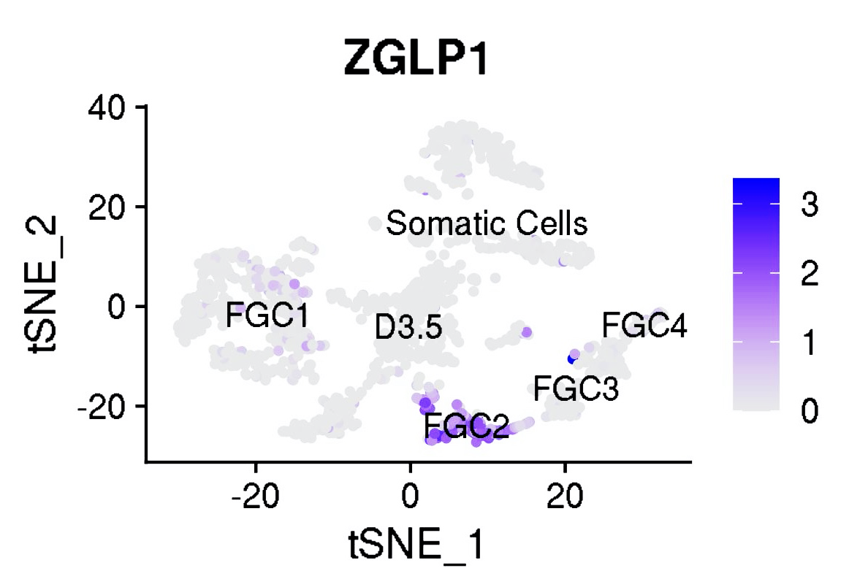
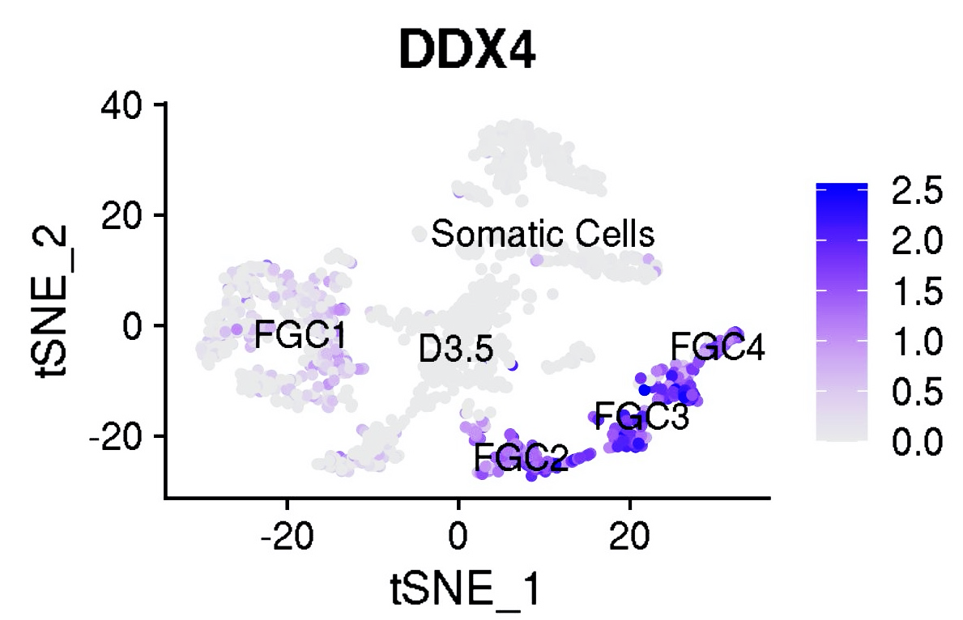
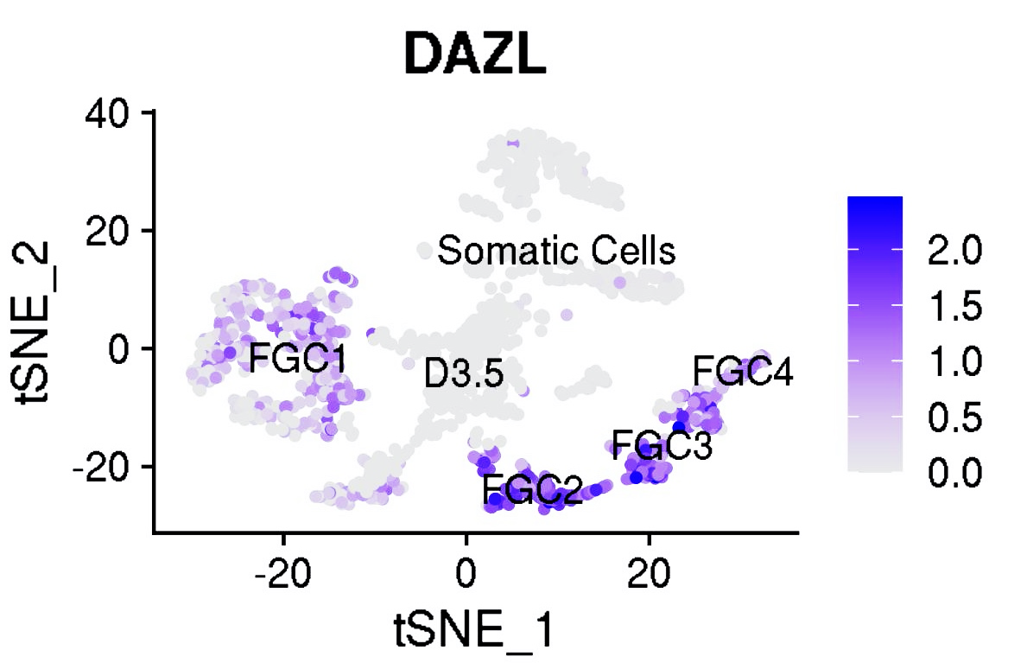
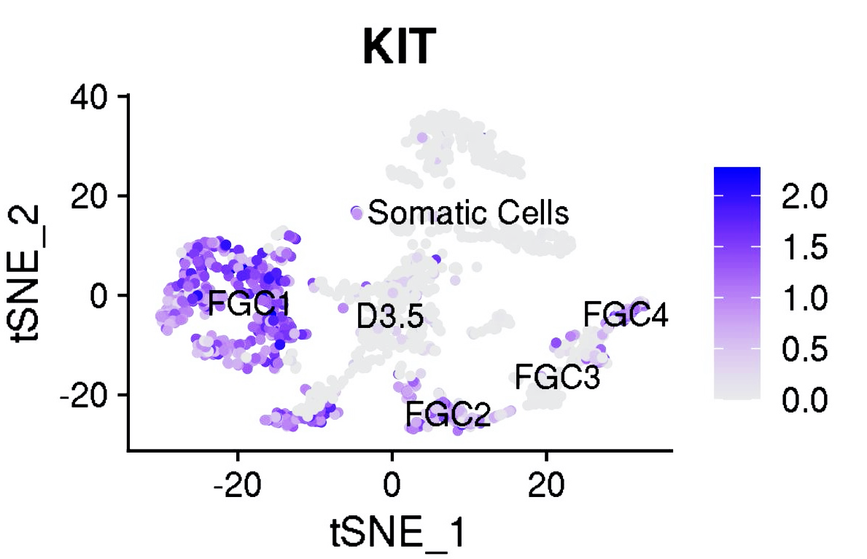
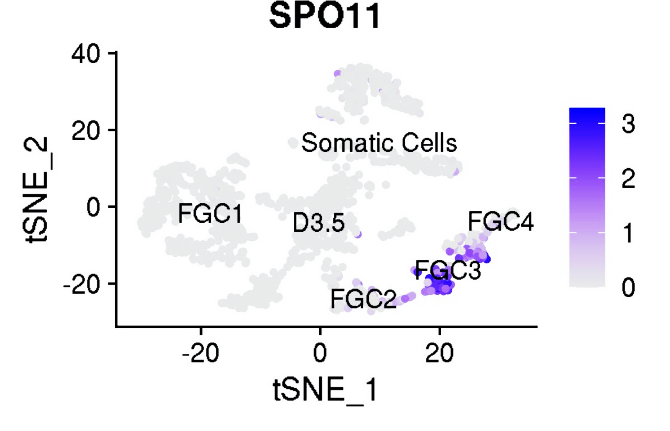
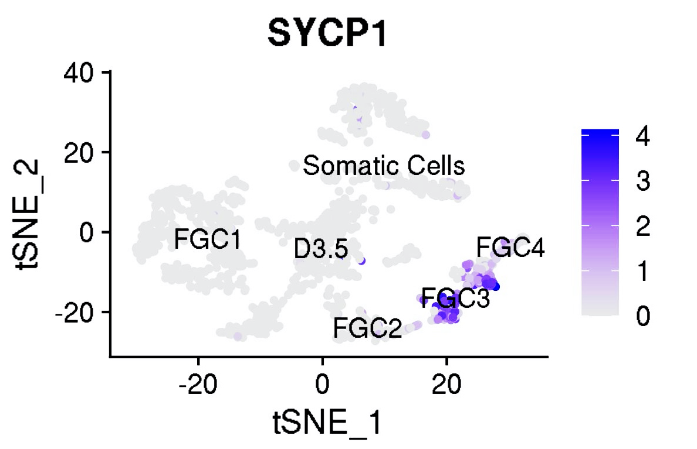
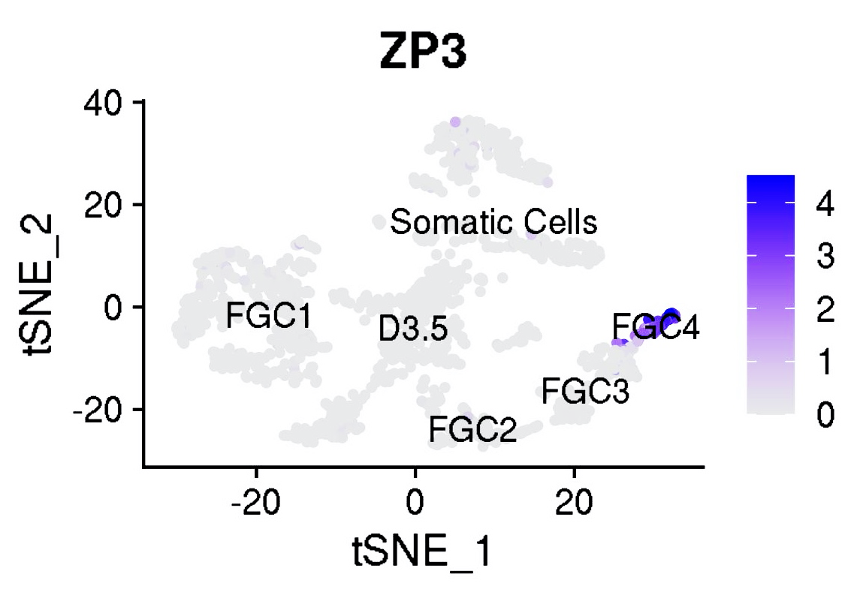
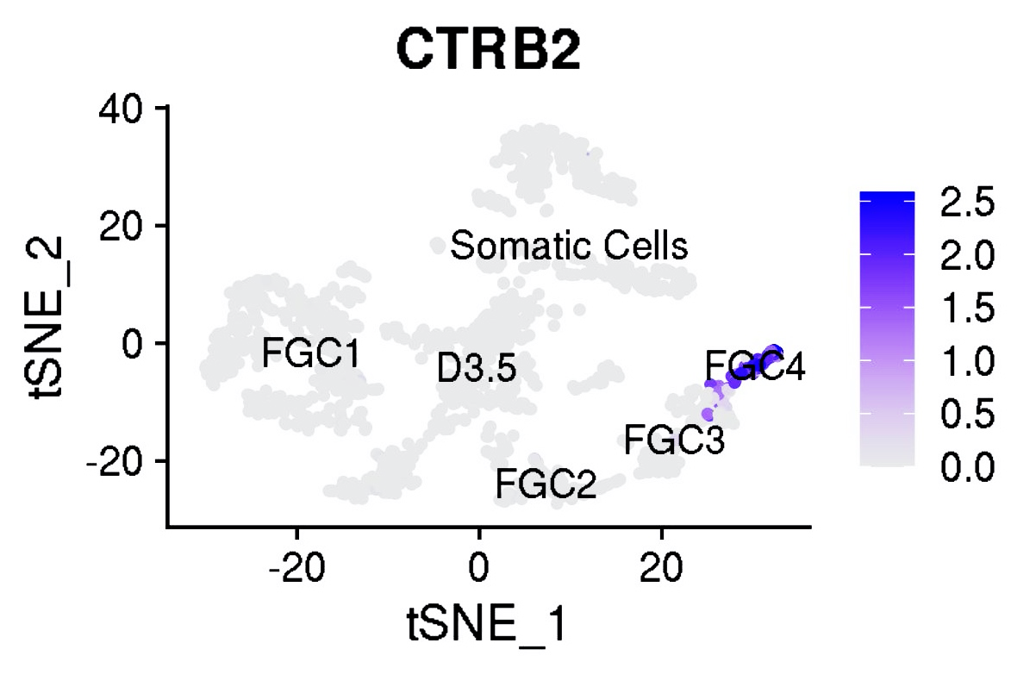
Fig. S6
A Effects of computationally downsampling the numbers of D3.5 PGCLCs used for single-cell RNA-seq analysis
Number of D3.5 cells | 300 | 545 | 1362 | 2724 | 4085 | 5447
Downsampling (%) | 94% | 90% | 75% | 50% | 25% | 0%
Genes detected | 16,590 | 17,190 | 17,617 | 17,643 | 17,645 | 17,645
Genes detected (%) | 94% | 97% | 100% | 100% | 100% | 100%
B Genes expressed in human PGCLCs in vitro and fetal PGCs in vivo
RA-responsive genes
Early oogenesis genes
Meiotic/late oogenesis genes

