Slide 1
** Note **
The following figure panels share portions of the indicated control images corresponding to the same samples: Figs. 3B, 3G, and 4F share portions of the TGFBI and β-actin control images; Figs. 3F, 3H, and 4G share portions of the TGFBI and β-actin control images; Figs. 2I and 4J share portions of the β-actin control image; and Figs. 2L, 3L, and 4K share portions of the β-actin control image.

Slide 2




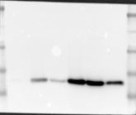
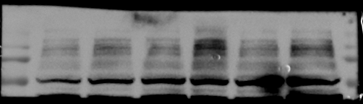





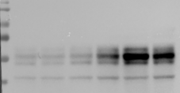
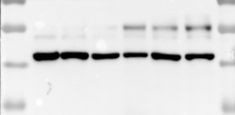
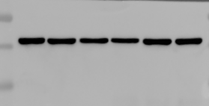
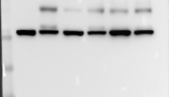
Fig. 2I
Repeat 1
Repeat 2
Repeat 3
kDa
WT
KO
WT
KO
WT
KO
170
170
130
130
PGC1α
130
95
95
70
95
70
35
43
UCP1
35
28
28
240
240
240
PRDM16
170
170
170
130
130
130
130
70
95
56
PPARγ
70
56
43
95
95
GLUT4
70
70
56
56
43
43
35
35
70
56
56
β-actin
43
43
43
35
35
35
28

Slide 3


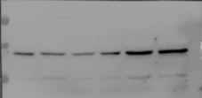






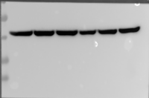
Fig. 2L
Repeat 1
Repeat 2
kDa
WT
KO
WT
KO
210
210
PGC1α
170
170
130
130
95
95
70
70
43
43
UCP1
35
35
28
28
240
170
170
130
PRDM16
130
95
PPARγ
56
56
43
56
70
43
56
35
β-actin
43
28
35
28

Slide 4
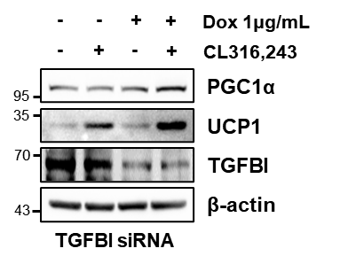



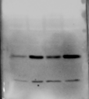
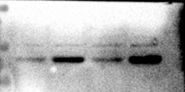




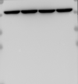
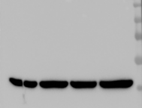
Fig. 3B
Repeat 1
Repeat 2
Repeat 3
kDa
170
170
210
130
130
PGC1α
170
95
95
130
70
70
95
43
35
UCP1
35
35
28
28
28
70
170
95
TGFBI
130
56
95
70
70
56
56
56
70
β-actin
43
56
43
35
43

Slide 5
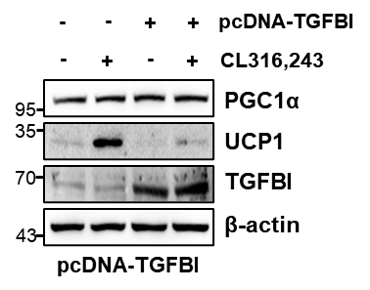


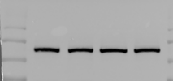
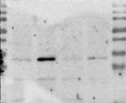

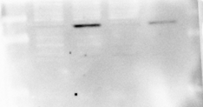




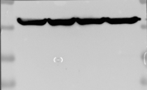
Fig. 3F
Repeat 1
Repeat 2
Repeat 3
kDa
130
170
170
95
PGC1α
130
70
130
95
56
95
70
70
43
35
UCP1
56
35
28
28
43
35
70
130
95
TGFBI
110
95
70
70
56
43
56
β-actin
43
43
35
35
35
28
28
28

Slide 6


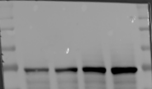

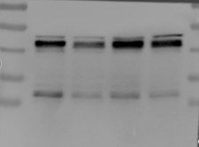
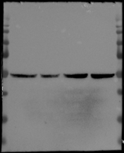

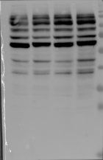
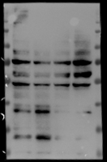
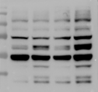



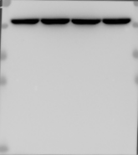


Fig. 3G
Repeat 1
Repeat 2
Repeat 3
130
70
130
β3-AR
95
56
95
95
70
70
56
70
56
43
56
70
70
43
56
56
56
C/EBPα
43
43
43
35
35
130
130
170
Phospho
-PKA
substrate
95
130
95
70
95
70
56
70
56
43
56
43
35
43
35
70
130
130
TGFBI
95
56
95
70
70
56
56
56
56
56
β-actin
43
43
43
35
35

Slide 7
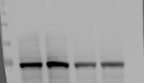
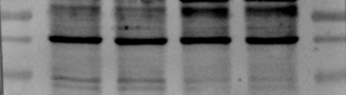




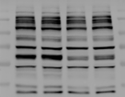
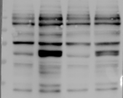
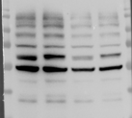





Fig. 3H
Repeat 1
Repeat 2
Repeat 3
130
56
70
95
43
β3-AR
56
70
56
35
43
70
70
56
56
C/EBPα
56
43
43
43
35
35
Phospho
-PKA
substrate
130
130
130
95
95
95
70
70
70
56
56
56
43
43
43
95
70
TGFBI
70
70
56
95
70
70
43
β-actin
56
56
35
43
43

Slide 8
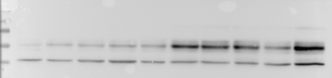




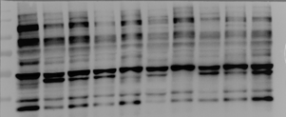
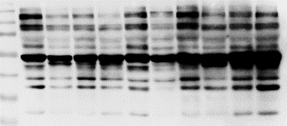


Fig. 3I
Repeat 1
Repeat 2
kDa
Veh
CL316,243
Veh
CL316,243
95
43
C/EBPα
70
35
56
43
70
70
β3-AR
56
56
43
56
43
Phospho-
PKA
substrate
130
170
95
130
70
95
56
70
43
56
35
43
35
56
56
β-actin
43
43
35
35

Slide 9
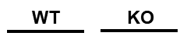

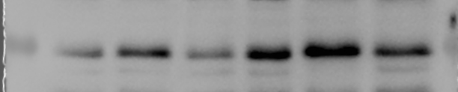




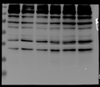




Fig. 3L
Repeat 1
Repeat 2
Repeat 3
kDa
56
43
C/EBPα
43
43
56
95
β3-AR
56
70
43
56
130
43
130
Phospho-
PKA
substrate
95
95
70
95
70
56
70
56
56
43
43
43
35
35
35
56
70
56
43
56
β-actin
43
35
43
28
35

Slide 10

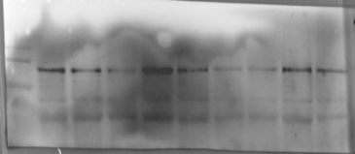
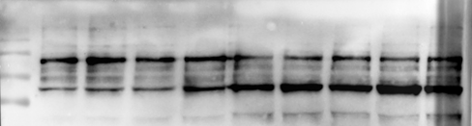

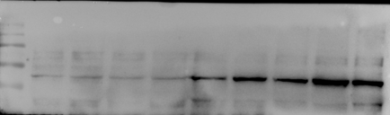

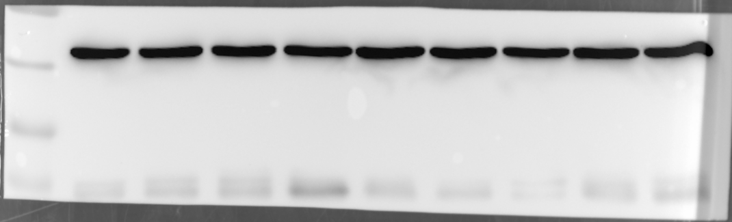
Fig. 4B
Repeat 1
Repeat 2
kDa
Veh
CL316,243
Veh
CL316,243
70
95
TGFBI
56
70
56
170
170
Notch1
130
130
95
95
70
70
130
210
NICD
170
95
130
95
56
70
β-actin
43
43
35
35
28
28

Slide 11
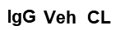
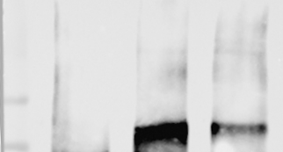


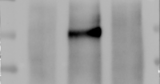
















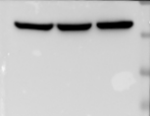
Fig. 4D
Repeat 1
Repeat 2
Repeat 3
kDa
Notch1
130
110
110
110
95
95
95
95
130
130
TGFBI
70
110
95
95
56
70
70
130
170
NICD
110
130
130
95
110
95
70
95
70
70
56
56
HES1
43
43
35
35
35
28
28
TGFBI
110
95
70
95
70
70
56
56
130
210
130
110
170
110
Notch1
130
95
95
70
95
70
β-actin
56
56
43
43
43
35
35
28
35
28

Slide 12
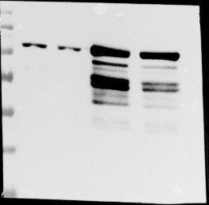
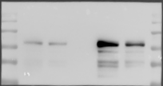

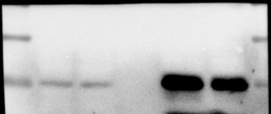
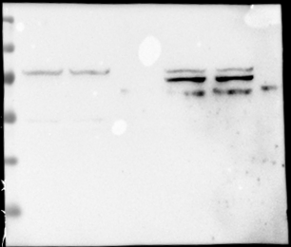
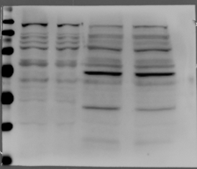
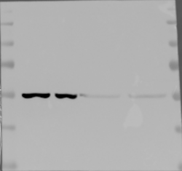

Fig. 4E
Repeat 1
Repeat 2
kDa
Cytosol
Nucleus
Cytosol
Nucleus
170
130
170
95
130
Notch1
(NICD)
70
95
56
70
43
56
35
56
56
HES1
43
43
35
35
130
170
95
130
70
95
Lamin B1
70
56
56
43
43
35
35
130
95
95
70
70
56
β-tubulin
43
56
43
35
35

Slide 13







Fig. 4F
Repeat 1
Repeat 2
Repeat 3
kDa
170
210
NICD
130
170
170
95
130
130
70
95
95
HES1
56
35
35
43
28
35
130
95
110
70
TGFBI
70
95
56
70
56
43
56
95
70
β-actin
70
56
43
56
35
43
43

Slide 14








Fig. 4G
Repeat 1
Repeat 2
Repeat 3
kDa
170
130
210
NICD
130
95
170
95
70
130
70
95
35
56
56
HES1
43
43
28
35
35
95
70
70
TGFBI
70
56
95
70
70
56
β-actin
43
56
43
43
35
35

Slide 15








Fig. 4H
Repeat 1
Repeat 2
kDa
Cytosol
Nucleus
Nucleus
170
130
Notch1
(NICD)
130
95
110
70
56
95
56
56
43
43
HES1
35
35
28
28
130
170
110
Lamin B1
130
95
95
70
70
56
56
43
130
95
95
70
β-tubulin
70
56
56
43
35
43

Slide 16






Fig. 4J
Repeat 1
Repeat 2
Repeat 3
kDa
130
NICD
130
110
110
95
95
95
70
56
35
HES1
35
43
35
28
70
56
56
56
β-actin
43
43
43
35
35
35

Slide 17









Fig. 4K
Repeat 1
Repeat 2
Repeat 3
kDa
130
170
130
NICD
95
130
95
70
95
56
70
56
43
70
HES1
43
56
43
35
43
35
35
70
28
56
95
70
β-actin
70
56
43
56
43
35
43
28
35
35

Slide 18



















Fig. 4L
Repeat 1
Repeat 2
Repeat 3
210
170
170
130
NICD
130
130
95
95
35
43
HES1
35
28
28
35
70
56
56
95
β3-AR
43
70
43
56
35
35
43
70
43
70
56
56
C/EBPα
35
43
43
35
28
70
170
130
TGFBI
130
56
95
95
43
70
70
56
56
70
β-actin
43
56
43
35
43
35
28
35
28

Slide 19



















Fig. 4M
Repeat 1
Repeat 2
Repeat 3
170
170
NICD
130
130
130
95
95
95
35
43
HES1
35
28
28
35
130
130
95
56
95
β3-AR
70
70
56
56
43
43
43
43
56
43
C/EBPα
43
35
35
35
28
28
130
70
70
95
TGFBI
56
70
56
43
56
43
43
56
β-actin
35
43
35
28
28
13
35

Slide 20












Fig. 5B
Repeat 1
Repeat 2
130
Notch1
95
170
70
130
56
95
70
His pull-down
170
130
95
70
170
170
130
130
95
95
His-TGFBI
70
70
56
56
43
43
35
35
28
28
13
13
95
95
70
70
56
56
His-TGFBI
43
43
35
35
28
28
Input
13
13
170
170
Notch1
130
130
95
95
70
70
70
56
β-actin
56
43
43
35
35
28
28
13

Slide 21




















Fig. 5C
Repeat 1
Repeat 2
Repeat 3
CL316,243
-
+
+
+
+
+
-
+
+
+
+
+
-
+
+
+
+
+
rcTGFBI
-
-
ΔEMI
ΔFAS
ΔRGD
-
-
ΔEMI
ΔFAS
ΔRGD
-
-
ΔEMI
ΔFAS
ΔRGD
FL
FL
FL
170
210
Notch1
130
130
170
95
130
95
70
95
170
170
NICD
130
130
130
95
95
95
70
70
70
56
56
56
HES1
43
43
43
35
35
35
28
28
56
70
C/EBPα
56
43
56
43
35
43
35
28
35
β3-AR
56
56
56
43
43
43
35
35
43
43
UCP1
35
43
35
35
β-actin
56
70
43
56
56
43
43
35

Slide 22











Fig. 6G
Repeat 1
Repeat 2
95
130
70
95
β3-AR
56
70
43
56
35
43
28
170
170
P-PKA
substrates
130
130
95
95
70
56
70
43
56
35
56
UCP1
28
43
35
28
PGC1α
170
170
130
130
95
95
70
130
170
β-tubulin
70
130
95
56
70
43
56
43

Slide 23




Fig. S2G
kDa
WT
KO
130
95
70
56
PPARγ
43
35
28
170
PGC1α
130
95
70
56
43
UCP1
35
70
56
GLUT4
43
35
28
70
56
β-actin
43
35
28

Slide 24






Fig. S5C
170
Notch1
130
95
70
His pull-down
130
95
70
56
His-TGFBI
43
35
28
13
95
70
56
His-TGFBI
43
35
28
13
Input
170
Notch1
130
95
70
56
β-actin
43
35
28

Slide 25












Fig. S6A
130
95
TGFBI
70
56
95
70
β3-AR
56
43
56
β-actin
43
35
95
170
70
130
TGFBI
95
56
70
56
95
95
70
70
β3-AR
56
56
43
43
35
56
130
β-actin
95
43
70
56
43

