Slide 1
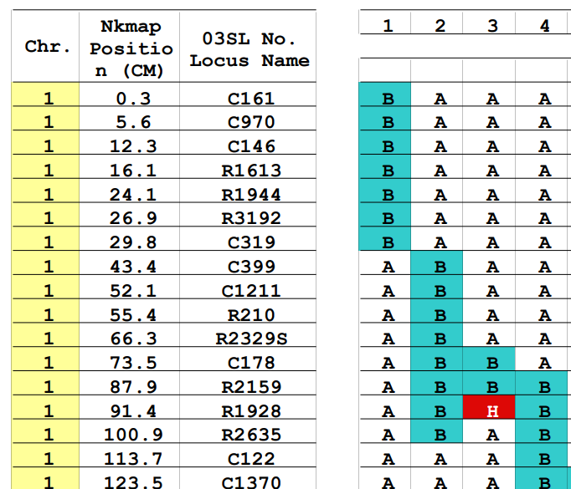

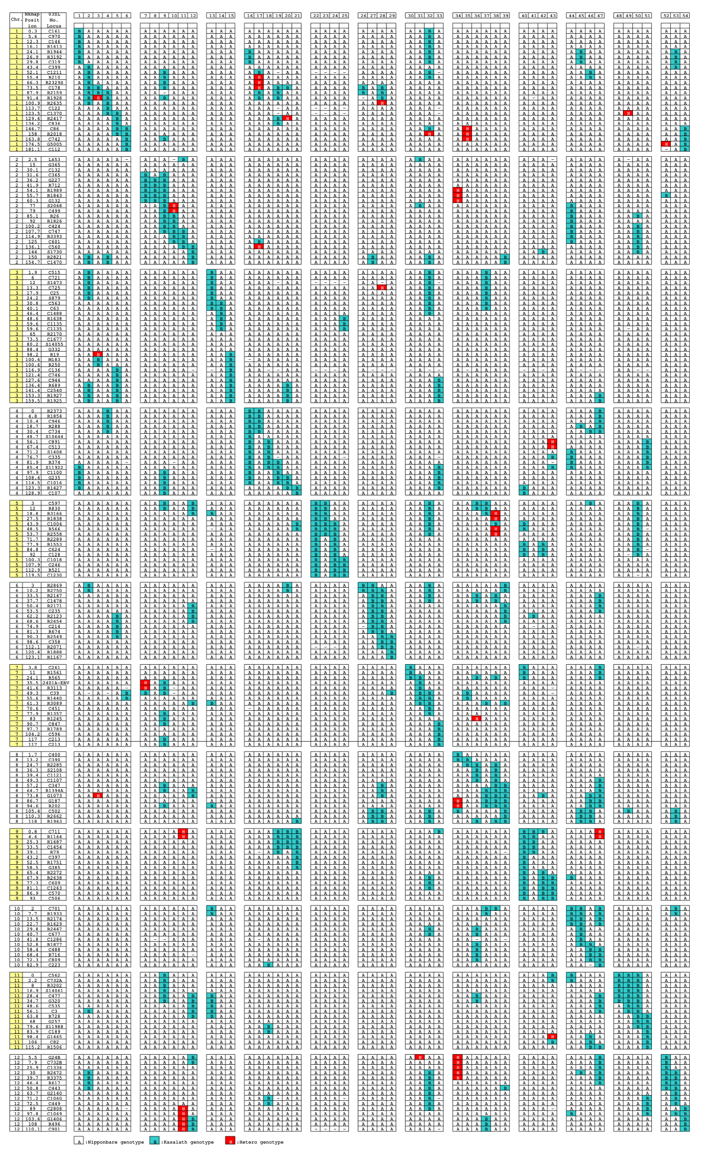
Title: Lower anther culture response in indica than in japonica rice is associated with a callus-induction bottleneck and early browning of sporophytic anther tissues
  : Nipponbare
  : Kasalath
  : Hetero
A
B
H
Fig. S1 Graphical genotypes of the 54 chromosome segment substitution lines (CSSLs) derived from Nipponbare and Kasalath. Graphical genotypes were constructed using molecular markers distributed across the 12 rice chromosomes. White cells (A) indicate homozygous Nipponbare alleles, turquoise cells (B) indicate homozygous Kasalath alleles, and red cells (H) indicate heterozygous regions. The enlarged section shows the marker genotypes of selected CSSLs on chromosome 1, with marker names and genetic positions (cM). The graph showing the insertion of the Kasalath fragment from 54 CSSLs on chromosome 12 of Nipponbare was taken directly from the figure in Mizuta et al. (2005)

Slide 2
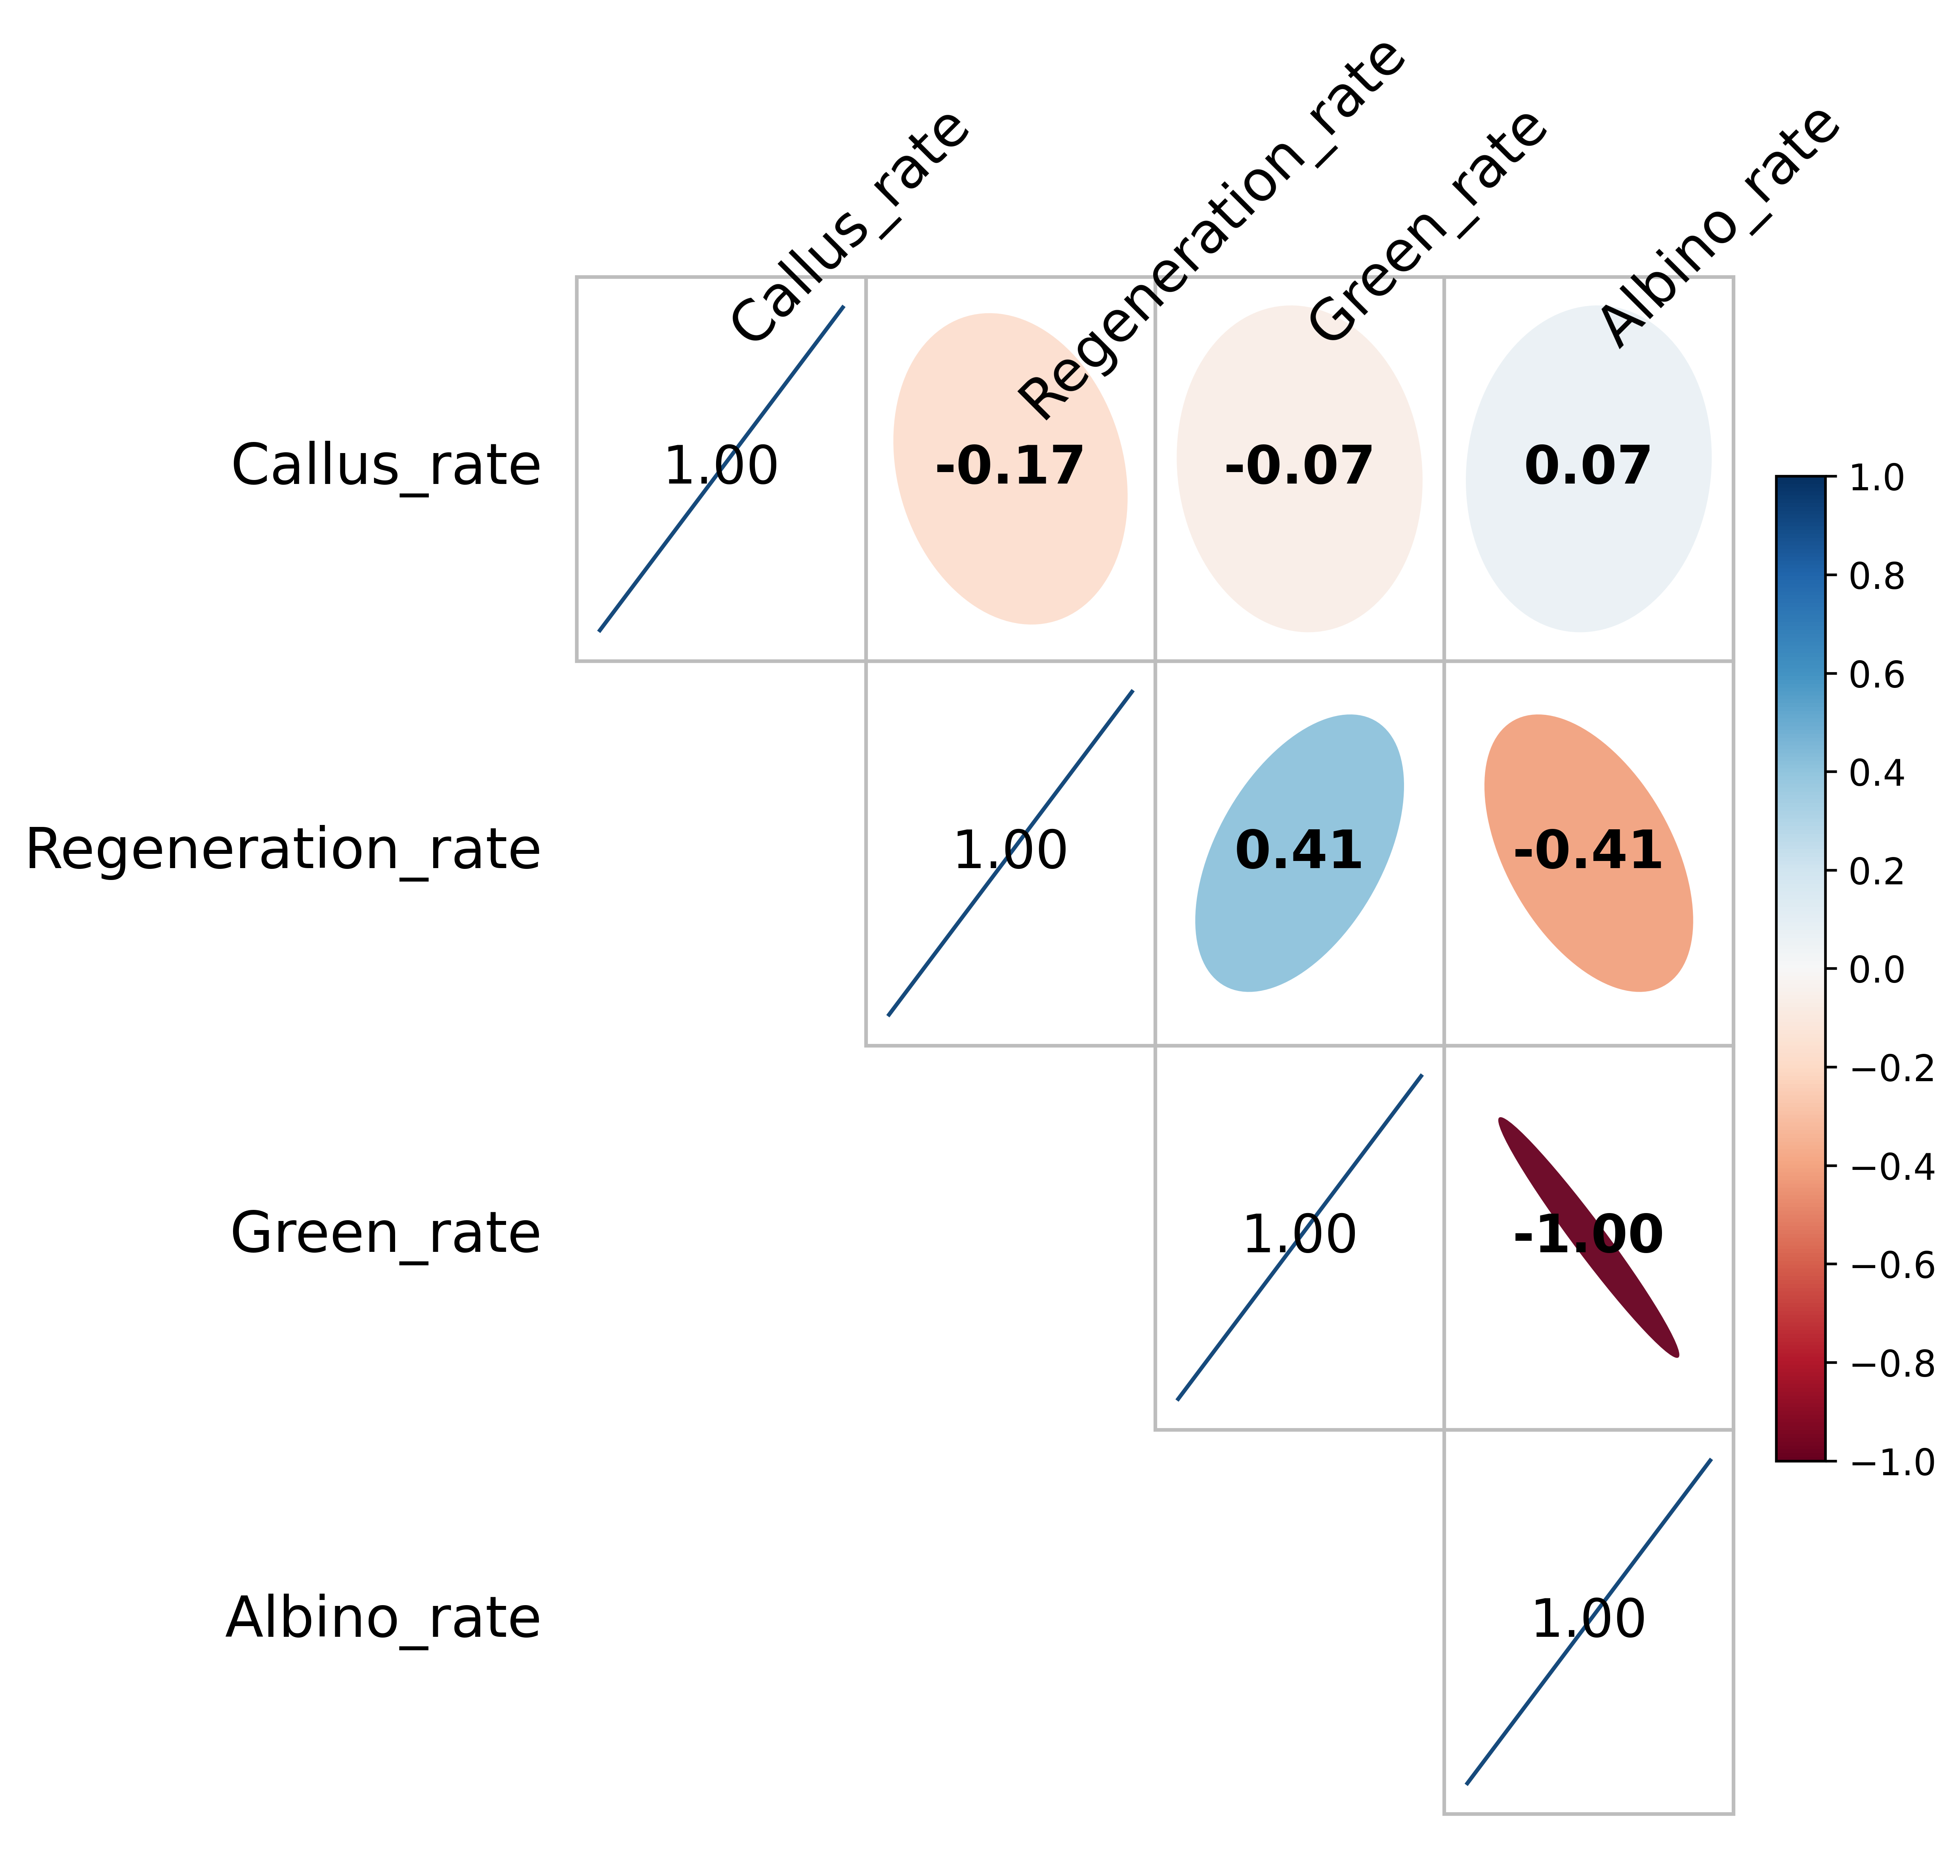
Fig. S2 Pearson correlation matrix of anther culture traits in the CSSL population. Pairwise Pearson correlations are shown among callus induction rate, regeneration rate, green plant rate, and albino plant rate. Numbers within the matrix indicate Pearson’s correlation coefficients (r). Blue and red ellipses indicate positive and negative correlations, respectively, with ellipse shape and colour intensity representing the magnitude of the correlation.

Slide 3
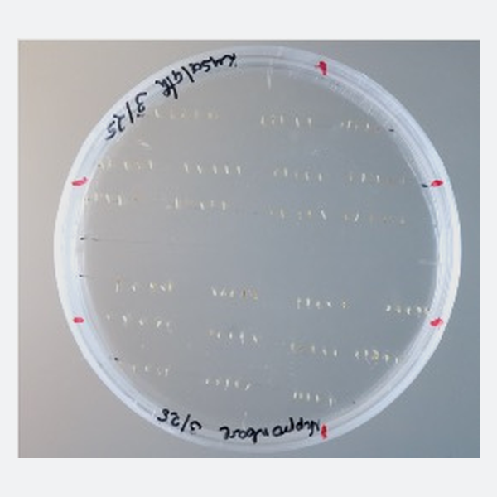
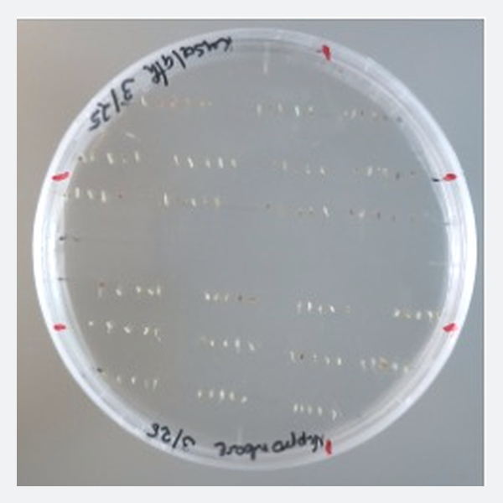
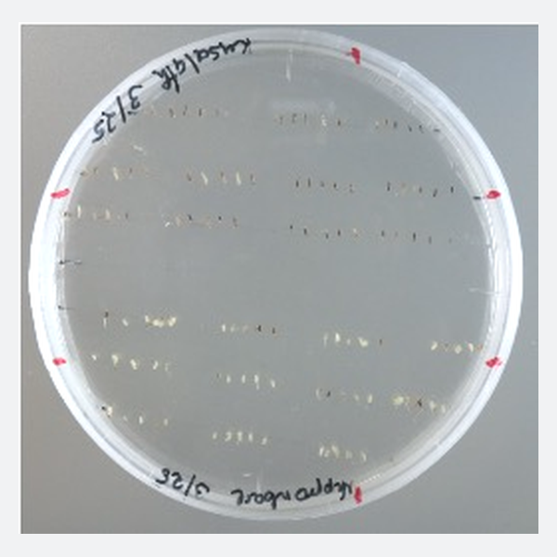
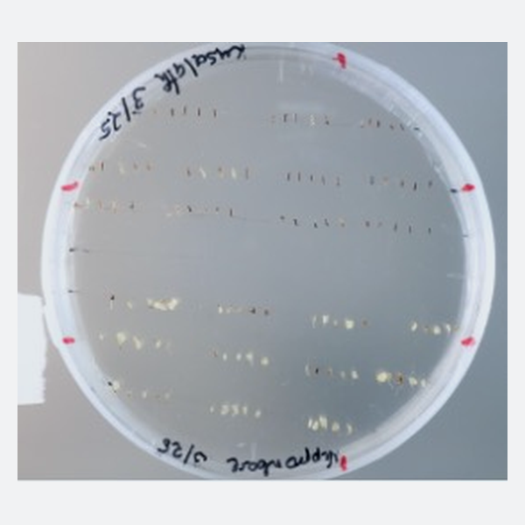
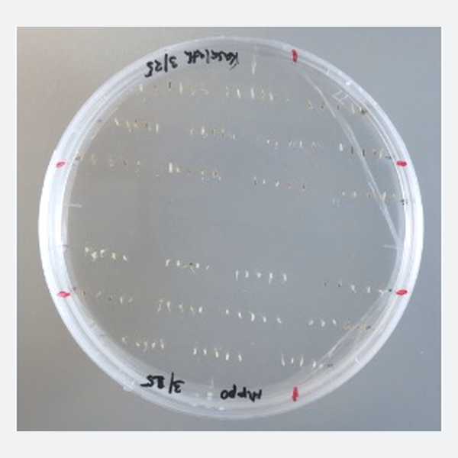
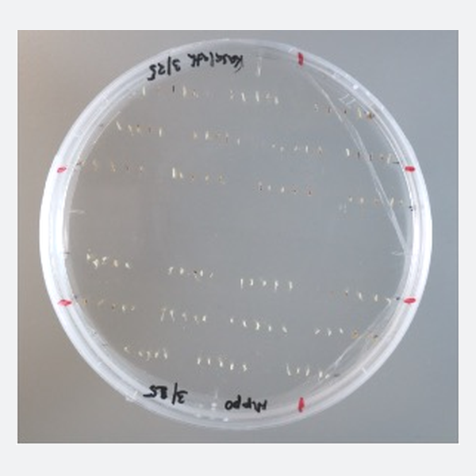
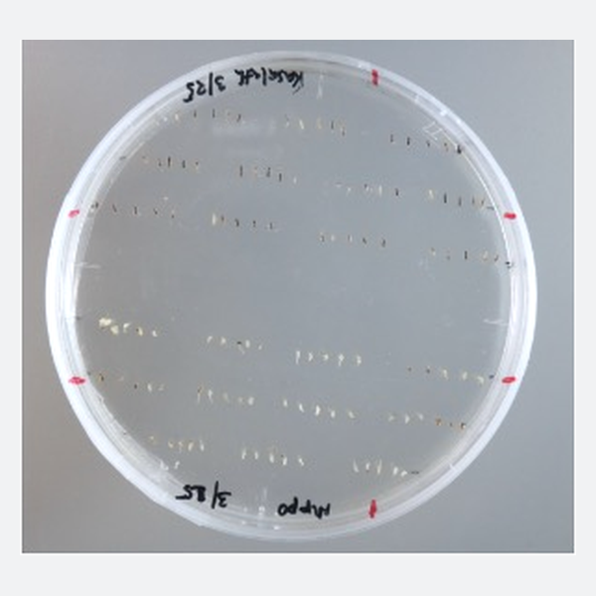
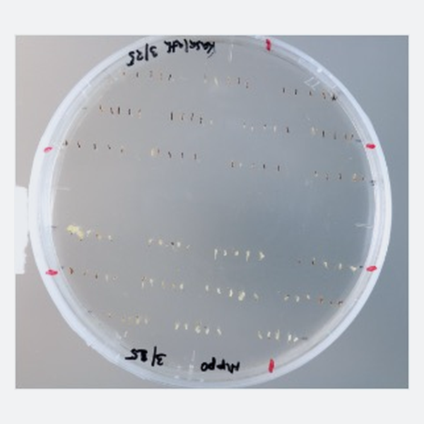
Week 1
Week 2
Week3
Week 4
Upper rows: Kasalath | Lower rows: Nipponbare
Fig. S3 Time-course observation of anther browning in Kasalath and Nipponbare during culture. Representative culture plates photographed weekly from Week 1 to Week 4. Within each plate, the upper rows contain Kasalath anthers and the lower rows contain Nipponbare anthers.

Slide 4
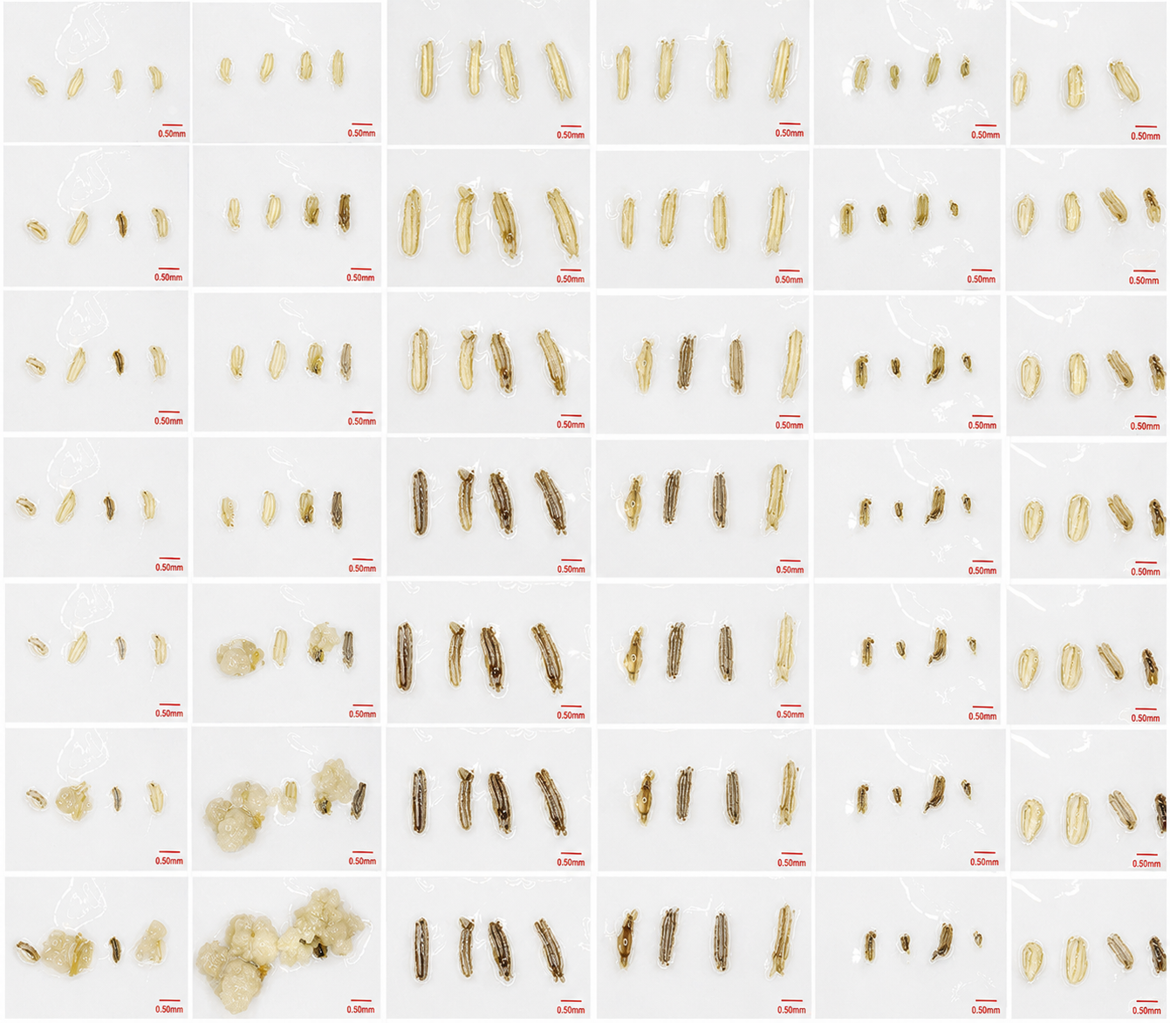
Nipponbare_1
Nipponbare_2
Kasalath_1
Kasalath_2
Fig. S4 Time-course observation of cultured anthers from Nipponbare and Kasalath. Sequential images show representative cultured anthers from two independent biological replicates of each genotype at successive observation time points during culture. Columns correspond to Nipponbare replicate 1 and replicate 2 and Kasalath replicate 1 and replicate 2.Scale bars = 0.50 mm.

Slide 5
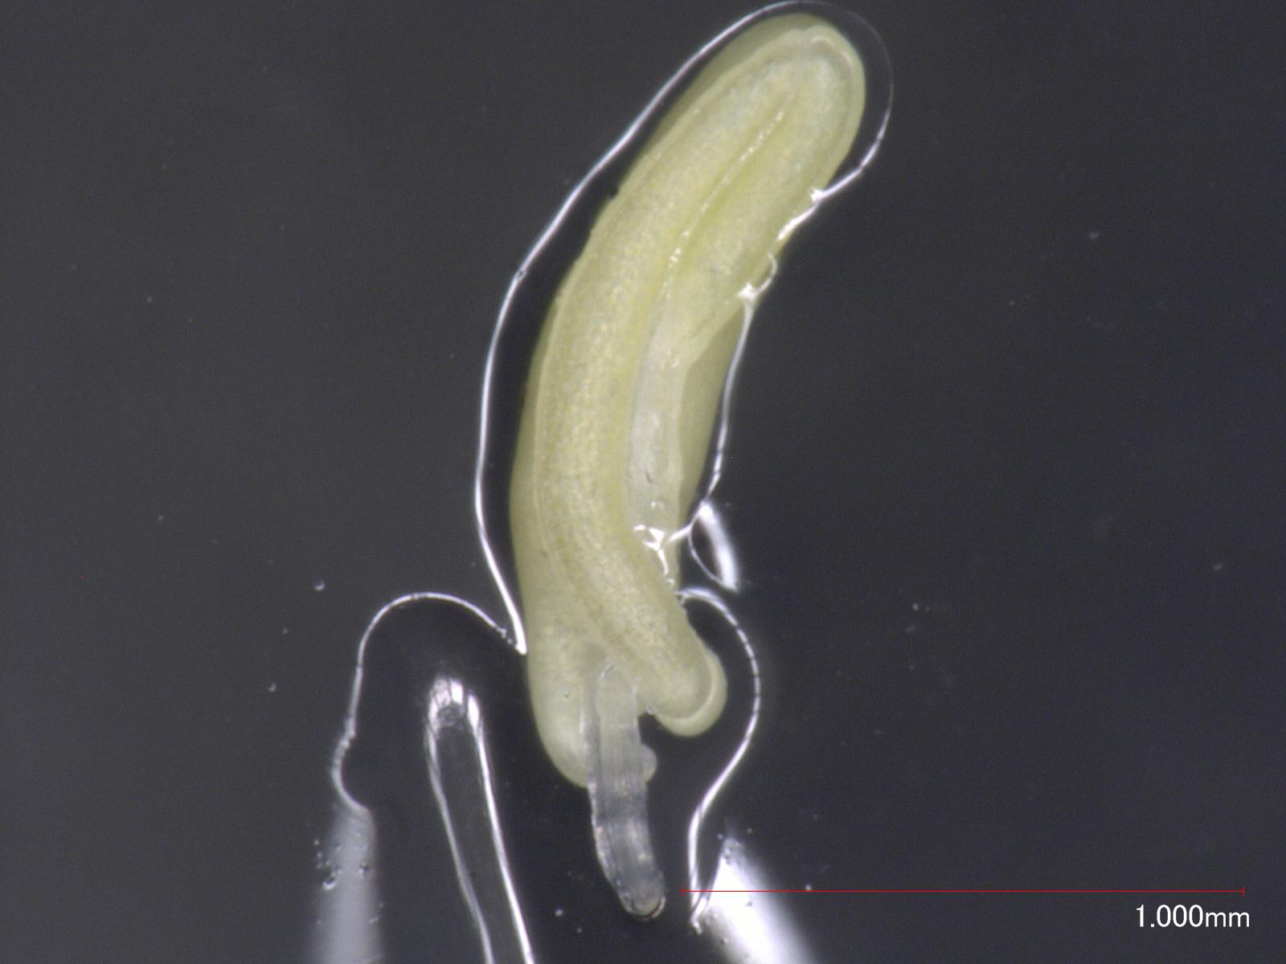
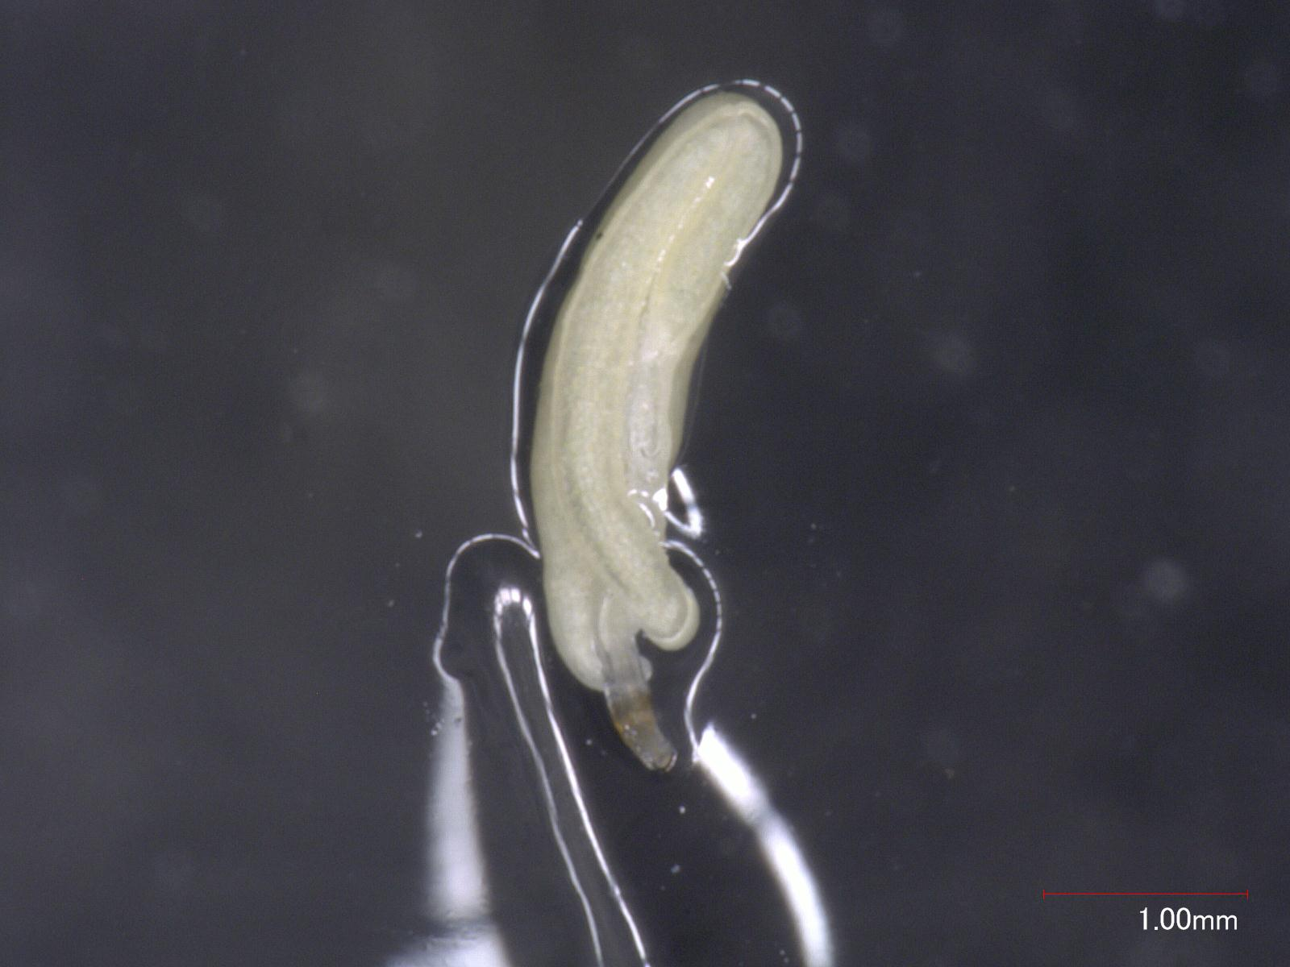
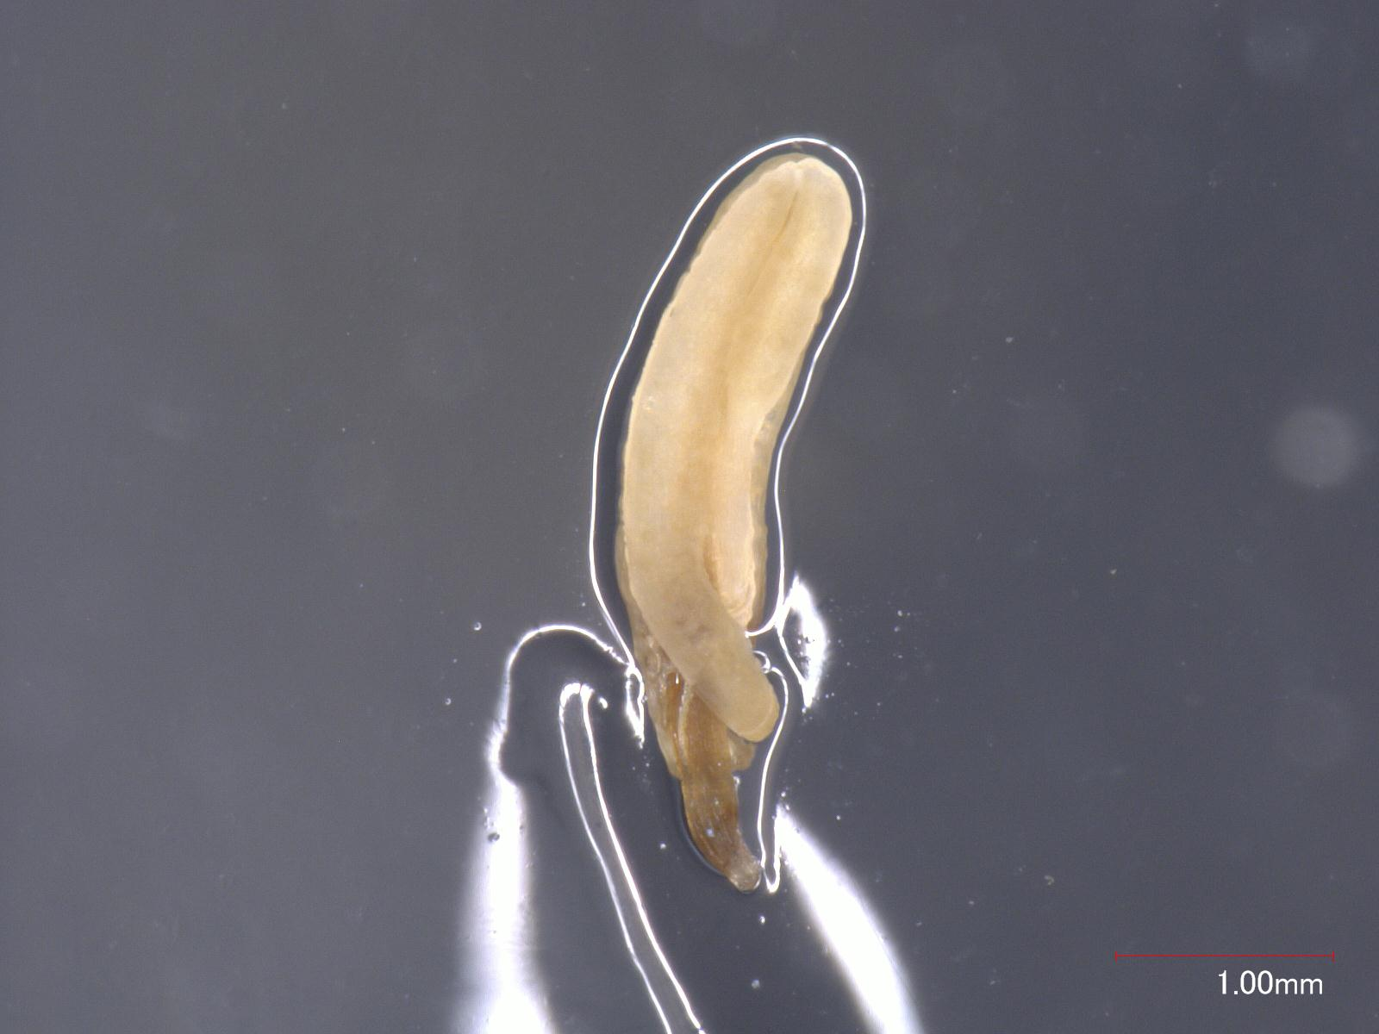
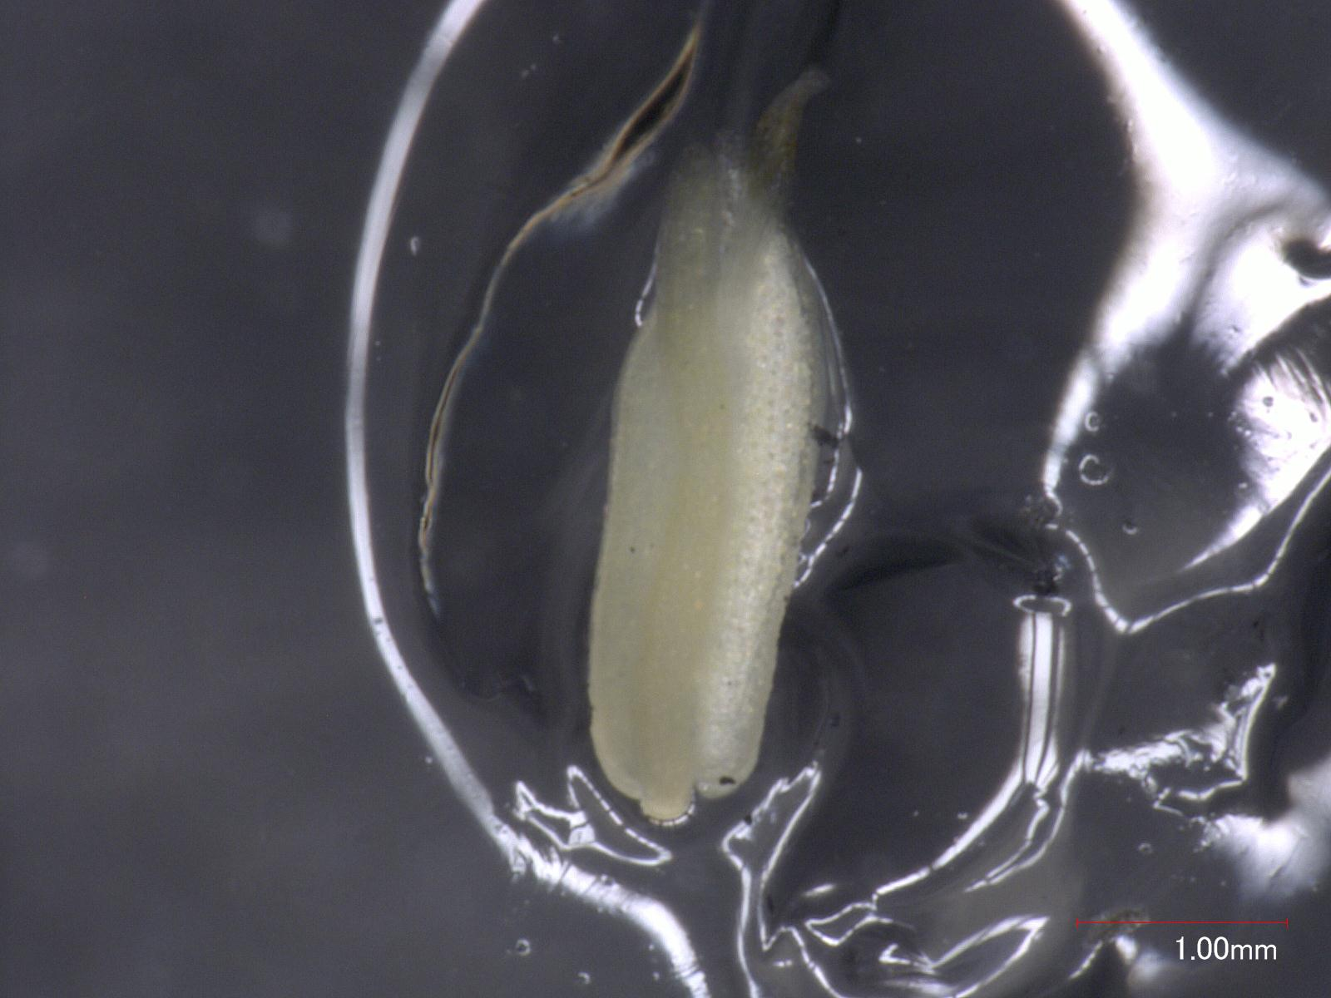
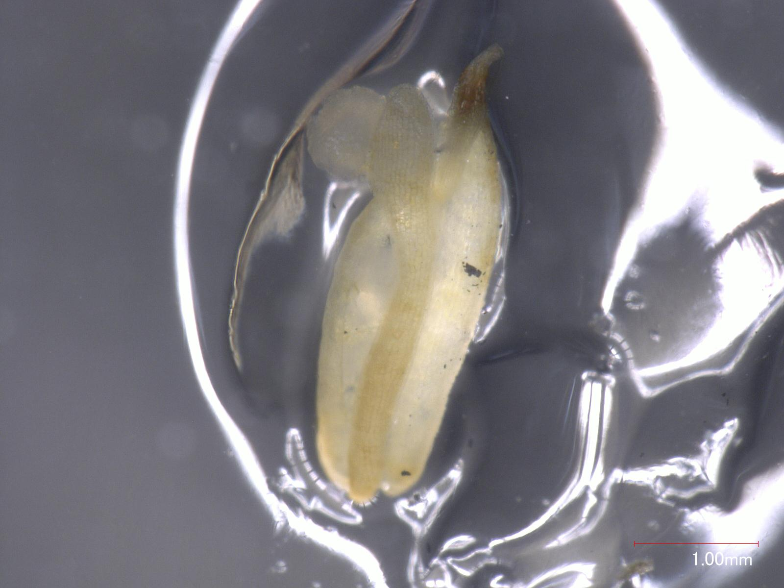
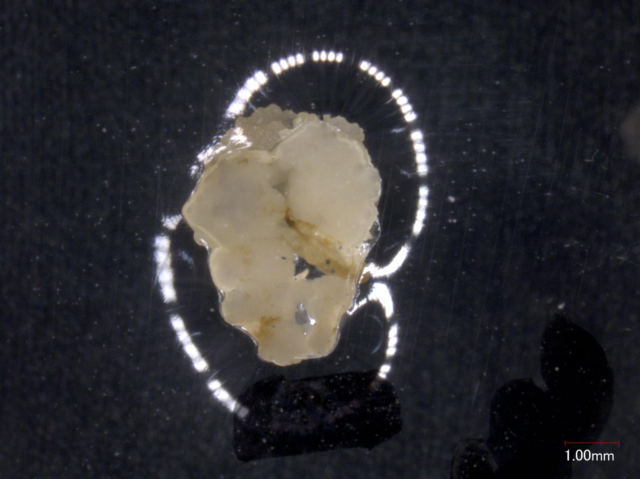
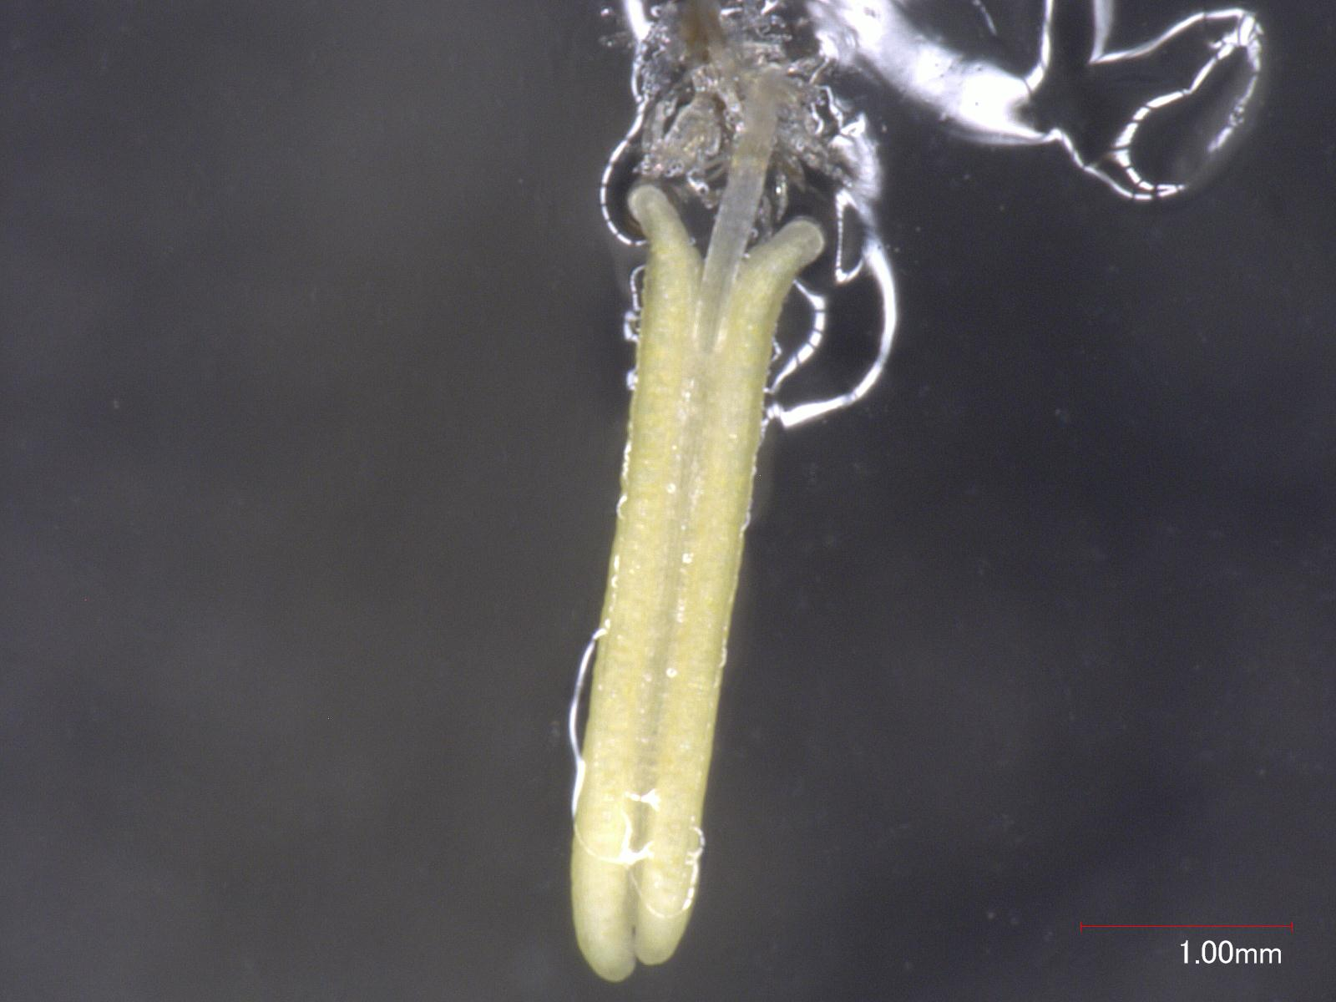
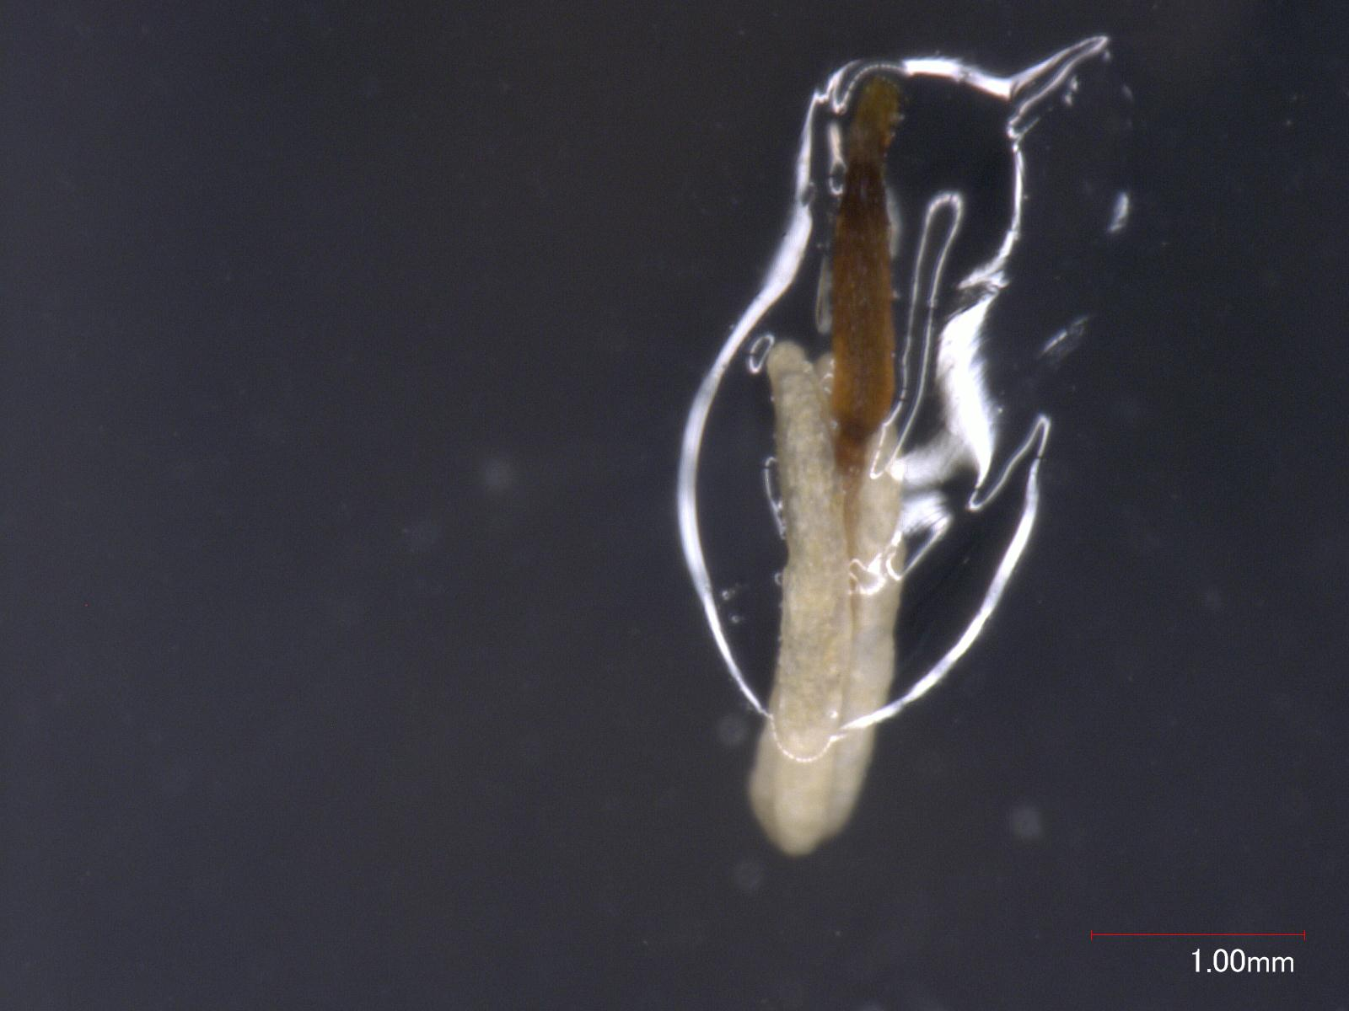
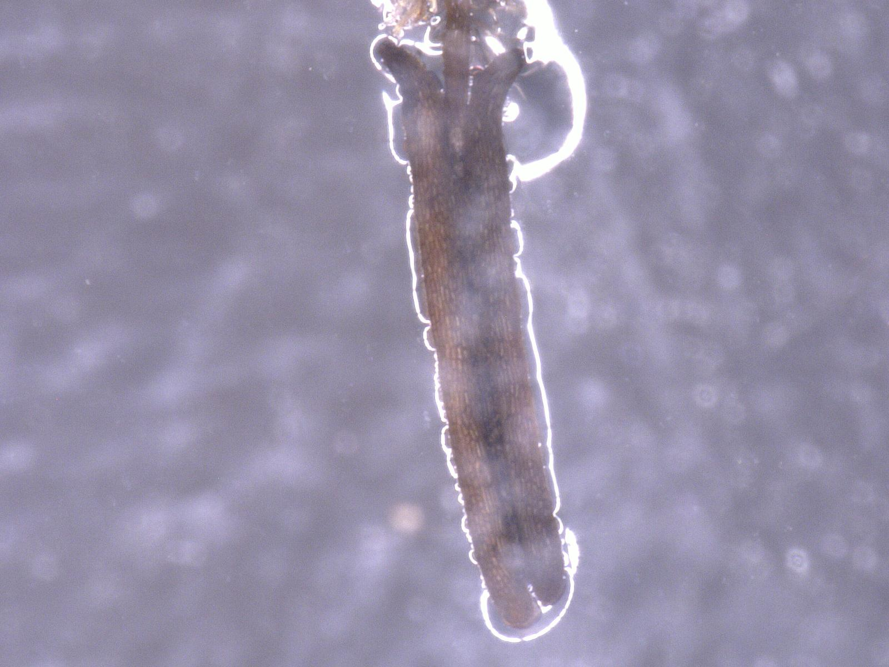
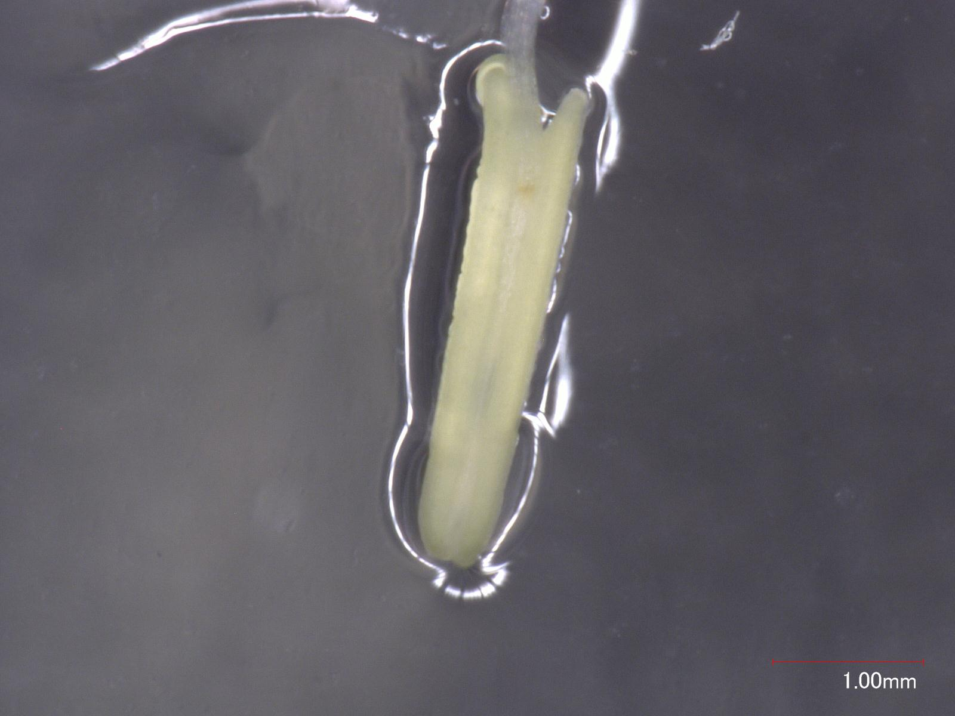
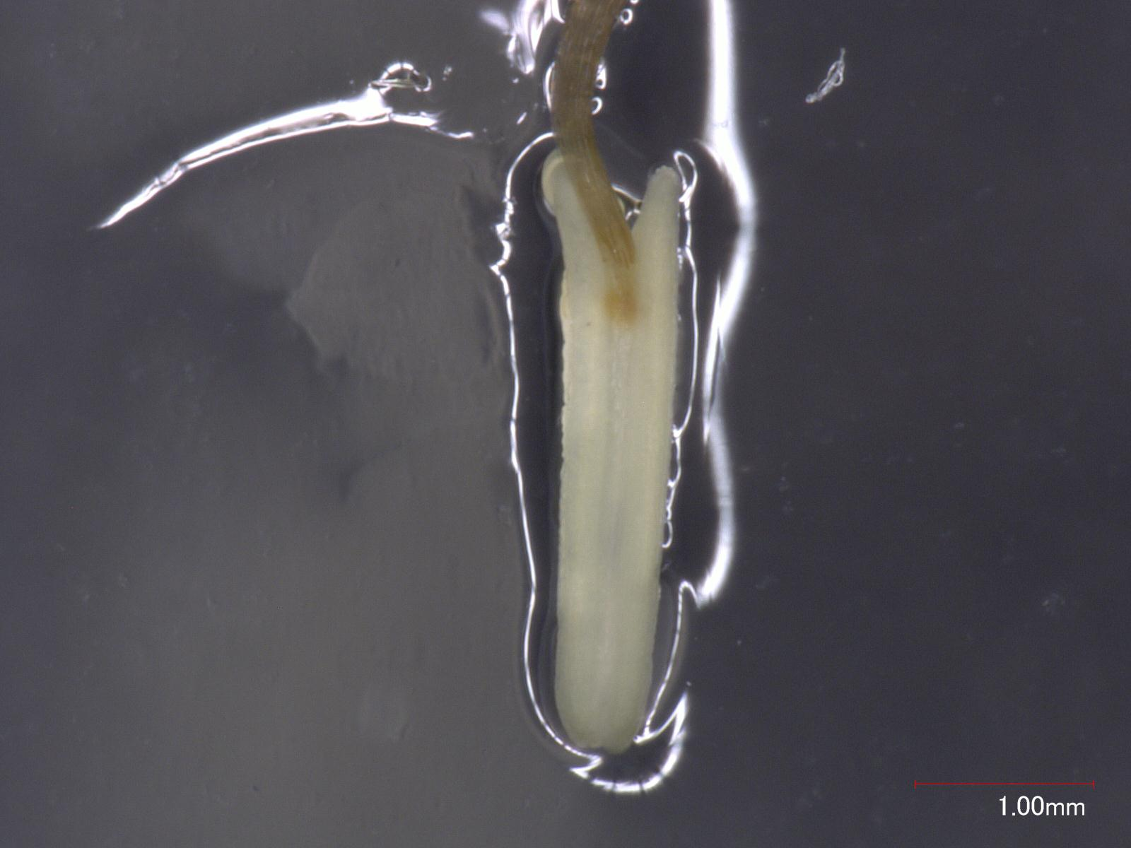
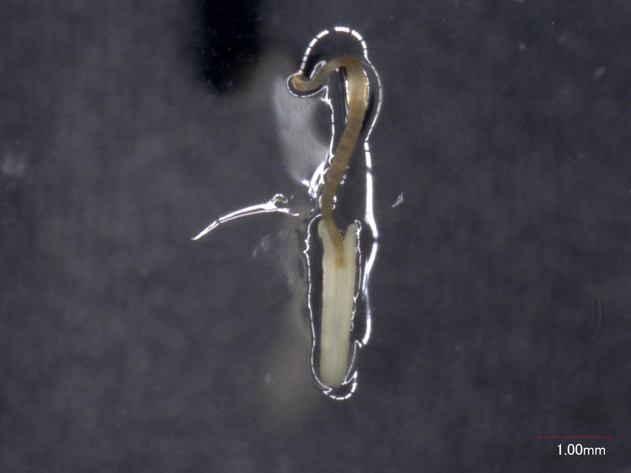
Week 1
Week 2
Week 3
Nipponbare
Replicate 1
Nipponbare
Replicate 2
Kasalath
Replicate 1
1.00mm
Kasalath
Replicate 2
Fig. S5 Representative images of Nipponbare and Kasalath anthers during three weeks of culture. Anthers from two independent biological replicates of Nipponbare and Kasalath are shown at Weeks 1, 2, and 3 of culture. Rows represent the two biological replicates of each genotype, and columns represent successive culture weeks from left to right. Scale bars = 1.00 mm.

Slide 6
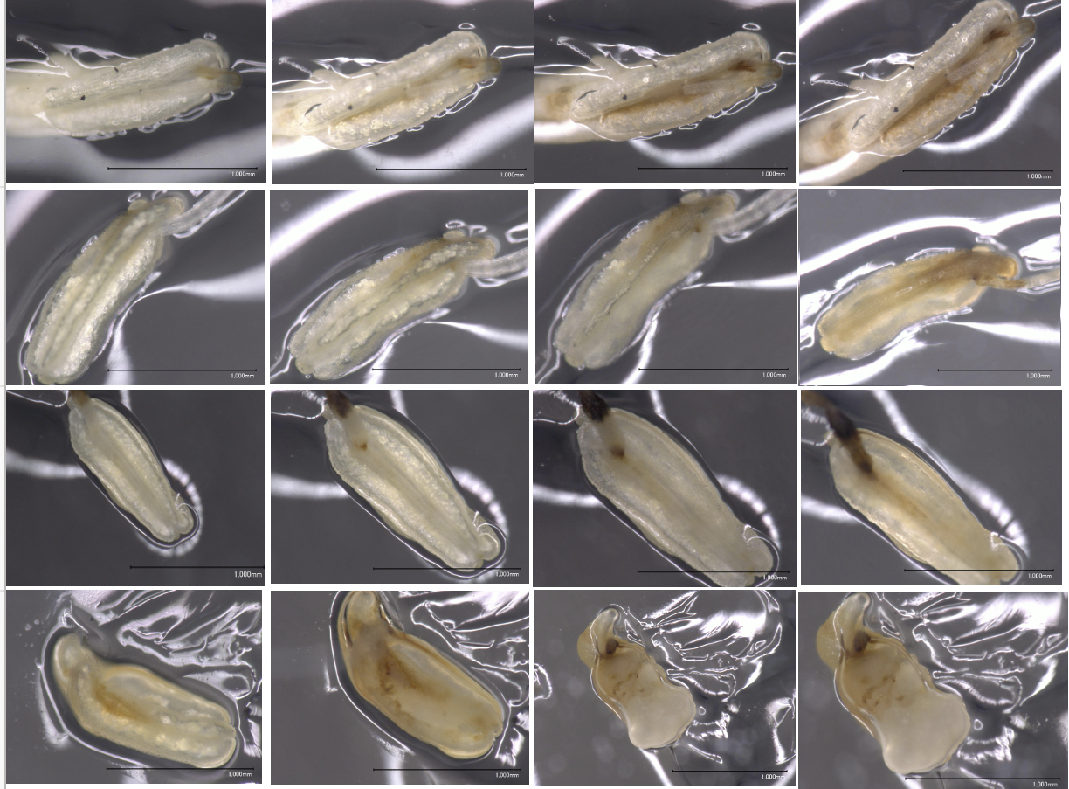
DAY 5
DAY 10
DAY 15
DAY 20
Fig. S6 Time-course observation of the initiation and spread of anther browning during culture. Representative anthers are shown at Days 5, 10, 15, and 20 of culture, arranged chronologically from left to right. Each row shows sequential observations of representative anthers during culture. Red arrows indicate localized sites of browning. Scale bars = 1.00 mm.

Slide 7
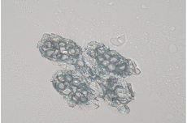
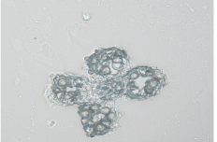
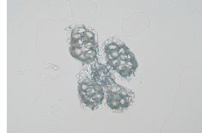
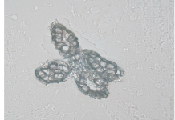
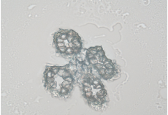
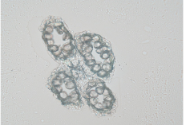
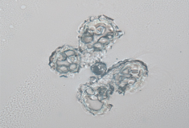
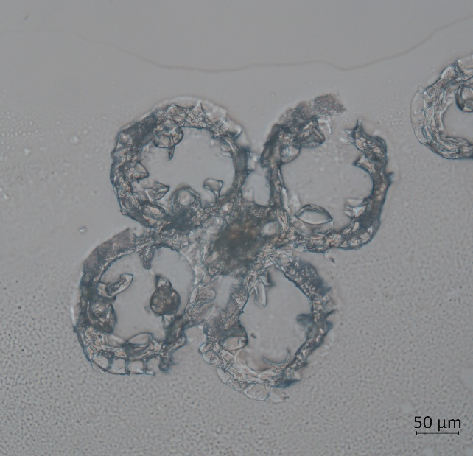
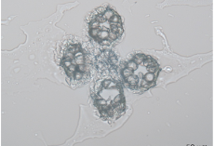
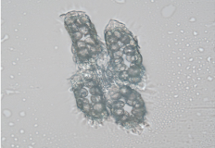
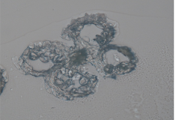
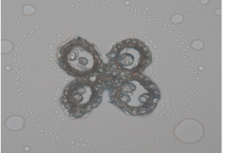
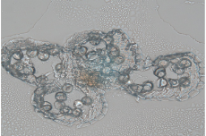
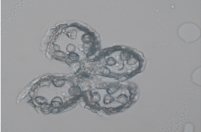
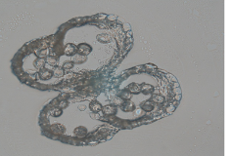
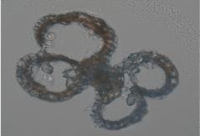
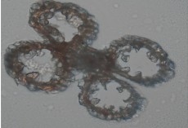
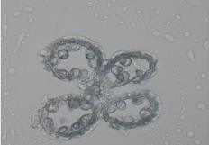
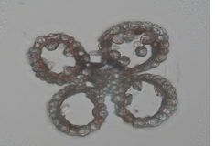
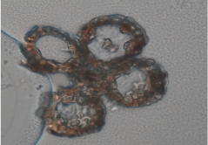
Nipponbare
Replicate 1
Nipponbare
Replicate 2
Kasalath
Replicate 1
Kasalath
Replicate 2
Week 0
50 µm
50 µm
50 µm
50 µm
Week 1
50 µm
50 µm
50 µm
50 µm
Week 2
50 µm
50 µm
50 µm
50 µm
Week 3
50 µm
50 µm
50 µm
50 µm
Week 4
50 µm
50 µm
50 µm
50 µm
Fig. S7 Cryostat transverse sections of Nipponbare and Kasalath anthers during culture. Representative transverse sections from two independent biological replicates of Nipponbare and Kasalath are shown from Week 0 to Week 4. Columns represent Nipponbare replicate 1, Nipponbare replicate 2, Kasalath replicate 1, and Kasalath replicate 2, and rows represent successive culture weeks. White arrows indicate sites of visible browning within the anther sections. Scale bars = 50 µm.

