Slide 1
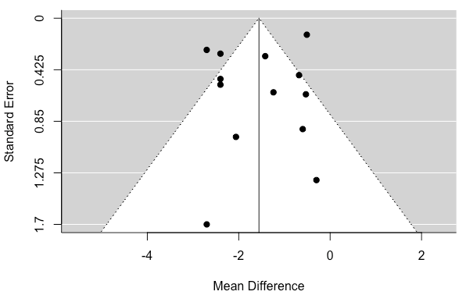
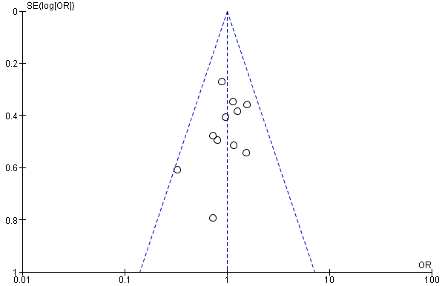
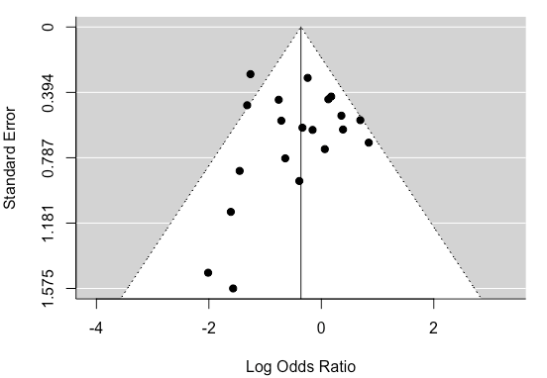
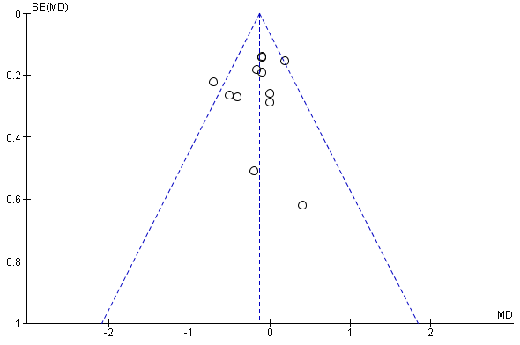
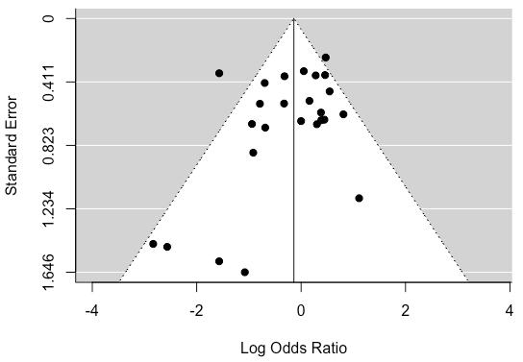
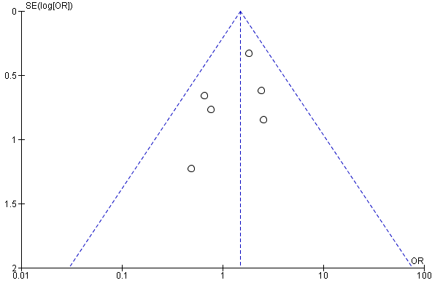
Supplementary Fig. S3: Funnel Plots
a) Gestational weight gain (throughout pregnancy)
b) Pregnancy-induced hypertension
c) Pre-eclampsia
d) Gestational age at delivery
e) Preterm (all causes)
f) Preterm (spontaneous)

Slide 2
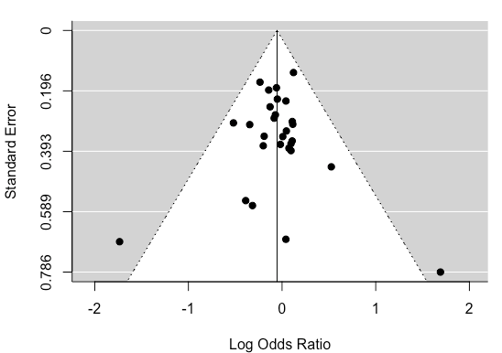
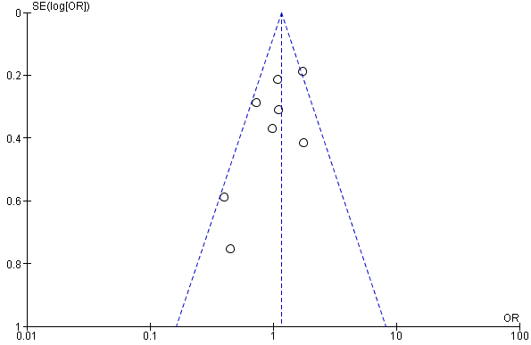
Supplementary Fig. S3: Funnel Plots (continued)
g) Ceserean section rate
h) Incidence of GDM
Funnel Plot analysis
C-section=ceserean-section; GDM=gestational diabetes mellitus; met=metformin.
Odds Ratio or mean difference (where appropriate) ± 95% CI. Fixed or random-effect models where appropriate.

