Slide 1
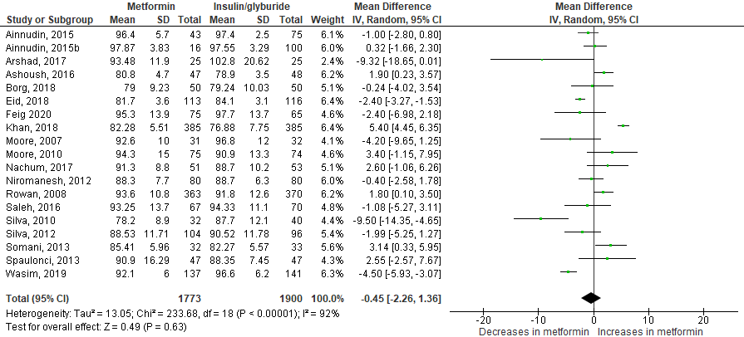
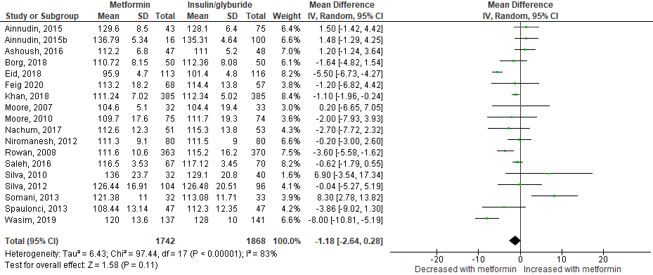
Supplementary Fig. S8: Glycaemic control
a) FBS
b) RBS

Slide 2
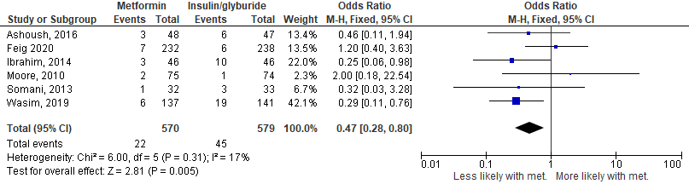
Supplementary Fig S7: Glycaemic control (continued)
c) Maternal hypoglycemia
Maternal glycaemic control (including FBS, RBS and maternal hypoglycaemia)
Mean differences and Odds Ratios (where appropriate) ± 95% CI.
FBS=fasting plasma glucose; RBS=random blood glucose; met=metformin

