Slide 1


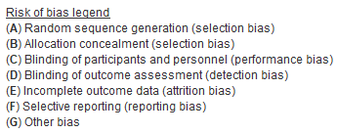
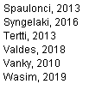
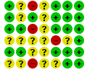
Supplementary Table S2: Risk of Bias
Risk of Bias analysis
Green circles=low risk of bias; yellow circles=unknown risk of bias; red circles=high risk of bias

