Slide 1
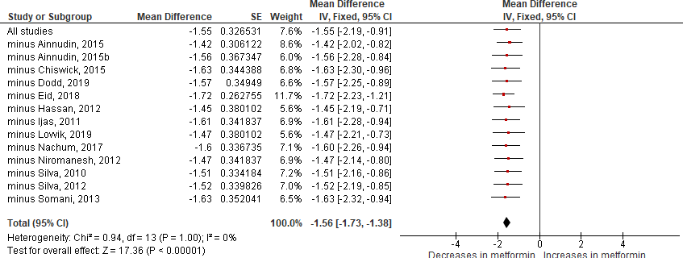
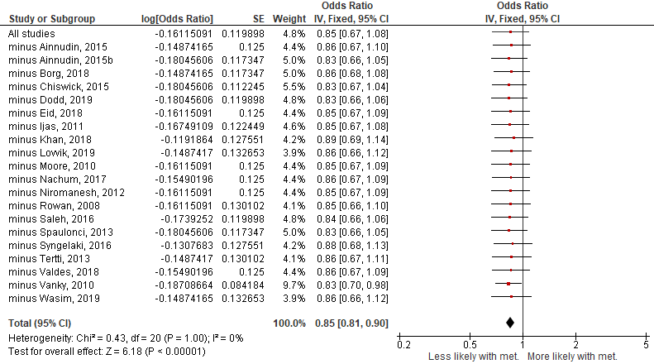
Supplementary Fig. S4: Sensitivity analysis: Leave-one-out
a) Gestational weight gain: Metformin vs. all interventions
b) Pre-eclampsia: Metformin vs. all interventions

Slide 2
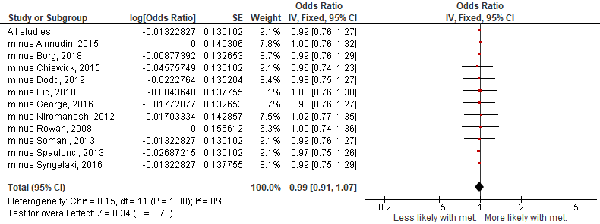
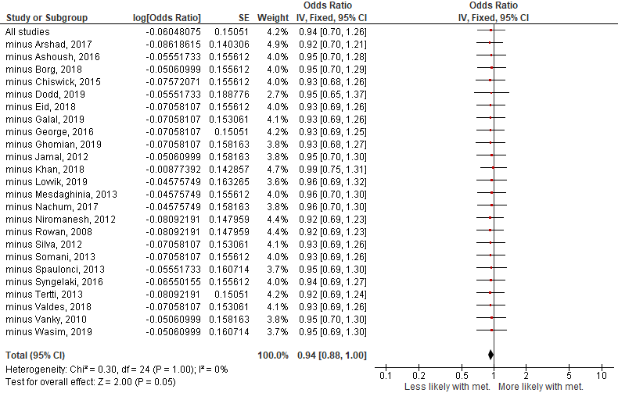
Supplementary S4 Fig: Sensitivity analysis: Leave-one-out (continued)
c) Pregnancy-induced hypertension: Metformin vs. all interventions
d) Preterm (all causes): Metformin vs. all interventions

Slide 3
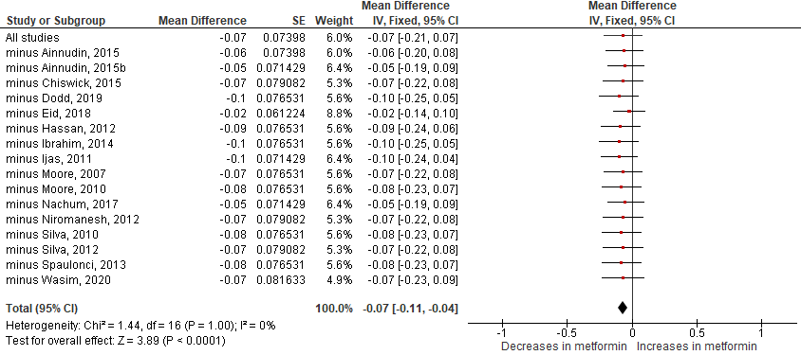
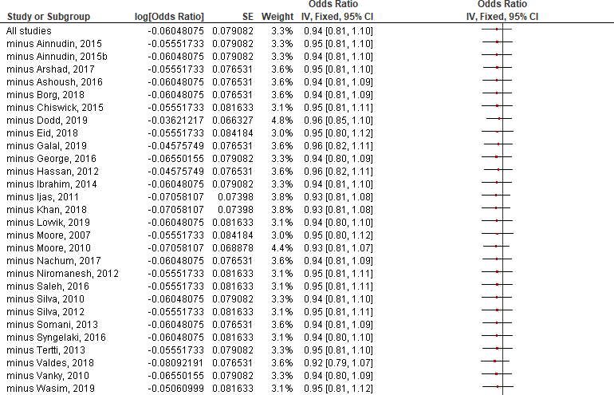
Supplementary S2 Fig: Sensitivity analysis: Leave-one-out (continued)
e) Gestational age at delivery: Metformin vs. all interventions
f) C-section rates: Metformin vs. all interventions

Slide 4
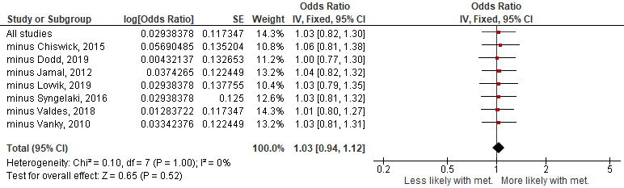
Supplementary S4 Fig: Sensitivity analysis: Leave-one-out (continued)
g) Development of GDM: Metformin vs. all interventions
Sensitivity analysis of outcome measures one study was removed.
C-section=ceserean-section; GDM=gestational diabetes mellitus; met=metformin.
Odds Ratio or mean difference (where appropriate) ± 95% CI. Fixed or random-effect models where appropriate.

