Slide 1
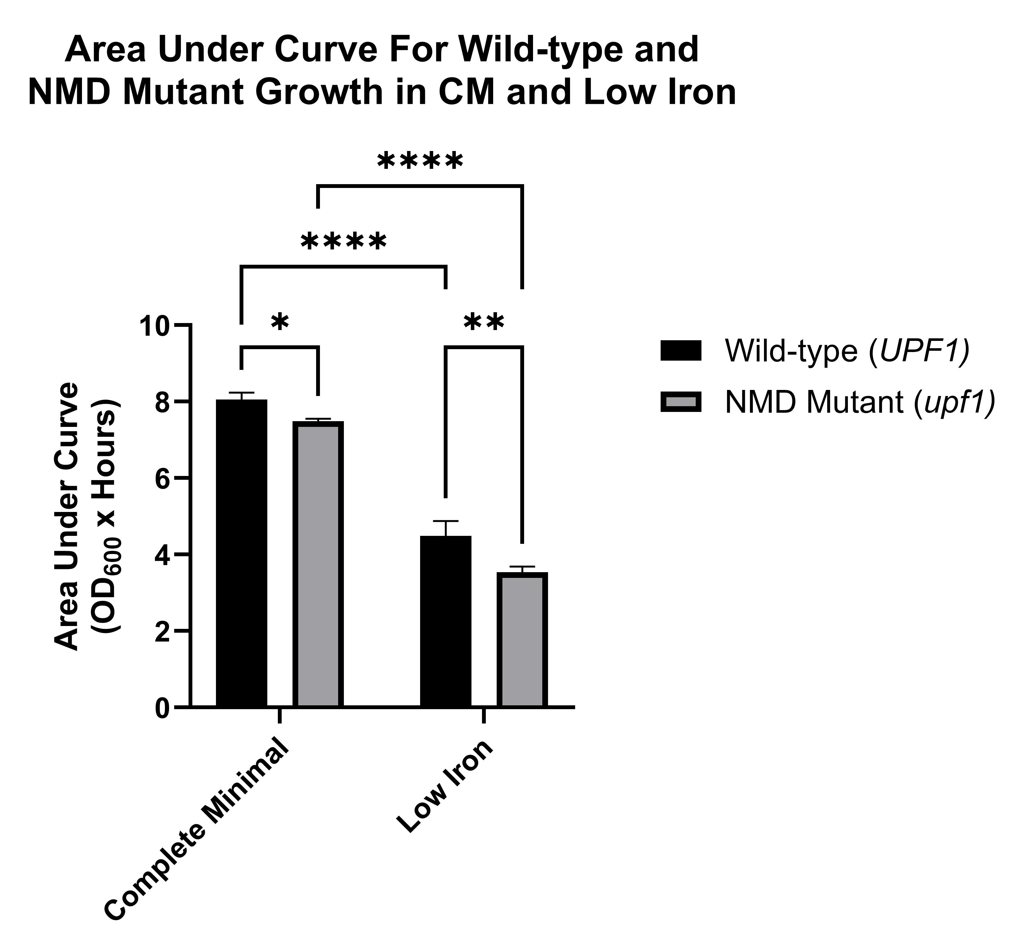
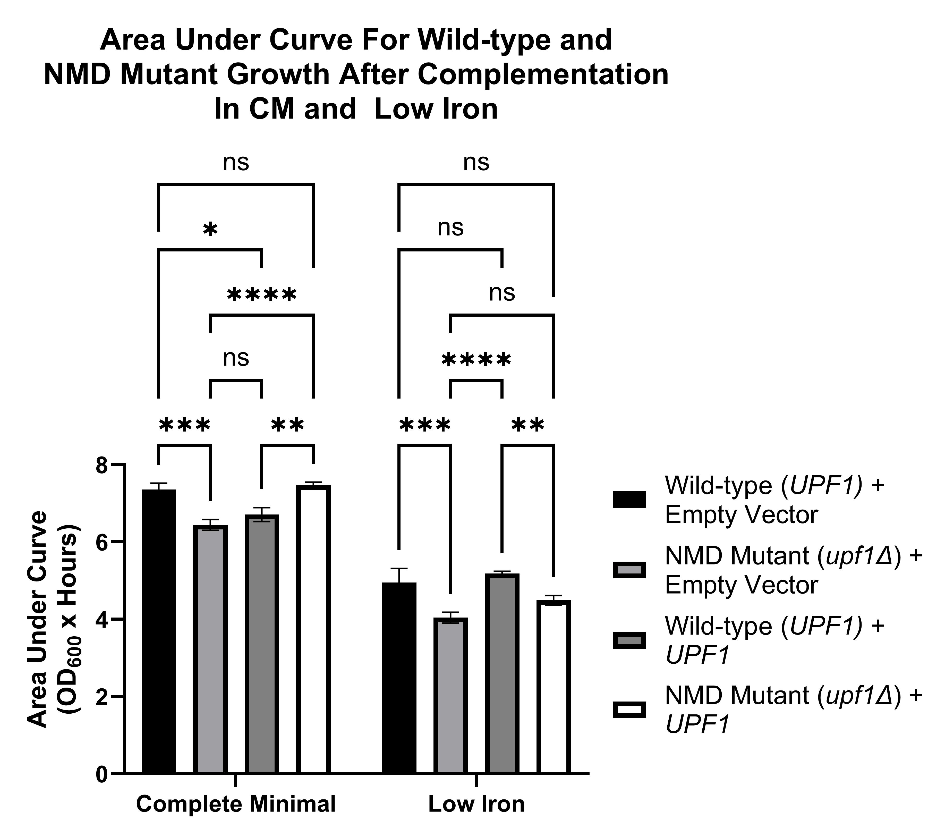
Supplementary Figure 1
A.
B.
Supplementary Figure 1. Area under the curve (AUC) of wild-type (UPF1) and NMD mutant (upf1∆) yeast strains, empty vector and Upf1 complementation, in Complete Minimal (CM) and low iron (CM + 100 µM BPS) conditions. A) Area under the curve (AUC) was calculated for each replicate growth curve of wild-type (UPF1) and NMD mutant (upf1∆) yeast cells. Statistical analysis was performed using a two-way ANOVA on GraphPad Prism revealing statistically significant effects of genotype and growth condition on cell growth (p = 0.0005 and p < 0.0001, respectively. Sidak’s multiple comparisons tests were then conducted to evaluate which groups significantly differed. Significance is denoted with asterisks (p < 0.5 = *, p < 0.01 = **, p < 0.001 = ***, p < 0.0001 = ****). B) Area under the curve (AUC) for each replicate was calculated for each replicate growth curve of wild-type (UPF1) and NMD mutant (upf1∆) yeast cells, each complemented with an empty vector (pRS315) or functional Upf1 (pRS315-UPF1). Statistical analysis was performed using a two-way ANOVA on GraphPad Prism revealing statistically significant effects of genotype and growth condition on cell growth (both with p < 0.0001). Sidak’s multiple comparisons tests were then conducted to evaluate which groups significantly differed.

Slide 2
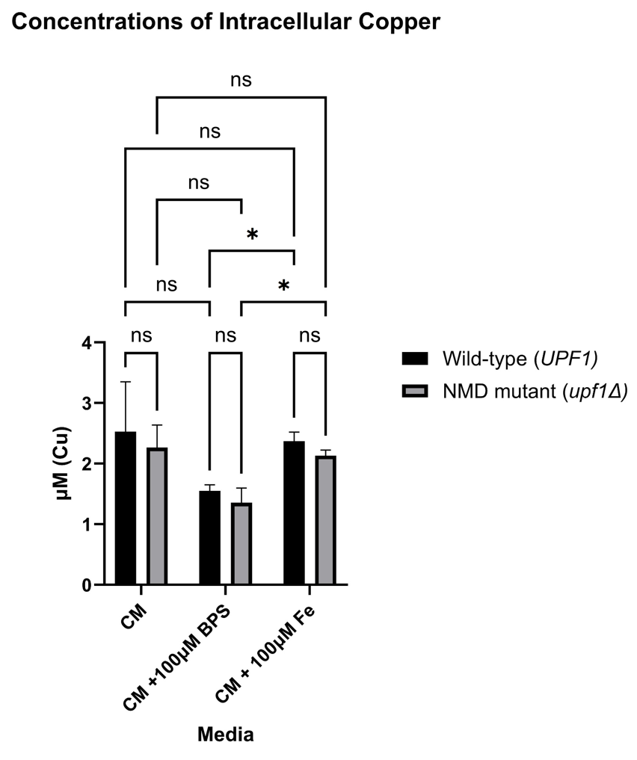
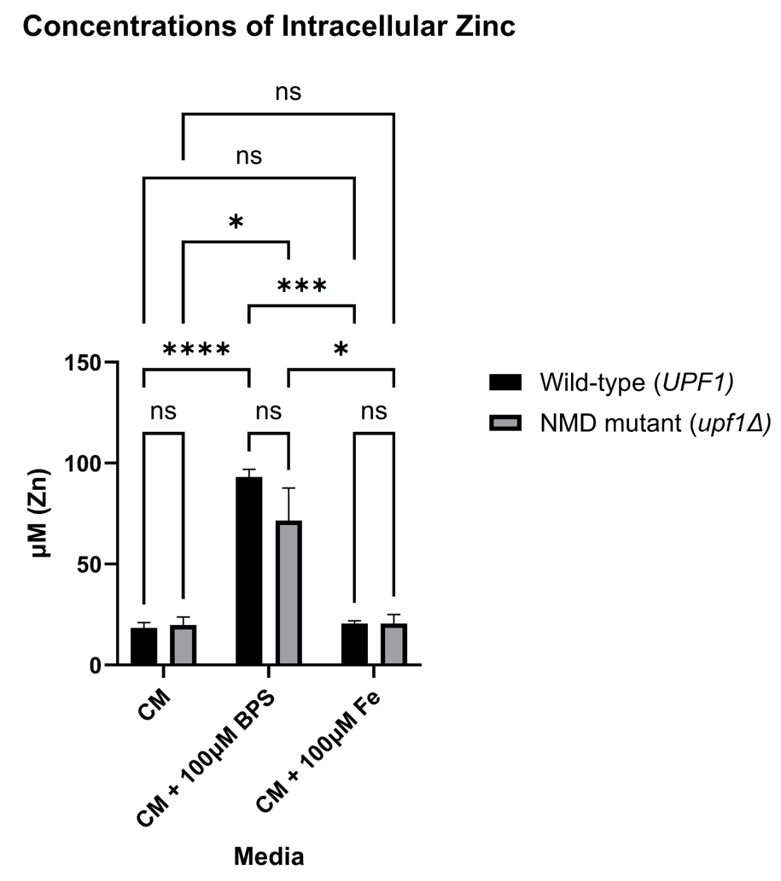
Supplementary Figure 2
A.
B.
Supplementary Figure 2. Total cellular copper and zinc content in wild-type (UPF1) and NMD mutant (upf1Δ) yeast cells. Total intracellular copper (A) and zinc (B) content of the wild-type and NMD mutant yeast strains were measured via inductively coupled plasma mass spectrometry (ICP-MS) in iron-sufficient conditions (CM), low iron conditions (CM + 100 µM BPS), and high iron conditions (CM + 100 µM Fe(III)Cl). The average cellular copper(A), zinc (B) levels are shown with the standard deviations in the different growth conditions. Three independent biological replicates were done for each growth condition. Multiple unpaired t-tests were conducted to evaluate significance differences between genotype and between conditions. Significance is denoted with asterisks (p < 0.05 = *, p < 0.01 = **, p < 0.001 = ***, p < 0.0001 = ****)

Slide 3
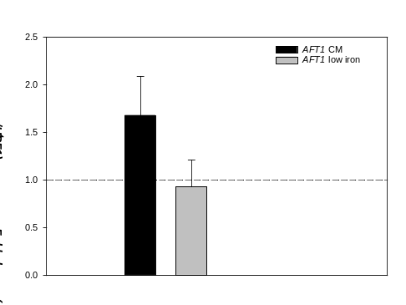
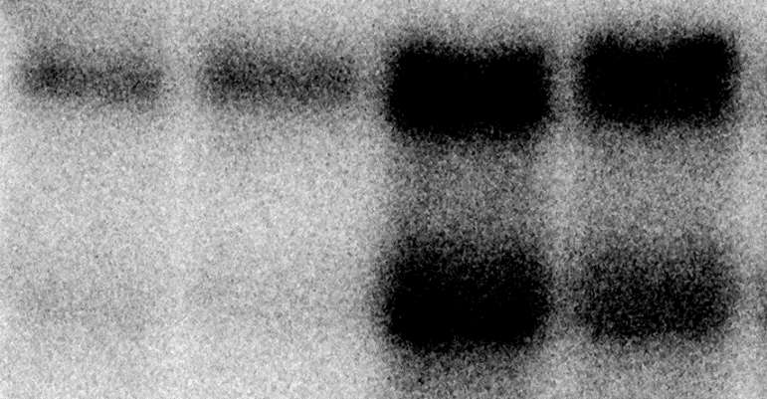
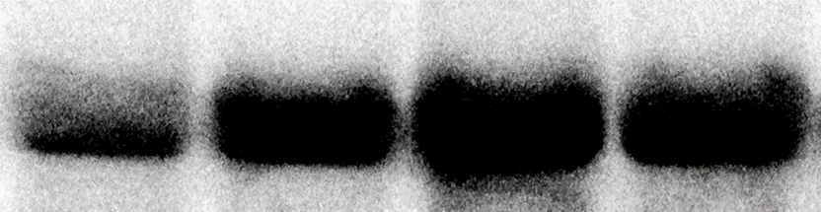
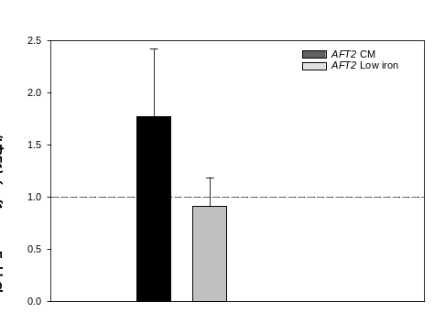
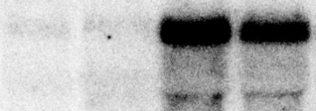
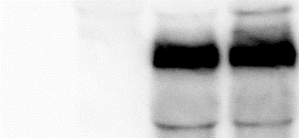
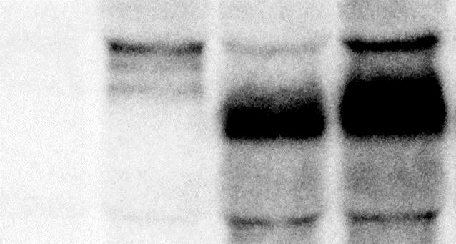
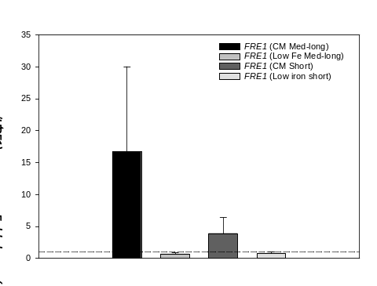
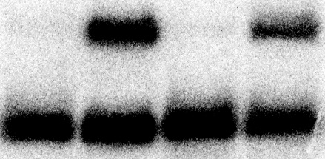

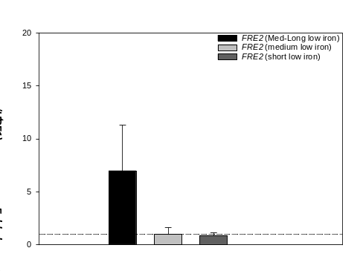
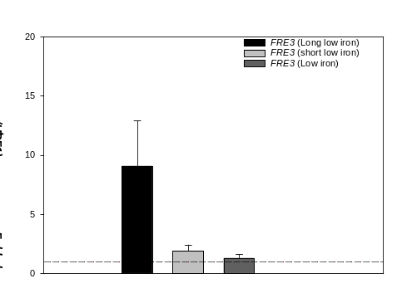
A.
B.
Supplementary Figure 3
CM
Low Fe
AFT1 mRNA steady-state fold change levels in CM and low iron.
WT
upf1Δ
WT
upf1Δ
1
2
3
4
^{Fold}
^{Change}
^{Low} Fe
AFT1
1.0 (long 4.3 Kb)
AFT1
(short)
(long 2.8 Kb)
C.
AFT2 mRNA steady-state fold change levels in CM and low iron.
AFT2
0.9
(med-long)
FRE1
0.7
FRE1
(short)
FRE2
(med-long)
FRE2
1.0(medium)
(short)
FRE2
1.0
(long)
FRE3
9.0
FRE3
(short)
FRE3
1.9
D.
FRE1 mRNA steady-state fold change levels in CM and low iron.
FRE3
1.3
CYH2
pre-mRNA
CYH2 mRNA
SCR1
E.
FRE2 mRNA steady-state fold change levels in low iron.
F.
FRE3 mRNA steady-state fold change levels in low iron.
Supplementary Figure 3: Steady-state mRNA accumulation levels of AFT1-2, FRE1-3 of cells grown in Complete Minimal and low iron conditions to mid-log phase. Steady-state mRNA levels were measured with total RNA extracted from wild-type strain W303 (UPF1) and NMD mutants (upf1Δ) grown in complete minimal (CM, lanes 1-2) or low iron (lanes 3-4). The northern blot was sequentially probed with DNA specific to AFT1, AFT2, FRE1, FRE2, FRE3, CYH2 and SCR1 open reading frames (ORFs). The fold changes (upf1Δ/UPF1) of the measurable mRNA isoforms in CM and under low iron are shown to the right of the northern blots (A). Graphs representing AFT1 (B), AFT2 (C), FRE1-2 (D-F) fold changes for the mRNA isoforms that were measurable on northern blots. The dashed line represents 1.0 fold change in mRNA levels. Error bars represent standard deviations. CYH2 pre-mRNA is a positive control to establish the NMD status of the yeast strains. This pre-mRNA is inefficiently spliced and is transported to the cytoplasm where it’s degraded by NMD because of an in-frame stop codon in the intron. CYH2 mRNA is not degraded by NMD. CYH2 mRNA and SCR1 were used as a loading control.

