Slide 1
Metabolism of brorphine, chlorphine, fluorphine and N-propionitrile chlorphine in human hepatocytes and authentic N-propionitrile chlorphine case studies using high-resolution mass spectrometry
Supplementary Material
Prince S. Gameli^{1*}, Robert Kronstrand^{1,2}, Henrik Gréen^{1,2,3}
¹Division of Clinical Chemistry and Pharmacology, Department of Biomedical and Clinical Sciences, Linköping University, Linköping, Sweden
²Department of Forensic Genetics and Forensic Toxicology, Linköping University, Linköping, Sweden
¹Division of Clinical Chemistry and Pharmacology, Science for Life Laboratory, Linköping University, Linköping, Sweden
Corresponding author: Prince S. Gameli

Slide 2
Common brorphine, chlorphine and fluorphine metabolites

Slide 3
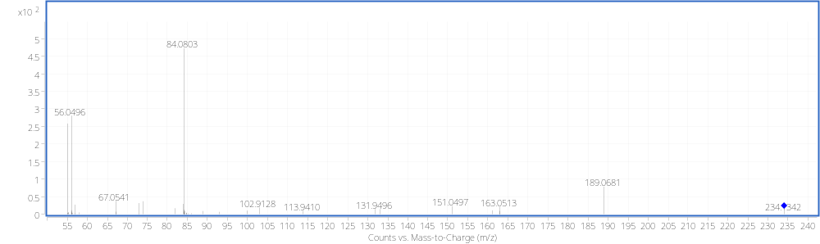
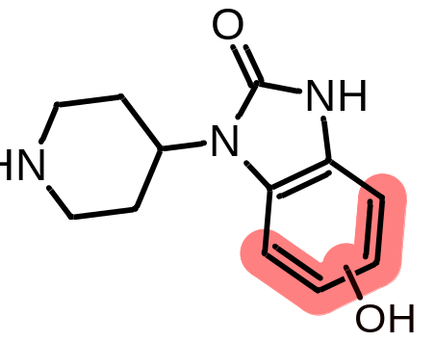
B1/C1/F1; N-Dealkylation (Piperidine) + Hydroxylation (Benzimidazole)

Slide 4
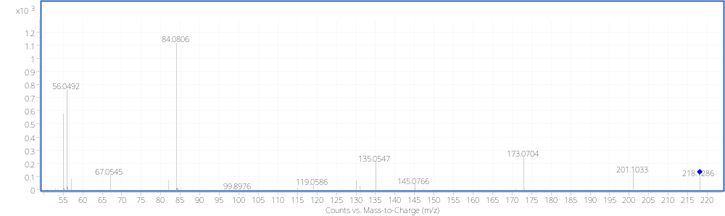
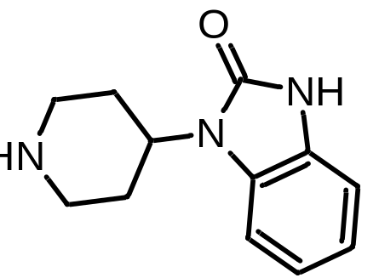
B2/C2/F2; N-Dealkylation (Piperidine)

Slide 5
Brorphine metabolites

Slide 6
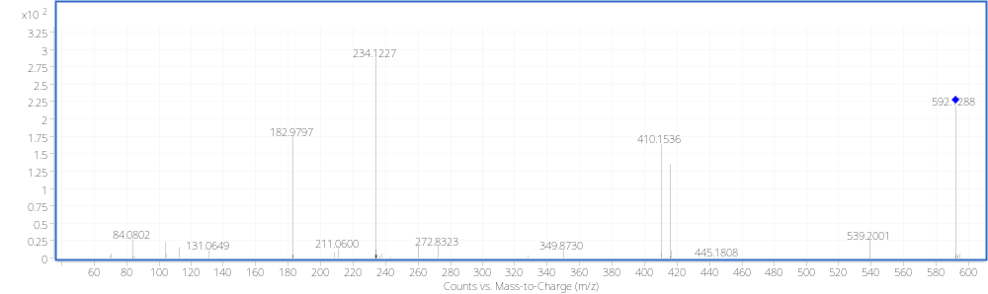
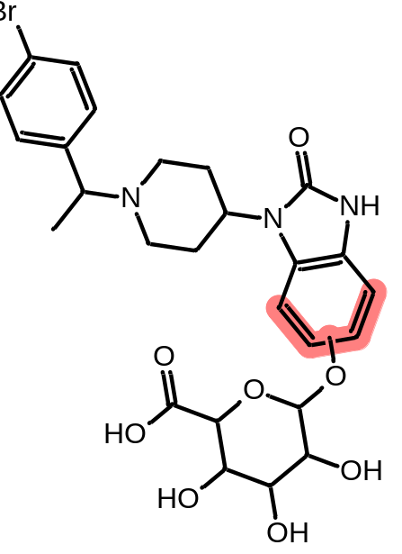
B3, B4 & B5; Hydroxylation + O-Glucuronidation (Benzimidazole)

Slide 7
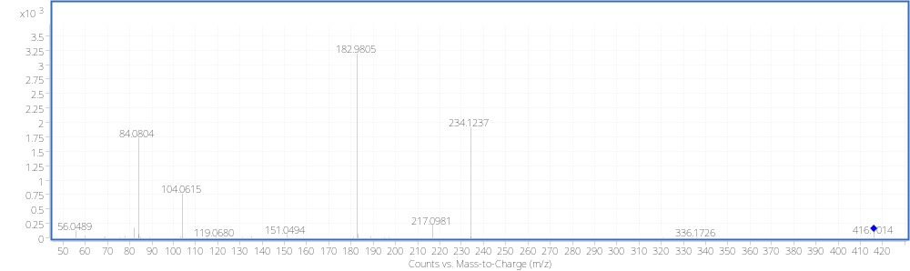
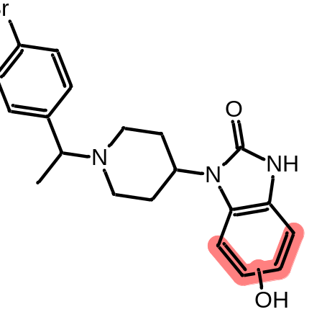
B6, B8 & B11; Hydroxylation (Benzimidazole)

Slide 8
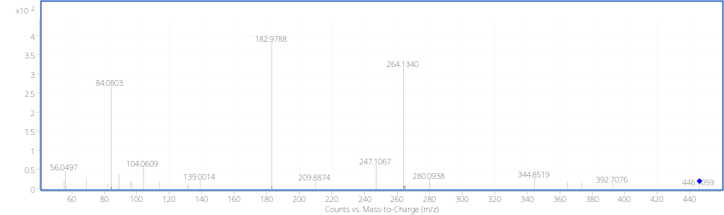
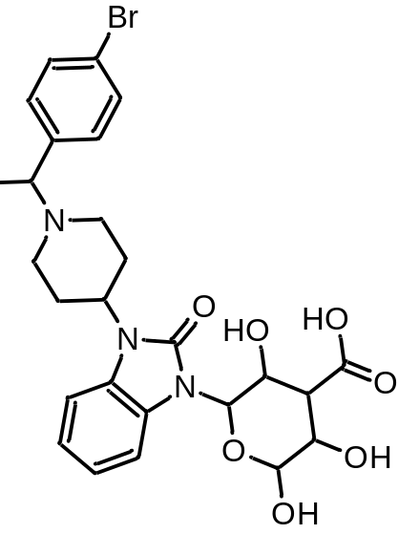
B7; N-Glucuronidation (Benzimidazole)

Slide 9
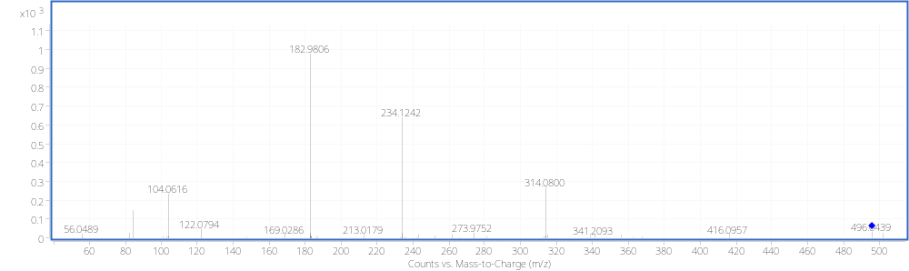
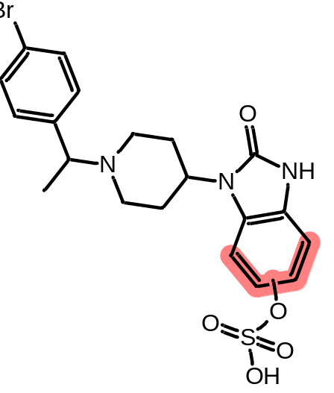
B9; Hydroxylation + O-Sulfation (Benzimidazole)

Slide 10
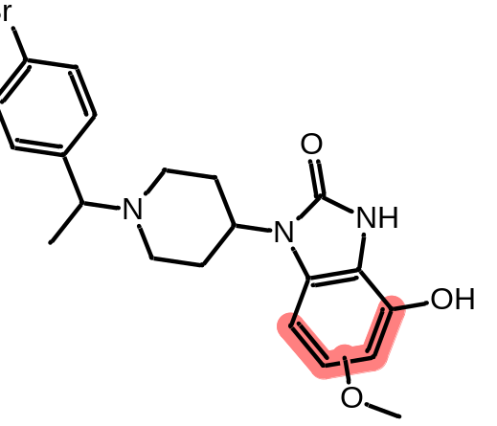
B10; Di-hydroxylations + O-Methylation (Benzimidazole)

Slide 11
Chlorphine metabolites

Slide 12
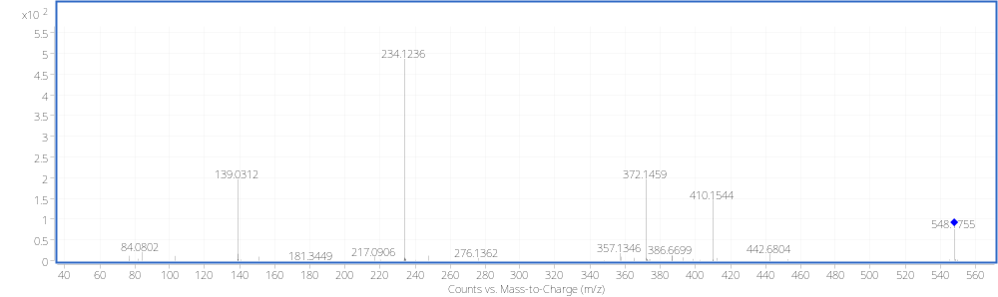
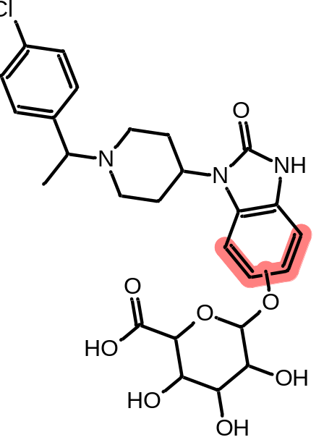
C3, C4 & C5; Hydroxylation + O-Glucuronidation (Benzimidazole)

Slide 13
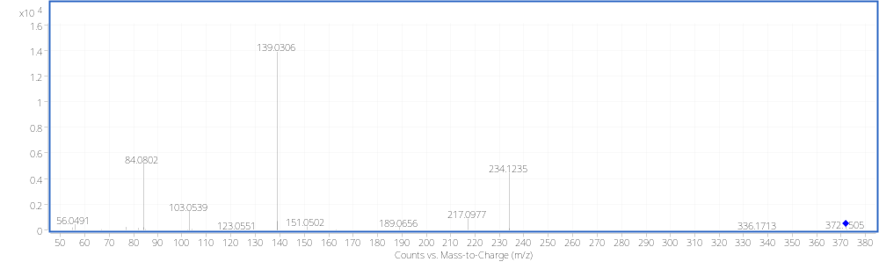

C6, C8 & C11; Hydroxylation (Benzimidazole)

Slide 14
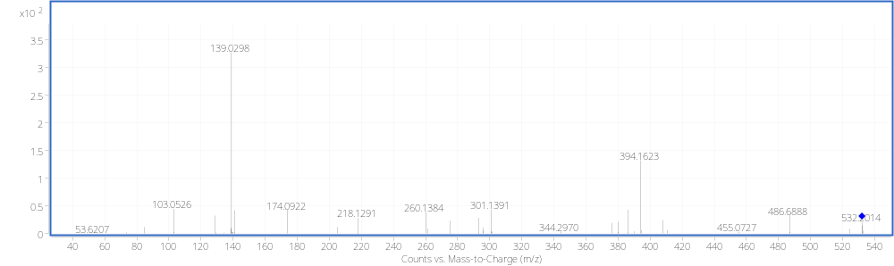

C7; N-Glucuronidation (Benzimidazole)

Slide 15
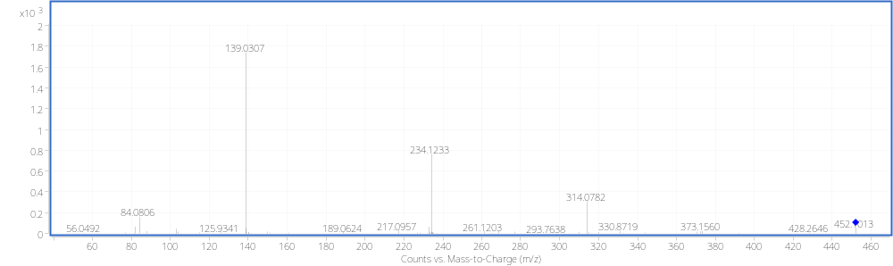

C9; Hydroxylation + O-Sulfation (Benzimidazole)

Slide 16
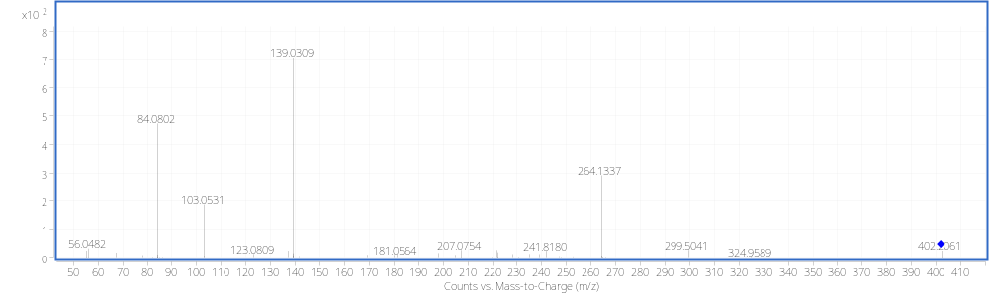

C10; Di-hydroxylations + O-Methylation (Benzimidazole)

Slide 17
Fluorphine metabolites

Slide 18
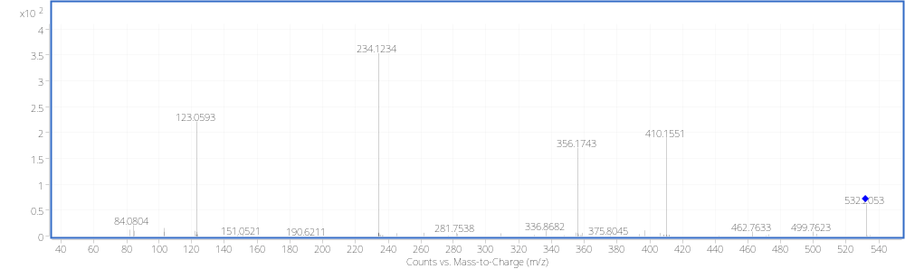
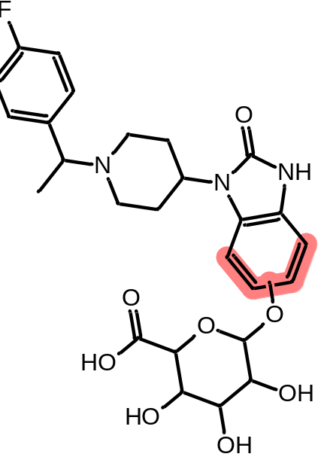
F3, F4 & F5; Hydroxylation + O-Glucuronidation (Benzimidazole)

Slide 19
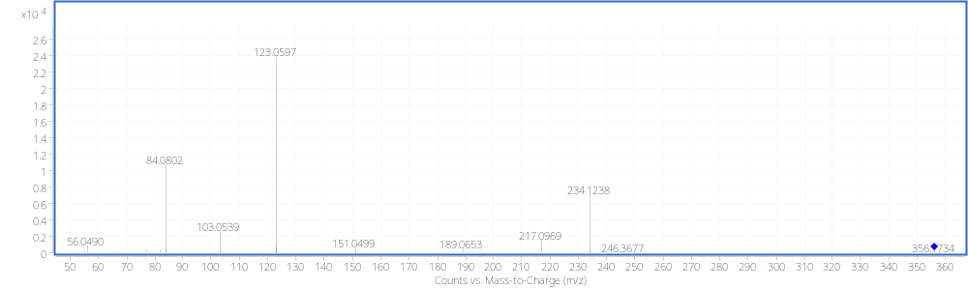
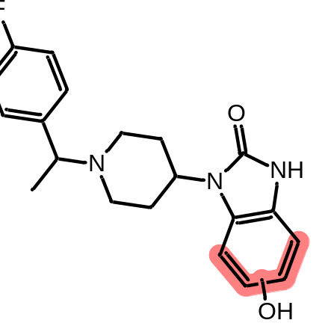
F6, F8, & F11; Hydroxylation (Benzimidazole)

Slide 20
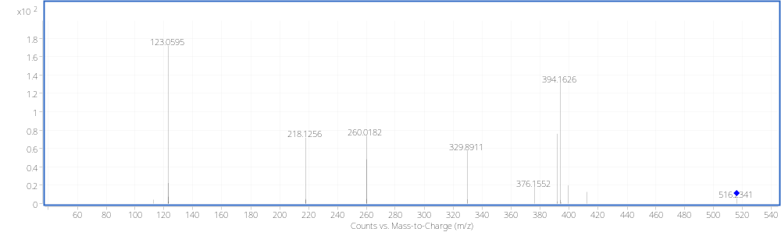
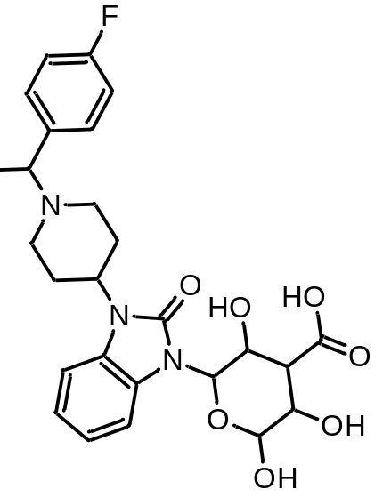
F7; N-Glucuronidation (Benzimidazole)

Slide 21
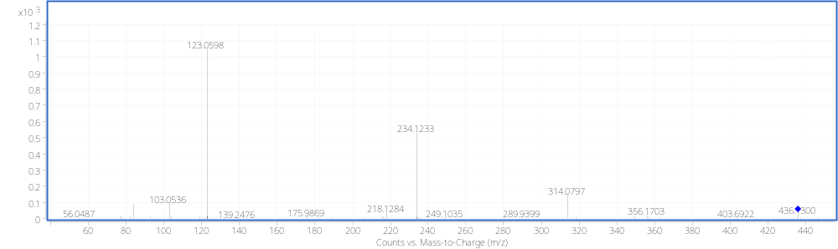
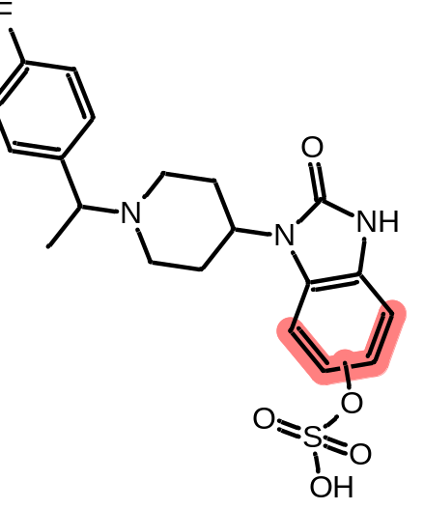
F9; Hydroxylation + O-Sulfation (Benzimidazole)

Slide 22
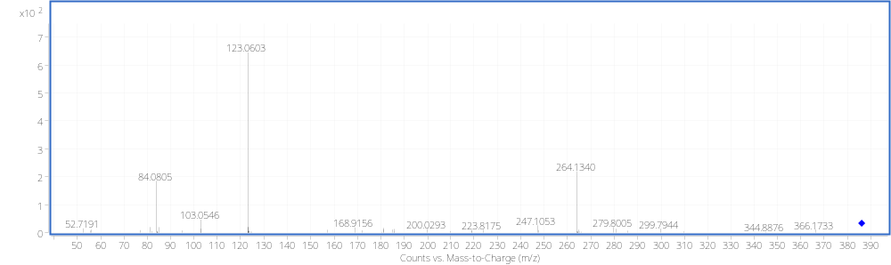
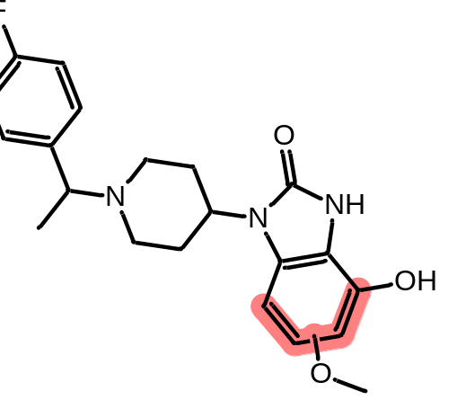
F10; Di-hydroxylations + O-Methylation (Benzimidazole)

Slide 23
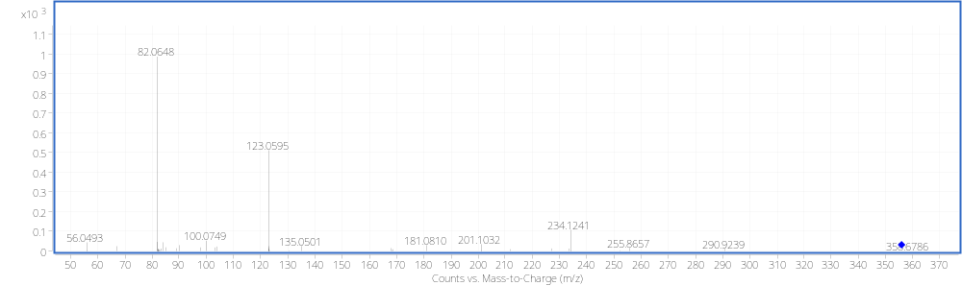
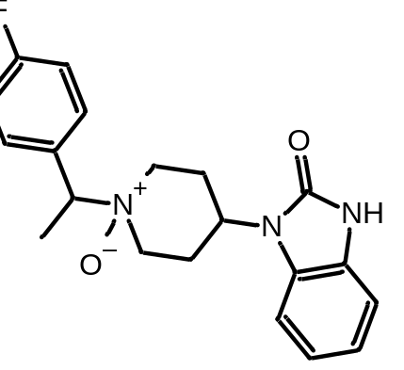
F12; N-Oxidation (Piperidine)

Slide 24
N-Propionitrile chlorphine metabolites

Slide 25
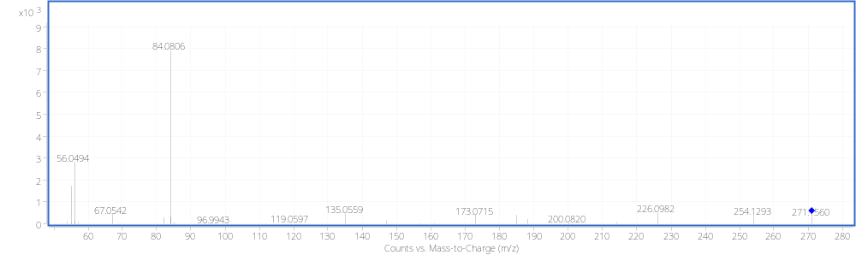
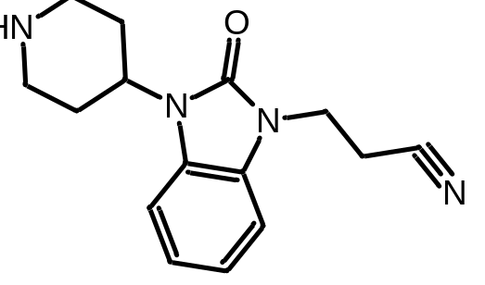
N1; N-Dealkylation (Piperidine)

Slide 26
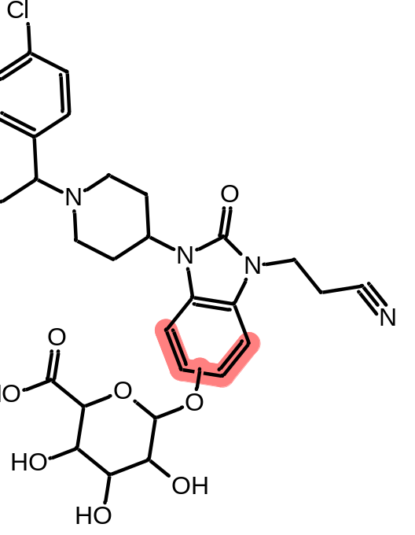
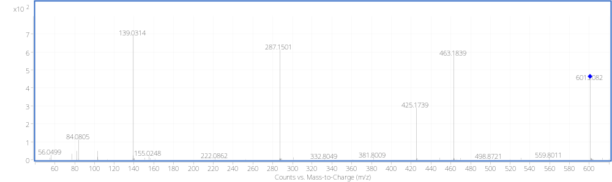
N2, N3 & N6; Hydroxylation + O-Glucuronidation (Benzimidazole)

Slide 27
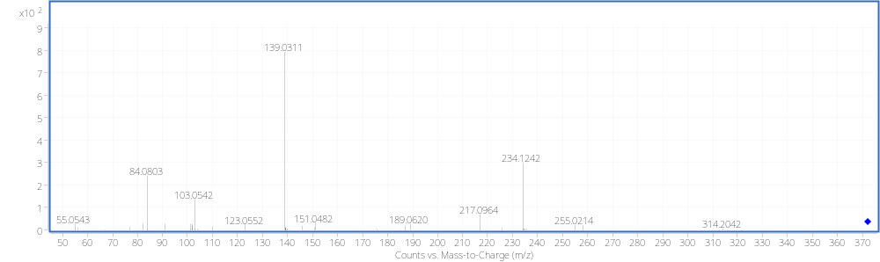
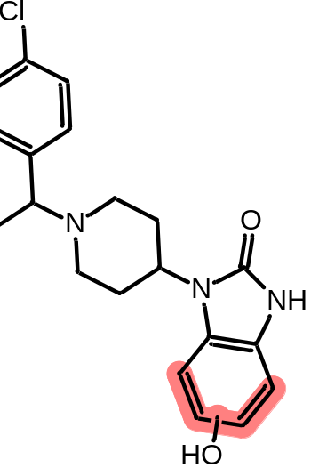
N4 & N5; N-Dealkylation + Hydroxylation (Benzimidazole)

Slide 28
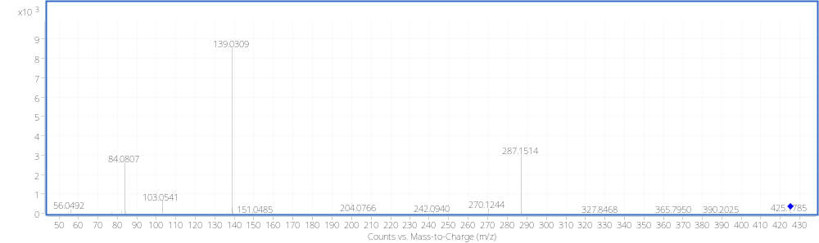
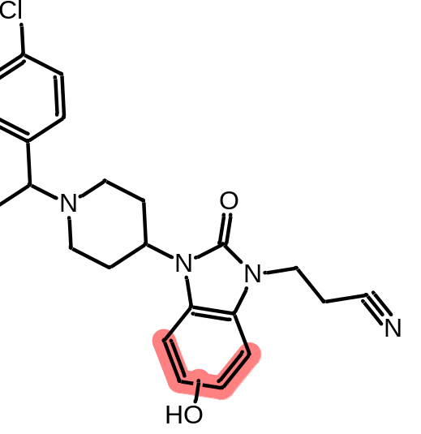
N7 & N11; Hydroxylation (Benzimidazole)

Slide 29
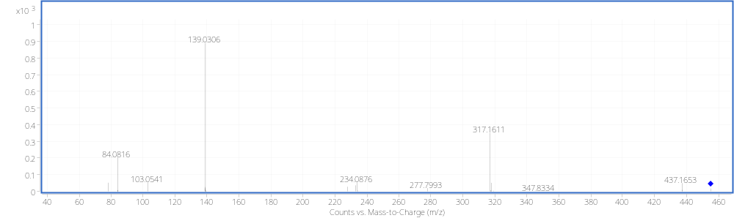
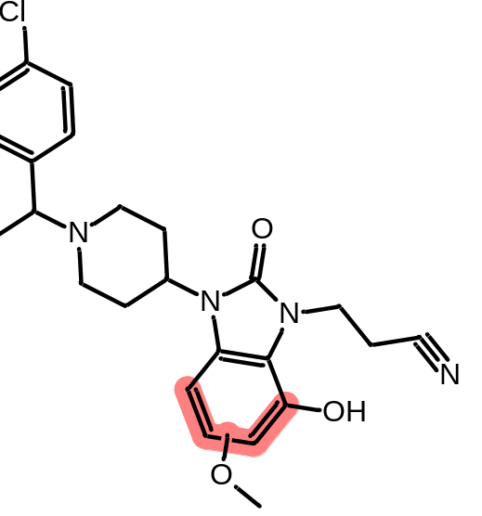
N8; Di-hydroxylations + O-Methylation (Benzimidazole)

Slide 30
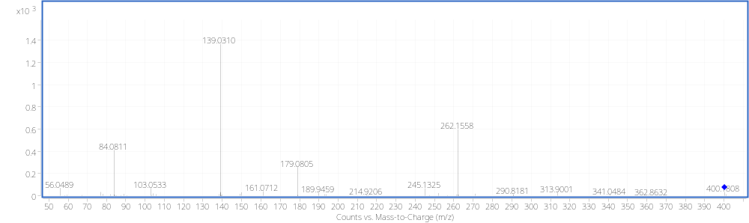
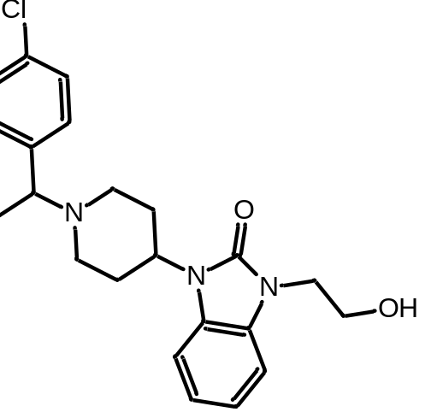
N9; De-cyanation to alcohol (Propionitrile)

Slide 31
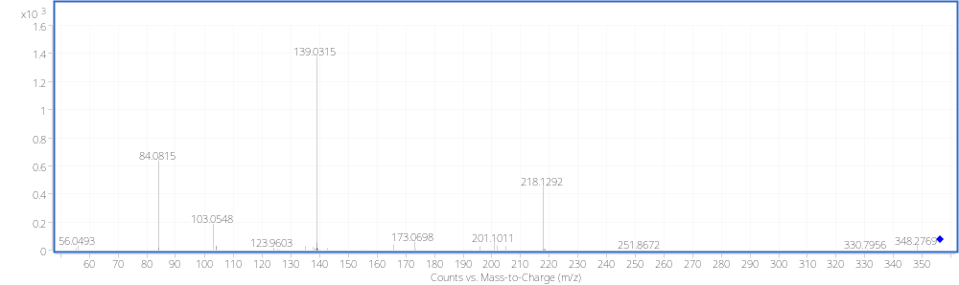
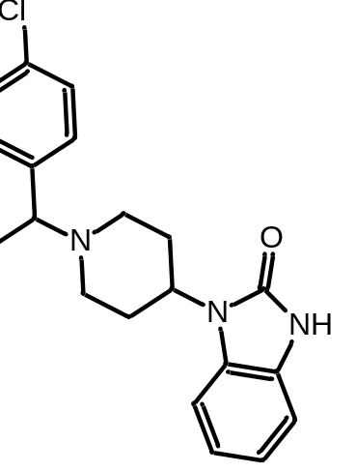
N10; N-Dealkylation (Benzimidazole)

Slide 32
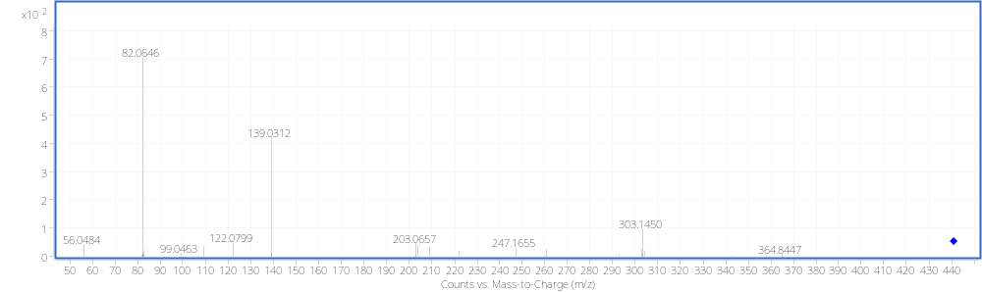
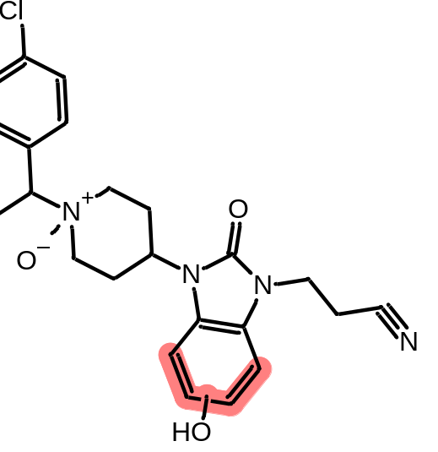
N12; N-Oxidation (Piperidine) + Hydroxylation (Benzimidazole)

Slide 33
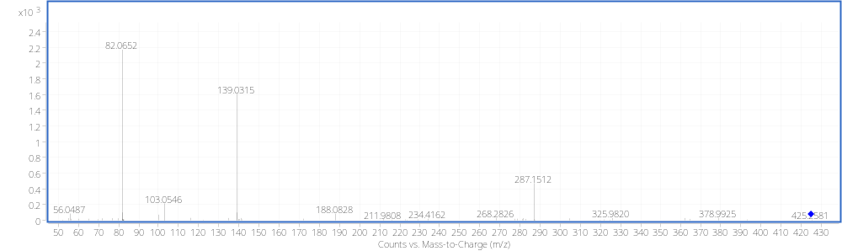
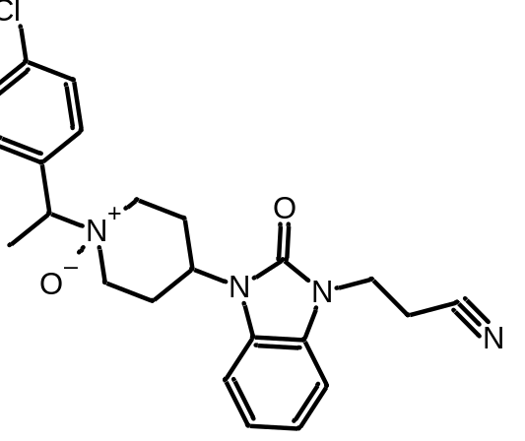
N13; N-Oxidation (Piperidine)

