Slide 1
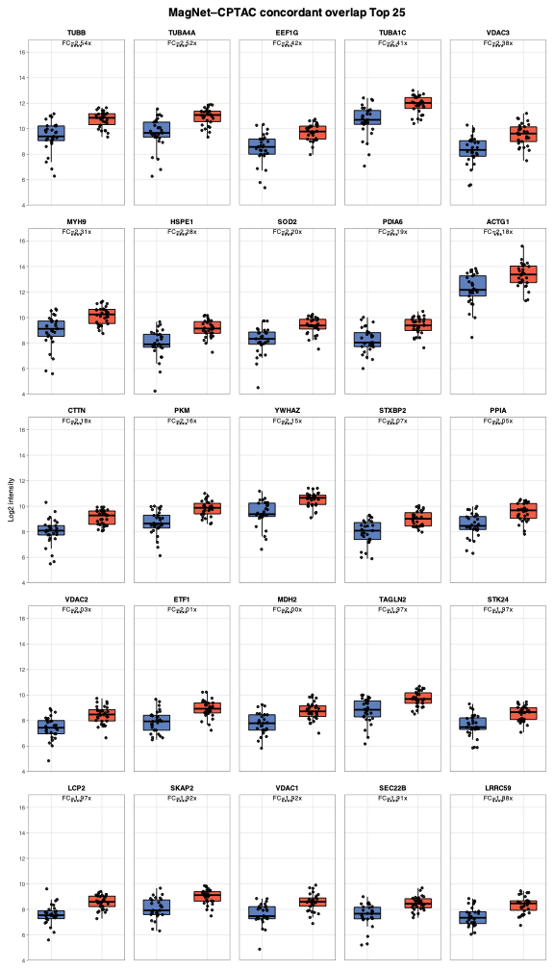
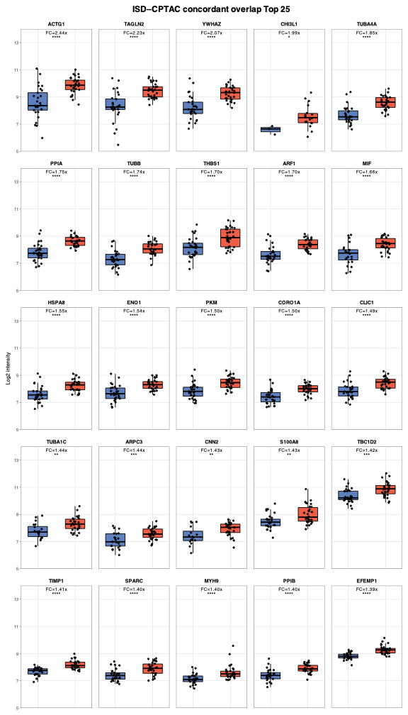
Supplementary Figure 1. Comparison of CRC-associated plasma protein alterations with the CPTAC colorectal tissue dataset.
A.
526
211
2310
213
55
2466
134
71
2922
15
6
2987
MagNet_p<0.05
Tissue dataset_p<0.05
ISD_p<0.05
Tissue dataset_p<0.05
B.
ISD_overlap_tissue dataset (top 25)
MagNet_overlap_tissue dataset (top 25)
(A) Direction-specific overlap of significantly altered proteins identified by Mag-Net (left) and ISD (right) with the CPTAC colorectal tissue dataset. Proteins with a raw p value < 0.05 were classified as upregulated (↑) or downregulated (↓) in CRC relative to healthy or normal controls. The intersecting regions represent proteins showing concordant directions of change in the in-house plasma and CPTAC tissue datasets. (B) Boxplots of the 25 concordant overlap proteins with the largest fold-change magnitude in the Mag-Net (left) and ISD (right) datasets. Blue and red indicate healthy controls and CRC samples, respectively. FC values and significance levels are based on the limma analysis. p values are indicated as: p ≥ 0.05; *, p < 0.05; **, p < 0.01; ***, p < 0.001; and ****, p < 0.0001.

Slide 2
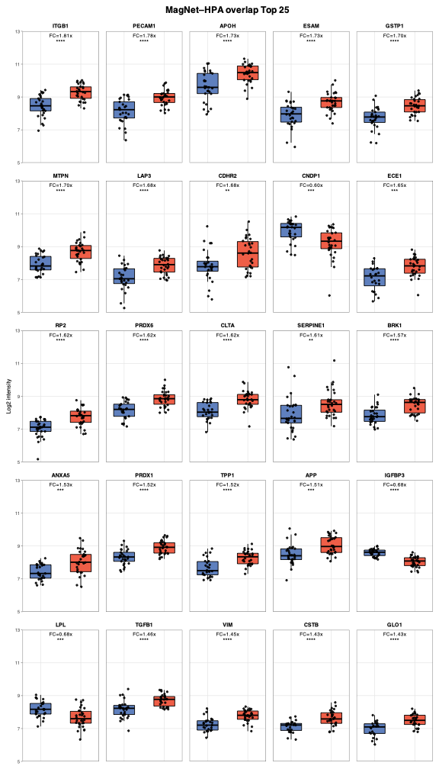
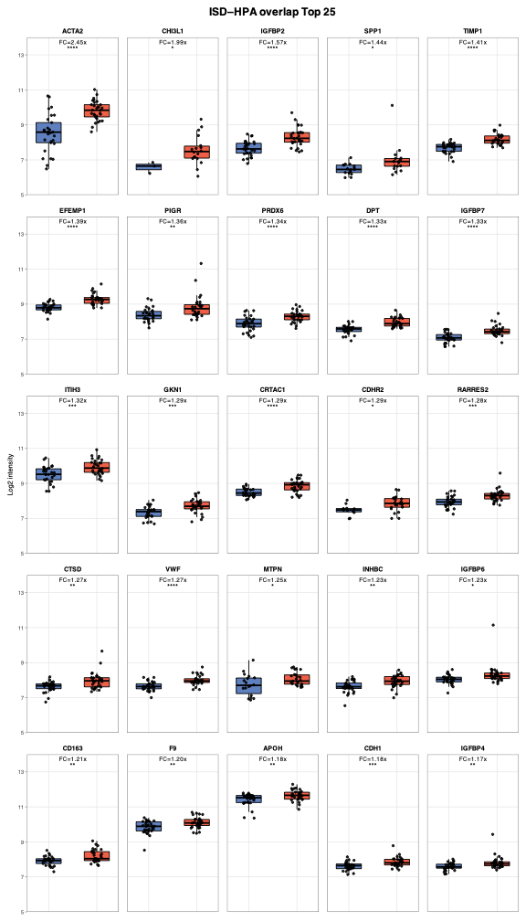
Supplementary Figure 2. Comparison of CRC-associated plasma protein alterations with the HPA plasma dataset.
A.
708
29
2493
244
29
2498
177
28
2966
15
6
2988
MagNet_p<0.05
Plasma dataset_p<0.05
ISD_p<0.05
Plasma dataset_p<0.05
B.
ISD_overlap_plasma dataset_Top 25
MagNet_overlap_plasma dataset_Top 25
(A) Direction-specific overlap of significantly altered proteins identified by Mag-Net (left) and ISD (right) with the HPA plasma dataset. Proteins with a raw p value < 0.05 were classified as upregulated (↑) or downregulated (↓) in CRC relative to healthy or normal controls. The intersecting regions represent proteins showing concordant directions of change in the in-house plasma and HPA plasma datasets. (B) Boxplots of the 25 concordant overlap proteins with the largest fold-change magnitude in the Mag-Net (left) and ISD (right) datasets. Blue and red indicate healthy controls and CRC samples, respectively. FC values and significance levels are based on the limma analysis. p values are indicated as: p ≥ 0.05; *, p < 0.05; **, p < 0.01; ***, p < 0.001; and ****, p < 0.0001.

Slide 3
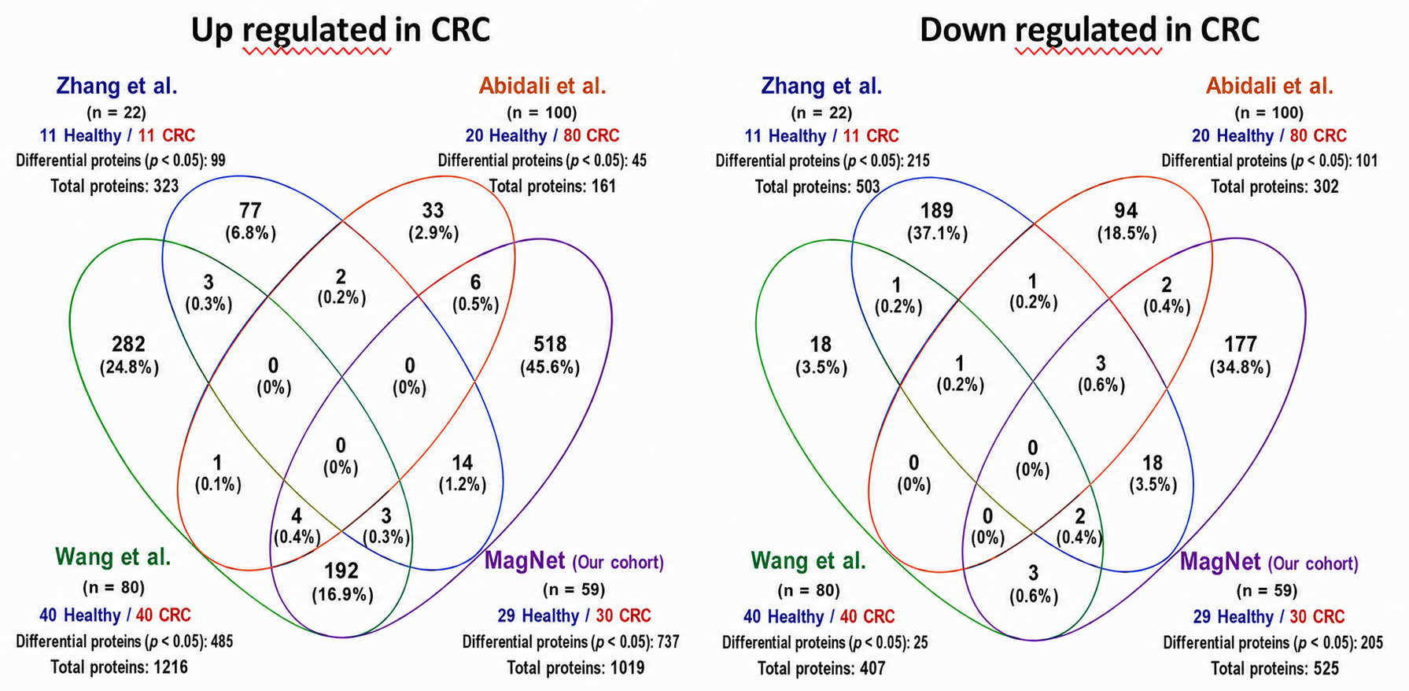
Supplementary Figure 3. Cross-study overlap of CRC-associated extracellular vesicle protein signatures.
Upregulated in CRC
Downregulated in CRC
Quantitative protein data from three published plasma extracellular vesicle (EV) proteomic studies and the Mag-Net cohort were analysed using a consistent statistical workflow. Proteins detected in more than 10% of samples were retained, and differential abundance between CRC and healthy controls was determined using limma (p<0.05). “Total proteins” indicates the number of retained proteins assigned to each direction according to the sign of the fold change, whereas “Differential proteins” indicates the subset meeting the limma significance threshold. Overlaps among differentially abundant proteins are shown separately for proteins increased and decreased in CRC. Numbers within the Venn diagrams indicate protein counts, with percentages of all unique differential proteins in the corresponding direction-specific comparison shown in parentheses. Details of the included studies and complete re-analysis results are provided in Supplementary Tables 2 and 3, respectively.

