Slide 1
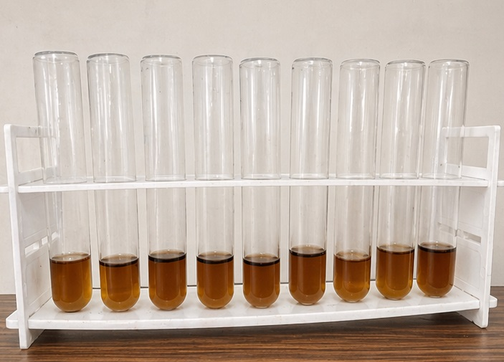
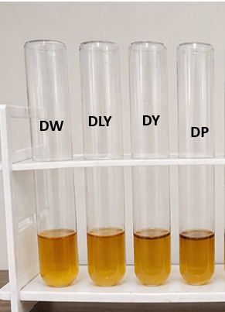
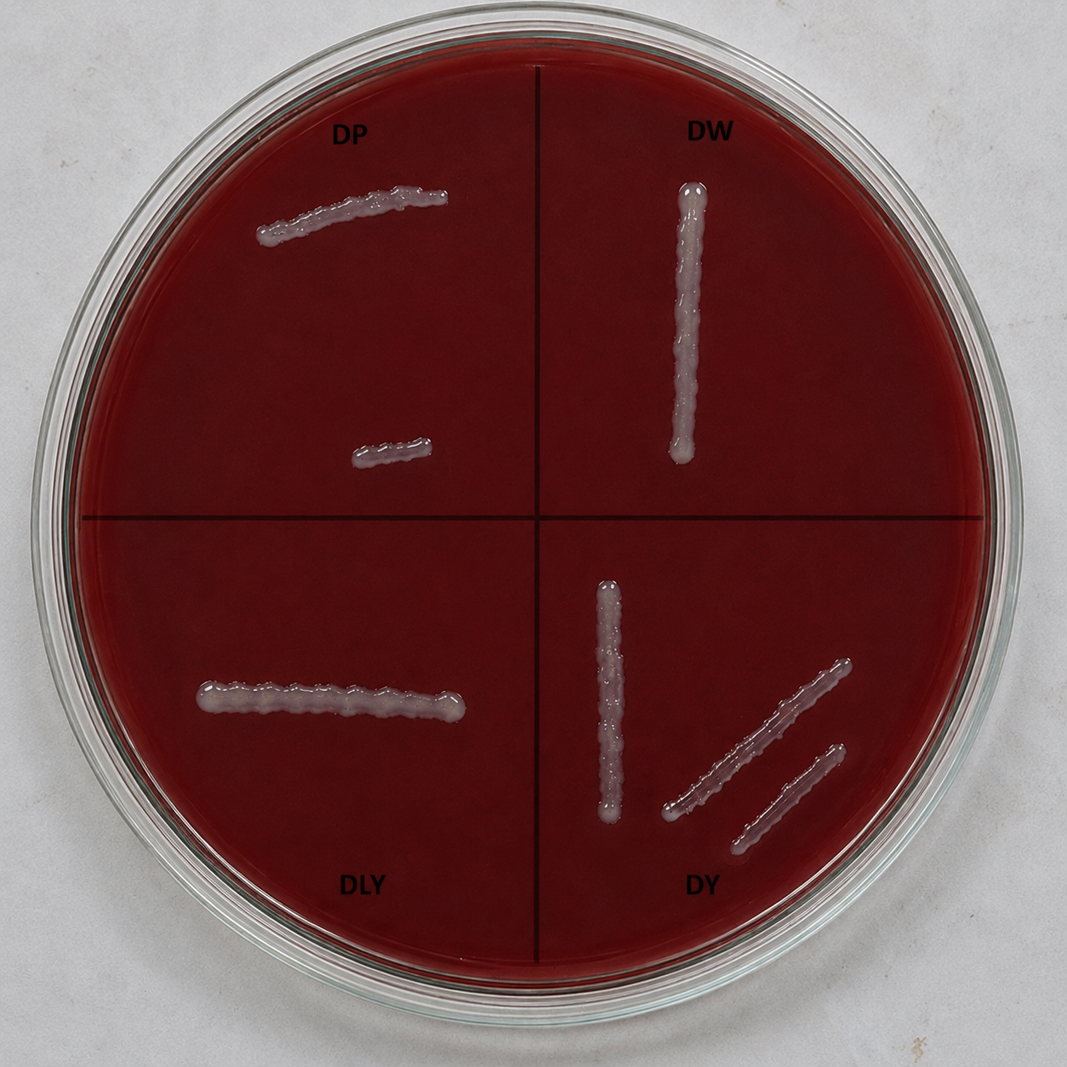
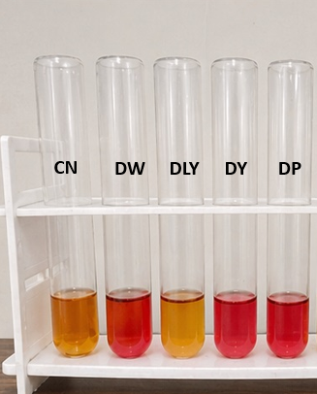
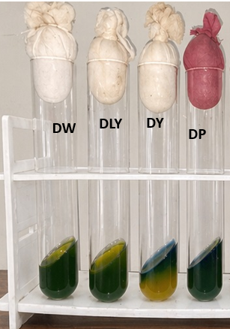
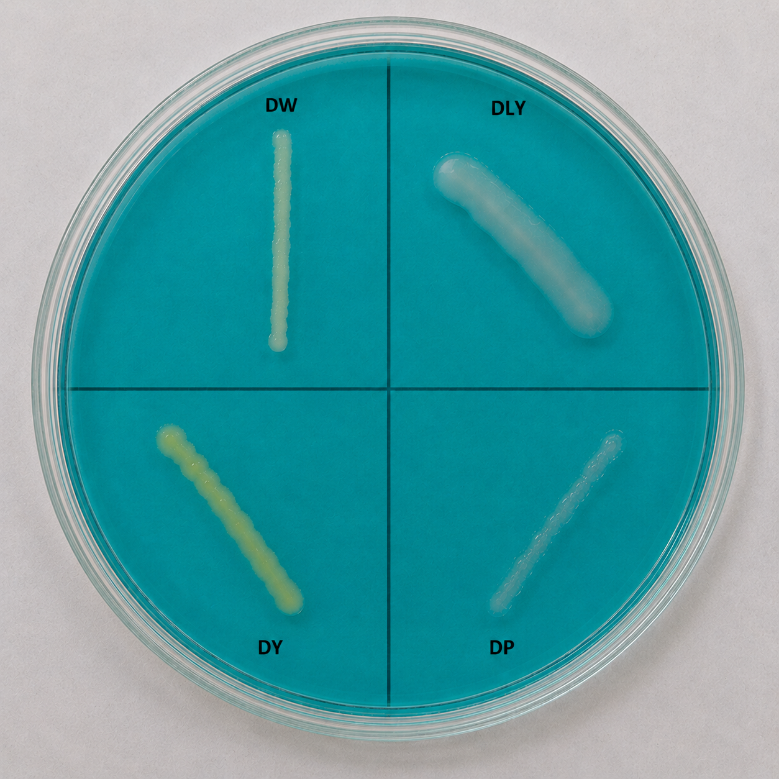
Environmental Assessment of Strains
1. Indole test
3. Voges Proskauer test
5. Blood Agar test
DW DLY DY DP
Result : All strain shows negative indole reaction.
Result : None of the stains shows hemolytic activity (γ hemolysis).
Result : All stains show negative VP reactions.
2. Methyl Red test
4. Simmons Citrate Agar Test
6. DNAs Agar Test
Result :DW, DP and DY showed positive MR reaction, while DLY showed negative result.
Result :All strains showed positive citrate utilization by colour change from green to blue.
Result :All strains showed negative DNase activity due to absence of clear zone formation.

Slide 2
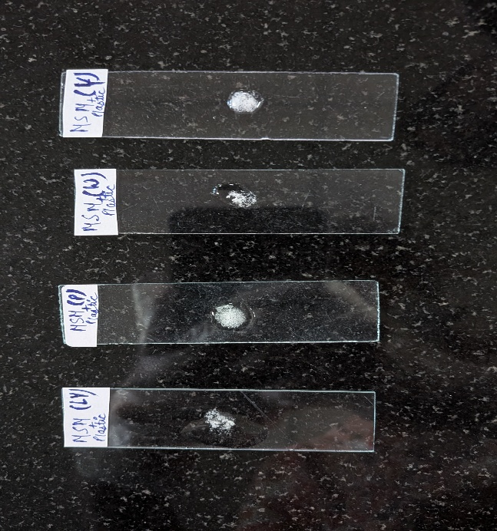
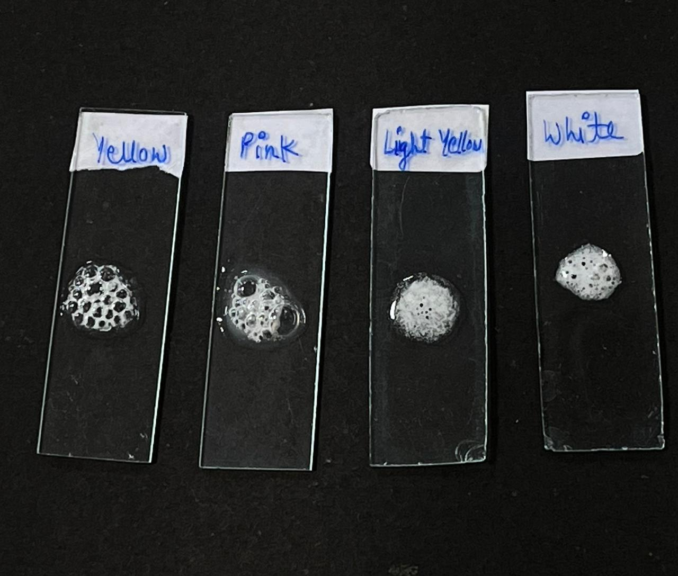
RESULTS
Biochemical Analysis
Biochemical tests were performed to evaluate the metabolic and enzymatic capabilities of the bacterial isolates associated with plastic degradation.
Enzyme-based tests such as catalase, lipase or esterase, protease, α-amylase, and cellulase were selected because these enzymes mainly belong to the hydrolase group which plays an important role in degrading complex polymers. These enzymes break chemical bonds through hydrolysis reactions and may contribute to the biodegradation of plastic polymers.
1. Catalase Test
Catalase test detects the presence of the catalase enzyme by adding hydrogen peroxide (H₂O₂) to the culture.
Formation of bubbles (oxygen release) indicates a positive result.
Formation of bubbles on LB grown bacteria
Formation of bubbles on MSM grown bacteria

Slide 3
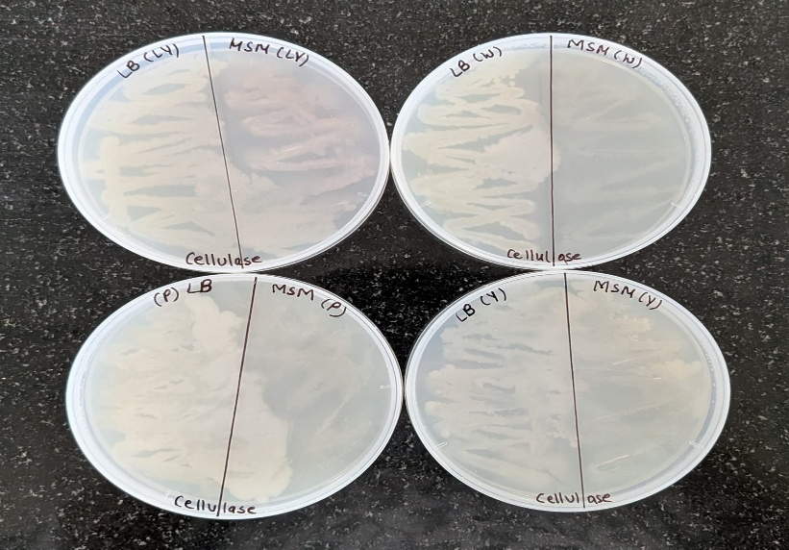
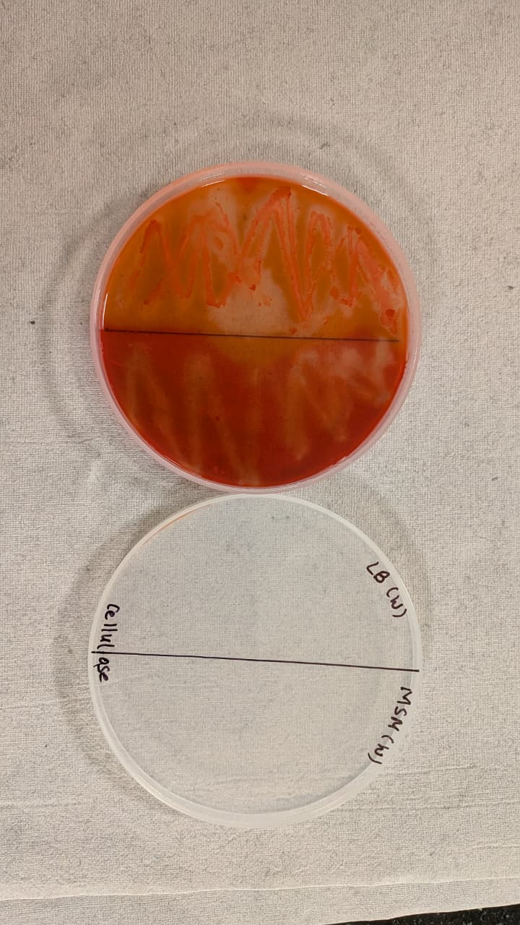
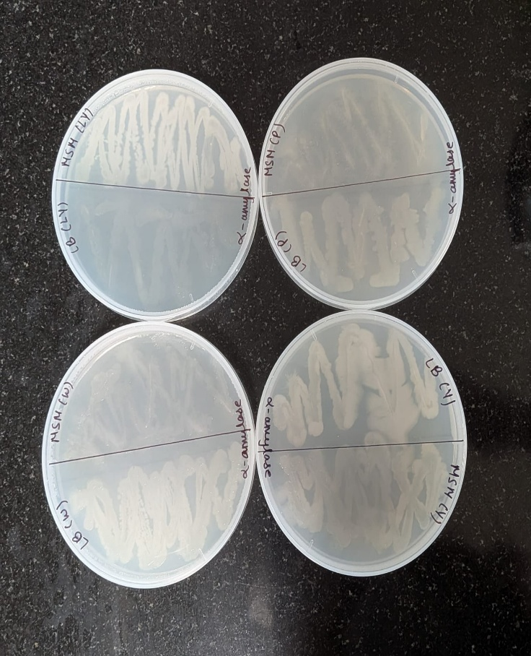
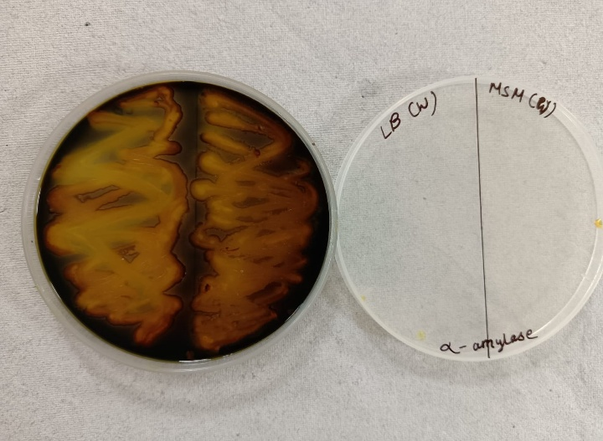
RESULTS
2. Cellulase Test
3. Alpha Amylase Test
The cellulase test is used to detect the ability of microorganisms to degrade cellulose using the enzyme cellulase.
Bacterial isolates are grown on cellulose agar plates and then flooded with Congo red dye.
A clear zone around the colony after washing indicates cellulose degradation (positive result), while no clear zone indicates a negative result.
The α-amylase test is used to detect the ability of microorganisms to hydrolyze starch using the enzyme α-amylase.
Bacterial isolates are grown on starch agar plates and then flooded with iodine solution.
A clear zone around the colony indicates starch degradation (positive result), while a dark color indicates a negative result.
Clear zone
Clear zone
Growth of LB and MSM grown bacterial on cellulose agar plate
Clear zone formation on White bacteria
Growth of LB and MSM grown bacterial on α-Amylase agar plate
Clear zone formation on White bacteria

Slide 4
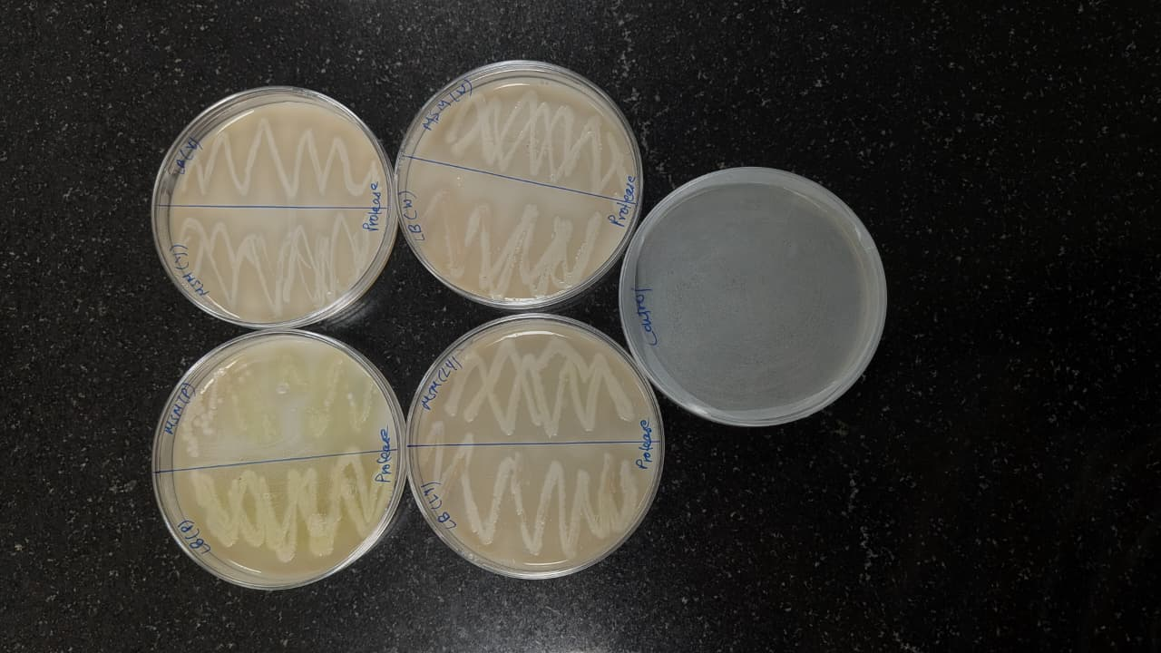
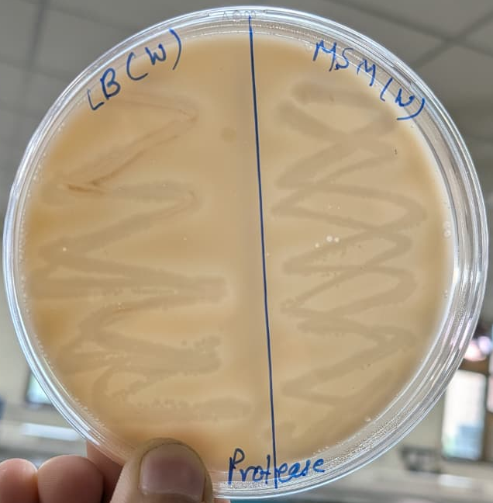
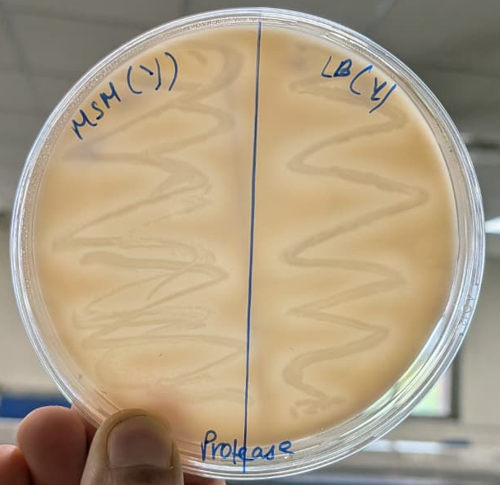
RESULTS
4. Protease Test
Protease test was performed using skim milk agar medium to determine the ability of bacterial strains to produce protease enzyme. The bacterial cultures were inoculated on skim milk agar plates and incubated for 24 to 48 hours.
Observation
Formation of a clear zone around the bacterial colony indicated positive protease activity due to the hydrolysis of casein present in skim milk powder. Absence of a clear zone indicated negative protease activity.
Clear zone
Growth of LB and MSM grown bacterial on skim milk agar plate
Clear zone formation on White and Yellow colony

Slide 5
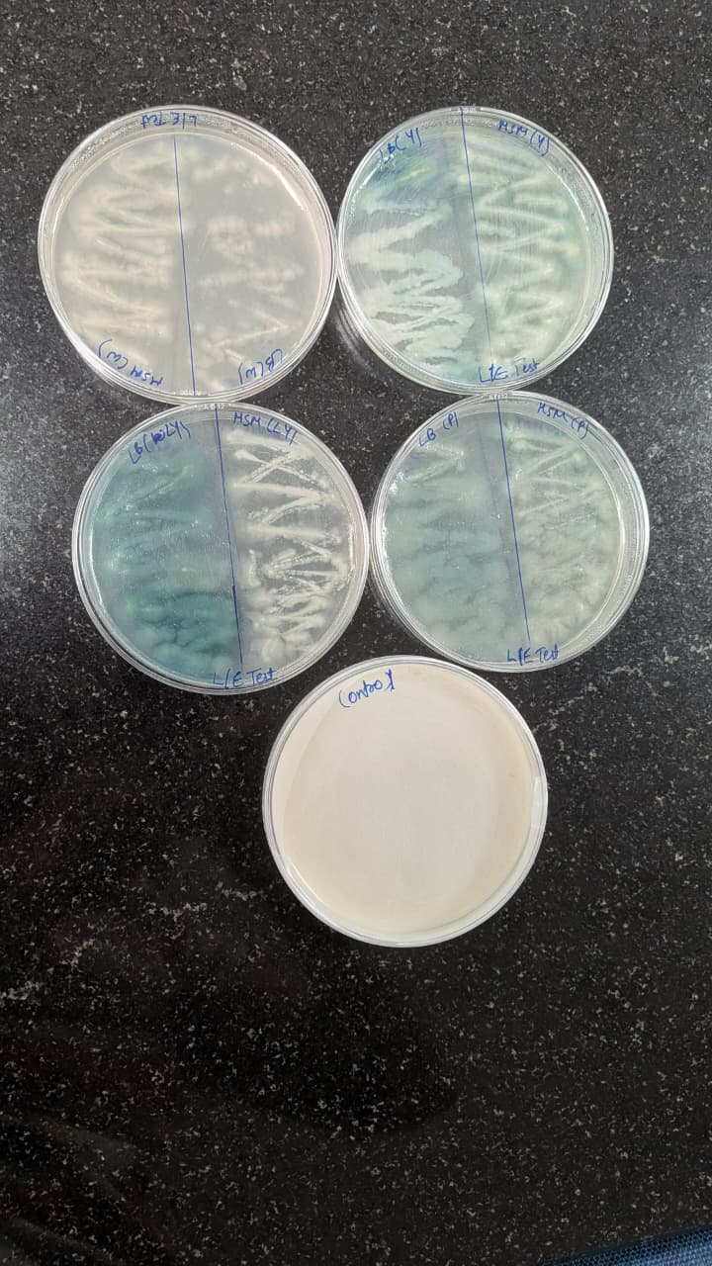
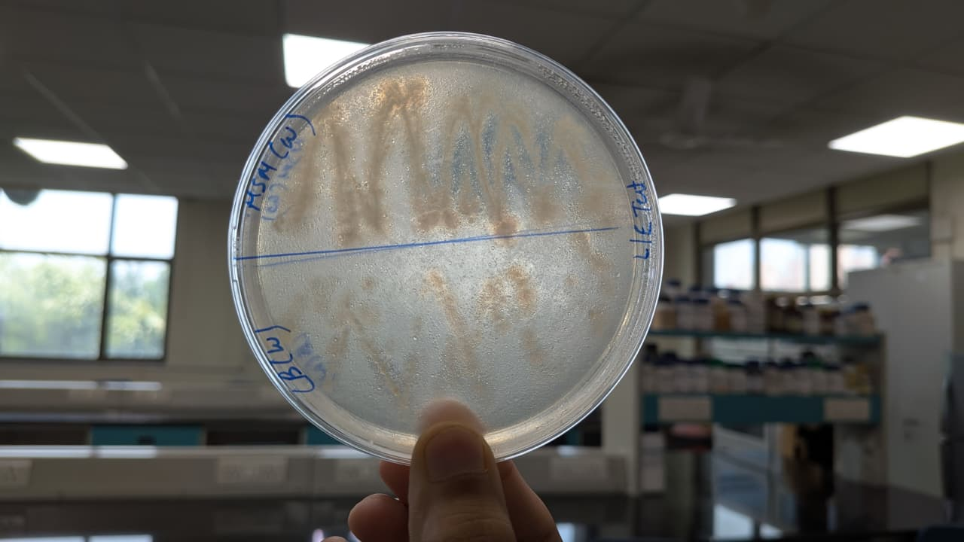
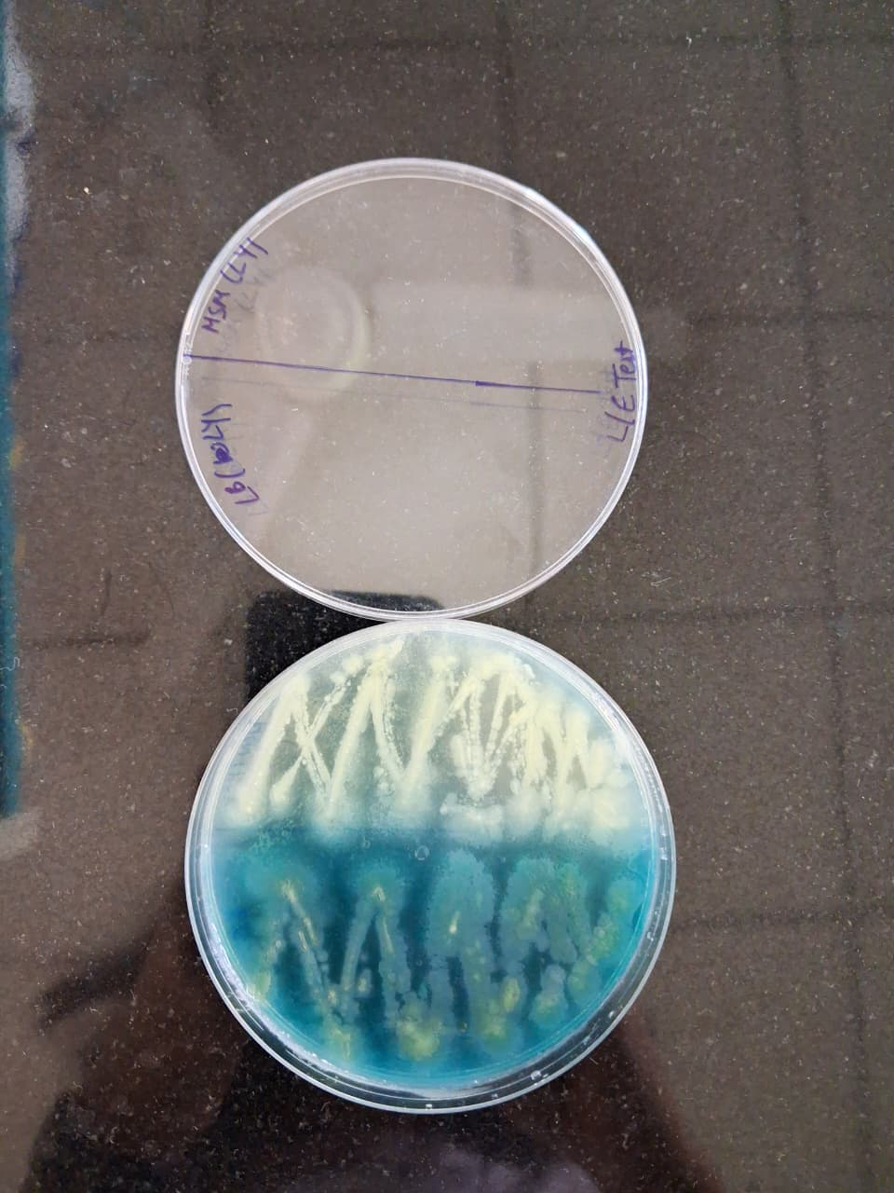
RESULTS
5. Lipase/ Esterase Test
Lipase or Esterase test was carried out using tributyrin agar medium to evaluate the ability of bacterial strains to produce lipase or esterase enzymes. The bacterial cultures were inoculated onto tributyrin agar plates and incubated for 24–48 hours under suitable conditions.
Observation
Formation of a clear zone around the bacterial colony indicated positive lipase/esterase activity due to the hydrolysis of tributyrin, while absence of a clear zone indicated negative activity.
Clear zone
Growth of LB and MSM grown bacterial on tributyrin agar plate
Clear zone formation on White colony
The characteristics green colour arises from a mixture of blue pigment (pyocyanin) and yellow green pigment (pyoverdine).

Slide 6
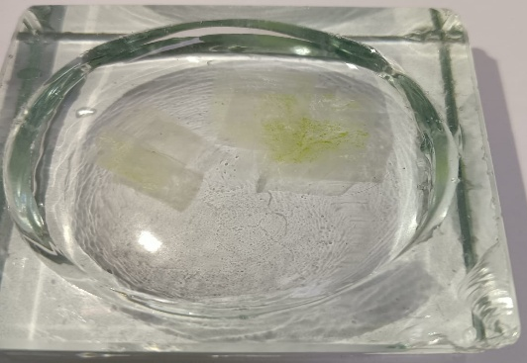
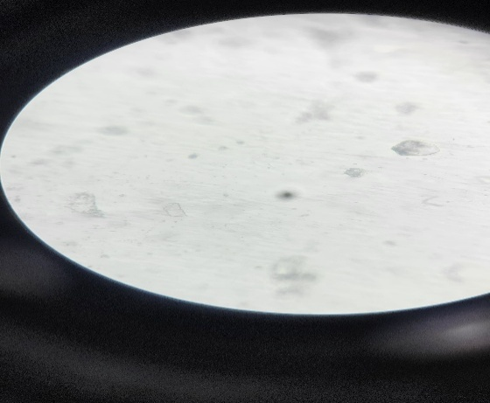

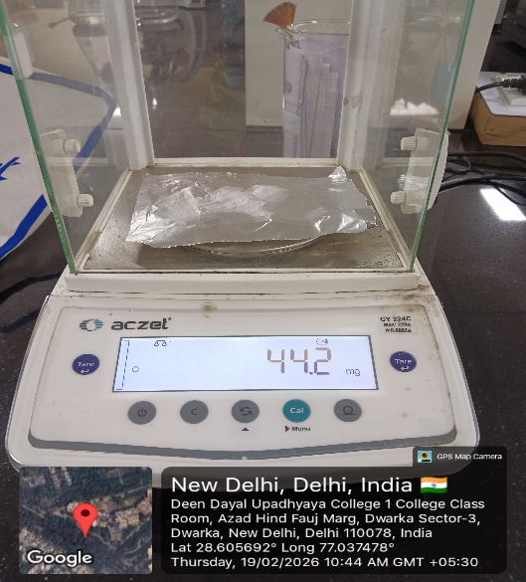
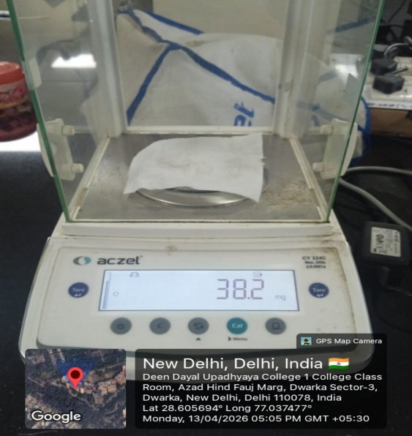
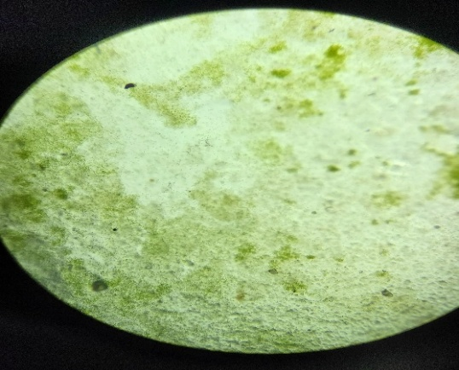
Plastic Degradation Study
Weight Loss Method
Microscopic Analysis
Plastic degradation was evaluated using weight loss method, where pre weighed plastic samples were incubated with bacterial isolates in MSM. After incubation, plastic were dried and reweighed and degradation was calculated by using the formula:
Bacterial growth( LY) on plastic pieces
Plastic with no bacteria at 10x
Initial Weight
Final Weight
The percentage weight loss was calculated as 13.6%, indicating a reduction of 6.0 mg from the initial weight.
Plastic with LY bacteria at 10x

