Slide 1
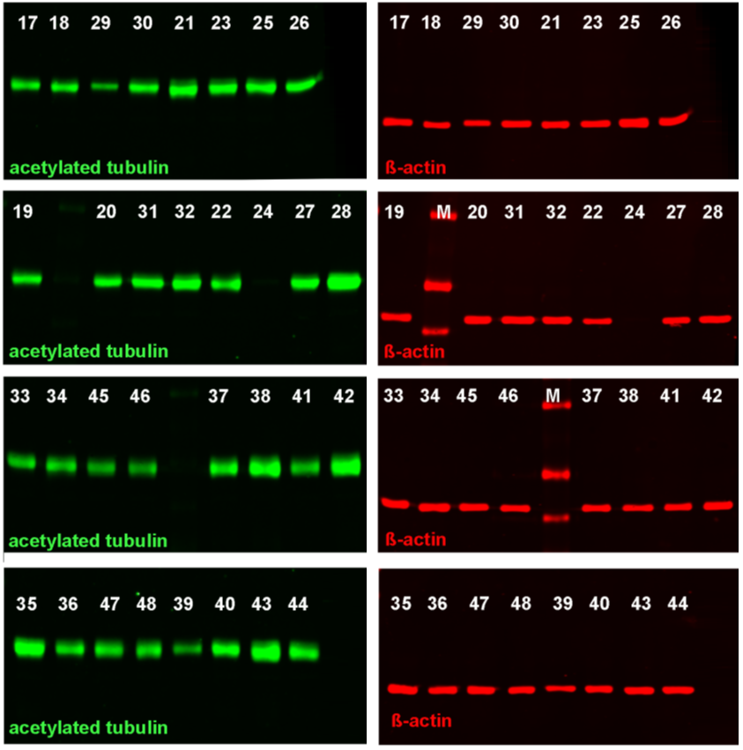
Figure S1
CTR
55 KDa
40 KDa
55 KDa
40 KDa
STS
55 KDa
40 KDa
55 KDa
40 KDa
Fig. S1. Exemplary of Western blots. Detection of acetylated-α-tubulin (55 kDa) and β-actin (40 kDa) by green fluorescence and red fluorescence spectrum, respectively. Protein lysates from the prefrontal cortex of four biological replicates derived from the control (CTR; 17-32) and the stress group (STS; 33-44) were used. Control animals (17-32): 17-20 (V +V group), 21-24 (V+W group), 25-28 (R+W group), 29-32 (R+V group). Stressed animals (33-44): 33-36 (V+V group), 37-40 (V+W group), 41-44 (R+W group), 45-48 (R+V group). M=molecular mass marker. CTR, control; STS, stress.

