Slide 1
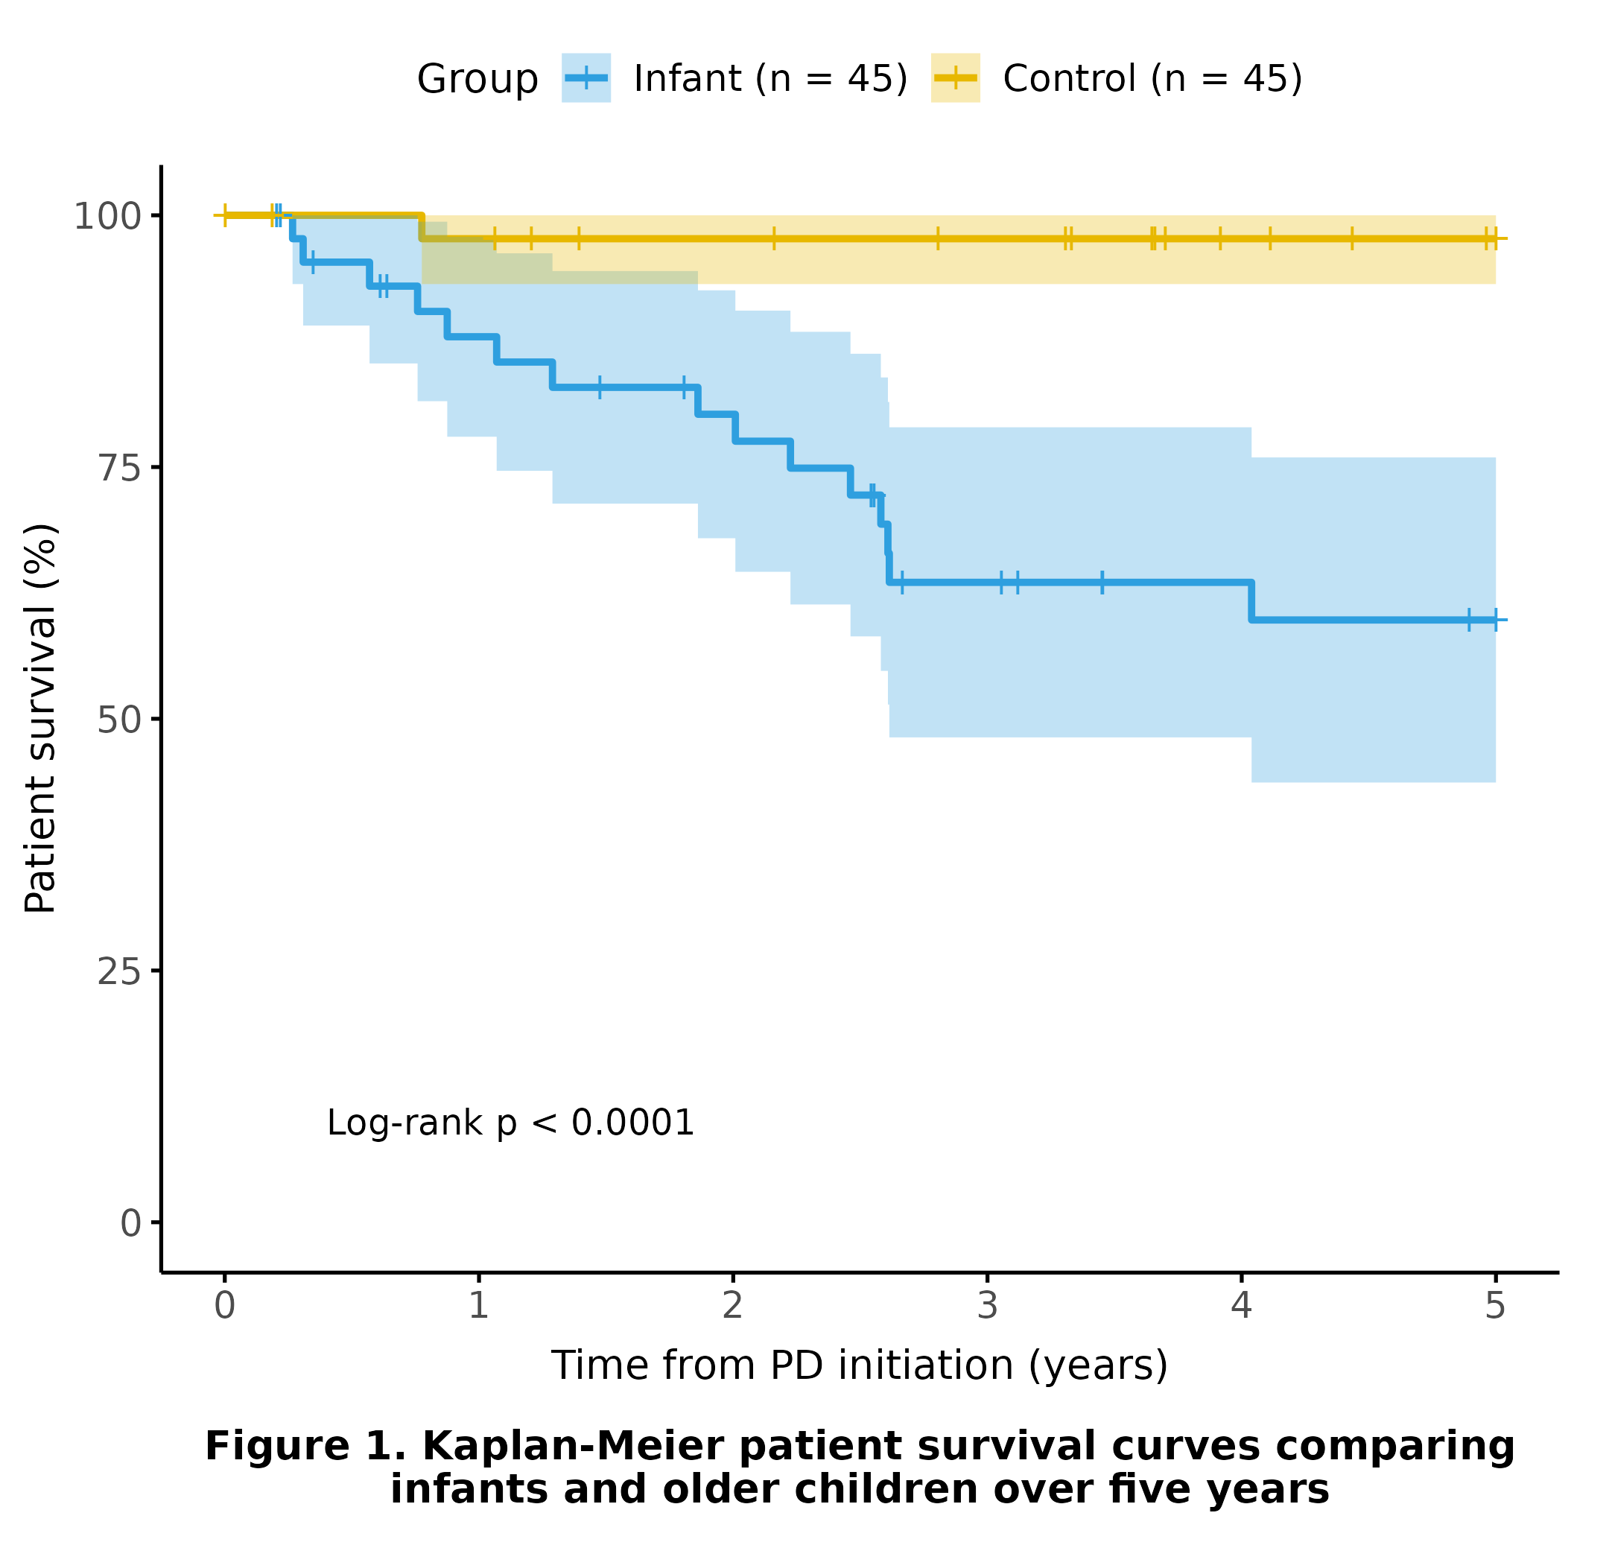
Long-Term Outcomes of Maintenance Peritoneal Dialysis Initiated During Infancy: A Temporally Aligned Comparative Study
HYPOTHESIS: PD initiating in infancy is associated with poorer survival and a greater peritonitis burden
DESIGN & OUTCOMES:
90 children initiating
maintenance PD
Higher peritonitis burden and catheter failure in infants
45 ınfants
PD initiated < 12 months of age
>50% of infants underwent kidney transplantation
45 controls
PD initiated > 12 months of age
Better survival in patients with CAKUT in infants
Lower 5-year survival in infants
CONCLUSION: Infants initiating maintenance PD had poorer five-year survival and higher peritonitis burden, but chronic PD enabled kidney transplantation in more than half of the infants
Gulmez et al. 2026

