Slide 1
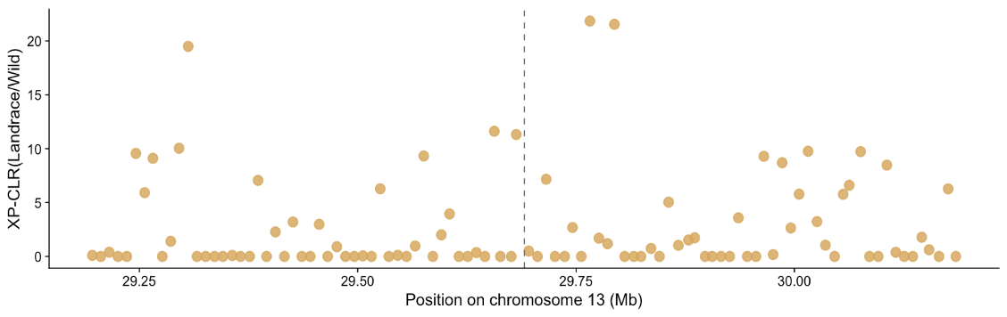
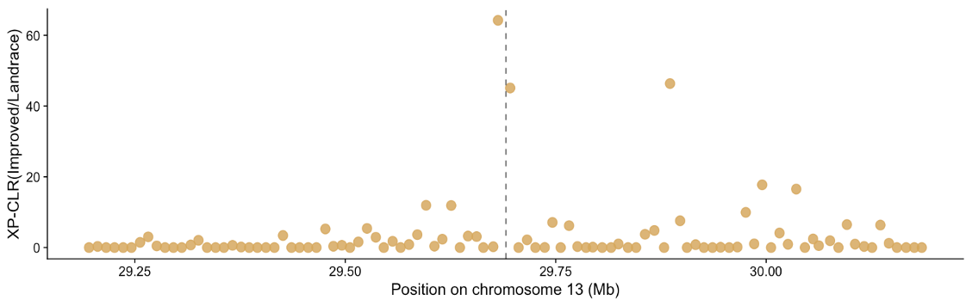
a
b
Notes:
Supplementary Fig. S6. XP-CLR profiles around the chromosome 13 candidate gene region. XP-CLR scores were examined around the Glyma.13G183500 in the (a) Landrace/Wild and (b) Improved/Landrace comparison. The vertical dashed line indicates the genomic position of Glyma.13G183500. Elevated XP-CLR signals near this gene, especially in the Improved/Landrace comparison, suggest possible selection during improvement.

