Slide 1
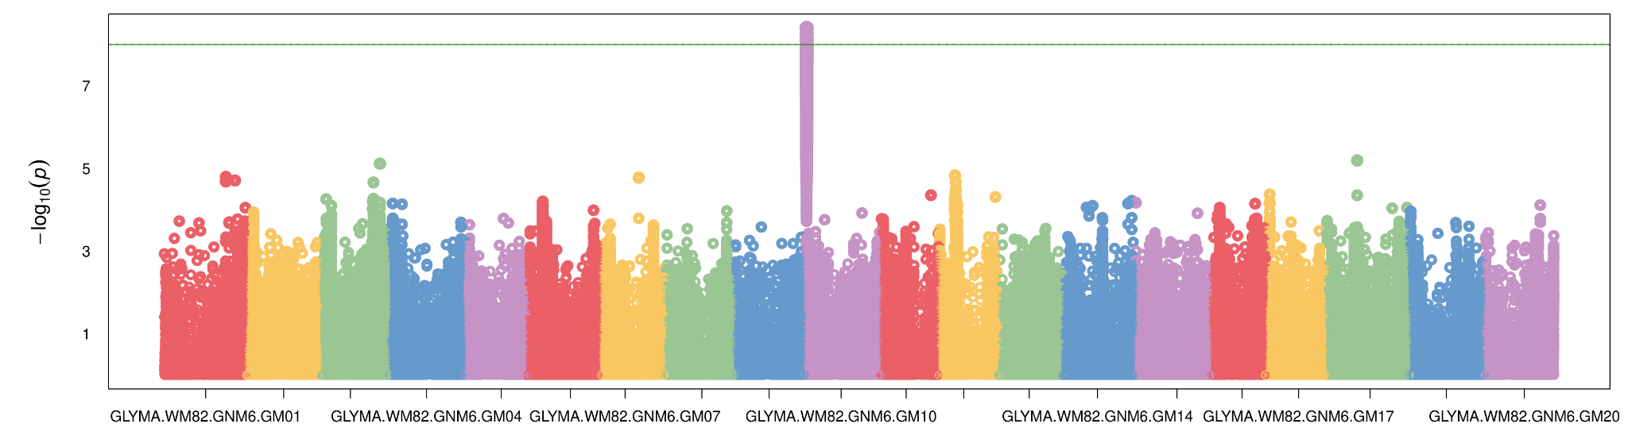
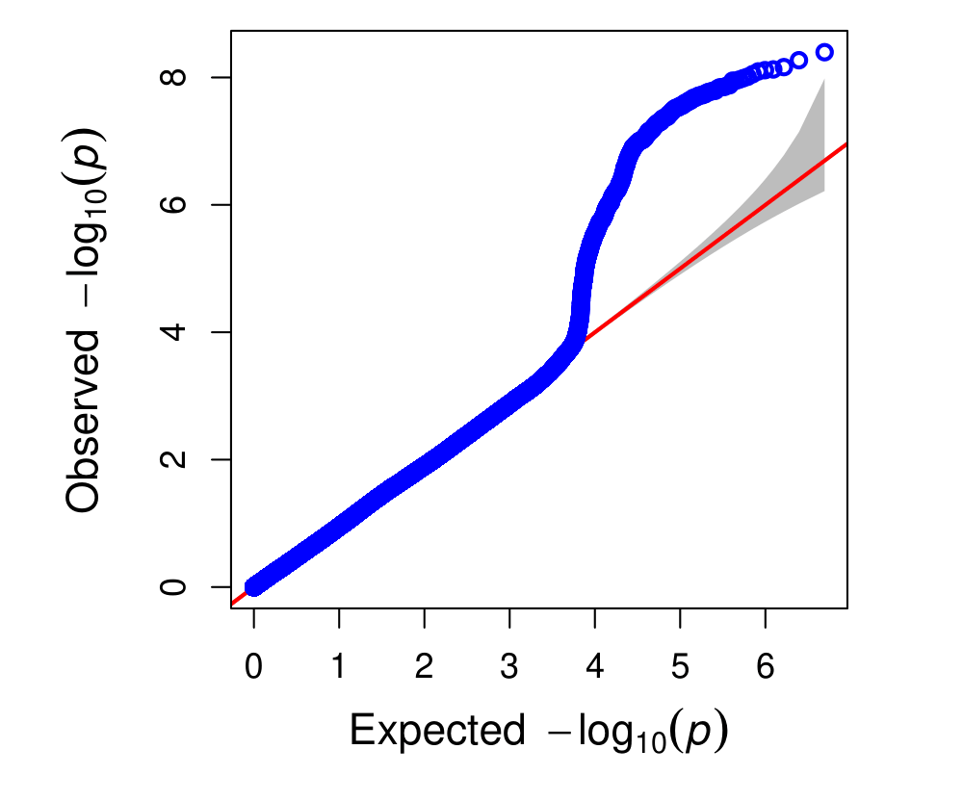
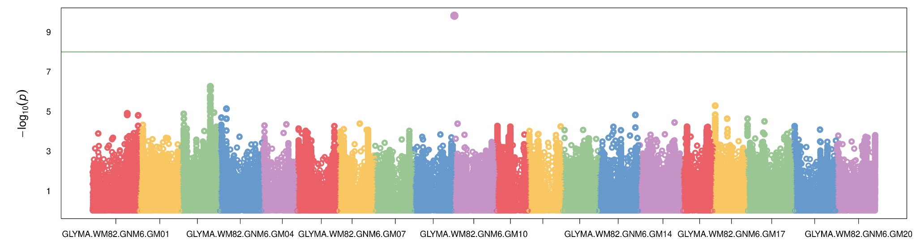
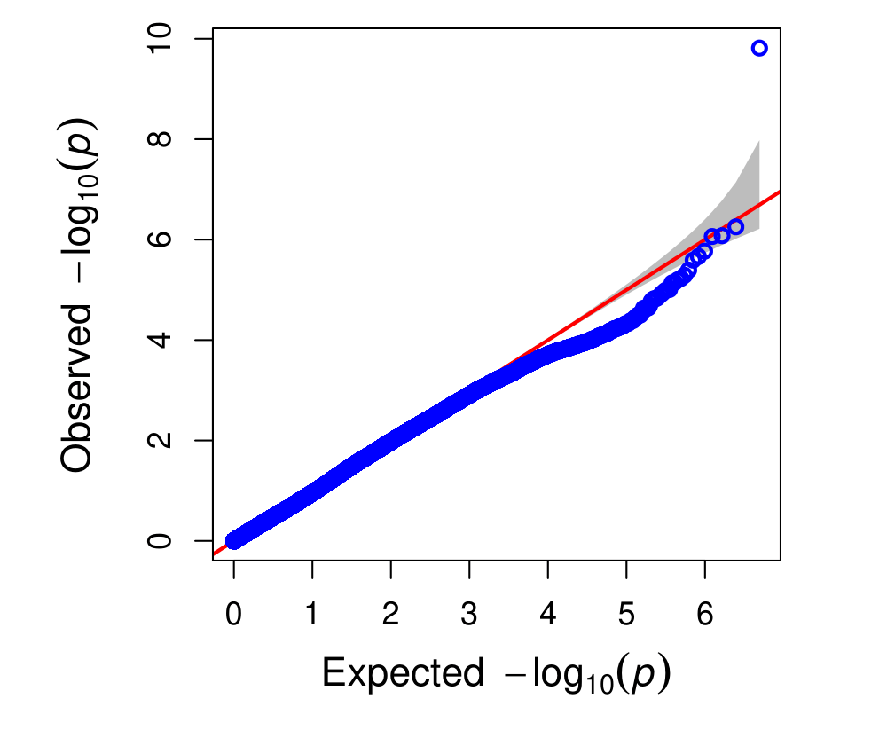
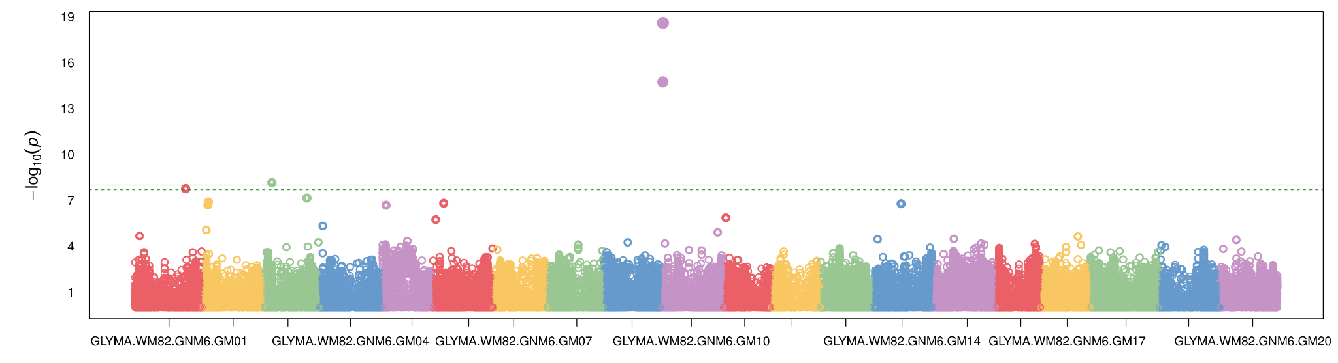
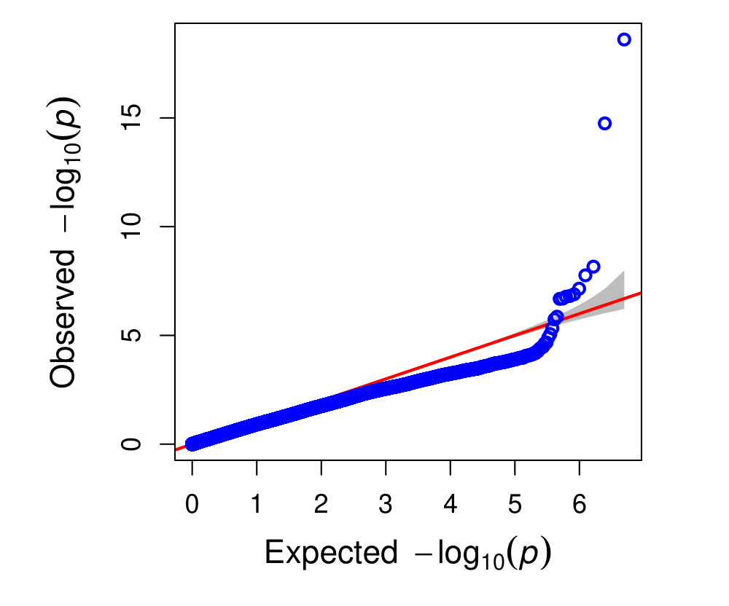
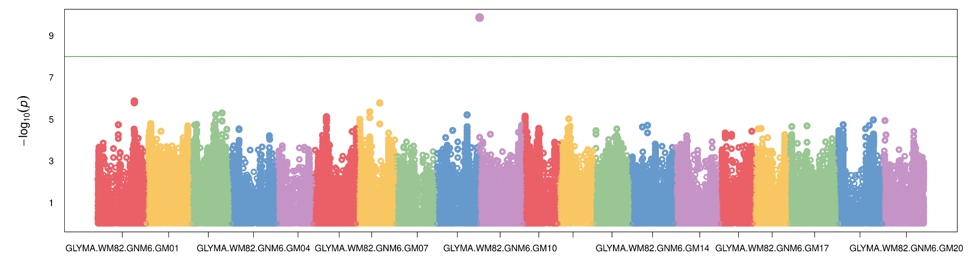
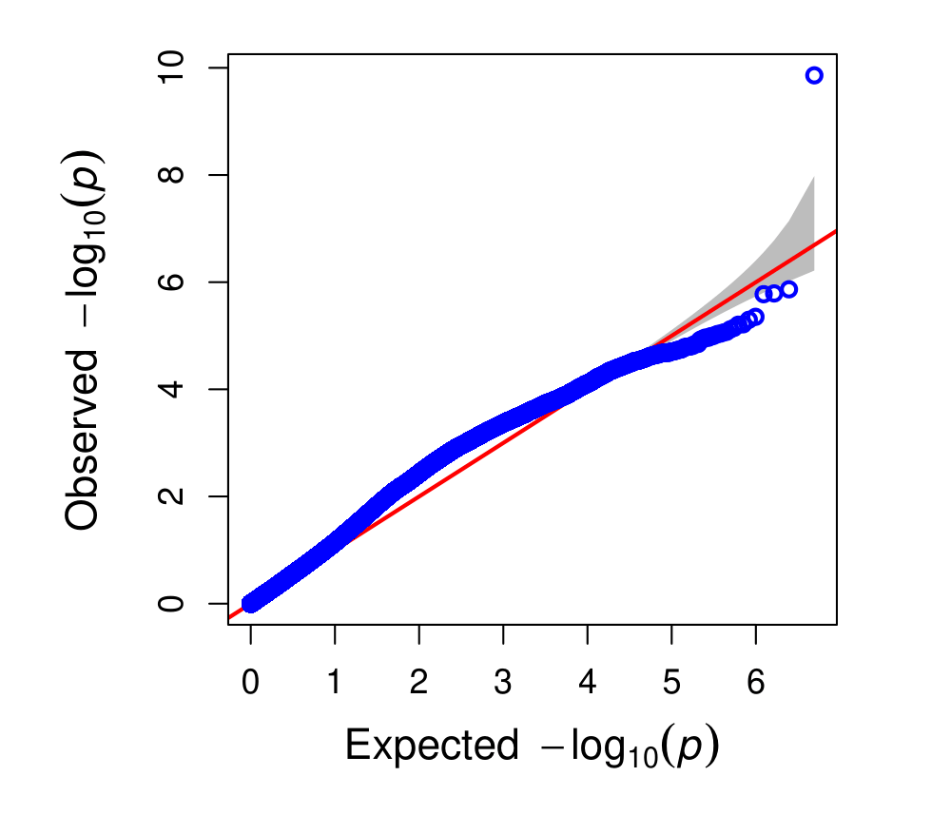
a
b
c
d
e
f
g
h
Notes:
Supplementary Fig. S2. Manhattan plot & qq plots for GWAS of wilting score. Manhattan plots generated using (a) MLM, (c) MLMM, (e) FarmCPU, (g) BLINK, with the corresponding Q-Q plots shown in (b), (d), (f), and (h), respectively.

