Slide 1
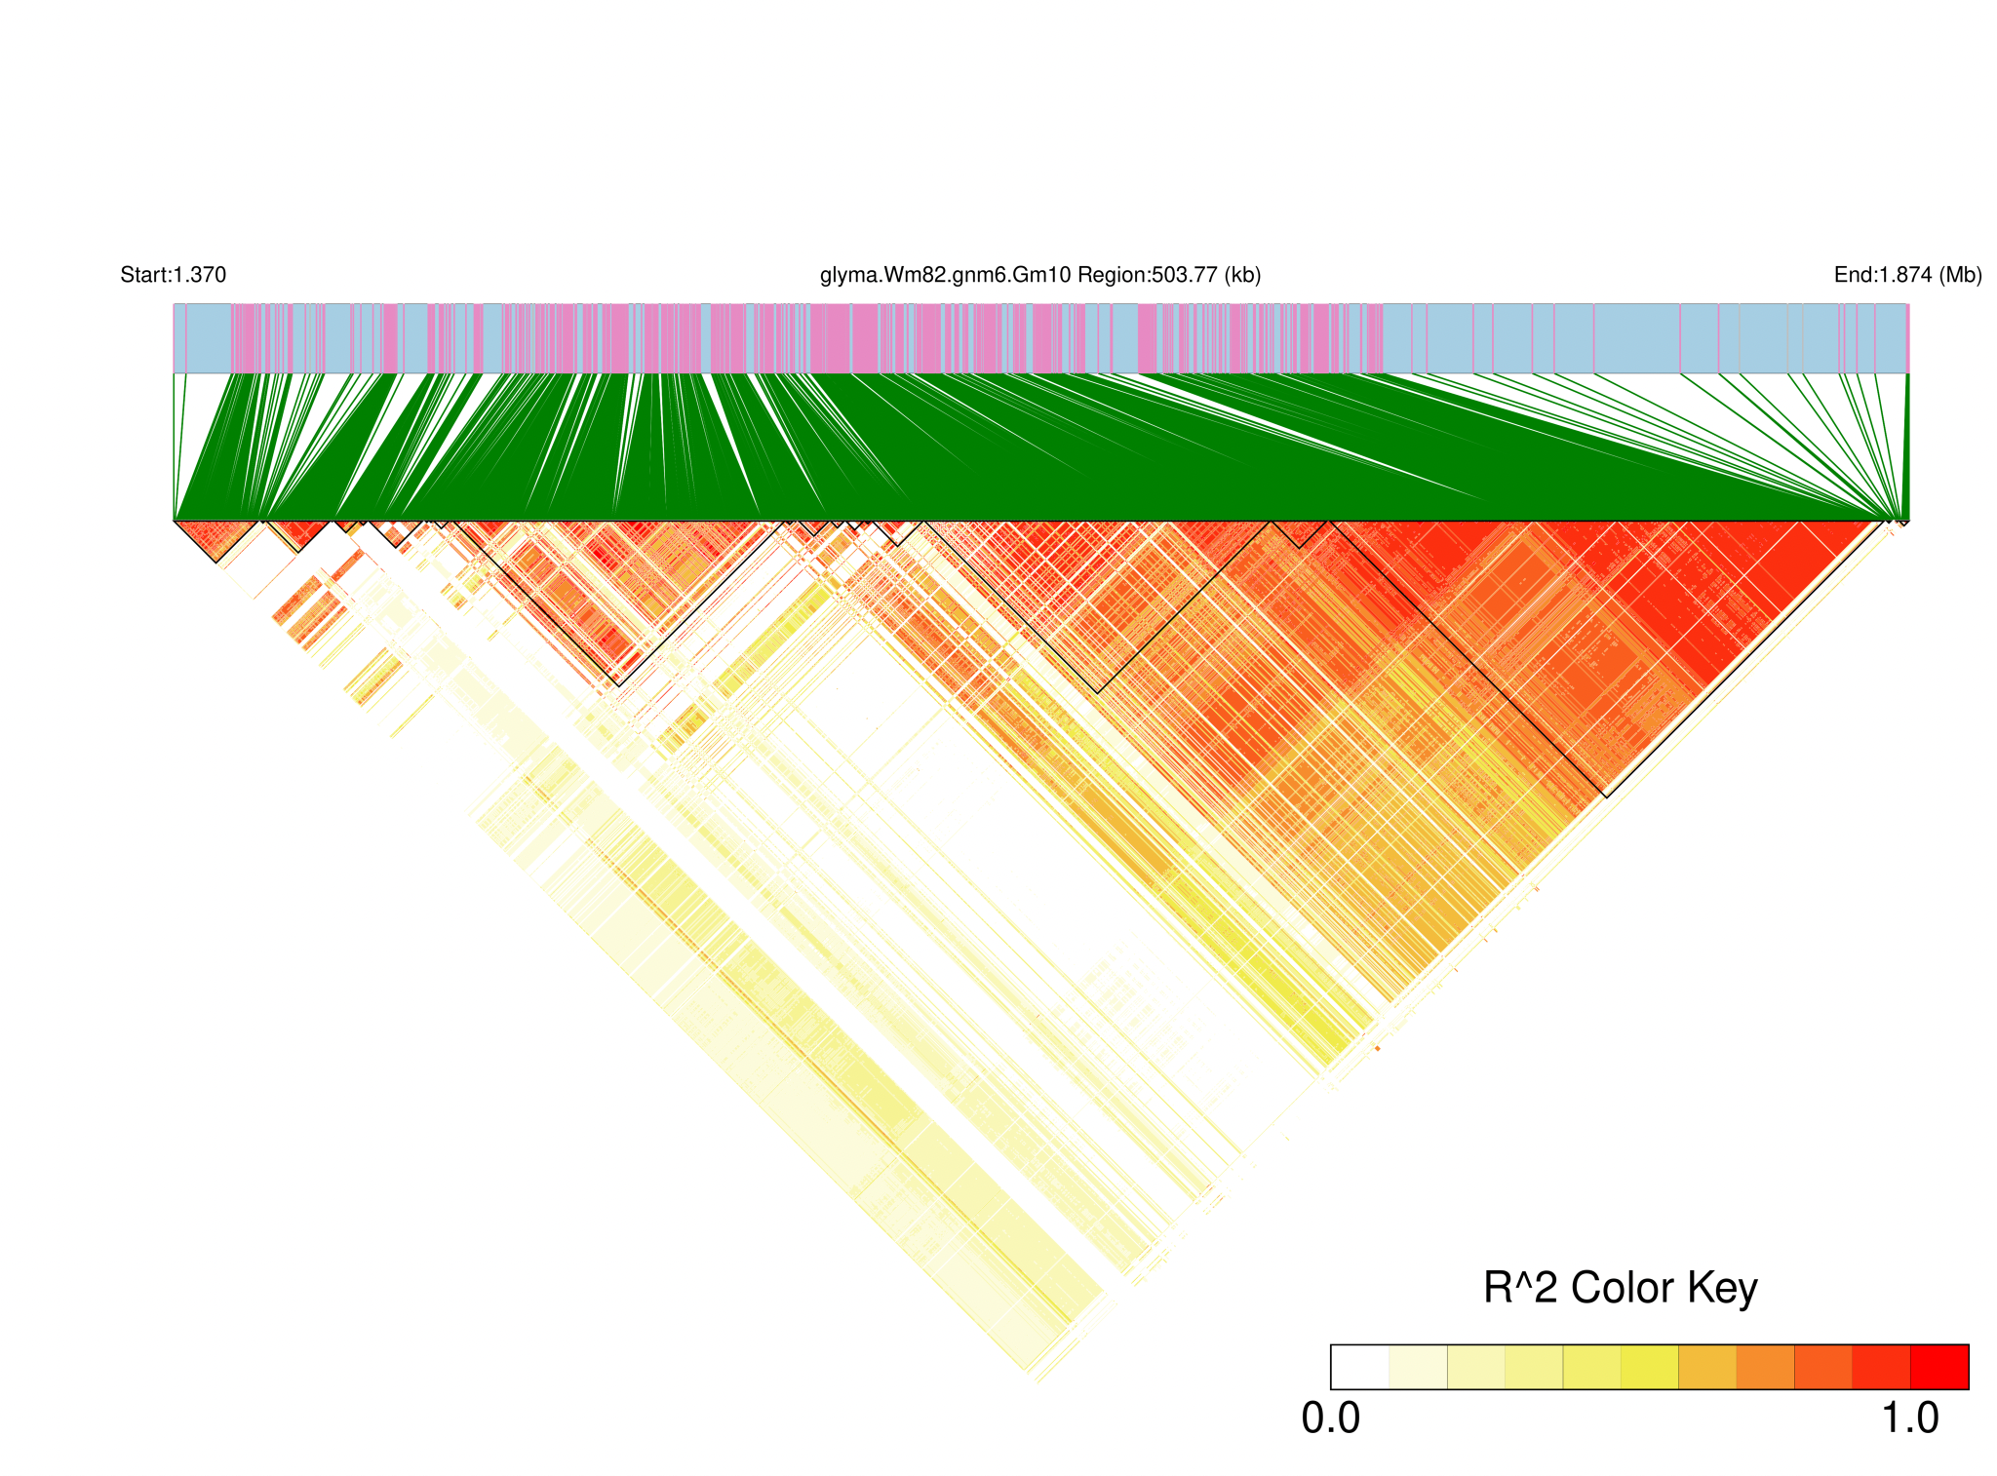
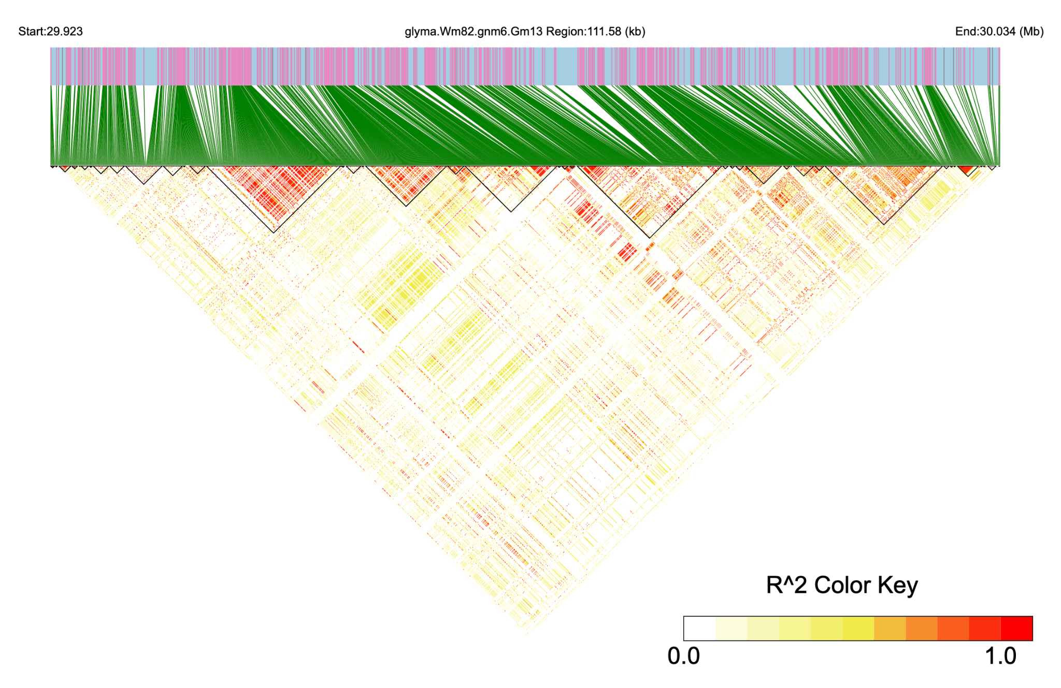
a
b
Notes:
Supplementary Fig. S5. Linkage disequilibrium (LD) block analysis of the GWAS association regions. (a) LD block analysis of the shared GWAS association region identified for wilting score and leaf moisture content (LMC) on chromosome 10. (b) LD block analysis of the GWAS association region associated with H₂O₂ content on chromosome 13.

