Slide 1
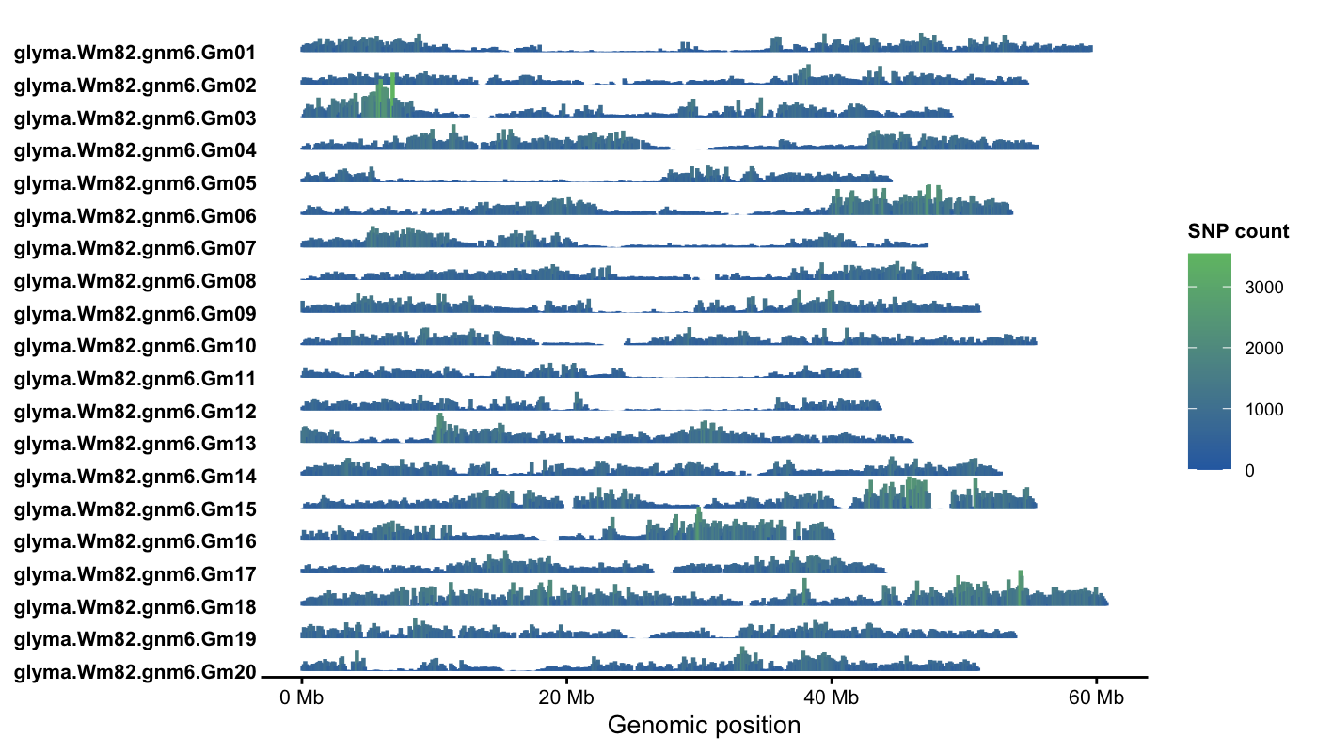
Notes:
Supplementary Figure S1. SNP density of the genotype dataset for GWAS. SNP density was calculated in 100k sliding genomic windows, and the color gradient indicates the SNP count per window.

