Slide 1
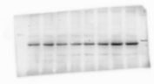
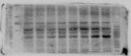
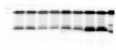
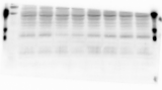
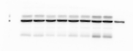
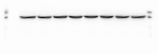
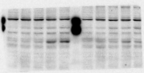
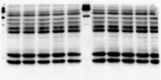
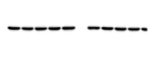
Figure 1F
Figure 1G
Sciatic nerve
Spinal cord
ACR
0
10
20
40
(mg/kg)
ACR
0
10
20
40
(mg/kg)
SARM1
SARM1
95 kDa
95 kDa
72 kDa
72 kDa
55 kDa
55 kDa
NMNAT2
72 kDa
NMNAT2
72 kDa
34 kDa
34 kDa
β-actin
β-actin
45 kDa
45 kDa
Figure 1J
ACR
0
0.5
1
1.5
2
2
(mM)
Time
24
0
3
6
12
24
(h)
SARM1
95 kDa
72 kDa
55 kDa
NMNAT2
72 kDa
34 kDa
β-actin
45 kDa

Slide 2
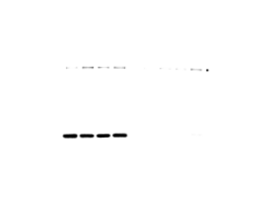
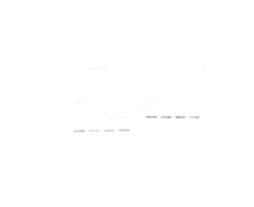
Figure 2B
mito
cyto
ACR
0
10
20
40
0
10
20
40
(mg/kg)
SARM11
95 kDa
72 kDa
55 kDa
VDAC
32 kDa
β-actin
45 kDa
35 kDa

Slide 3
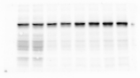
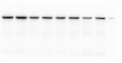
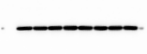
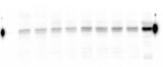
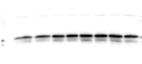
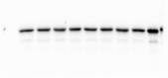
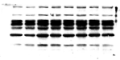
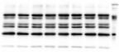
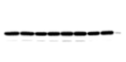
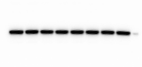
Figure 3C
ACR
0
10
20
40
(mg/kg)
DRP1
95 kDa
72 kDa
p-DRP^{Ser616}
95 kDa
72 kDa
Mfn2
86 kDa
OPA1
95 kDa
72 kDa
VDAC
32 kDa
Figure 3D
Figure 3E
ACR
0
10
20
40
(mg/kg)
ACR
0
10
20
40
(mg/kg)
PINK1
63 kDa
LC3-Ⅰ
18 kDa
LC3-Ⅱ
16 kDa
Parkin
50 kDa
P62
62 kDa
OPTN
66 kDa
VDAC
32 kDa
NDP52
52 kDa
VDAC
32 kDa

Slide 4
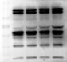
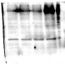
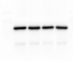
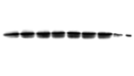
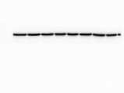
Figure 4A
ACR
0
0.5
1
1.5
(mM)
Time
24
(h)
PINK1
63 kDa
Parkin
50 kDa
VDAC
32 kDa
Figure 4B
ACR
0
1
1.5
0
1
1.5
(mM)
Pepstatin A+E-64d
-
-
-
+
+
+
(10 μg/mL)
LC3-Ⅰ
18 kDa
LC3-Ⅱ
16 kDa
P62
62 kDa
β-actin
45 kDa

Slide 5
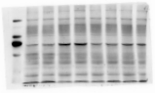
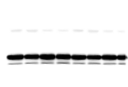
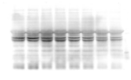
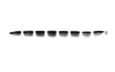
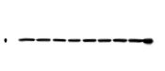
Figure 5F
ACR
-
+
-
+
RAPA
-
-
+
+
SARM1
92 kDa
75 kDa
VDAC
32 kDa
PINK1
63 kDa
LC3-Ⅰ
18 kDa
LC3-Ⅱ
16 kDa
P62
62 kDa
VDAC
35 kDa

Slide 6
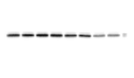
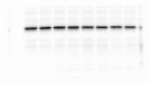
Figure S5
ACR
-
+
-
+
RAPA
-
-
+
+
DRP1
95 kDa
72 kDa
p-DRP1^{Ser616}
95 kDa
72 kDa
VDAC
32 kDa

