Slide 1
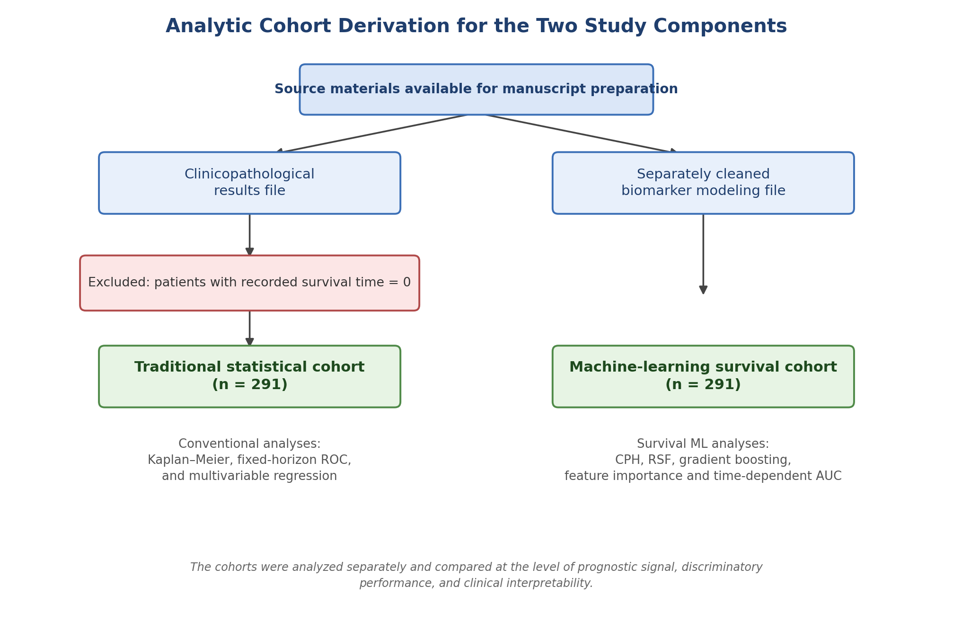
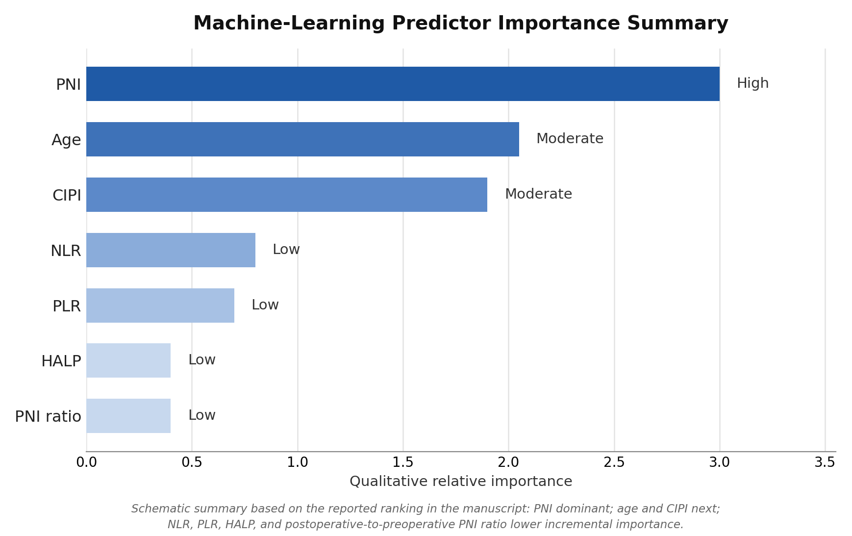
Perioperative Immune-Nutritional Biomarkers in Resected Colorectal
Cancer
VISUAL ABSTRACT
Conventional statistics and survival machine learning identified PNI as the most consistent prognostic signal.
Background
FIG 1
FIG 2
CRC outcomes remain heterogeneous after resection. Low-cost immune-nutritional biomarkers may improve postoperative prognostic stratification.
Methods
Retrospective single-center cohort
• Conventional cohort: n = 291
• Survival ML cohort: n = 291
Biomarkers: PNI, NLR, PLR, HALP, CIPI, PNI ratio
Key Results
Detailed conventional ROC panels were moved to the Supplementary Appendix to keep the main submission lean.
• Postoperative PNI had the best single-marker mortality discrimination (AUC 0.600 at 3 years; 0.611 at 5 years).
• Preoperative PNI remained independently associated with OS and PFS.
• In survival ML, PNI ranked highest, followed by age and CIPI.
• Best 5-year OS AUC: 0.725 (gradient boosting).
Clinical Message
Use perioperative PNI for bedside risk stratification, and reserve multivariable survival models for MDT-level individualized surveillance planning.
Study focus: perioperative host status can complement clinicopathologic staging in surgically treated CRC.

