Slide 1
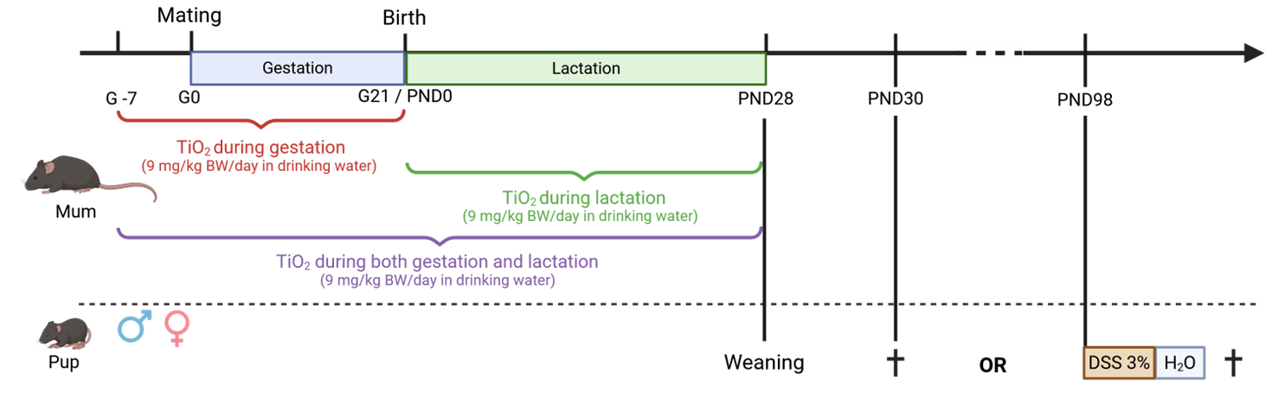

Supplementary Figure 1
PND 84
$$†$$
or

Slide 2
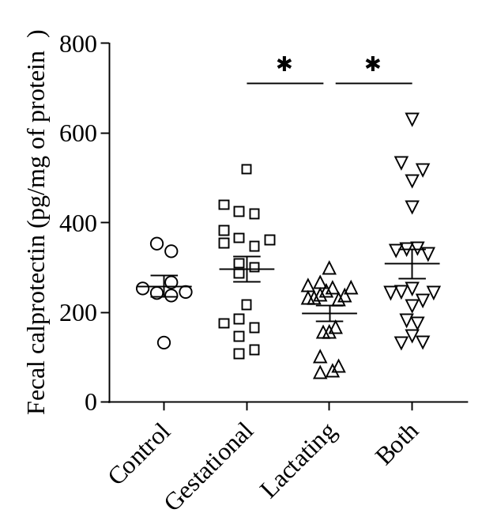
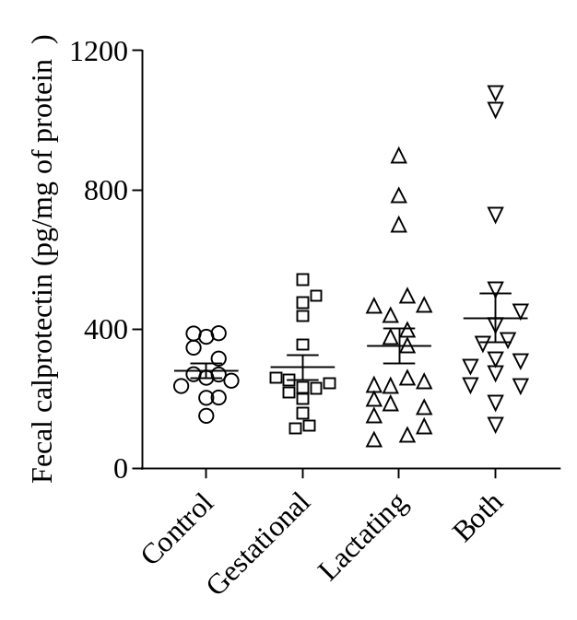
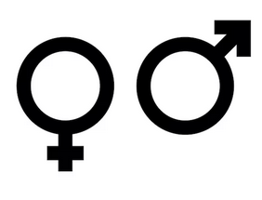
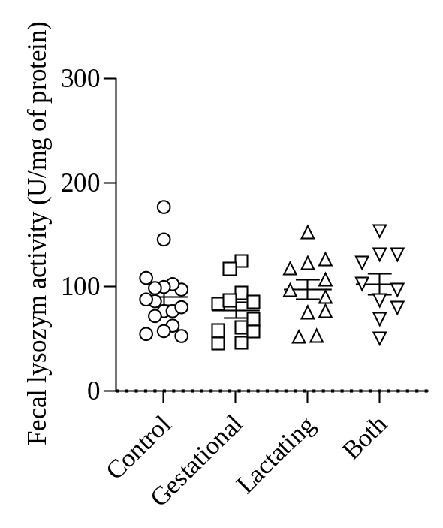
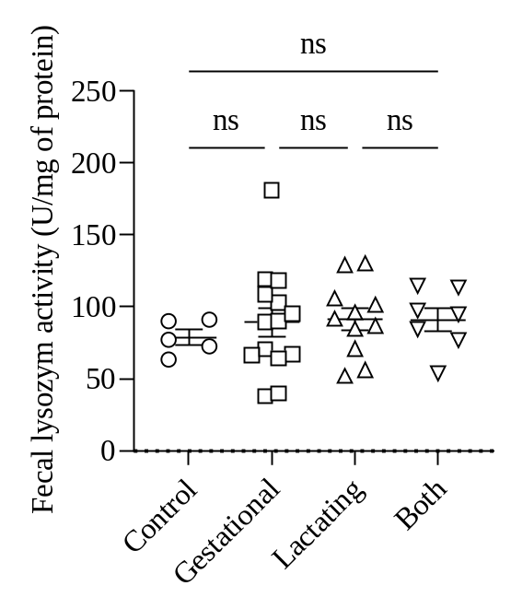
Supplementary Figure 2
A
B
C
D

Slide 3
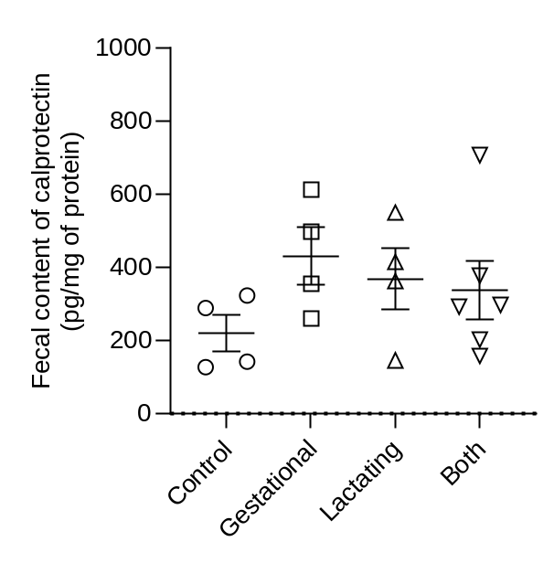
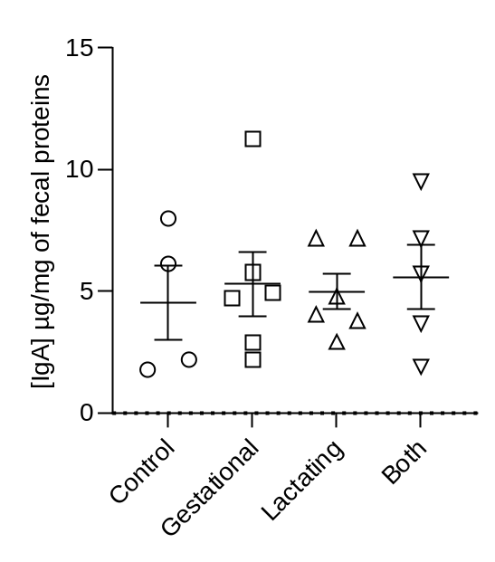
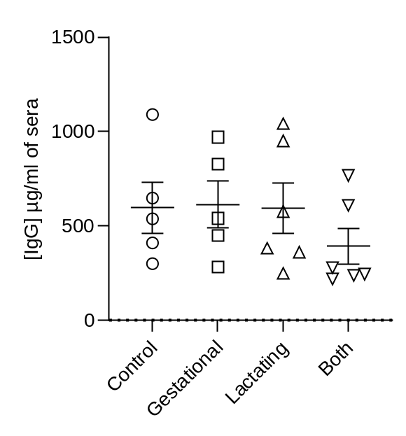
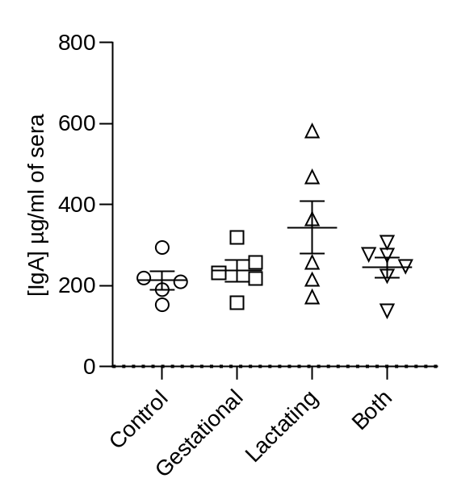
Supplementary Figure 3
Dams PND28
A
B
C
D

Slide 4
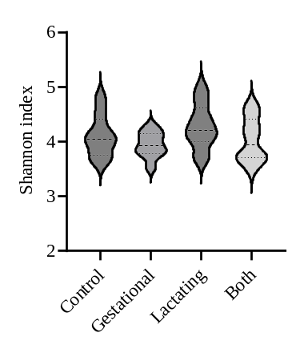
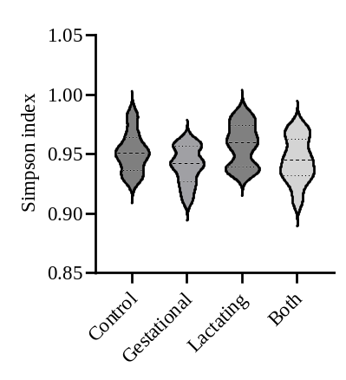
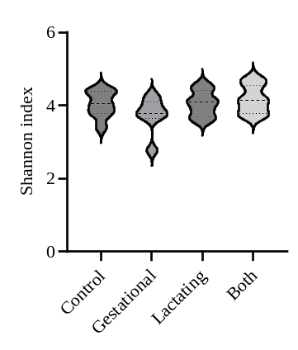
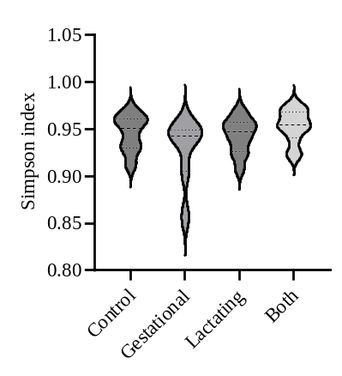
Supplementary Figure 4
A
B
D
E

Slide 5
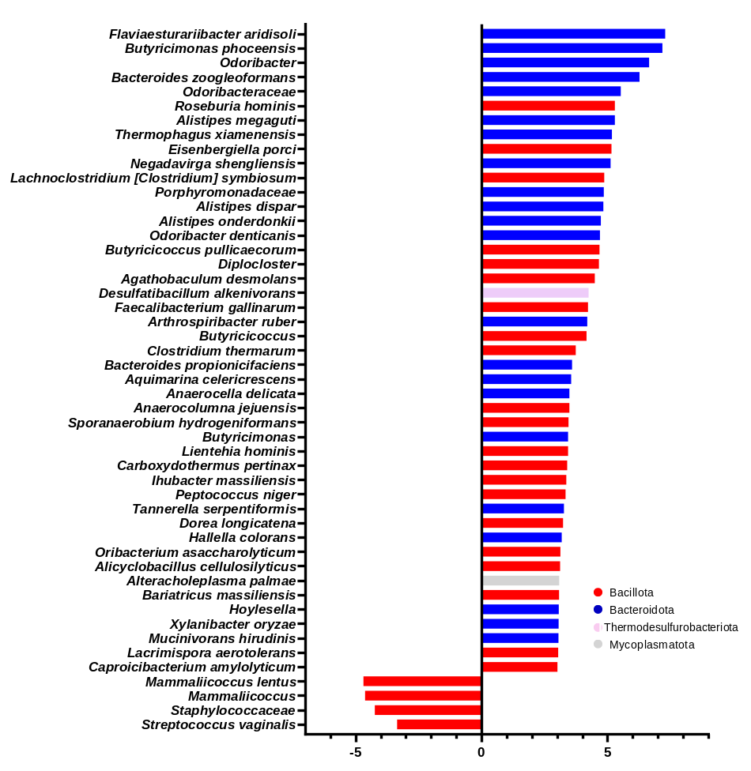
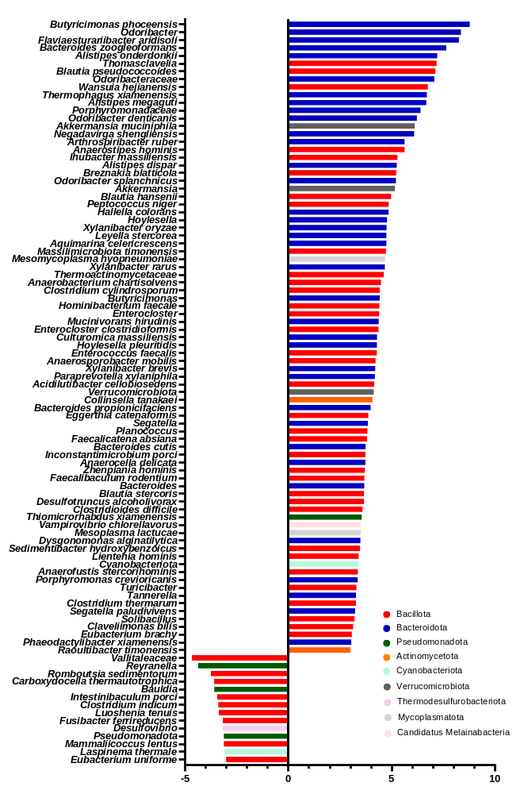
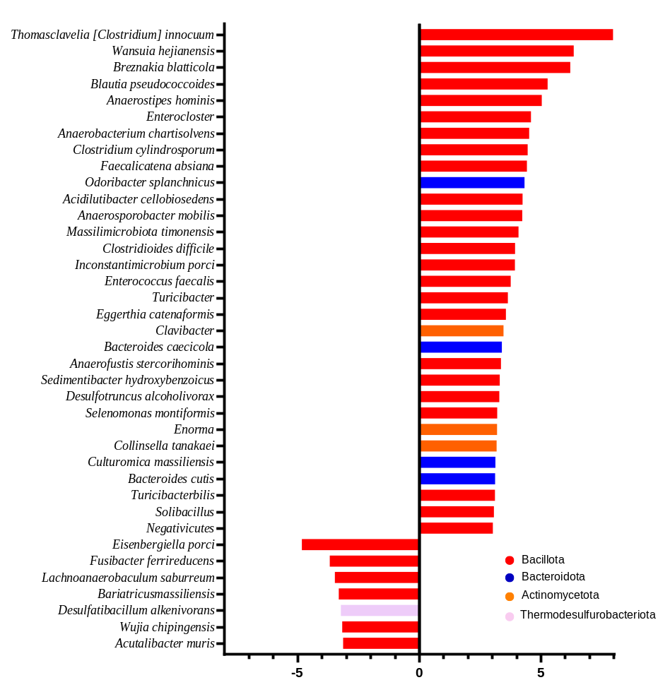
Supplementary Figure 5
A
B
Decrease in GL-M
Increase in GL-M
C
Decrease in L-M
Increase in L-M
Decrease in GL-M
Increase in GL-M
Lactation versus Gestation (FC> 3)
Gestation-Lactation versus Lactation (FC> 3)
Gestation-Lactation versus Gestation (FC> 3)

Slide 6
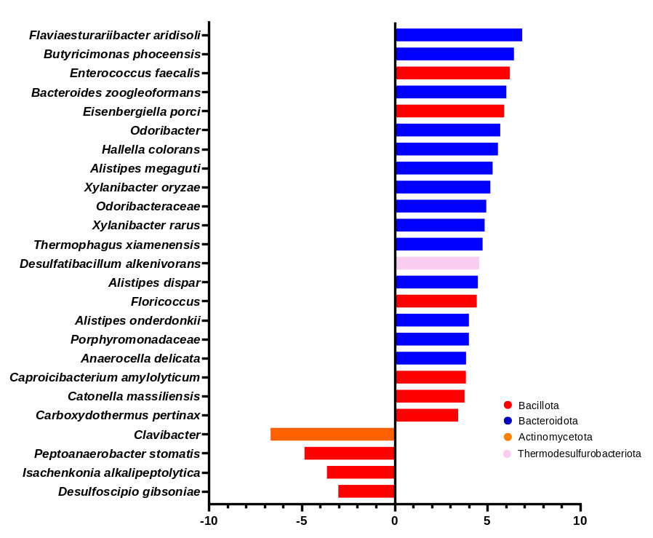
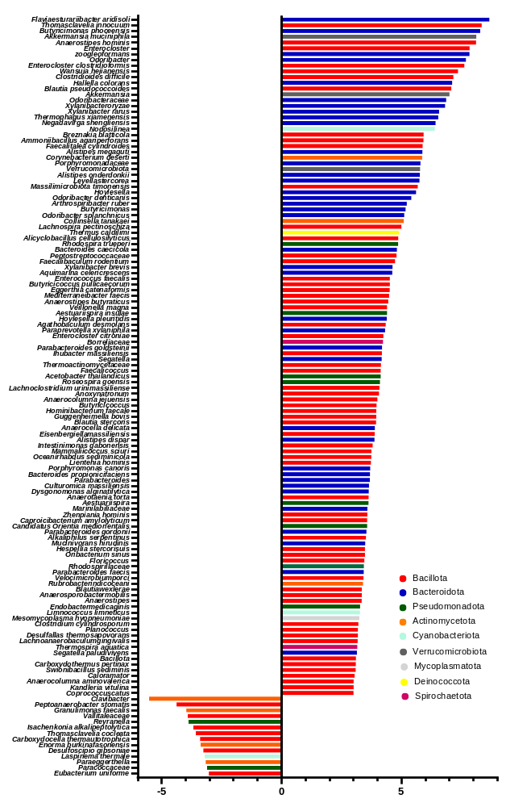
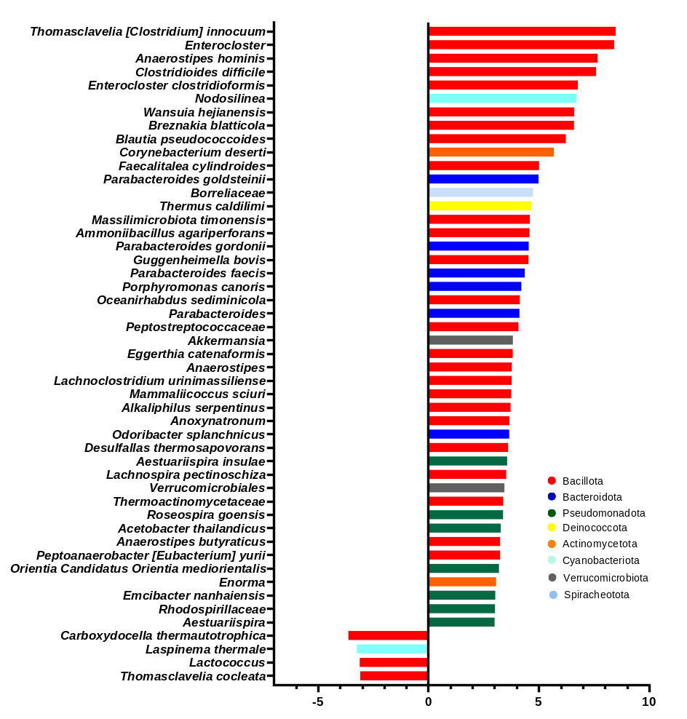
Supplementary Figure 6
A
B
C
Decrease in L-F
Increase in L-F
Decrease in GL-F
Increase in GL-F
Decrease in GL-F
Increase in GL-F
Lactation versus Gestation (FC> 3)
Gestation-Lactation versus Lactation (FC> 3)
Gestation-Lactation versus Gestation (FC> 3)

Slide 7
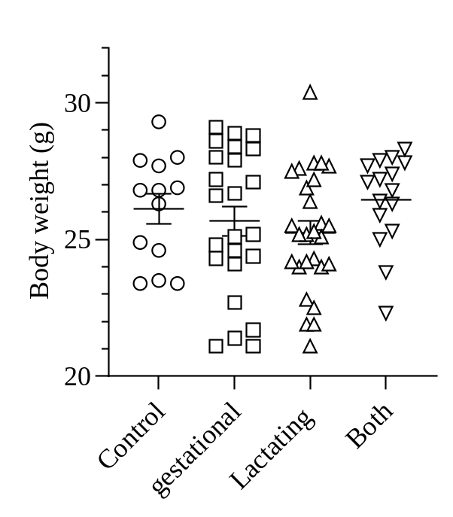
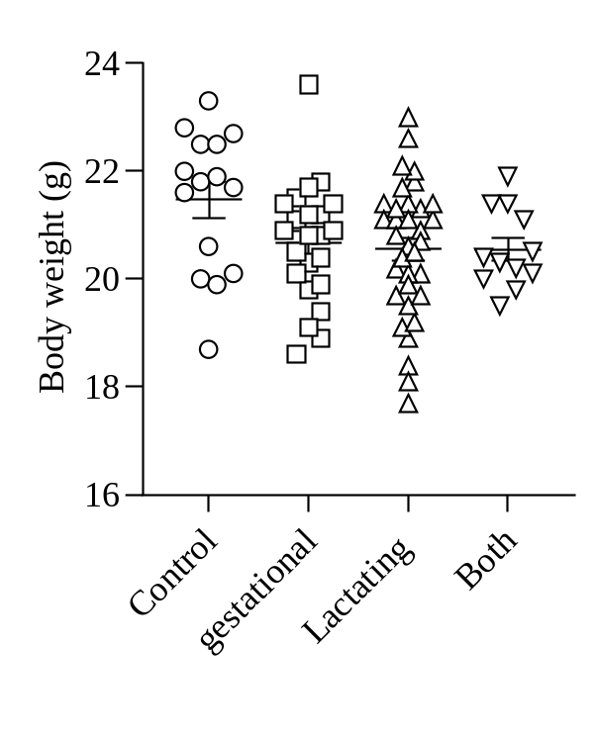
Supplementary Figure 7
A
B

Slide 8
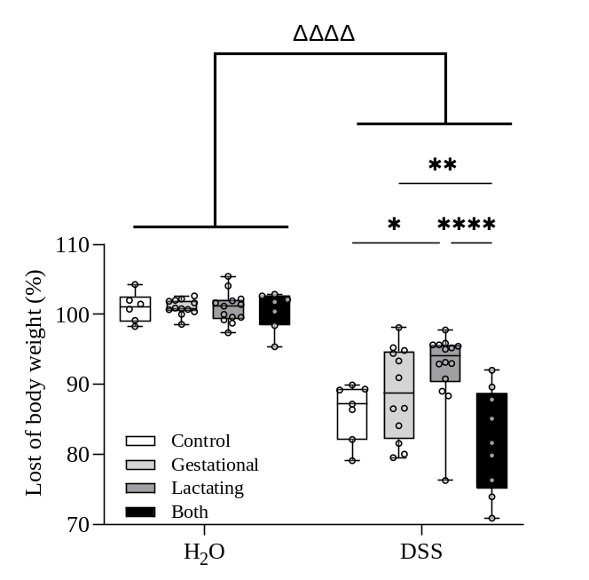
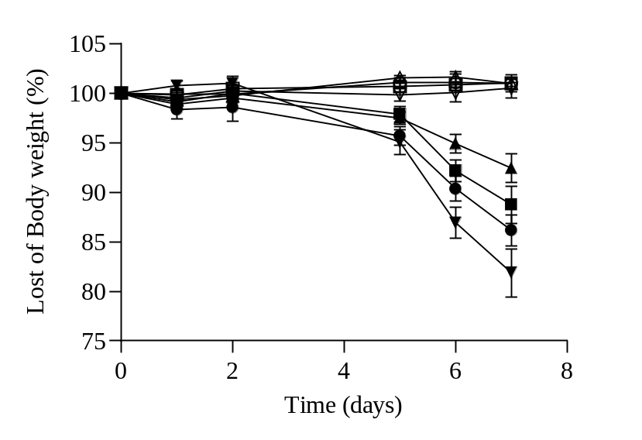
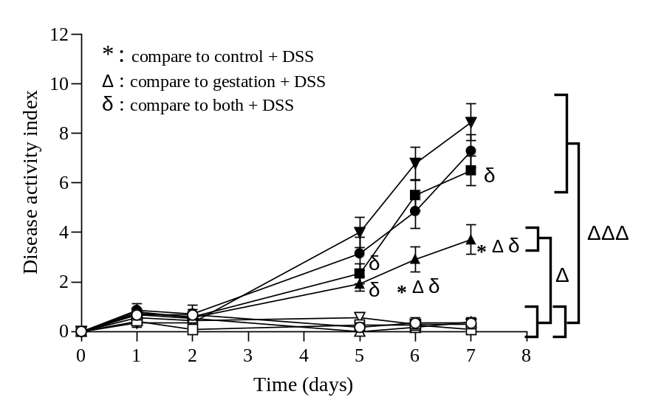
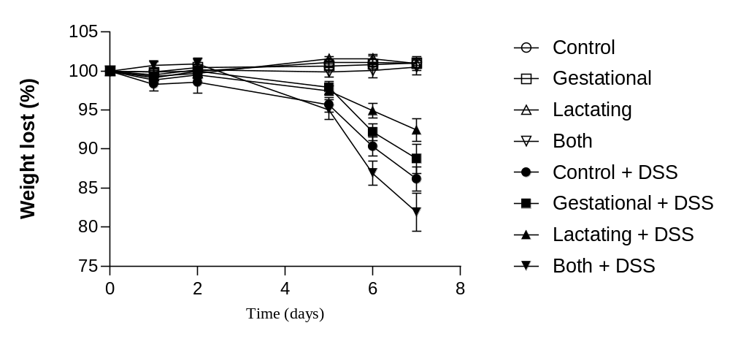
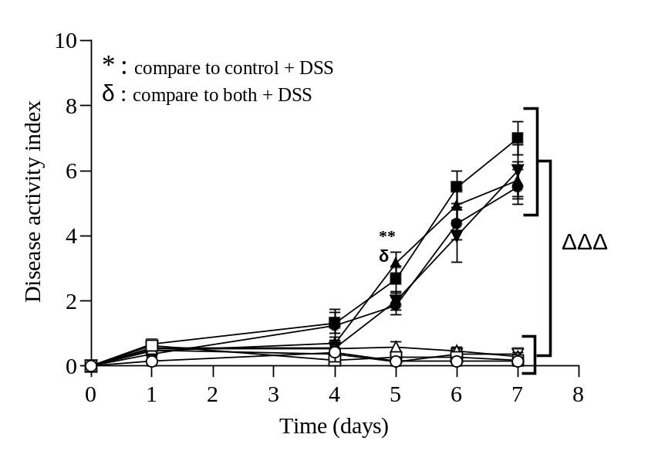
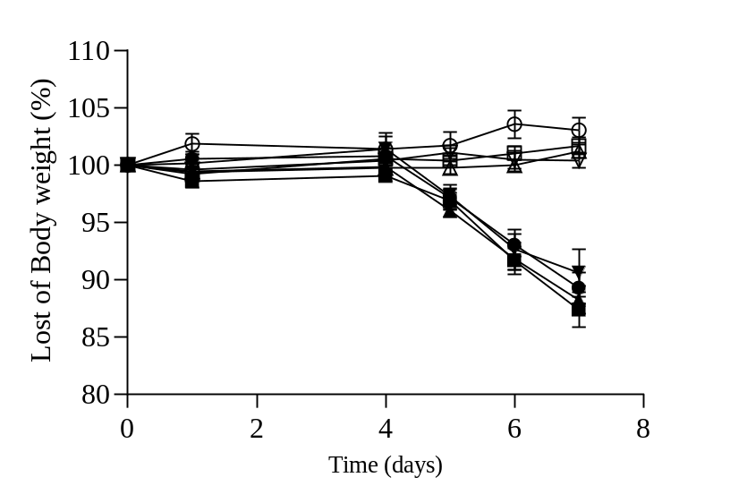
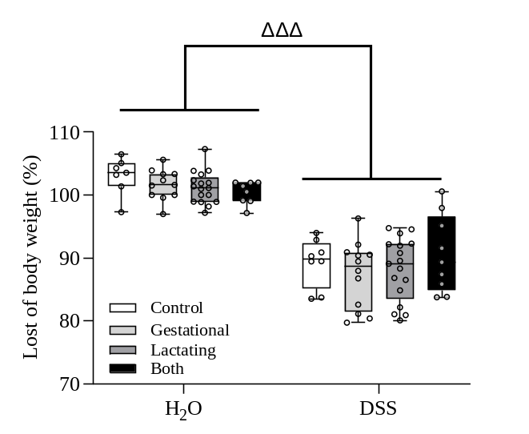
Supplementary Figure 8
A
B
C
D

Slide 9
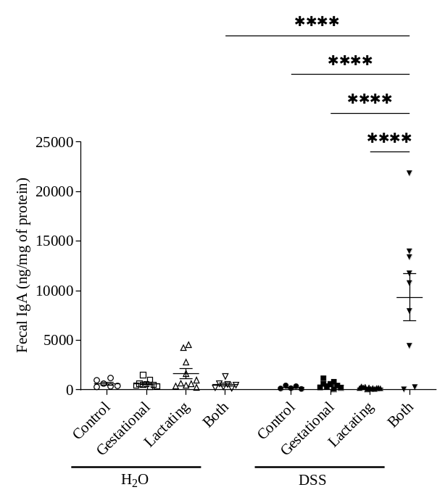
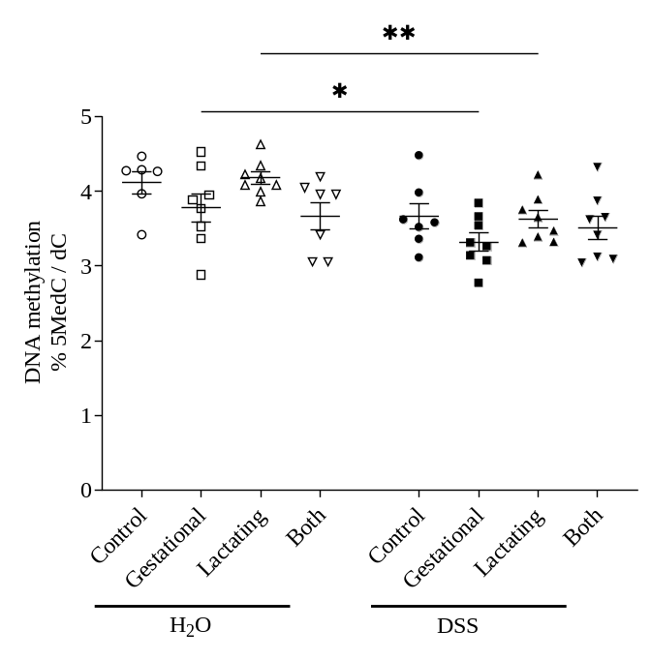
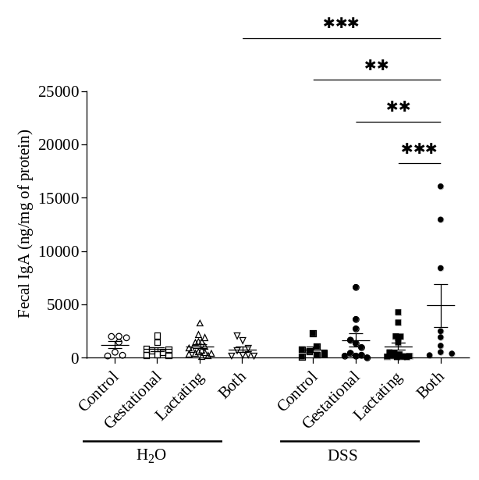
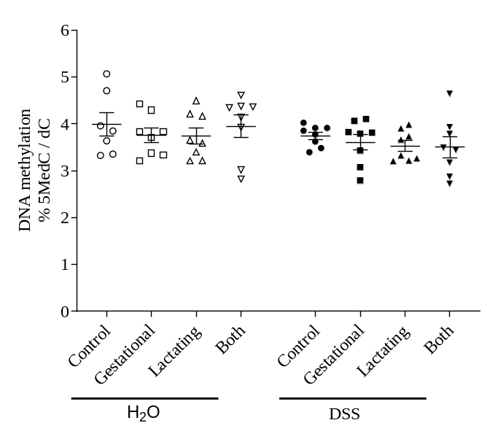
Supplementary Figure 9
A
B
C
D

Slide 10
Supplementary Table 1
Males |  | G-M vs Control-M | L-M vs Control-M | Both-M vs Control-M | L-M vs G-M | Both-M vs G-M | Both-M vs L-M
Pval<0.05 | Up | 13 | 61 | 185 | 157 | 289 | 167
 | Down | 38 | 22 | 81 | 38 | 112 | 131
Pval<0.05, abs(log(FC))>3 | Up | 5 | 36 | 67 | 45 | 81 | 31
 | Down | 18 | 6 | 12 | 4 | 14 | 7
Females |  | G-F vs Control-F | L-F vs Control-F | Both-F vs Control-F | L-F vs G-F | Both-F vs G-F | Both-F vs L-F
Pval<0.05 | Up | 1 | 89 | 253 | 27 | 286 | 192
 | Down | 33 | 87 | 83 | 13 | 166 | 84
Pval<0.05, abs(log(FC))>3 | Up | 0 | 33 | 94 | 21 | 45 | 118
 | Down | 22 | 28 | 7 | 4 | 4 | 14

