Slide 1
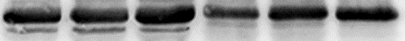
Fig.1d
NRF2
Control Periodontitis
NRF2
PRDX6
GAPDH
PRDX6
GAPDH

Slide 2
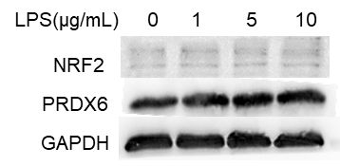
Fig.2c
NRF2
PRDX6
GAPDH

Slide 3
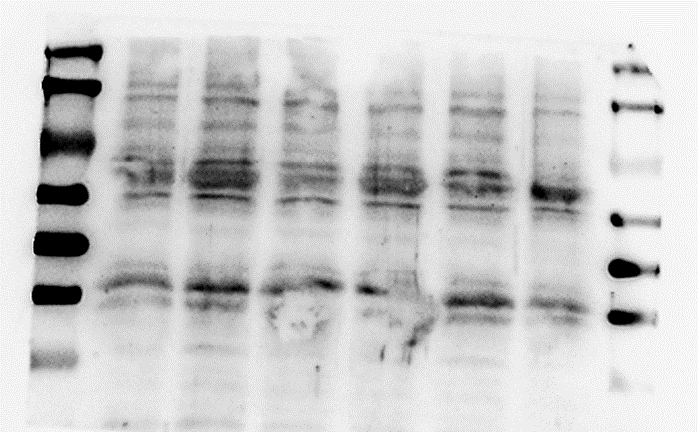
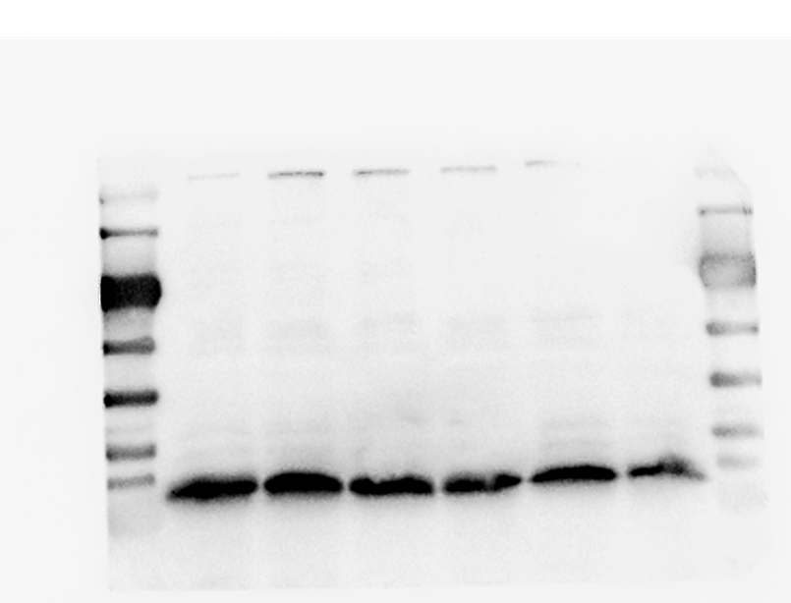
Fig.2e
NRF2
0h 12h 24h 48h
NRF2
PRDX6
GAPDH
PRDX6
GAPDH

Slide 4
Fig.3a
Control siRNA
PRDX6 siRNA
PRDX6
PRDX6
GAPDH
GAPDH

