Slide 1
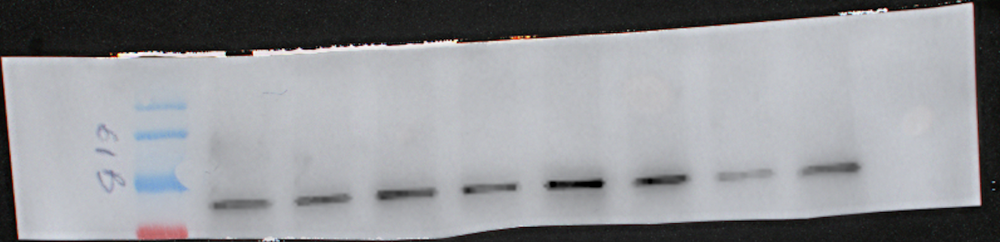
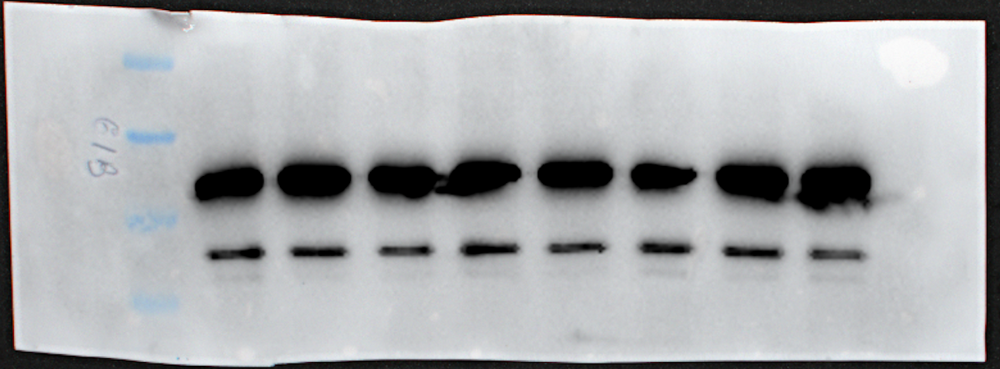
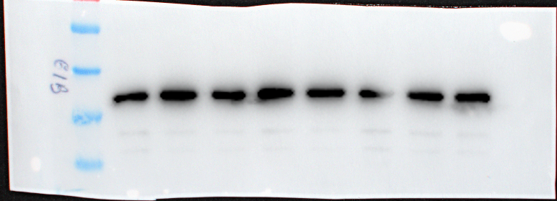
Fig. 5g
IFN-α 24h
kDa
NT JAK1/2i TYK2i JNKi NT JAK1/2i TYK2i JNKi
170
BiP
(78 kDa)
130
100
70
70
55
40
CHOP
(30 kDa)
35
25
70
55
40
GAPDH
(37 kDa)
35
25

Slide 2
Fig. 6c
CCL21 | CCL28 | CXCL16 | Chemerin | CXCL5 | CCL26 | CX3CL1 | CXCL1
CCL14 | CCL1 | CXCL8 | IL-16 | CXCL10 | CXCL11 | XCL1 | CCL2
CCL7 | CCL22 | Midkine | CXCL9 | CCL3 | CCL15 | CCL20 | CCL19
CXCL7 | CCL18 | CXCL4 | CCL5 | CXCL12 | CCL17 | CXCL17
FBGN | IL6ST | CD71 | Neg Ctrl
NT
IFN-⍺ 48h

Slide 3
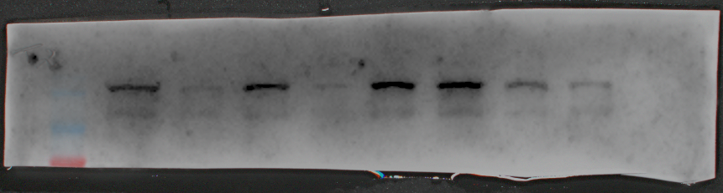
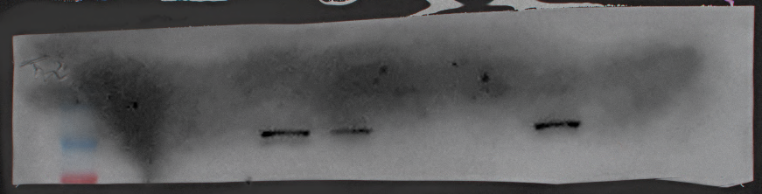
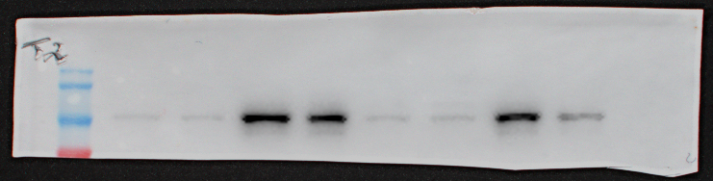
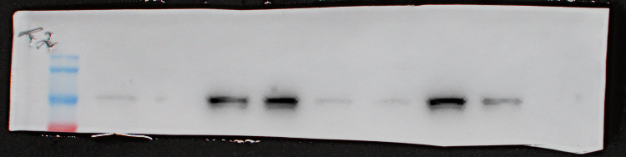
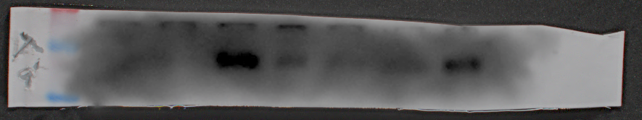
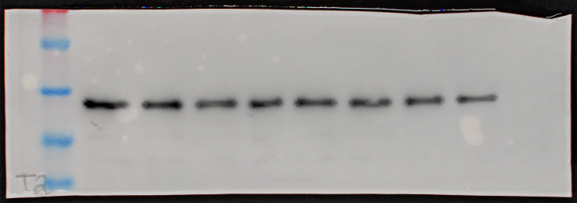
Fig. 8a
IFN-α 24h
IFN-α 24h
kDa
siCTL siTYK2 siCTL siTYK2 NT TYK2i NT TYK2i
170
TYK2
(134 kDa)
130
100
70
170
P-STAT1-Y701
(84, 91 kDa)
130
100
70
170
P-STAT1-S727
(91 kDa)
130
100
70
170
STAT1
(84, 91 kDa)
130
100
70
70
55
PD-L1
(40, 50 kDa)
40
70
55
40
GAPDH
(37 kDa)
35
25

Slide 4
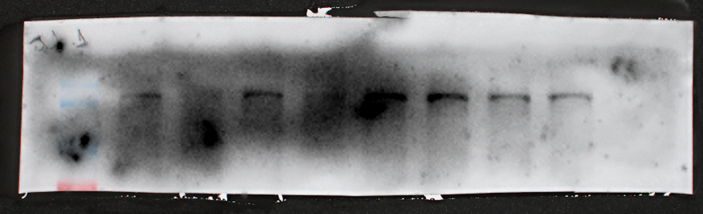
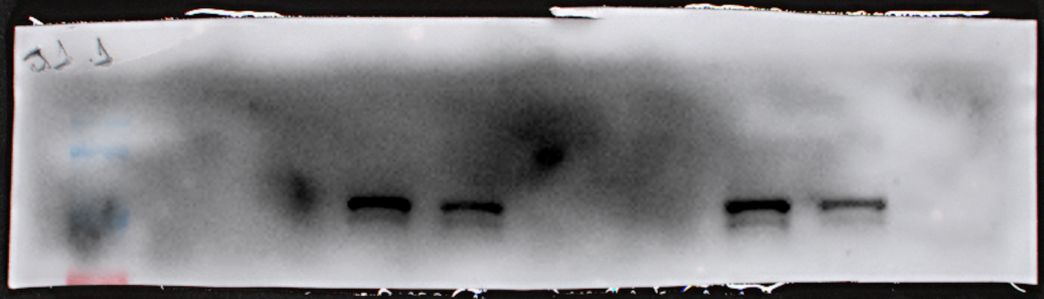
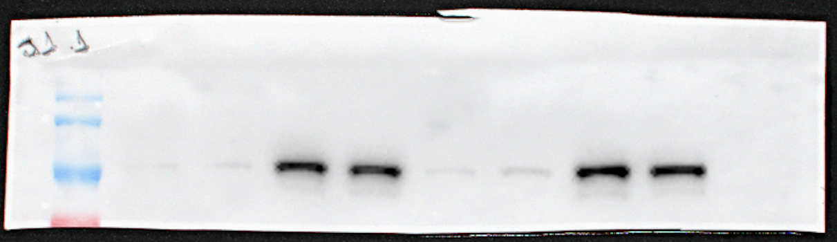
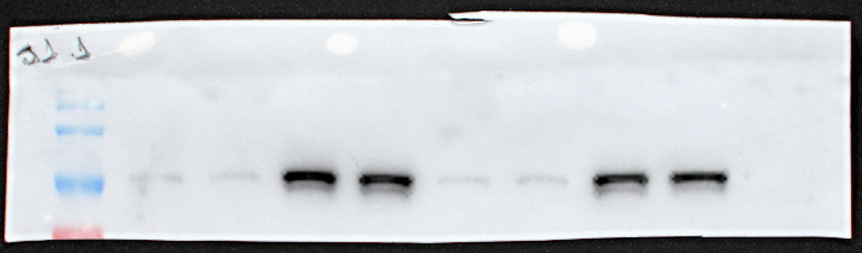
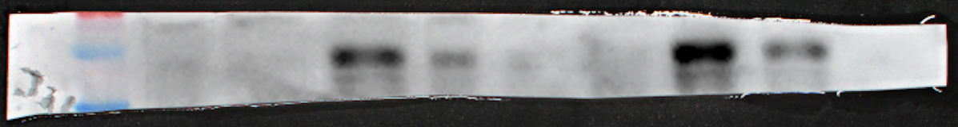
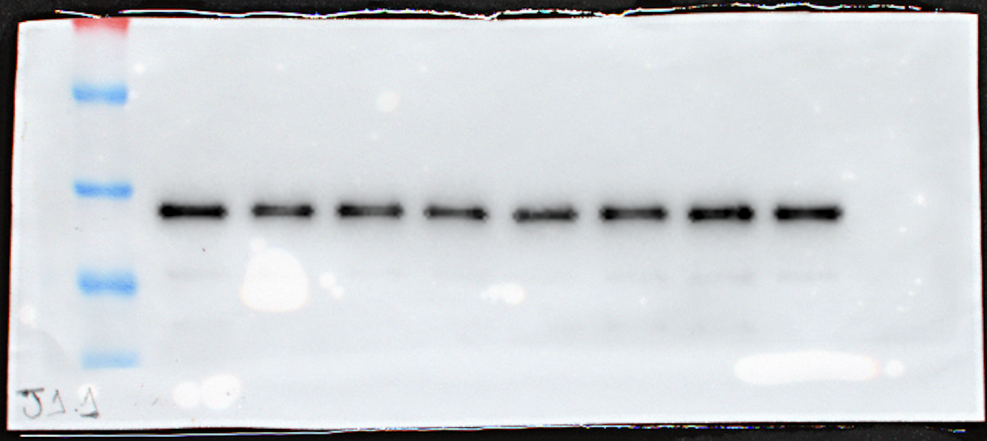
Fig. 8b
IFN-α 24h
IFN-α 24h
kDa
siCTL siJAK1 siCTL siJAK1 NT JAK1/2i NT JAK1/2i
170
JAK1
(130 kDa)
130
100
70
170
P-STAT1-Y701
(84, 91 kDa)
130
100
70
170
P-STAT1-S727
(91 kDa)
130
100
70
170
STAT1
(84, 91 kDa)
130
100
70
70
PD-L1
(40, 50 kDa)
55
40
70
55
40
GAPDH
(37 kDa)
35
25

Slide 5
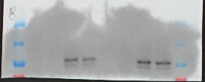
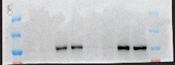
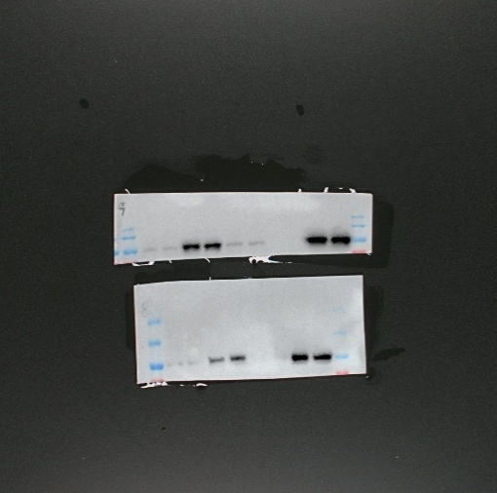
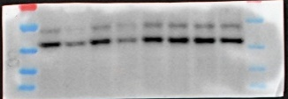
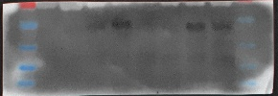
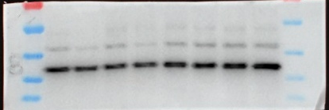
Fig. 8c
IFN-α 24h
IFN-α 24h
kDa
siCTL siJNK1 siCTL siJNK1 NT JNKi NT JNKi
170
130
P-STAT1-Y701
(84, 91 kDa)
100
70
170
P-STAT1-S727
(91 kDa)
130
100
70
170
STAT1
(84,91 kDa)
130
100
70
70
55
JNK1
(46, 54 kDa)
40
35
25
70
55
PD-L1
(40,50 kDa)
40
35
25
70
55
GAPDH
(37 kDa)
40
35
25

Slide 6
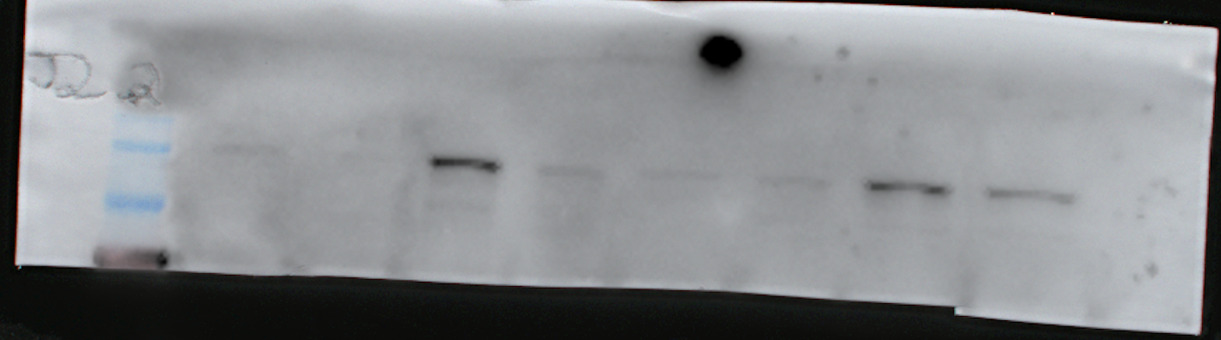
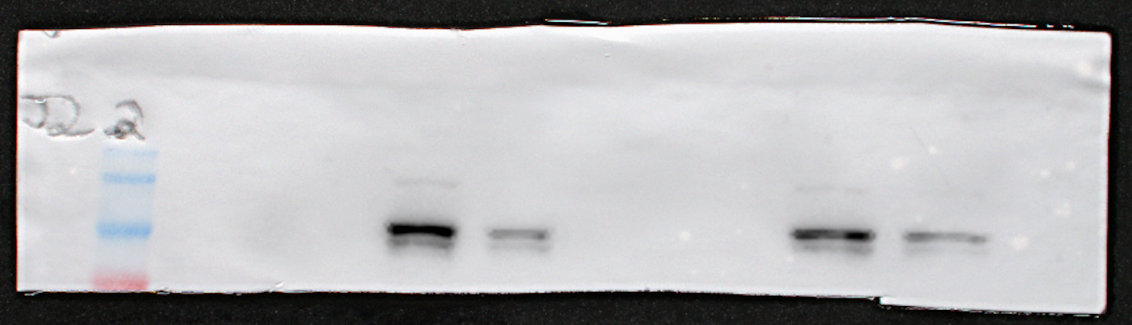
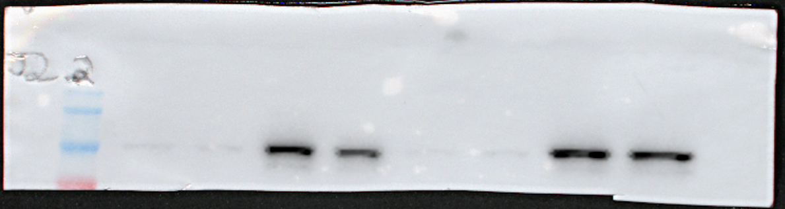
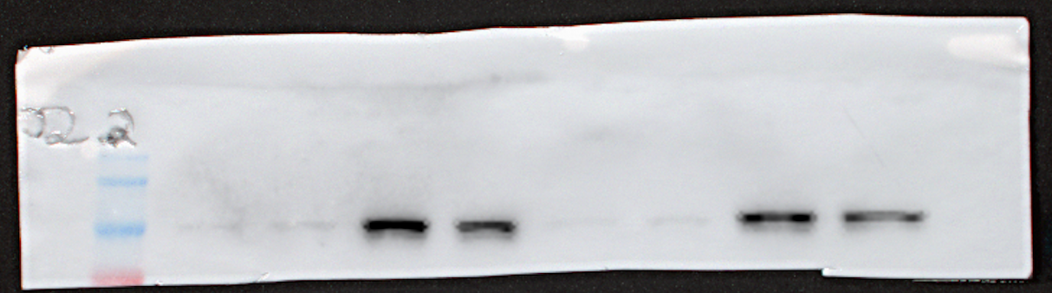
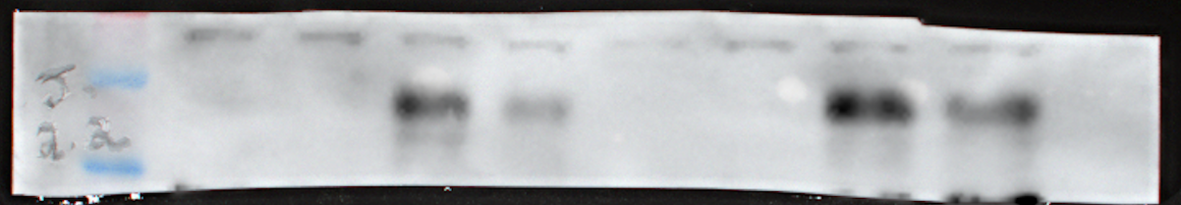
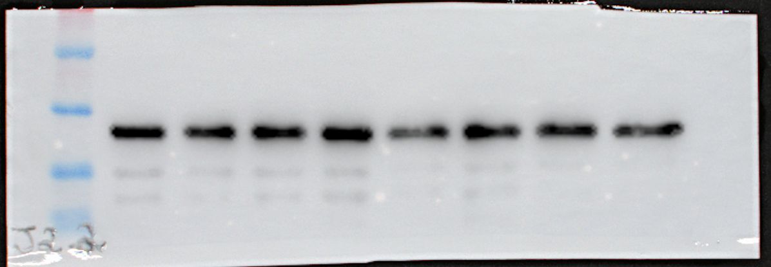
Fig. 8d
IFN-γ 24h
IFN-γ 24h
kDa
siCTL siJAK2 siCTL siJAK2 NT JAK1/2i NT JAK1/2i
JAK2
(125 kDa)
170
130
100
70
170
P-STAT1-Y701
(84, 91 kDa)
130
100
70
170
P-STAT1-S727
(91 kDa)
130
100
70
170
STAT1
(84, 91 kDa)
130
100
70
70
PD-L1
(40, 50 kDa)
55
40
70
55
GAPDH
(37 kDa)
40
35
25

Slide 7
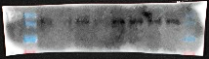
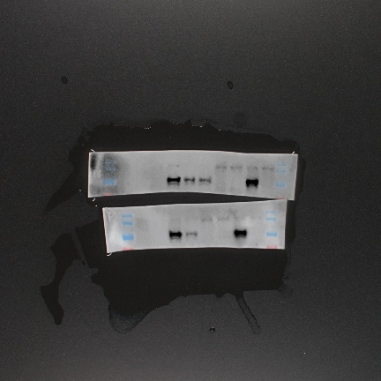
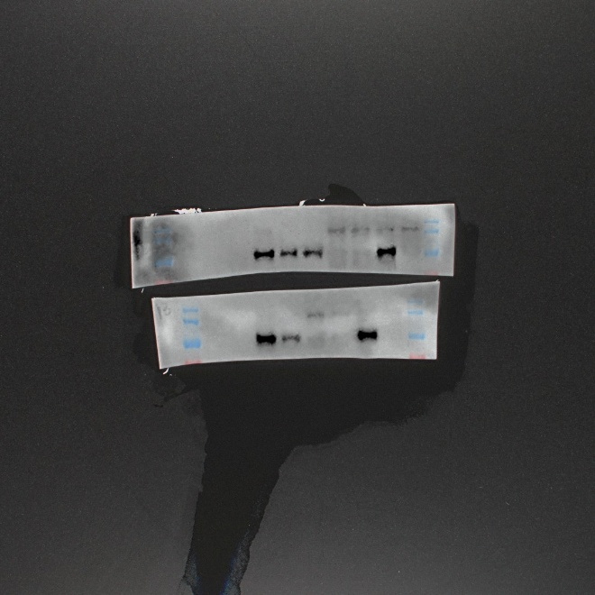
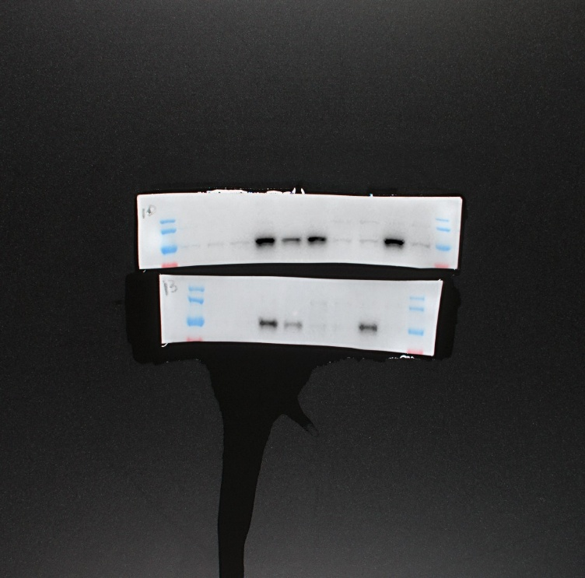
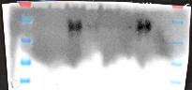
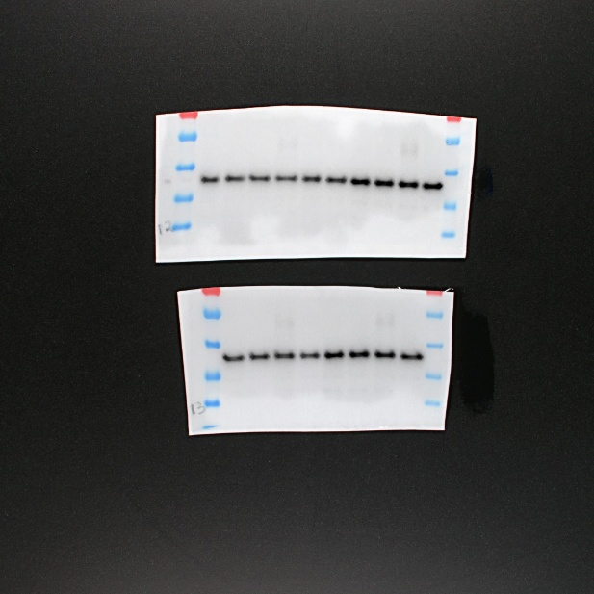
Fig. 8e
IFN-γ 24h
IFN-γ 24h
kDa
siCTL siJAK1 siCTL siJAK1 NT JAK1/2i NT JAK1/2i
170
JAK1
(130 kDa)
130
100
70
170
P-STAT1-Y701
(84, 91 kDa)
130
100
70
170
P-STAT1-S727
(91 kDa)
130
100
70
170
STAT1
(84, 91 kDa)
130
100
70
70
PD-L1
(40, 50 kDa)
55
40
35
25
70
55
GAPDH
(37 kDa)
40
35
25

Slide 8
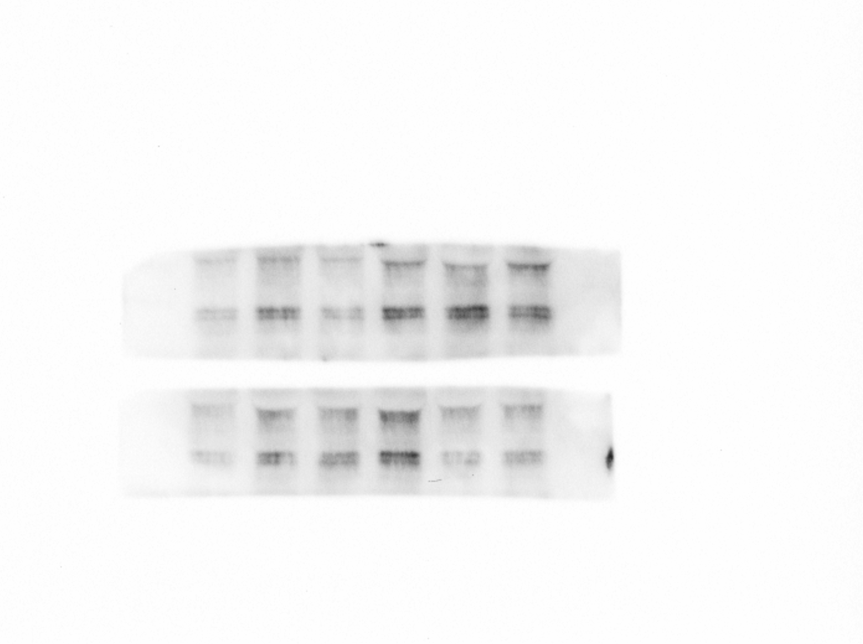
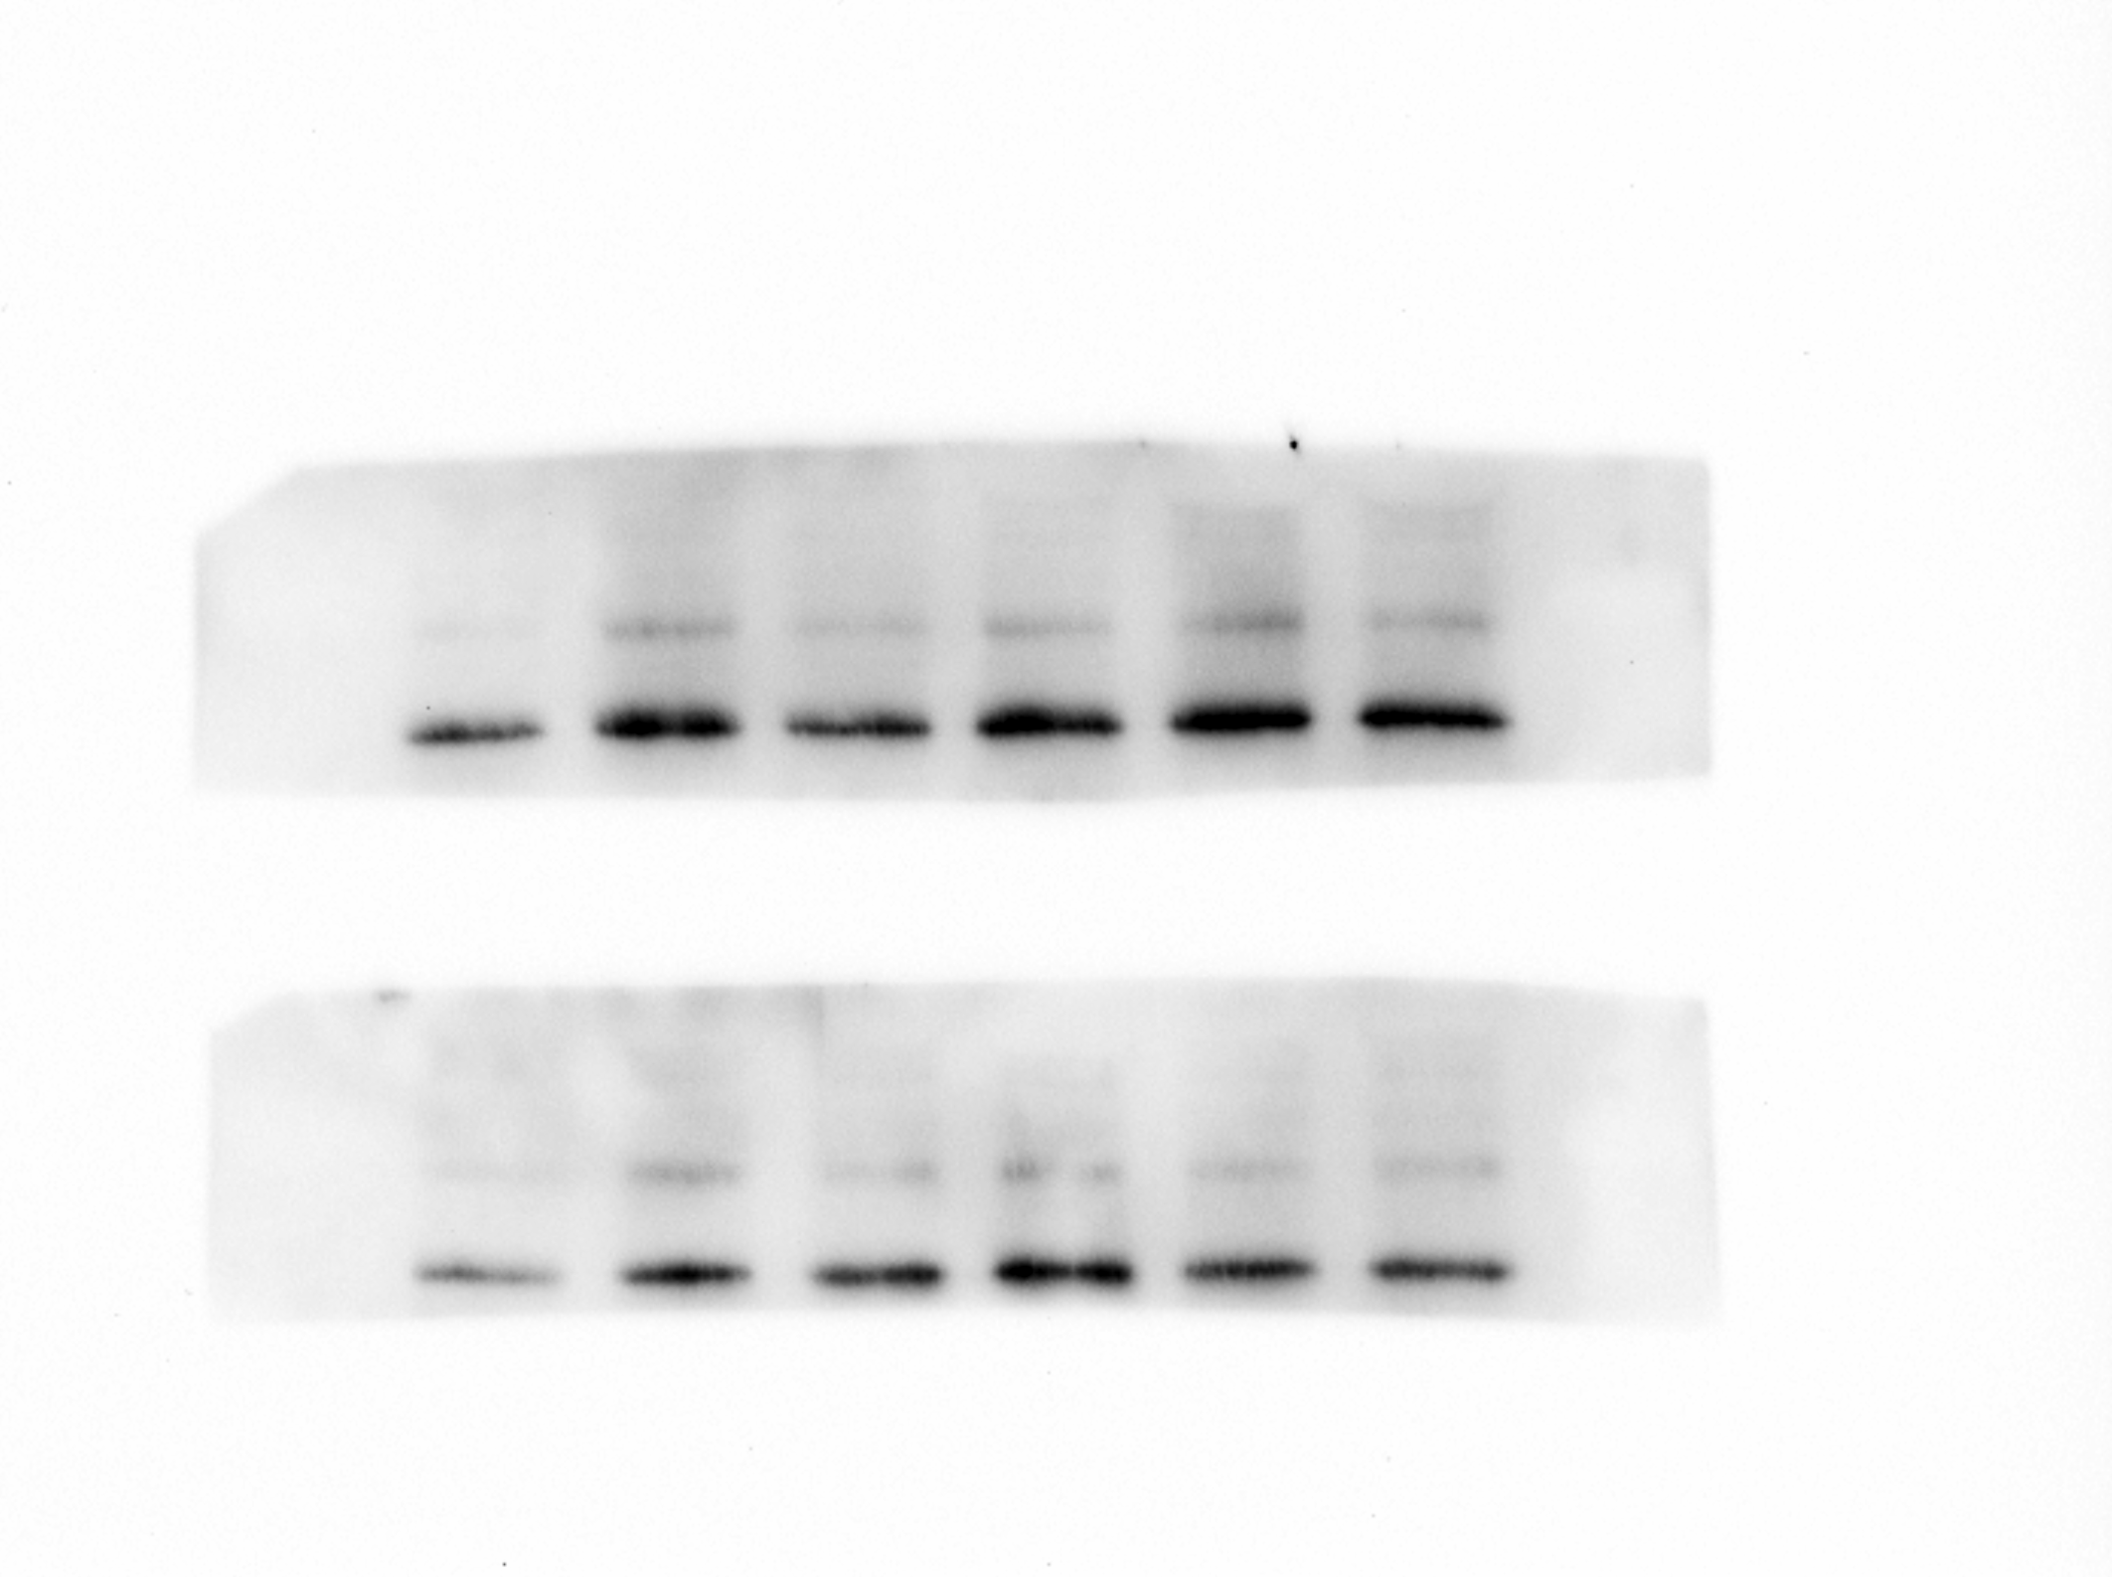
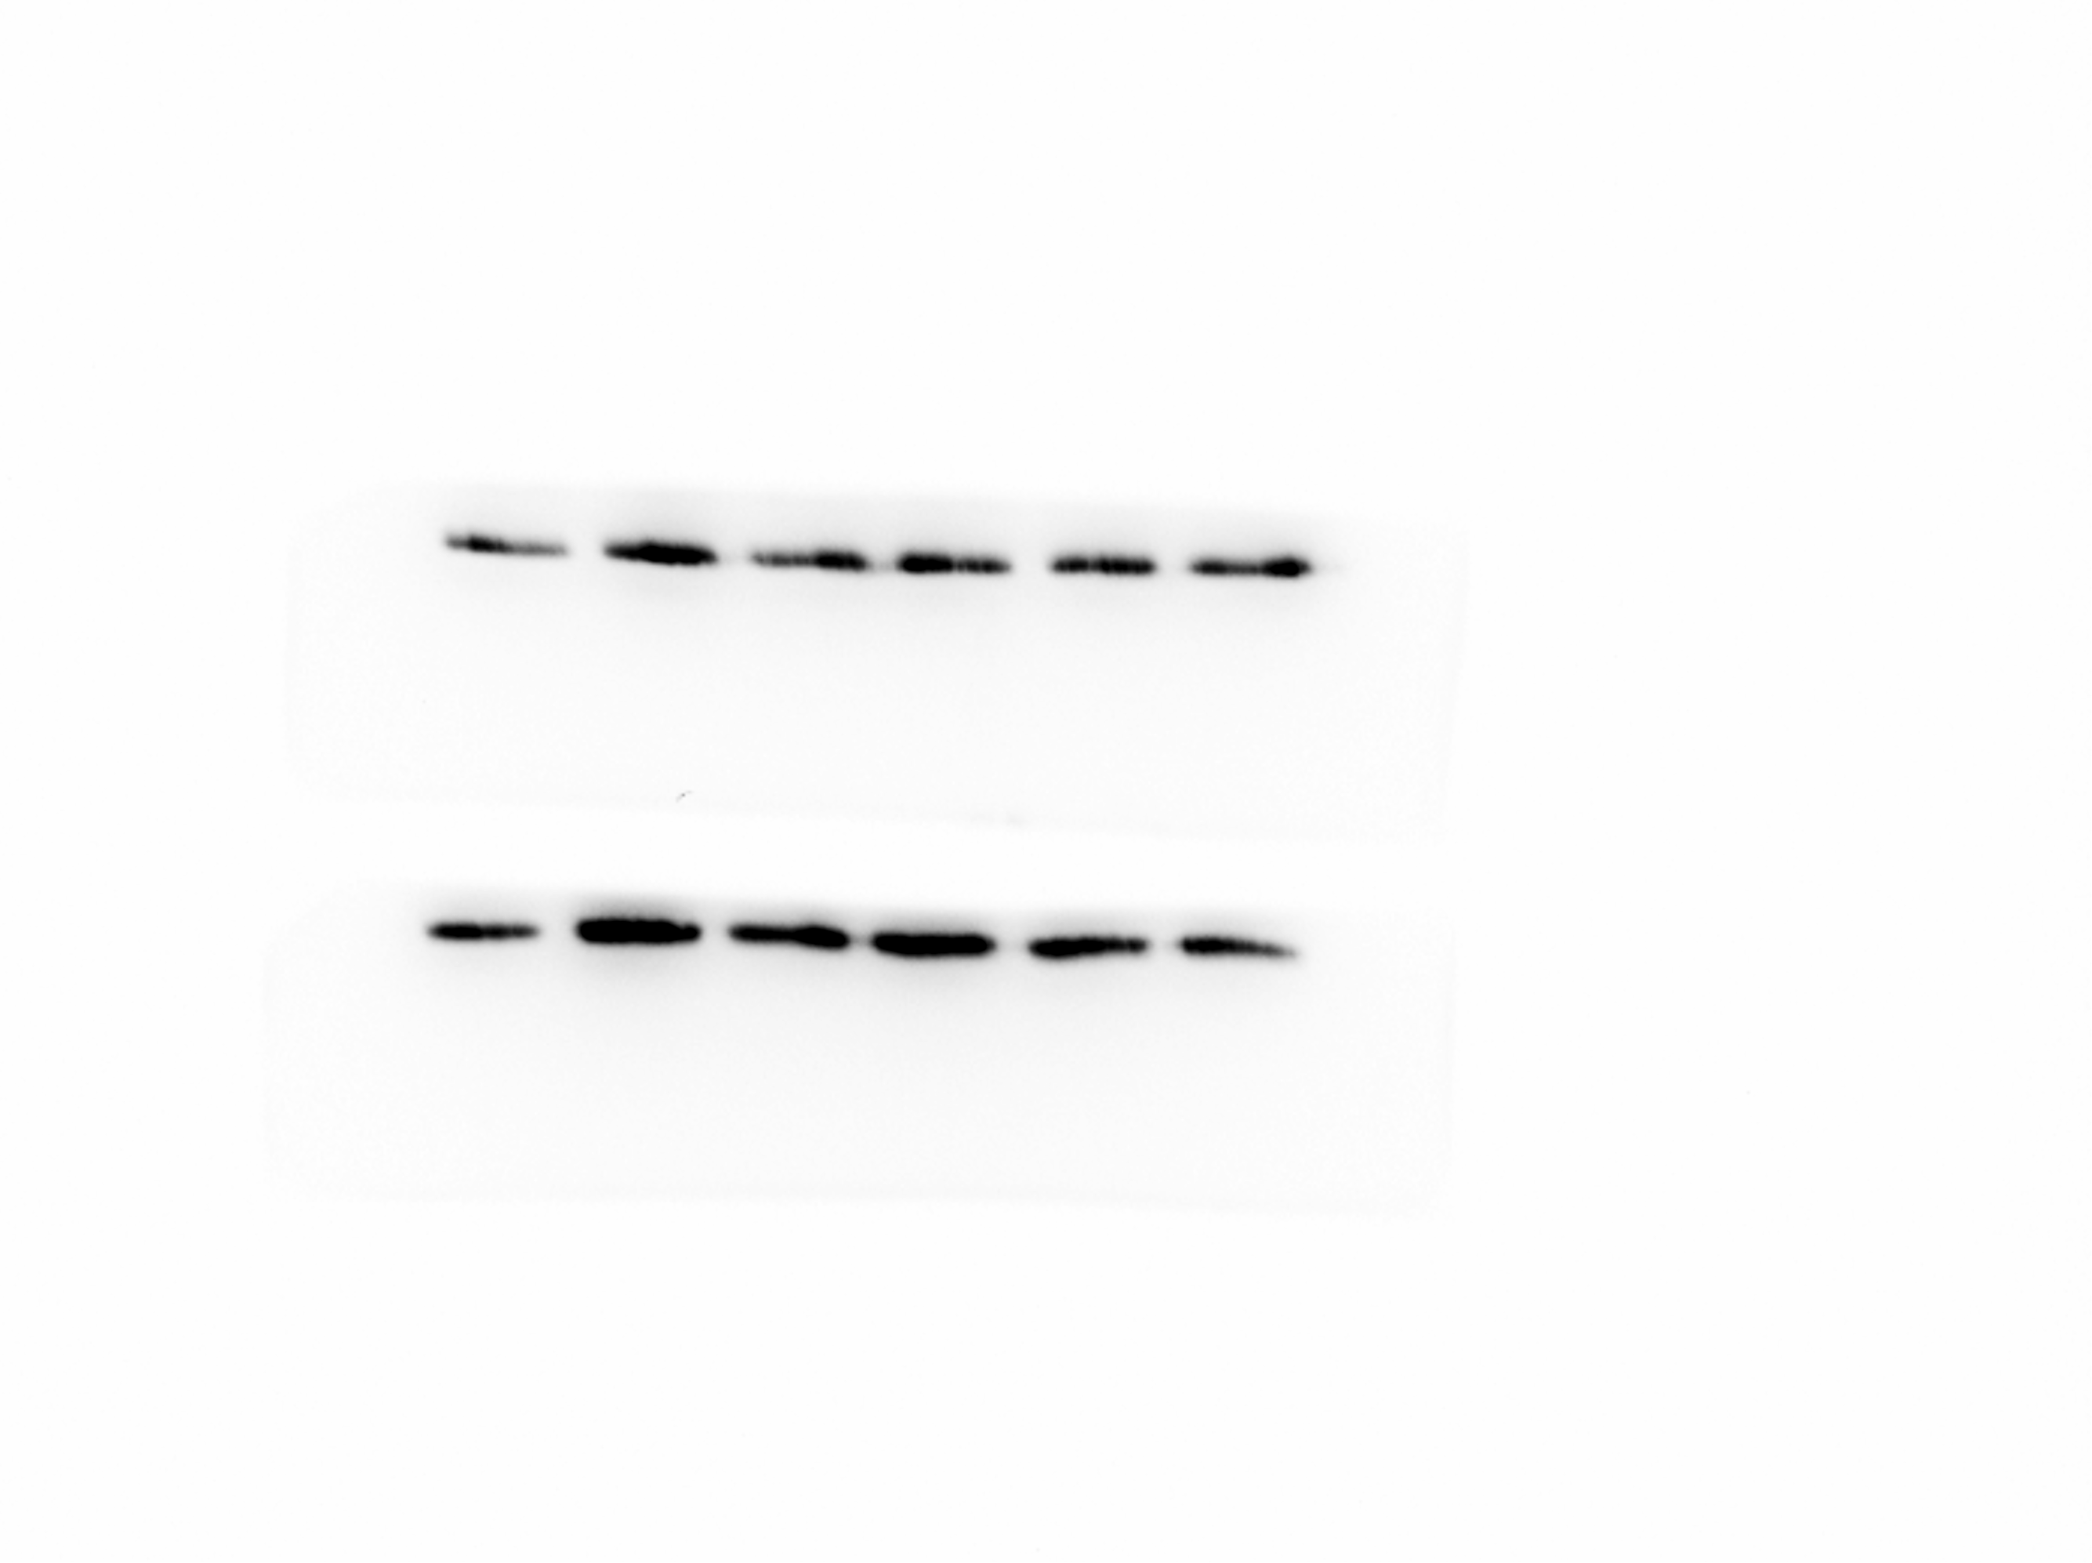
Fig. S2
JAK1/2i
kDa
+IFN-α 1h
NT 0.4 4 NT 0.4 4
70
P-JNK1
(46, 54 kDa)
55
40
70
JNK1
(46, 54 kDa)
55
40
55
40
GAPDH
(37 kDa)
35
25
TYK2i
kDa
+IFN-α 1h
NT 0.03 0.3 NT 0.03 0.3
70
P-JNK1
(46, 54 kDa)
55
40
70
JNK1
(46, 54 kDa)
55
40
55
40
GAPDH
(37 kDa)
35
25

Slide 9
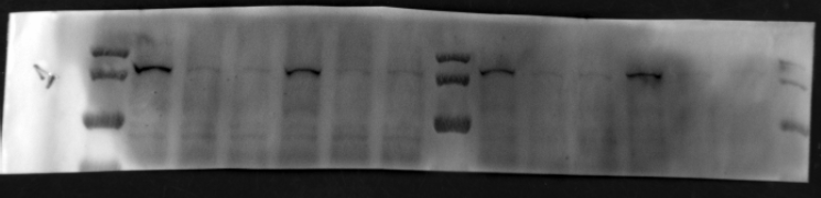
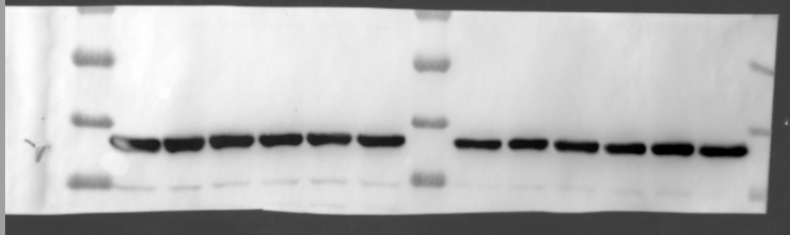
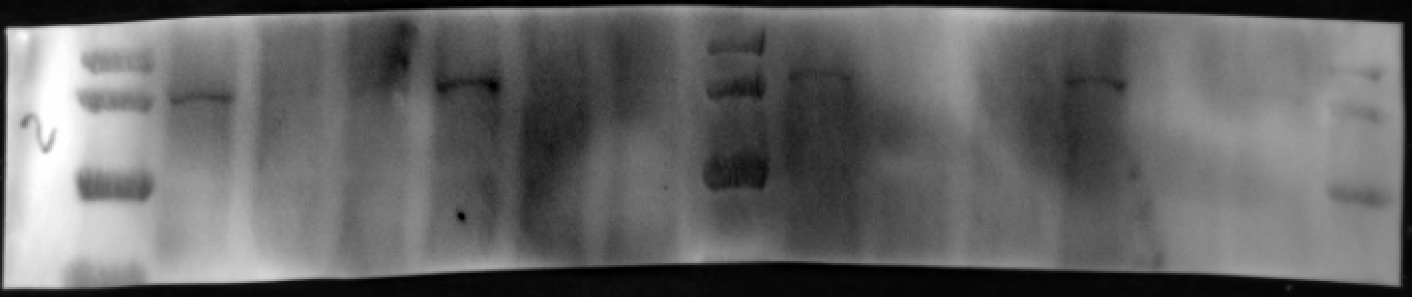
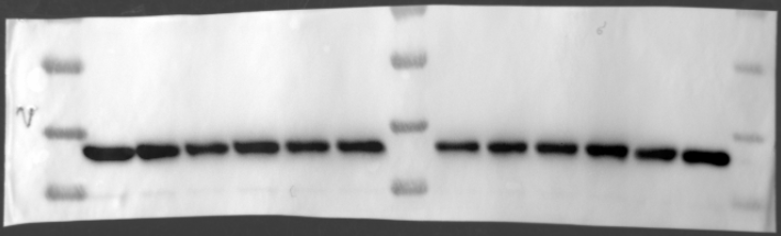
Fig. S3a
IFN-α 24h
IFN-α 24h
kDa
siTYK2
siTYK2
siTYK2
siTYK2
siCTL si#1 si#2 siCTL si#1 si#2 siCTL si#1 si#2 siCTL si#1 si#2
170
TYK2
(134 kDa)
130
100
70
70
55
40
GAPDH
(37 kDa)
35
Fig. S3b
IFN-α 24h
IFN-α 24h
kDa
siJAK1
siJAK1
siJAK1
siJAK1
siCTL si#1 si#2 siCTL si#1 si#2 siCTL si#1 si#2 siCTL si#1 si#2
170
JAK1
(130 kDa)
130
100
70
70
55
GAPDH
(37 kDa)
40
35

Slide 10
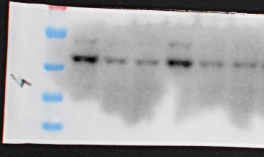
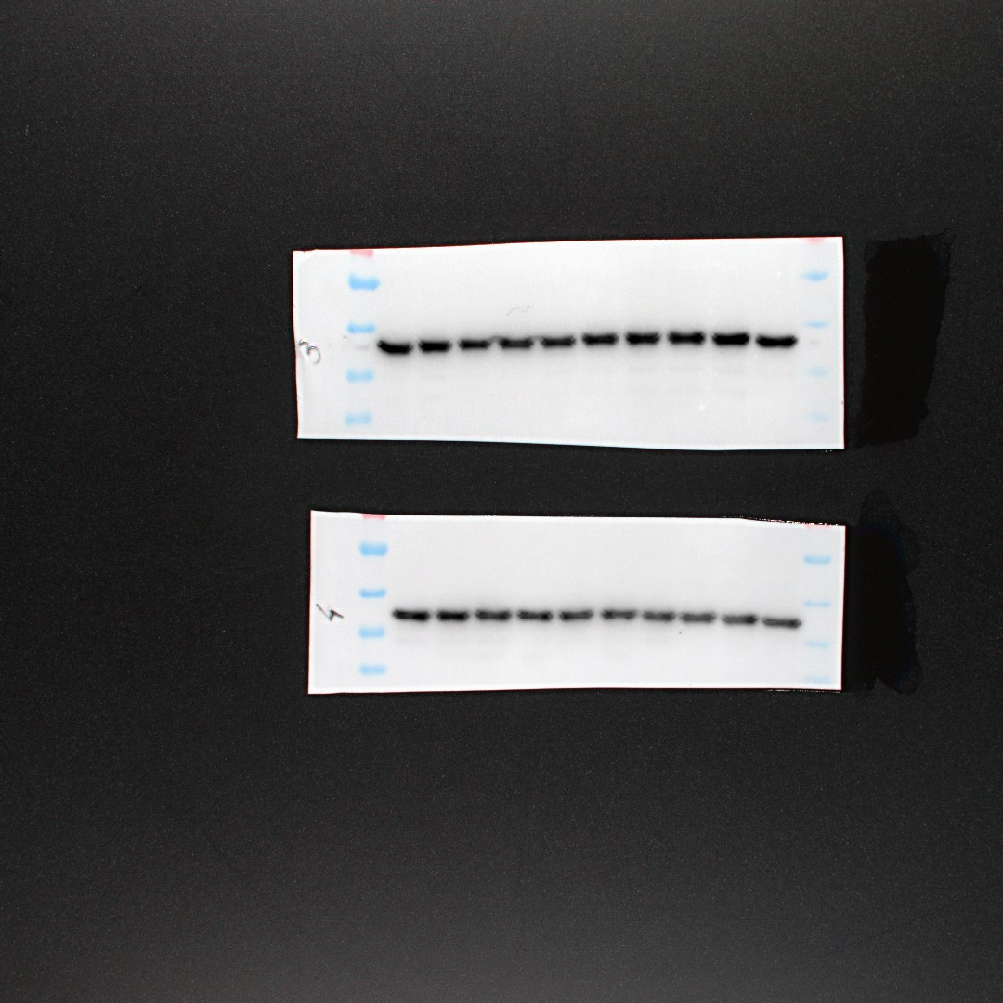
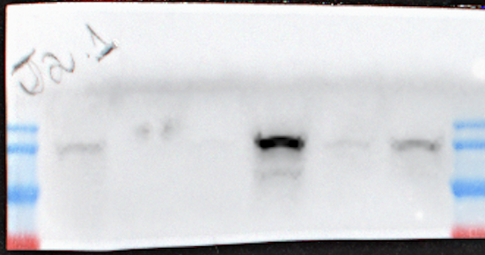
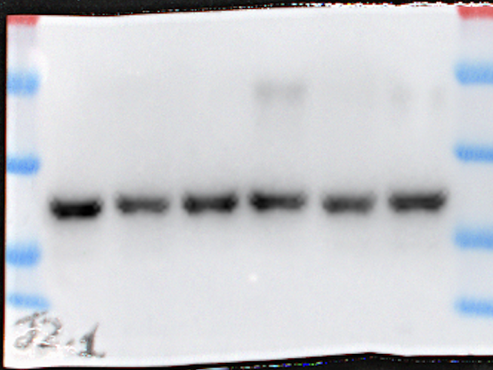
Fig. S3c
IFN-α 24h
kDa
siJNK1
siJNK1
70
siCTL si#1 si#2 siCTL si#1 si#2
55
40
JNK1
(46, 54 kDa)
35
25
70
55
GAPDH
(37 kDa)
40
35
25
Fig. S3d
IFN-γ 24h
kDa
siJAK2
siJAK2
siCTL si#1 si#2 siCTL si#1 si#2
170
JAK2
(125 kDa)
130
100
70
70
55
40
GAPDH
(37 kDa)
35
25

Slide 11
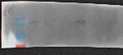
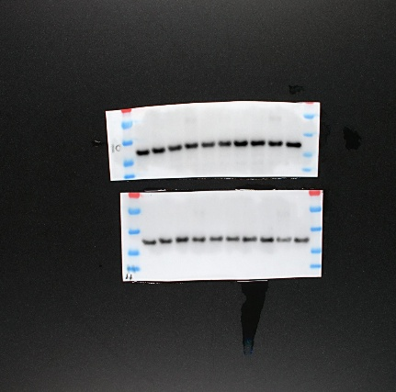
Fig. S3e
IFN-γ 24h
kDa
siJAK1
siJAK1
siCTL si#1 si#2 siCTL si#1 si#2
170
JAK1
(130 kDa)
130
100
70
70
55
40
GAPDH
(37 kDa)
35
25

Slide 12
Fig. S4g
CCL21 | CCL28 | CXCL16 | Chemerin | CXCL5 | CCL26 | CX3CL1 | CXCL1
CCL14 | CCL1 | CXCL8 | IL-16 | CXCL10 | CXCL11 | XCL1 | CCL2
CCL7 | CCL22 | Midkine | CXCL9 | CCL3 | CCL15 | CCL20 | CCL19
CXCL7 | CCL18 | CXCL4 | CCL5 | CXCL12 | CCL17 | CXCL17
FBGN | IL6ST | CD71 | Neg Ctrl
JAK1/2i+IFN-⍺ 48h
TYK2i+IFN-⍺ 48h
JNKi+IFN-⍺ 48h

