Slide 1
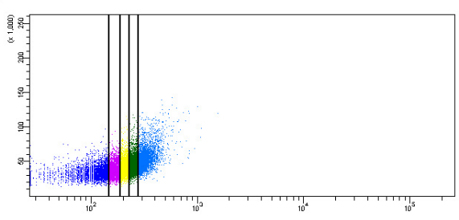
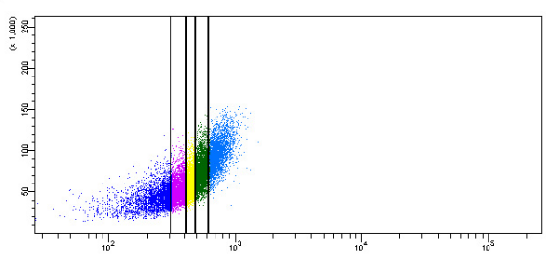
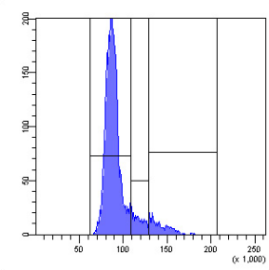
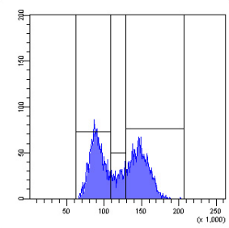
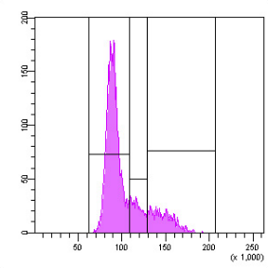
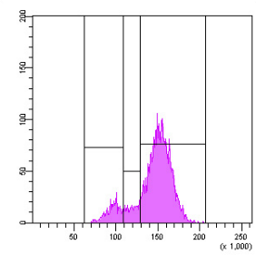
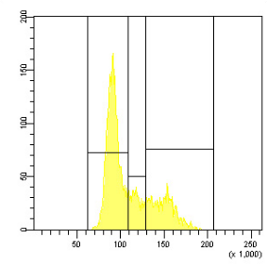
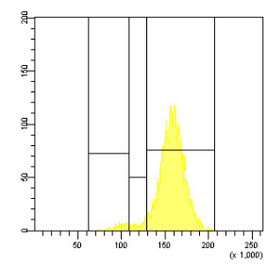
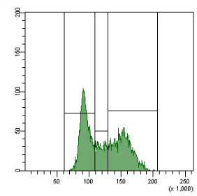
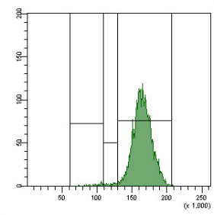
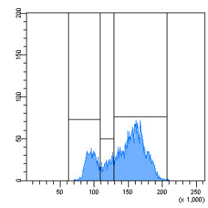
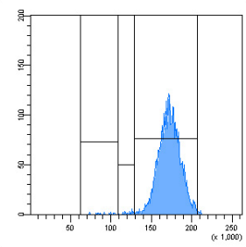
Supporting Figure 3
Jurkat
Base line
24 h 0.2 µM etoposide
A
SSC
SSC
B
Cyto-ID fluorescence
Low Cyto-ID
Medium-low Cyto-ID
Cell number
Medium Cyto-ID
Medium-high Cyto-ID
High Cyto-ID
See next page
for caption.
DRAQ5 fluorescence

Slide 2
Figure S3. Cell cycle phase and autophagy are tightly associated. Autophagy and cell cycle phases were determined by flow-cytometric analysis of Cyto-ID + DRAQ5 double-stained cells. (A) Cell populations were grouped into quintiles based on their Cyto-ID fluorescence intensities. (B) Cell cycle histograms of each quintile of cells. Dot plots and histograms are representative of three independent measurements.

