Slide 1
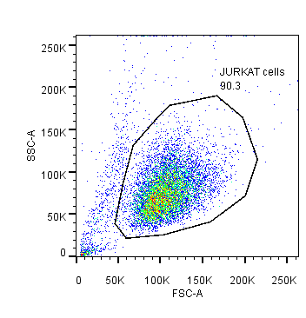
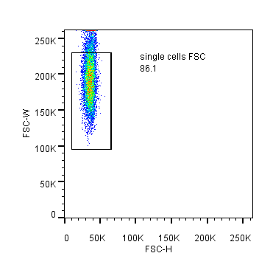
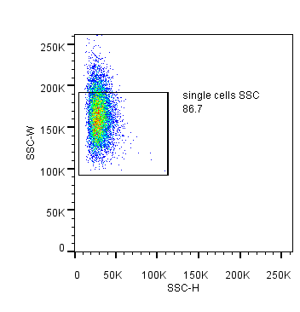
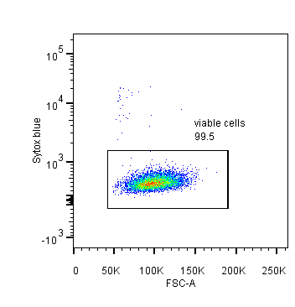
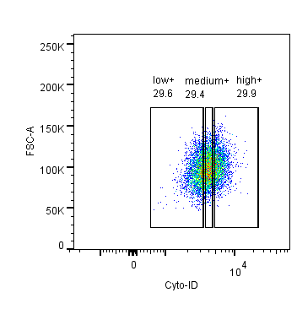
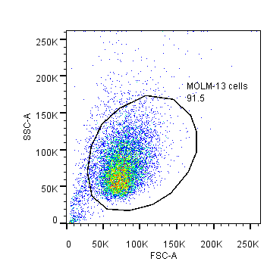
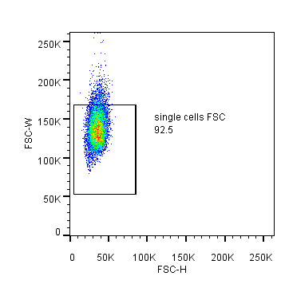
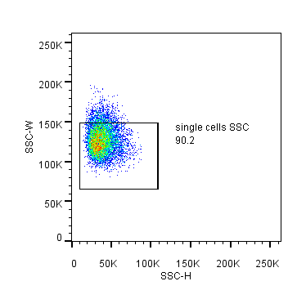
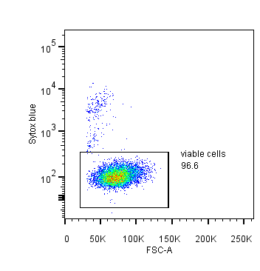
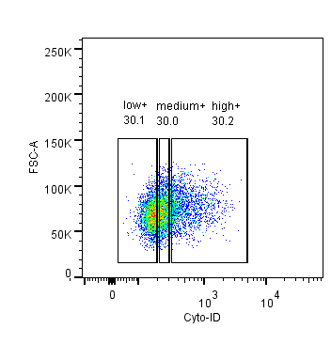
Supporting Figure 4
Jurkat
MOLM-13
Figure S4. Gating strategy for Cyto-ID-based cell sorting. Debris and aggregates were excluded from the sorting using a sequential gating strategy relying on FSC-A versus SSC-A followed by FSC-H versus FSC-W and SSC-H versus SSC-W. Dead cells were excluded by gating on Sytox Blue-negative cells. Cells were sorted into three subpopulations of approximately equal number based on their Cyto-ID fluorescence intensities, i.e., into populations with low, medium and high Cyto-ID fluorescence. The numbers within the plots indicate the percentages of the respective parent population.

