Slide 1
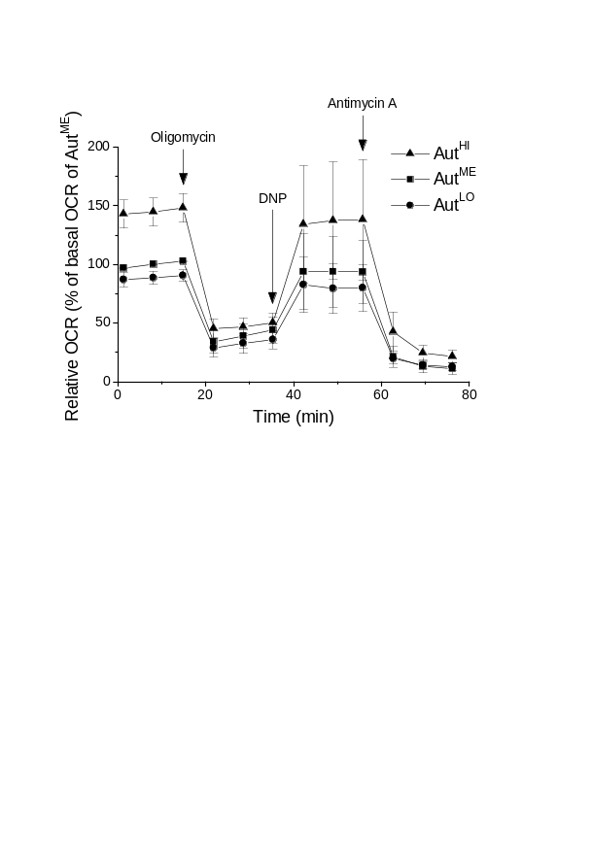
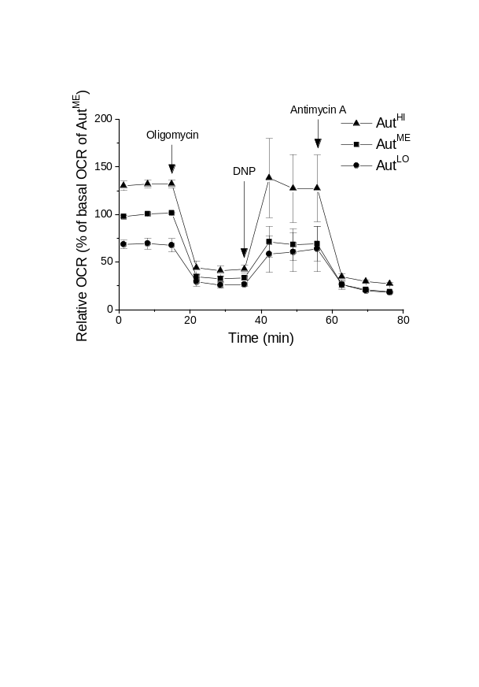
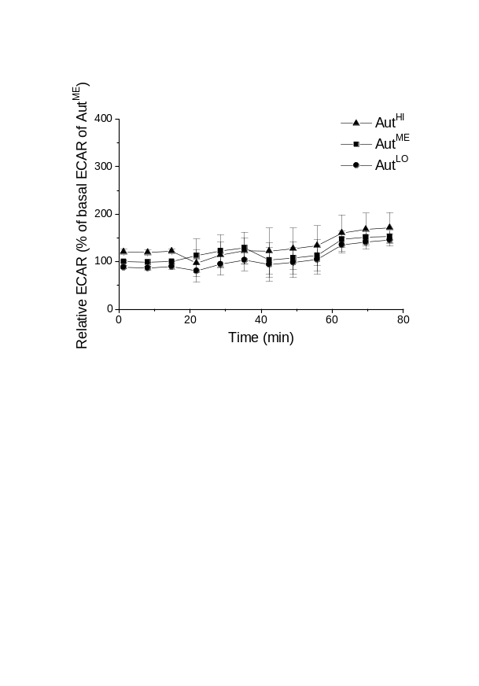
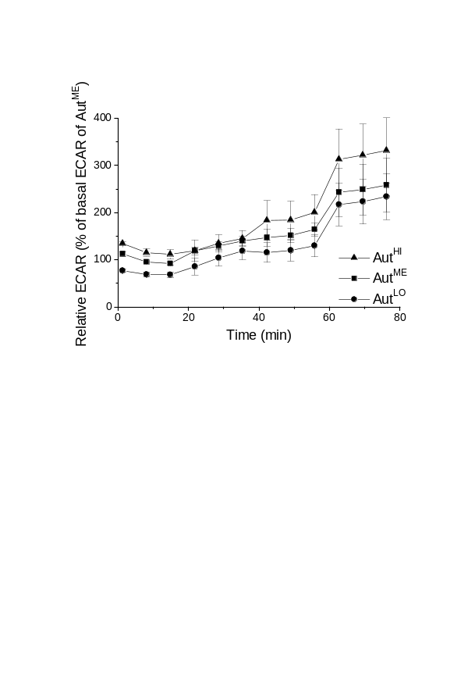
Supporting Figure 6
Cyto-ID-sorted Jurkat
Cyto-ID-sorted MOLM-13
A
B
Figure S6. Metabolic phenotype of Cyto-ID-sorted cells. Cells were flow-cytometrically sorted on the basis of their Cyto-ID fluorescence intensity into subpopulations with low, medium and high Cyto-ID fluorescence (Aut^{LO}, AutME and Aut^{HI}, respectively). Oxygen consumption (OCR) and extracellular acidification rates (ECAR) were measured at basal conditions and after sequential injection of oligomycin (ATP synthase inhibitor), 2,4-dinitrophenol (DNP; oxidative phosphorylation uncoupler) and antimycin A (cytochrome c reductase inhibitor). (A) Higher basal mitochondrial respiration and ATP production in Aut^{HI} compared with Aut^{LO} and AutME. OCR as a proxy for oxidative metabolism was measured with the Seahorse Cell Mito Stress Test. (B) Higher glycolytic activity in Aut^{HI} compared with Aut^{LO} and AutME. ECAR was measured as a proxy for glycolytic activity. OCR and ECAR curves are representative of three independent measurements; each curve consisted of six readings.

