Slide 1
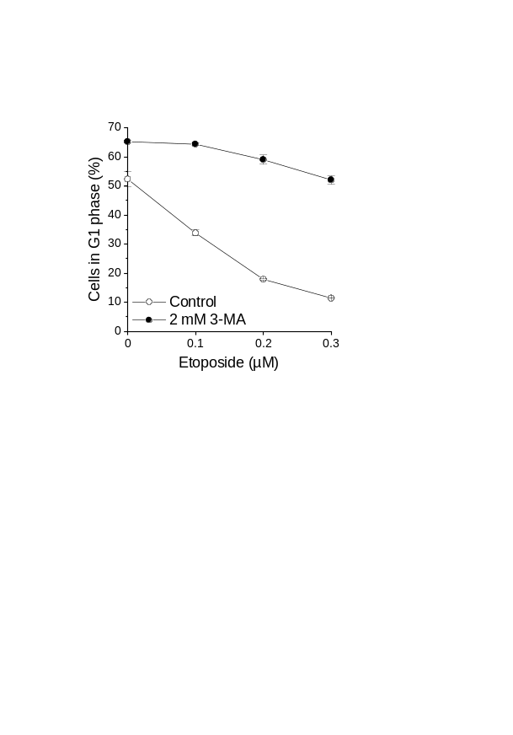
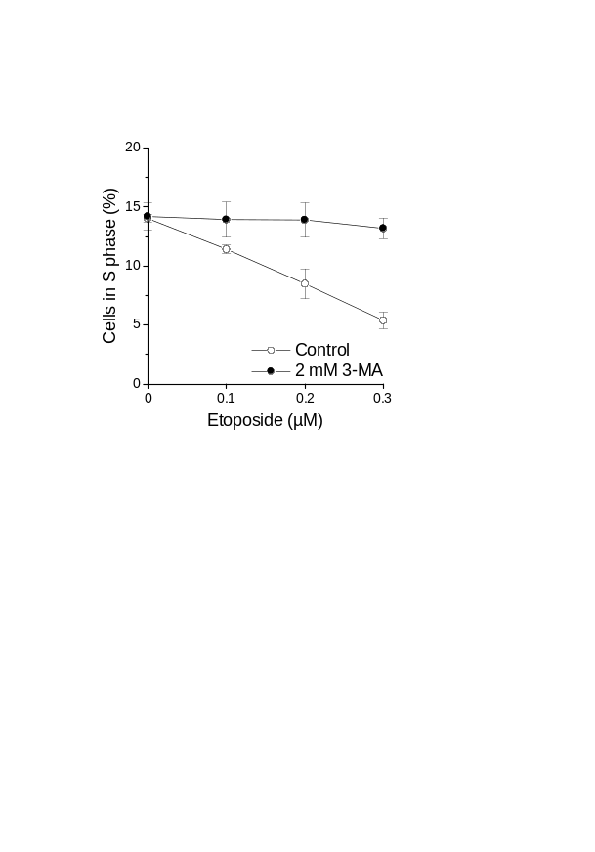
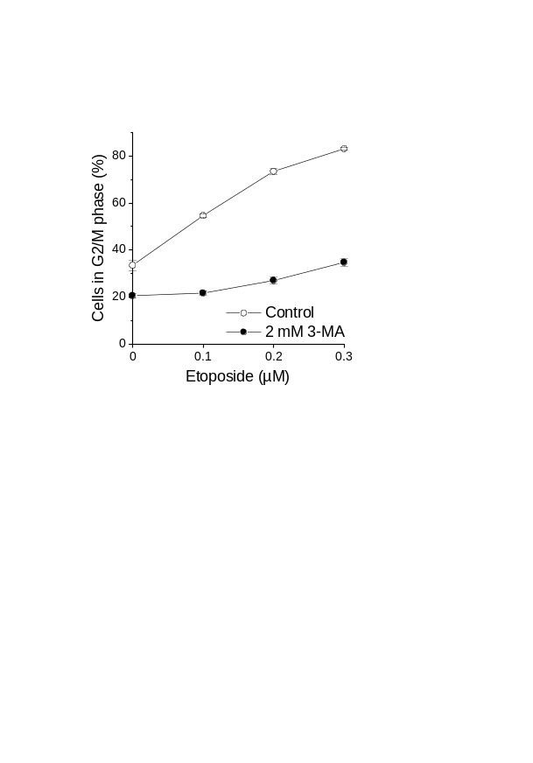

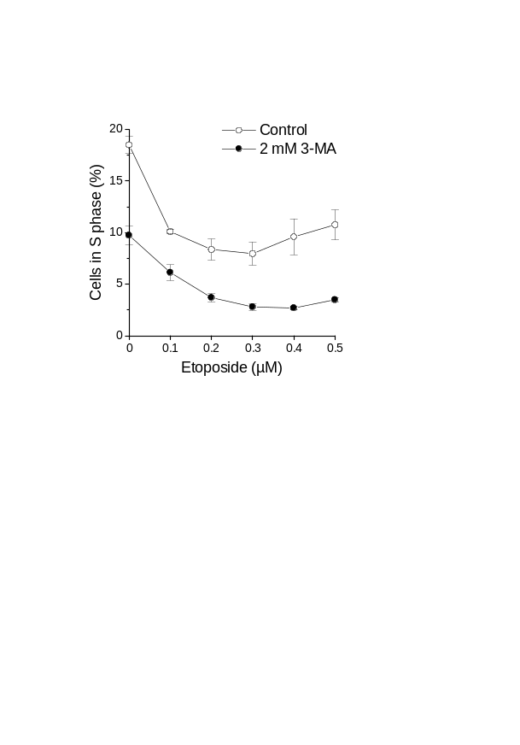
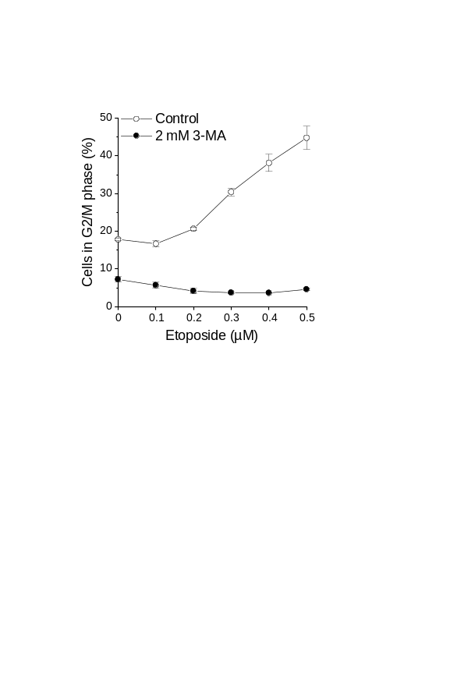
Supporting Figure 1
Jurkat
MOLM-13
Figure S1. Autophagy inhibition affects etoposide-induced cell cycle arrest. Cells were exposed to etoposide with or without 3-MA for 24 h (Jurkat) or 48 h (MOLM-13). Cell cycle phases were determined by flow-cytometric analysis of DRAQ5-stained cells. Means ± SEM of each three separate measurements are shown.

