Slide 1
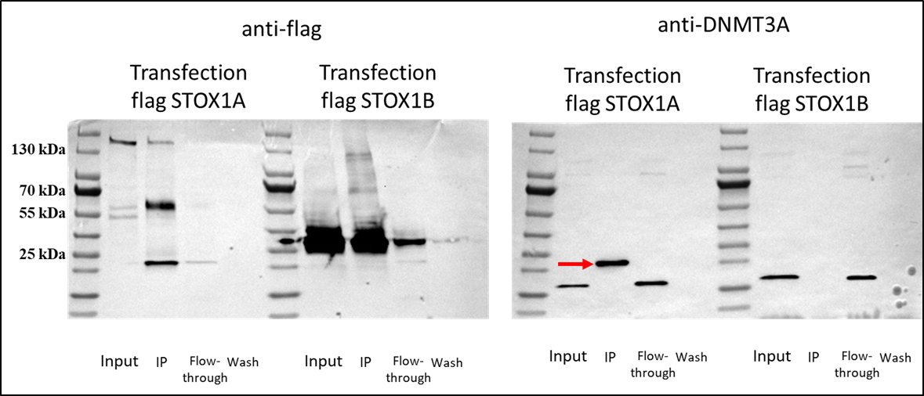
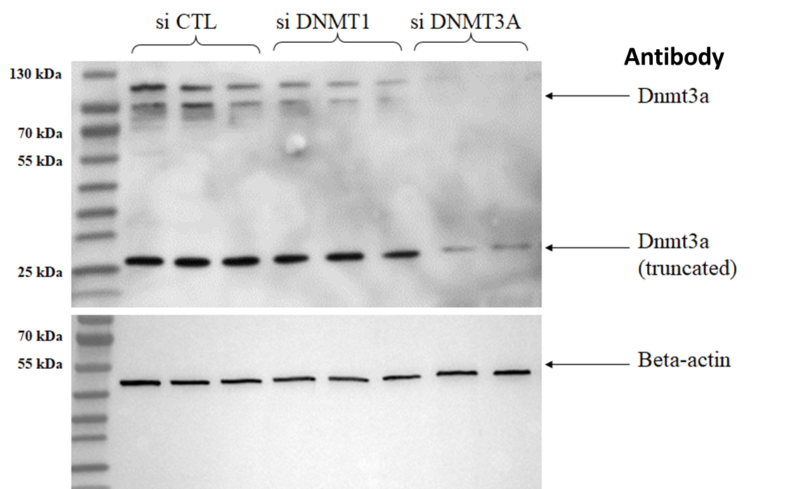
Uncropped WB from figure 7C (identical to the original one that was not cropped (size markers as a proof)
Uncropped WB from Supplementary figure 6 (identical to the original one that was not cropped (size markers as a proof)

