Slide 1
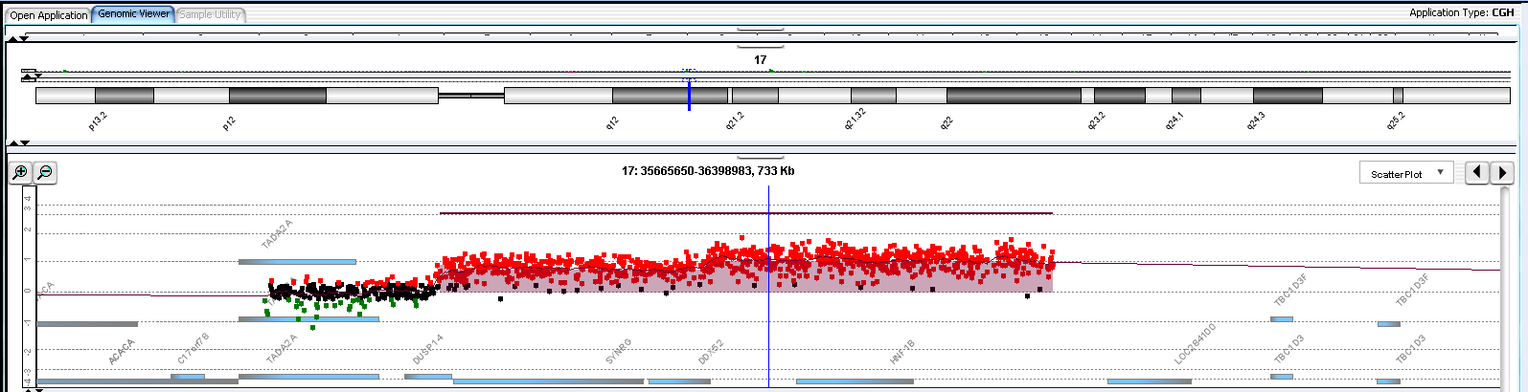
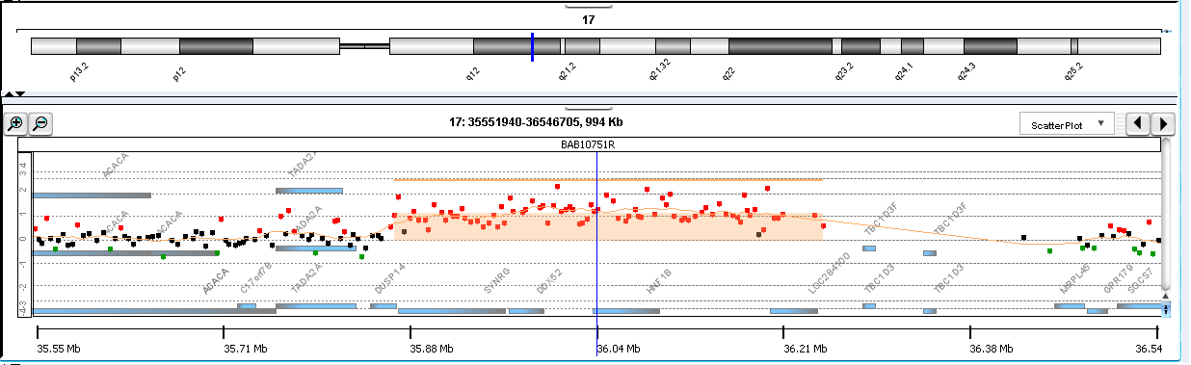
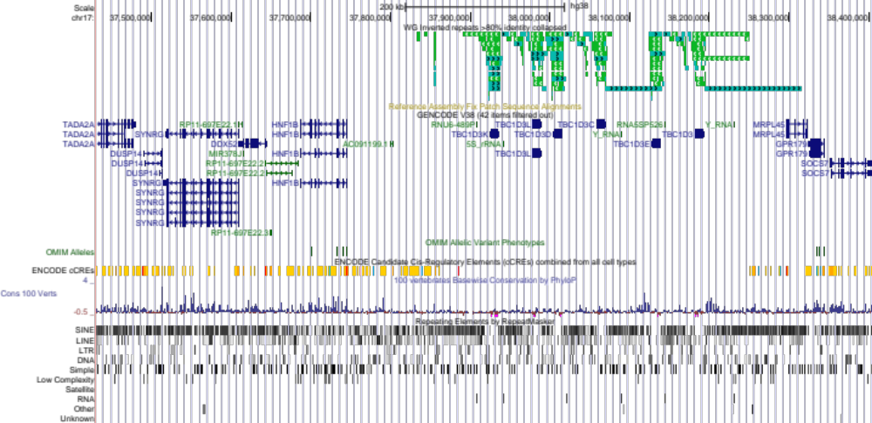
A
B
SYNRG
DDX52
HNF1B
C
Notes:
Supplementary Figure 1. Inverted Repeats within the CGR in proband BAB10751. (A) High resolution-custom array with high-density probes spanning the CGR region. Notably,
no probes were present at the distal end of the CGR. (B) Custom array designed to cover the entire chr17q region, also indicating the absence of probes at the distal end
of the CGR. (C) UCSC Genome Browser view displaying inverted repeats overlapping with the uncovered region in the arrays, explaining the absence of probes.

